Slide 1



Slide 2


Slide 3
Presentation
25 mins + 5 mins Q&A
Project Presentation
Presentation submission: 20 points
Instructor’s evaluation: 20 points
Peer’s evaluations: 40 points
Presentation Critique: https://pitt.co1.qualtrics.com/jfe/form/SV_bPGLFQRYFiYFH8y
1 evaluation per team.

Slide 4
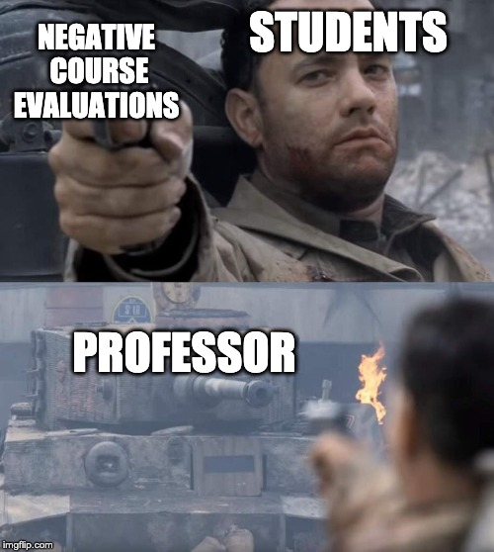


Course Evaluation

Slide 5

What’s left?
Assignment | Due Date
Project Report | Dec 13
Final Evaluation | Dec 12
Second Exam | Dec 12

Slide 6




