Slide 1



Install packages in RStudio
Get URL: https://github.com/mikenguyen13/bm_F22_practice

Slide 2
iClicker Question
From what perspective should brand reputation be measured?
Stakeholders
Stockholders
Customers

Slide 3
iClicker Question
What are the drivers of brand reputation?
Brand Equity
Relationship Equity
Customer Equity
Corporate reputation
A, B, C
A, B, D

Slide 4
iClicker Question
Why is Twitter a good social media to track brand sentiment?
Twitter accounts are public (Conversations on Twitter have a larger impact on public brand perception).
Brands maintain an active presence on Twitter (brand conversations are publicly observed)
Twitter has a publicly available application programming interface that can identify conservation about the brands
All of the above

Slide 5
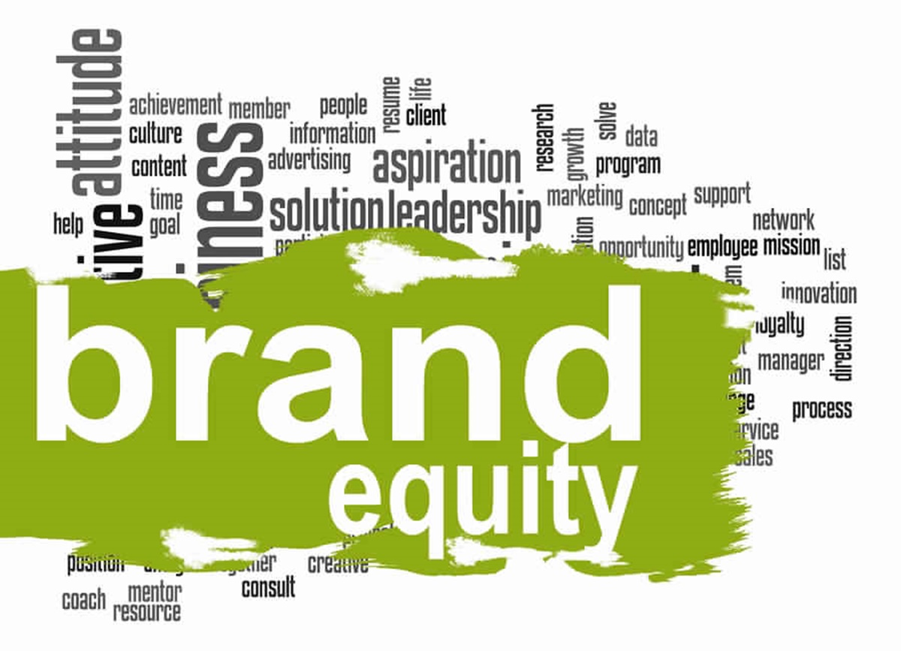
Chapter 9
Developing a Brand Equity Measurement and Management System
Notes:
Developing a Brand Equity Measurement and Management System

Slide 6
Brand Management Building Blocks
Developing a Brand Strategy
Designing and Implementing Brand Marketing Programs
Measuring and Interpreting Brand Performance
Growing and Sustaining Brand Equity
Notes:
This week we will cover our next brand management building block: measuring and interpreting brand performance.

Slide 7
Learning Objectives
9.1 Describe the new accountability in terms of ROMI (Return on Marketing Investment)
9.2 Create an understanding of analytics dashboards as a tool for monitoring performance and the implications of brand investments
9.3 Outline the two main steps in conducting a brand audit and how to execute a digital marketing review
9.4 Describe how to design, conduct, and interpret a tracking study
9.5 Identify the steps in implementing a brand equity management system

Slide 8

The New Accountability (1 of 2)
Virtually every marketing dollar spent today must be justified as both effective and efficient in terms of
Return on marketing investment (R O M I)
Increased accountability
Has forced marketers to address tough challenges
Develop new measurement approaches
Notes:
Complicating matters is that, depending on the particular industry or category, some observers believe up to 70 percent (or even more) of marketing expenditures may be devoted to programs and activities that improve brand equity but cannot be linked to short-term incremental profits.

Slide 9

The New Accountability (2 of 2)
Conducting Brand Audits
Brand Inventory
Brand Exploratory
Brand Positioning and the Supporting Marketing Program
Notes:
We all know must be familiar with the brand audit.
I will go over this lecture quickly so we can do some actual analysis.

Slide 10

Conducting Brand Audits (1 of 2)
Brand audit
Comprehensive examination of a brand to discover its sources of brand equity
Consists of two steps
Brand inventory
Brand exploratory
Notes:
Brand audit
Consumer-focused exercise to assess the health of the brand, uncover its sources of brand equity, and suggest ways to improve and leverage its equity.
Useful background for managers as they set up their marketing plans and can have profound implications on brands’ strategic direction and resulting performance.

Slide 11
Conducting Brand Audits (2 of 2)
Marketing audit
Independent examination of a company’s marketing environment, objectives, strategies, and activities
Agreement on objectives, scope, and approach
Data collection
Report preparation and presentation
Notes:
A similar concept has been suggested for marketing
Marketing audit is an Internal, company-focused exercise to make sure marketing operations are efficient and effective.

Slide 12

Brand Inventory (1 of 2)
First step in the brand audit
Purpose of the brand inventory
Provide a current, comprehensive profile of how all products and services are marketed and branded
Profiling each product or service requires marketers to catalogue:
Visual and written form for each product or service sold
The inherent product attributes or characteristics of the brand
Pricing, communications, and distribution policies
Notes:
The brand inventory is a valuable first step for several reasons.
First, it helps to suggest what consumers’ current perceptions may be based on. Consumer associations are typically rooted in the intended meaning of the brand elements attached to them—but not always.
The brand inventory provides useful information for interpreting follow-up research. it can supply some useful analysis too and initial insights into how brand equity may be better managed.

Slide 13

Brand Inventory (2 of 2)
A digital inventory of brand assets may provide useful insights:
Outdated brand accounts that have fallen into disuse
Overlapping brand assets which can be merged or deleted.
What factors determined the success of brand M&A?
Existing brand accounts with information that is either inaccurate or not up-to-date
Particular digital and social media channels where the brand does not have a presence
Notes:
The outcome of the brand inventory—both online and offline—should be an accurate, comprehensive, and up-to-date profile of how all the products and services are branded in terms of which brand elements are employed and how, and the nature of the supporting marketing program. Marketers should also profile competitive brands in as much detail as possible to determine points-of-parity and points-of-difference.
factors determined the success of brand M&A:
Marketing, R&D, operation capability and asset synergy.

Slide 14

Brand Exploratory
Second step of the brand audit
Provides detailed information about what consumers actually think of a brand
Research directed to understanding what consumers:
Think and feel about a brand
Act toward it
Helps identify sources of brand equity and possible barriers
Steps for brand exploratory:
Study prior research
Interview internal personnel
Conduct additional research
Notes:
Brand exploratory
Preliminary activities
A number of prior research studies may exist and be relevant
It is useful to interview internal personnel to gain an understanding of their beliefs about consumer perceptions for the brand and competitive brands
Additional research is often required to better understand how customers shop for and use different brands and what they think and feel about them

Slide 15
Brand Exploratory (2 of 3)
Three criteria to judge qualitative research techniques (according to Levy)
Direction
Depth
Diversity
Notes:
Ideally, qualitative research conducted as part of the brand exploratory should vary in direction and depth as well as in technique.
The challenge is to provide accurate interpretation—going beyond what consumers explicitly state to determine what they implicitly mean.

Slide 16
Figure 9-2: Summary of Qualitative Techniques
Free association
Adjective ratings and checklists
Confessional interviews
Projective techniques
Photo sorts
Archetypal research
Bubble drawings
Story telling
Personification exercises
Role playing
Metaphor elicitation*
Day/Behavior reconstruction
Photo/Written journal
Participatory design
Consumer-led problem solving
Real-life experimenting
Collaging and drawing
Consumer shadowing
Consumer–product interaction
Video observation
*Z M E T trademark

Slide 17
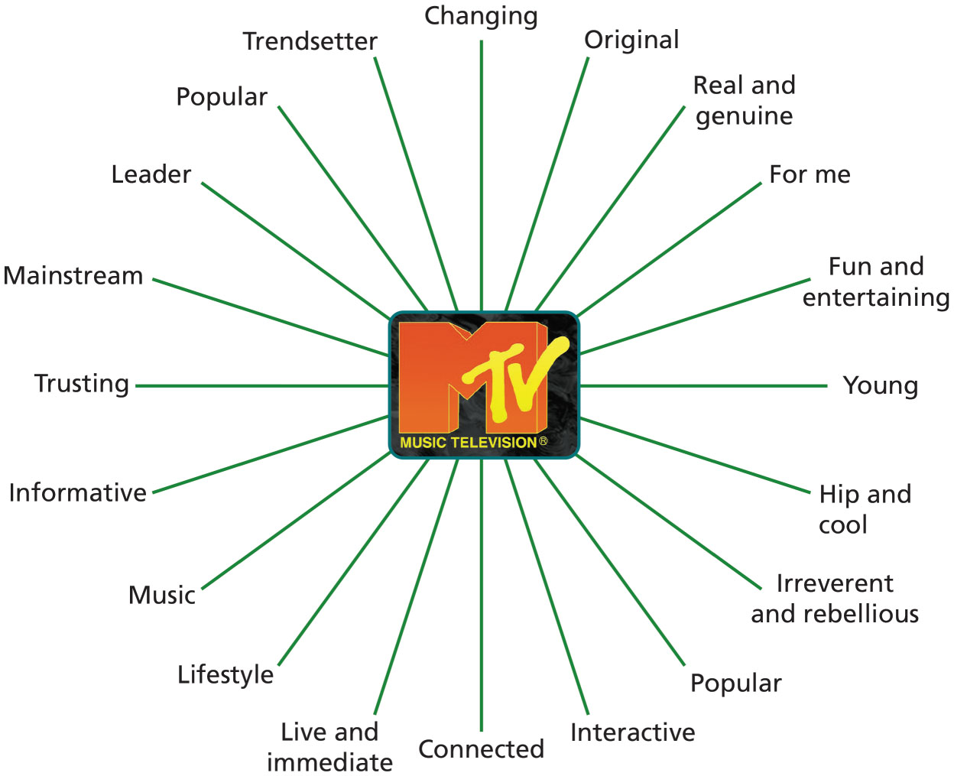
Figure 9-3A: Classic M T V Mental Map
Notes:
One useful outcome of qualitative research is a mental map. A mental map accurately portrays in detail all salient brand associations and responses for a particular target market. One of the simplest means to get consumers to create a mental map is to ask them for their top-of-mind brand associations.
It is sometimes useful to group brand associations into related categories with descriptive labels. Core brand associations are those abstract associations (attributes and benefits) that characterize the 5 to 10 most important aspects or dimensions of a brand.

Slide 18

Brand Exploratory
Digital marketing review
Can provide important input to a brand audit
Could help generate useful insights regarding a brand’s online presence
Notes:
A digital marketing review offers the following benefits:
It can highlight whether a brand’s digital efforts are received in online channels, relative to competitors.
It can help unlock important customer-level insights as well as industry trends, which is made possible due to in-depth analysis of online conversations surrounding a brand. This can be useful in developing a better picture of brand image and brand personality, as it pertains to digital channels.
It can provide useful input to brand strategy development and, by providing rich customer insights, the crafting or refinement of the brand positioning.
It can act as a health check of a brand’s digital marketing and social media strategy, and allow brand managers to introduce course correction measures, if the online strategy is seen as inconsistent with the brand’s overall strategy.

Slide 19
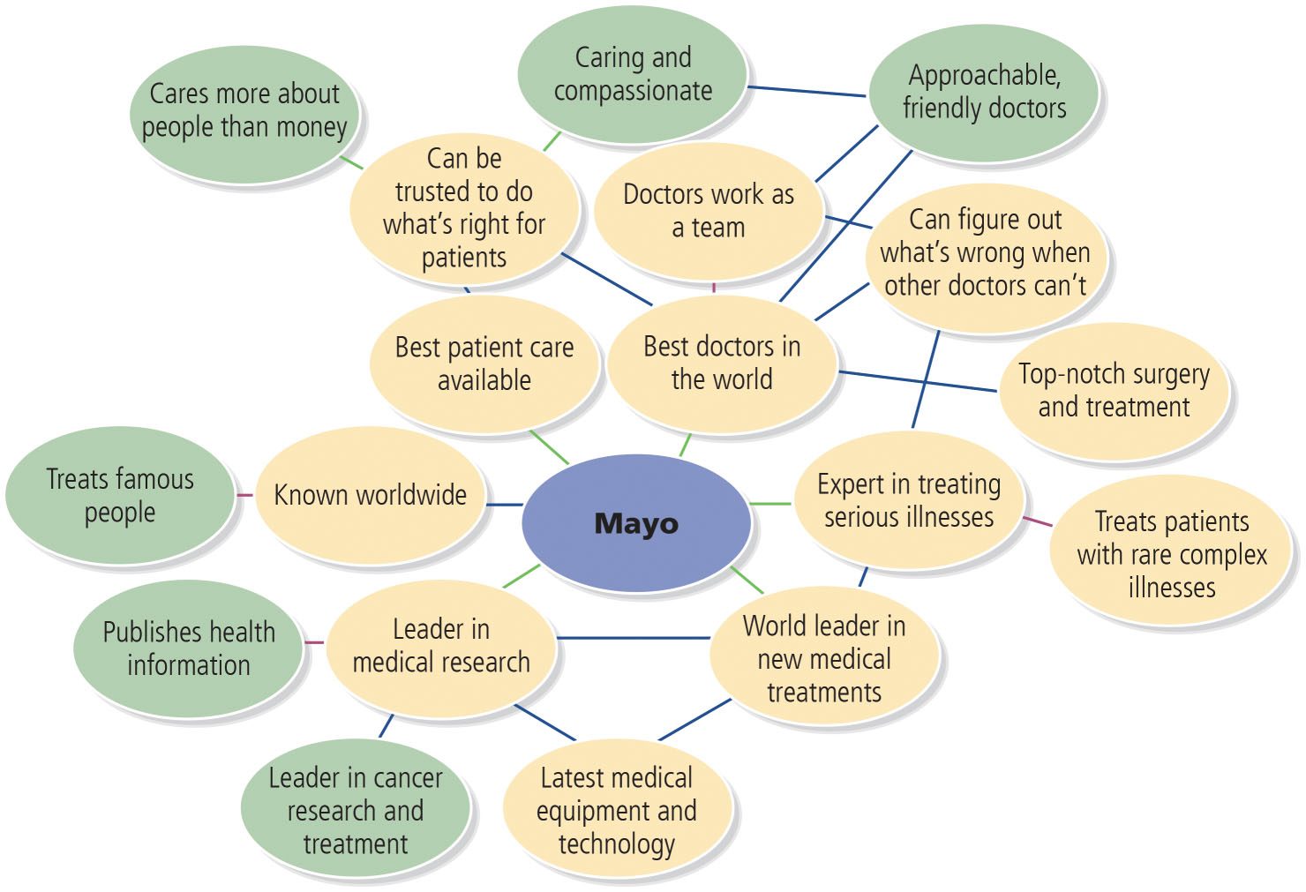
Figure 9-4: Sample Mayo Clinic Brand Concept Map

Slide 20
Brand Positioning and the Supporting Marketing Program
Ideal brand positioning aims to achieve congruence between:
What customers currently believe about the brand
What customers will value in the brand
What the firm is currently saying about the brand
Where the firm would like to take the brand

Slide 21
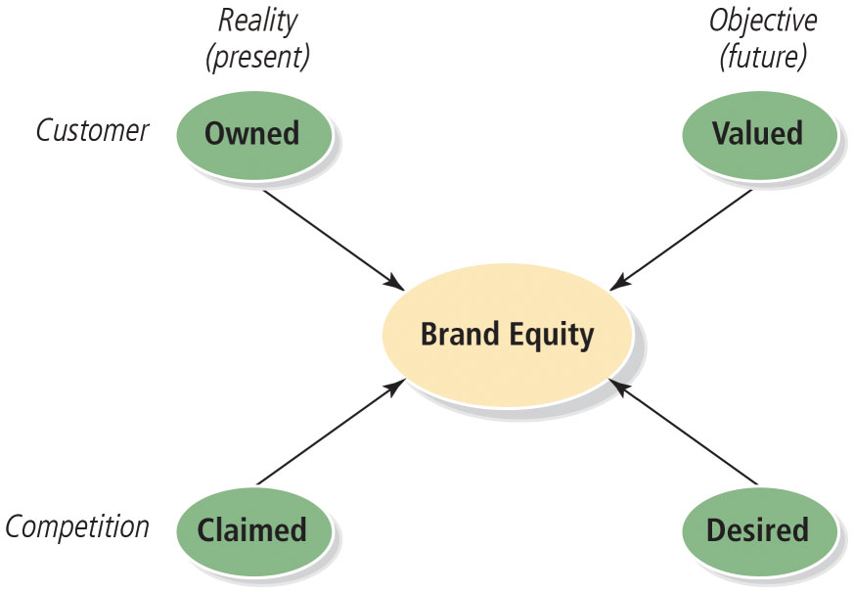
Figure 9-5: John Roberts’s Brand Positioning Considerations
Notes:
John Roberts, one of Australia’s top marketing academics, sees the challenge in achieving the ideal positioning for a brand as being able to achieve congruence among four key considerations:
What customers currently believe about the brand (and find credible)
What customers will value in the brand
What the firm is currently saying about the brand, and
Where the firm would like to take the brand?
Because each of the four considerations may suggest or reflect different approaches to positioning, finding a positioning that balances the four considerations as much as possible is key.

Slide 22

Designing Brand Tracking Studies
Brand tracking studies
Collect information from consumers
On a routine basis
Usually quantitative
On a number of key dimensions that marketers can identify in the brand audit
With brand extensions or additional communication methods
Becomes difficult and expensive to research
Yet necessary
Notes:
Tracking studies play an important role by providing consistent baseline information to facilitate day-to-day decision-making. A good tracking system can help marketers better understand a host of important considerations such as category dynamics, consumer behavior, competitive vulnerabilities and opportunities, and marketing effectiveness and efficiency.

Slide 23
What to Track
Product-Brand Tracking
May want to first ask consumers what brands come to mind
Next ask for recall of brands
Then tests of brand recognition
Corporate or Family Brand Tracking
May want to track corporation or family brand separately or concurrently with individual products
Global Tracking
May need a broader set of background measure for global tracking

Slide 24
Figure 9-6: Brand Context Measures (1 of 2)
Economic Indicators
Gross domestic product
Interest rates
Unemployment
Average wage
Disposable income
Home ownership and housing debt
Exchange rates, share markets, and balance of payments
Retail
Total spent in supermarkets
Change year to year
Growth in house brand
Technology
Computer at home
D V R
Access to and use of Internet
Phones
P D A
Microwaves
Television
Personal Attitudes and Values
Confidence
Security
Family
Environment
Traditional values
Foreigners versus sovereignty
Media Indicators
Media consumption: total time spent watching T V, consuming other media
Advertising expenditure: total, by media and by product category
Demographic Profile
Population profile: age, sex, income, household size

Slide 25
Figure 9-6: Brand Context Measures (2 of 2)
Geographic distribution
Ethnic and cultural profile
Other Products and Services
Transport: own car—how many
Best description of car Motorbike
Home ownership or renting
Domestic trips overnight in last year
International trips in last two years
Attitude to Brands and Shopping
Buy on price
Like to buy new things
Country of origin or manufacture
Prefer to buy things that have been advertised
Importance of familiar brands

Slide 26
Big Data and Marketing Analytic Dashboards
Troves of data exist
Can enable continuous tracking of customers
Marketing analytic dashboard
Systems and processes within an organization to communicate important metrics
And make them available throughout an organization
Notes:
Questions such as the following can be addressed using marketing analytics:
What is the likely impact of a 15 percent increase in our social media expenditure next year?
What is the return-on-investment of influencer marketing programs? Why is the ROI of one campaign higher than another?
What is the relative impact of offline versus online marketing expenditures on sales revenue growth in the past three years? What will happen if we shift the budget to spend more money in online than offline channels next year?

Slide 27
Establishing a Brand Equity Management System
Brand Charter or Bible
Brand Equity Report
Brand Equity Responsibilities
Notes:
Brand tracking studies, as well as brand audits, can provide a huge reservoir of information about how best to build and measure brand equity. To get the most value from these research efforts, firms need proper internal structures and procedures to capitalize on the usefulness of the brand equity concept and the information they collect about it. Although a brand equity measurement system does not ensure that managers will always make good decisions about the brand, it should increase the likelihood they do and, if nothing else, decrease the likelihood of bad decisions.
Brand equity management system
Set of organizational processes designed to:
Improve the understanding of brand equity.
Use of the brand equity concept within a firm.

Slide 28
Brand Charter or Bible
First step in establishing a brand equity management system
Formalizes the company view of brand equity into a document
Brand charter (or brand bible as sometimes called)
Provides relevant guidelines to marketing managers and key marketing partners
Should be updated annually
Notes:
The charter should define and clarify points-of-parity, points-of-difference, and the
brand mantra.
Explain how brand equity is measured in terms of the tracking study and the resulting brand equity report (described shortly).
Suggest how marketers should manage brands with some general strategic guidelines, stressing clarity, consistency, and innovation in marketing thinking over time.
Outline how to devise marketing programs along specific tactical guidelines, satisfying differentiation, relevance, integration, value, and excellence criteria. Guidelines for specific brand management tasks such as ad campaign evaluation and brand name selection may also be offered.
Specify the proper treatment of the brand in terms of trademark usage, design considerations, packaging, and communications. As these types of instructions can be long and detailed, it is often better to create a separate brand or corporate identity style manual or guide to address these more mechanical considerations
Although parts of the brand charter may not change from year to year, the firm should nevertheless update it on an annual basis to provide decision makers with a current brand profile and to identify new opportunities and potential risks for the brand. As marketers introduce new products, change brand programs, and conduct other marketing initiatives, they should reflect these adequately in the brand charter. Many of the in-depth insights that emerge from brand audits also belong in the charter.

Slide 29
Brand Equity Report
Second step in establishing a successful brand equity management system
Assemble results of the tracking survey and other relevant performance measure for the brand
Create a brand equity report or scorecard
Distribute to management regularly
Contents
A brand equity report should describe:
What is happening with the brand?
Why is it happening?
Should include more descriptive market-level information

Slide 30
Brand Equity Responsibilities (1 of 2)
Third step in establishing a successful brand equity management system
Clearly define organization responsibilities and processes
With respect to the brand
Notes:
Brands need constant, consistent nurturing to grow. Weak brands often suffer from a lack of discipline, commitment, and investment in brand building. In this section, we consider internal issues of assigning responsibilities and duties for properly managing brand equity, as well as external issues related to the proper roles of marketing partners.

Slide 31
Brand Equity Responsibilities (2 of 2)
Overseeing Brand Equity
Organizational Design and Structures
Managing Marketing Partners
Notes:
Overseeing brand equity
To provide central coordination, the firm should:
Establish a position responsible for overseeing the implementation of the brand charter and brand equity reports.
Ensure that product and marketing actions across divisions and geographic boundaries reflect their spirit as closely as possible.
Maximize the long-term equity of the brand.
Organizational design and structures
Firms may attempt to redesign their marketing organizations to better reflect the challenges faced by their brands.
To meet the challenges of changing job requirements and duties, traditional marketing departments may be replaced by business groups, multidisciplinary teams, and so on.
New organizational structure aims to improve internal coordination and efficiencies as well as external focus on retailers and consumers.
Managing marketing partners
Performance of a brand is also dependent on the actions taken by outside suppliers and marketing partners.
Global trend indicates that firms are increasingly consolidating their marketing partnerships and reducing the number of their outside suppliers.
Number of outside suppliers any firm will hire in any one area depends on:
Cost efficiencies
Organizational leverage
Creative diversification affect

Slide 32

Dollar Shave Club
Was purchased by Unilever for $1 billion
Founder net worth: $200 mil
How can a commodity product be so successful?

