Slide 1


Slide 2

iClicker Question
Constructs are the reflection of variables in reality
True
False

Slide 3

iClicker Question
A hypothesis is our guess about a relationship between two variables/constructs.
True
False

Slide 4

iClicker Question
Sweet Baby Ray's Barbecue Sauce is a
Flanker brand
Cash cow brand
Low-end, entry-level brand

Slide 5
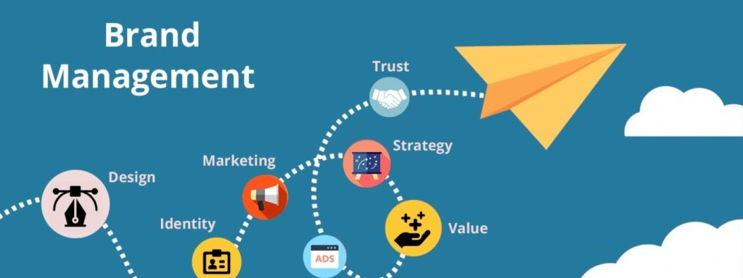
Managing Brands Overtime
Chapter 14

Slide 6
Learning Objectives
14.1 Understand the important considerations in brand reinforcement
14.2 Describe the range of brand revitalization options available to a company
14.3 Outline the various strategies to improve brand awareness and brand image
14.4 Define the key steps in managing a brand crisis

Slide 7

Reinforcing Brands
Maintaining Brand Consistency
Protecting Sources of Brand Equity
Fortifying versus Leveraging
Fine-Tuning the Supporting Marketing Program
Notes:
How should we reinforce brand equity over time?
How can marketers make sure consumers have knowledge structures that support brand equity for their brands?
Generally, we reinforce brand equity by marketing actions that consistently convey the meaning of the brand to consumers in terms of brand awareness and brand image.
More specifically, in this chapter, we examine 3 key issues regarding brand reinforcement.
Advantages of maintain brand consistency
Importance of protecting sources of brand equity
Tradeoff between fortifying and leveraging brands.

Slide 8

Maintaining Brand Consistency
Maintaining consistency involves two key aspects:
Consistency of marketing support
Consistency of brand associations
Notes:
Without question, the most important consideration in reinforcing brands is consistency in the nature and amount of marketing support the brand receives.
Brand consistency is critical to maintaining the strength and favorability of brand associations.
Another way to achieve a consistent appeal is through retro-marketing, or convincing consumers that heritage brands have nostalgic appeal that can help consumers connect with their past.
Consistent marketing support for market leader brands
Inadequate marketing support is a dangerous strategy when combined with price increases.
An example of failure to adequately support a brand occurred in the kitchen and bath fixtures market.
Consistency and change
Managing brand equity with consistency requires making numerous tactical shifts and changes.
In order to maintain the strategic thrust and direction of a brand.
Most effective tactics for a particular brand at any one time varies
Strategic positioning of many leading brands has been kept uniform over time by the retention of key elements of the marketing program and the preservation of the brand meaning.
The main message is “Cheers to all” (https://www.sotrender.com/blog/2021/04/brand-consistency/)
Social equality is trending and Heineken wanted to jump on this bandwagon. Do you consider this campaign is in line with their brand image.

Slide 9
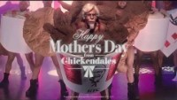

Brand Flashbacks
Notes:
Brand flashbacks
Dubbed retro-branding, retro-advertising, or nostalgia marketing by some marketing pundits, the tactic is a means to tie in with past advertising that was, and perhaps could be, a key source of brand equity.
Heritage can be a powerful point of difference where it conveys expertise, longevity, and experience, not just age.
Another example would be Oreo’s celebrating its anniversary. The research found that nostalgic ads can positively influence consumers, where they can create favorable attitudes toward the ad and the brand.
Another study found that the source of nostalgic purchase behavior, which is called intergenerational influence, or the influence of a parent’s purchase behavior and brand attitudes on a child’s behavior and attitudes.

Slide 10
Protecting Sources of Brand Equity
Unless the company makes strategic positioning of the brand less powerful, there is little need to deviate from a successful positioning
Although brands should always look for potentially powerful new sources of brand equity
Top priority is to preserve and defend those that already exist
Notes:
Does it remind you of anything?
Which is similar to customer retention.
Key sources of brand equity are of enduring value

Slide 11
Brand Crises
Brands that have a sincere brand personality can suffer more when a crisis occurs
Consumers are more likely o punish brands for transgressions when those concerns with strong relationships with brands
injustice or betrayal: when consumers directly experience the crisis
Forgiveness: when the crisis does not impact them directly (counter-argumentation)
Brands that have line extensions or extensions can suffer more from crises (spillover effect)

Slide 12
Recovering from a Brand Crisis or Scandal
Swiftness
Sincerity
Notes:
The longer it takes a firm to respond to a marketing crisis, the more likely customers will form a negative impression based on unfavorable media overage or WOM.
An example was the Volkswagen diesel emission crisis, which apologized too little to late.

Slide 13
Fortifying Versus Leveraging
Marketers can design marketing programs that mainly try to capitalize on or maximize brand awareness and image
Without its sources of brand equity, the brand itself may not continue to yield valuable benefits
Notes:
Marketers can design marketing programs that mainly try to capitalize on or maximize brand awareness and image—for example, by reducing advertising expenses, seeking increasingly higher price premiums, or introducing numerous brand extensions.

Slide 14
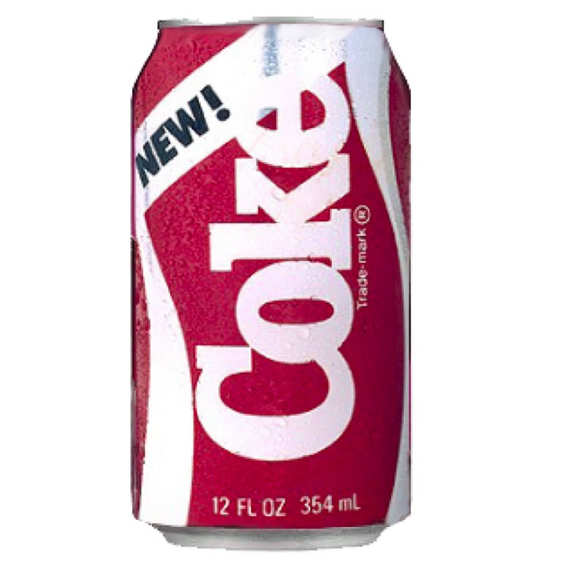
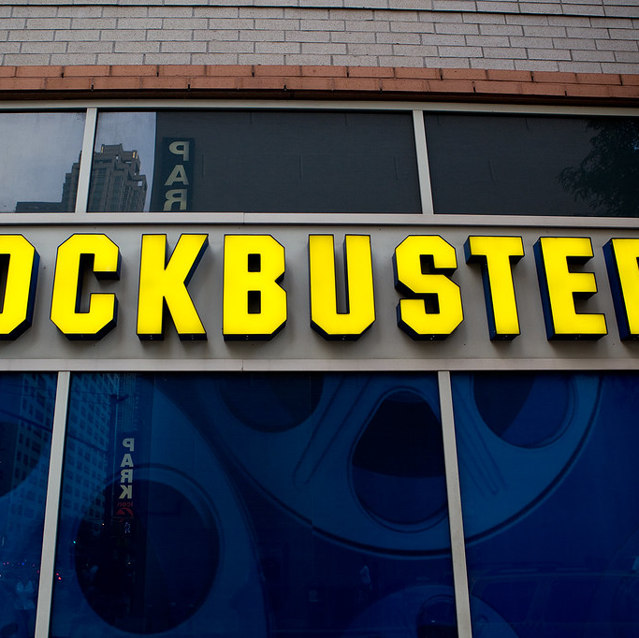
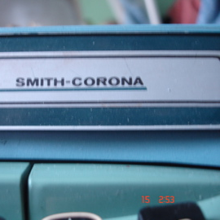
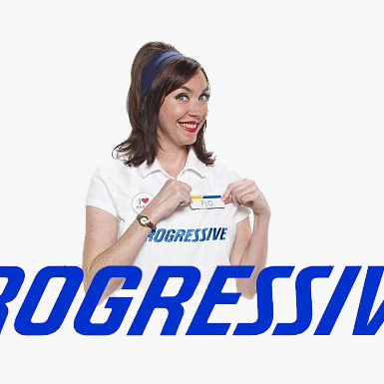
Fine-Tuning the Supporting Marketing Program
Product-related performance associations
Nonproduct-related imagery associations
This Photo by Unknown Author is licensed under CC BY-NC-ND
This Photo by Unknown Author is licensed under CC BY-NC-ND
This Photo by Unknown Author is licensed under CC BY-SA-NC
Notes:
Marketers are more likely to change the specific tactics and supporting marketing program for the brand than its basic positioning and strategic direction.
Product-related performance associations
For brands whose core associations are primarily product-related performance attributes or benefits, product design, manufacturing, and merchandising innovation are critical to maintaining or enhancing brand equity.
For companies in diverse categories, innovation is critical to success.
Product innovations are critical for performance-based brands whose equity sources reside primarily in product-related associations.
It is important not to change products too much, especially if the brand meaning for consumers is wrapped up in the product design or makeup.
Innovation is important for this association, i.e., progressive was the first to offer direct sales online and the ability to compare tup to 3 other insurers.
Smith corona filed for bankruptcy after the personal computer boom, but they should have understood their business and the document business, not the typewriter.
A similar story happened to Blockbuster, which Netflix replaced them.
However, marketers must also remember that we reassure consumers that we have a better product, not a different one.
Nonproduct-related imagery associations
For brands whose core associations are primarily nonproduct-related attributes and symbolic or experiential benefits, relevance in user and usage imagery is especially critical.
Ill-conceived or too-frequent repositionings cana brand’s image brand and confuse or even alienate consumers.
Brand images can be extremely sticky, and once strong associations have formed, they may be difficult to change.

Slide 15


Flip Flopping
Product-focused ad (“It’s All About the Beer”)
User-focus ad (“Give Yourself a Good Name”)
Notes:
Flip following between product-related performance and non product-related imagery associations

Slide 16
Revitalizing Brands
In virtually every product category are examples of once prominent and admired brands that have fallen on hard times or even completely disappeared
Brands such as Microsoft, G E, and Old Spice have successfully repositioned their brands
Two strategic options:
Expand the depth or breadth of brand awareness, or both
Improve strength, favorability, and uniqueness of the brand associations
Notes:
Brands sometimes have to return to their roots to recapture lost sources of equity.
In profiling brand knowledge structures to guide repositioning, marketers need to accurately and completely characterize the breadth and depth of brand awareness.
Revitalization strategies run along a continuum, with pure back-to-basics at one end and pure reinvention at the other.
Market failures, in which insufficient consumers are attracted to a brand, are typically much less damaging than product failures, in which the brand fundamentally fails to live up to its consumer promise.
In market failure, a relaunch can sometimes prove successful.
In product failure, the brand fundamentally fails to live up to its consumer promise.
Strategic options on how best to refresh old sources of brand equity or create new ones to achieve the intended positioning:
Expand the depth or breadth of brand awareness, or both, by improving consumer recall.
Improve the strength, favorability, and uniqueness of the brand associations making up the brand image.

Slide 17
Expanding Brand Awareness
Identifying Additional or New Usage Opportunities
Identifying New and Completely Different Ways to Use the Brand
Notes:
Identifying additional or new usage opportunities
To identify additional or new opportunities for consumers, the marketing program should include:
Communications about the appropriateness and advantages of using the brand more frequently in existing situations or in new situations.
Reminders to consumers to actually use the brand as close as possible in time to those situations for which it could be used.
To increase frequency of usage for products of short life spans:
Tie the act of replacing the product to a certain holiday, event, or time of year.
Oral-B toothbrushes
Provide consumers with better information about:
When they first used the product or need to replace it.
The current level of product performance.
Consumers can be convinced of the merits of more regular usage and overcome any potential hurdles to increased usage, such as by making product designs and packaging more convenient and easier to use.
Identifying new and completely different ways to use the brand
New usage applications may require more than just new ad campaigns or merchandising approaches.

Slide 18
Improving Brand Image
Identifying the Target Market
Repositioning the Brand
Changing Brand Elements

Slide 19
Identifying the Target Market
Key target market segments as part of the brand revitalization strategy:
Retaining vulnerable customers
Recapturing lost customers
Identifying neglected segments
Attracting new customers
Notes:
There is a clear hierarchy in these strategic targeting options. In an attempt to turn sales around, some firms mistakenly focus initially on the fourth one, chasing after new customers. This is the riskiest option. If it fails, two bad things can happen: the firm may fail to attract any new customers, but even worse, it may lose existing ones.

Slide 20
Repositioning the Brand
May require more compelling points-of-difference
May need to reposition to establish a point-of-parity on some key image dimension
Notes:
A common problem for marketers of established, mature brands is to make them more contemporary by creating relevant usage situations, a more contemporary user profile, or a more modern brand personality. Heritage brands that have been around for years may be seen as trustworthy but also boring, uninteresting, and not that likable.

Slide 21
Changing Brand Elements
May need to convey new information
May need to signal that a brand has taken on new meaning because something in the marketing program has changed
Notes:
The brand name is typically the most important brand element, and it’s often the most difficult to change. Nevertheless, we can drop names or combine them into initials to reflect shifts in marketing strategy or to ease pronounceability and recall. Shortened names or initials can also minimize potentially negative product associations.
For example, Federal Express chose to officially shorten its name to FedEx and introduce a new logo to acknowledge what consumers were actually calling the brand. In an attempt to convey a healthier image, Kentucky Fried Chicken abbreviated its name to the initials KFC.

Slide 22
Adjustments to the Brand Portfolio
Migration Strategies
Acquiring New Customers
Retiring Brands
Notes:
Managing brand equity and the brand portfolio requires taking a long-term view and carefully considering the role of different brands in the portfolio and their relationships over time. Sometimes a brand refresh just requires cleaning up the brand architecture.

Slide 23
Migration Strategies
Brand migration strategy
Helps consumers understand how various brands in the portfolio can satisfy their needs
As they change over time or as products and brands themselves change over time
Managing brand transitions is especially important in rapidly changing, technologically intensive markets
Ideally, brands will be organized in consumers’ minds
Notes:
A corporate or family branding strategy in which brands are ordered in a logical manner could provide the hierarchical structure in consumers’ minds to facilitate brand migration.

Slide 24
Acquiring New Customers
Trade-offs between attracting new customers and retaining existing ones
Firms must proactively develop strategies to attract new customers, especially younger ones
Notes:
The marketing challenge lies in making a brand seem relevant to vastly different generations and cohort groups or lifestyles. The challenge is greater when the brand has a strong personality or user image associations that tie it to one particular consumer group.
The response to the challenge of marketing across generations and cohort groups has taken all forms. Some marketers have attempted to cut loose from the past, as Tommy Hilfiger did by renouncing the urban styles it had come to embody in the 1990s.

Slide 25
Retiring Brands
Some brands are not worth saving
Sources of brand equity may have dried up
Damaging and difficult-to-change new associations may have been created
Notes:
In retiring a brand, several options are possible. A first step in retrenching a fading brand is to reduce the number of its product types (package sizes or variations). Such actions reduce the cost of supporting the brand and allow it to put its best foot forward so it can more easily hit profit targets. If a sufficiently large and loyal enough customer base exists, eliminating marketing support can be a means to milk or harvest profits from these cash cows.
An orphan brand is a once-popular brand with diminished equity that a parent company allows to decline by withdrawing marketing support. Typically, these orphan brands have a customer base too small to warrant advertising and promotional expenditures.
Finally, a permanent solution is to discontinue the product altogether. The marketplace is littered with brands that either failed to establish an adequate level of brand equity or saw their sources of brand equity disappear because of changes in the marketing environment.

Slide 26
Obsoleting Existing Products
Technological changes and shifting consumer tastes can be challenging for brands
May not have kept up with changes in the marketplace
Discontinuing brands (or deliberate obsoleting) may be a bold move
But one which paves the way for introducing innovative, new brands
Notes:
Fundamentally, the issue is the existing and latent equity of the brand. As the former head of consumer packaged-goods giant Unilever commented in explaining his company’s decision to review about 75 percent of its brands and lines of businesses for possible sell-offs, “If businesses aren’t creating value, we shouldn’t be in them. It’s like having a nice garden that gets weeds. You have to clean it up, so the light and air get in to the blooms which are likely to grow the best.”

Slide 27
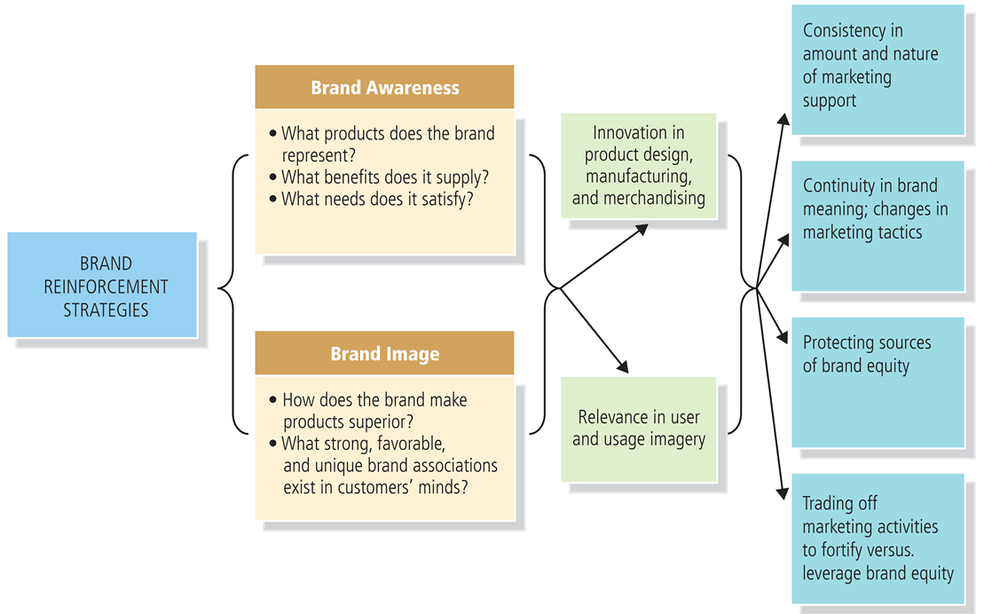
Figure 14-9: Brand Reinforcement Strategies

Slide 28
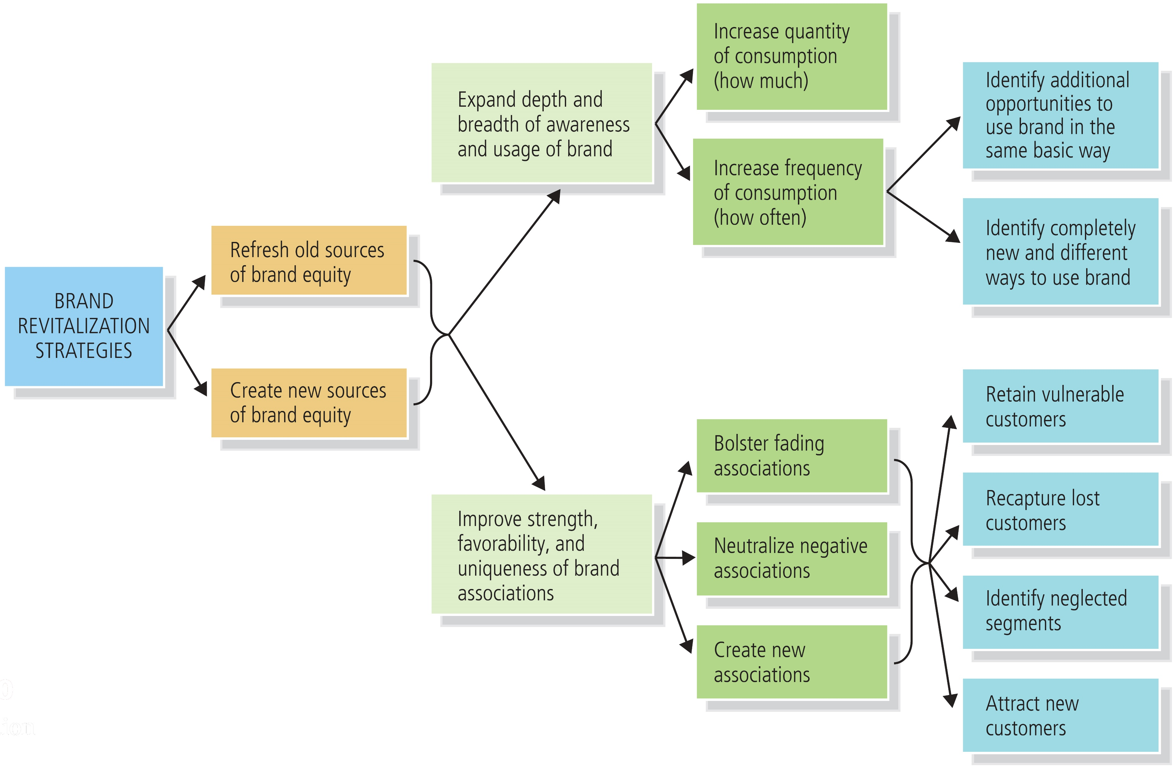
Figure 14-10: Brand Revitalization Strategies

Slide 29
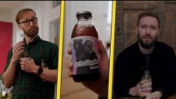
Snapple
Leading "New Age" beverage
Quaker Oats purchased Snapple in 1994.
was later sold to Triarc Beverage Group for $300 mil in 1997.
In 2000, it was sold to Cadbury Schweppes
then split to form Dr. Pepper.
Notes:
https://www.youtube.com/watch?v=6mDmdssPCws&ab_channel=Calvin%26Habs
https://www.youtube.com/watch?v=SAUIeP6oSFs&t=24s&ab_channel=Calvin%26Habs
Edgy Advertising
https://scottbassen.com/Snapple-Personified-Bottles

Slide 30



Please don’t do this for your report

Slide 31
Group Discussion – 15 mins
Presentation
Report

