Slide 1
Brand Management Building Blocks
Developing a Brand Strategy
Designing and Implementing Brand marketing Programs
Measuring and Interpreting Brand Performance
Growing and Sustaining Brand Equity

Slide 2
Developing a Brand Strategy

Slide 3
Chapter 2
Customer-Based Brand Equity and Brand Positioning

Slide 4
Learning Objectives
Define customer-based brand equity
Outline the sources and outcomes of customer-based brand equity
Identify the four components of brand positioning
Describe the guildines in developing a good brand positioning
Explain brand matras and how they should be developed

Slide 5
Customer-Based Brand Equity
Defining Customer-Brand Equity
Brand Equity as a Bridge
Notes:
Two questions often arise in brand marketing:
What makes a brand strong?
How do you build a strong brand?

Slide 6
Defining Customer-Based Brand Equity
Approaches brand equity from the perspective of the consumer
Stresses that the power of a brand lies in what resides in the minds and hearts of customers
Differential effect that brand knowledge has on customer response to the marketing of that brand
Notes:
The customer-based brand equity (CBBE) provides a unique point of view on what brand equity is and how it should best be built, measured, and managed. The CBBE concept approaches brand equity from the perspective of the consumer—whether the consumer is an individual or an organization, or an existing or prospective customer.
Positive customer-based brand equity: When consumers react more favorably to a product and the way it is marketed when the brand is identified than when it is not.
Negative customer-based brand equity: When consumers react less favorably to marketing activity for the brand compared with an unnamed or fictitiously named version of the product.
The three key ingredients of CBBE:
Differential effect
Brand knowledge
Consumer response to marketing

Slide 7
Figure 2-1: Marketing Advantages of Strong Brands
Improved perceptions of product performance
Greater loyalty
Less vulnerability to competitive marketing actions
Less vulnerability to marketing crises
Larger margins
More inelastic consumer response to price increases
More elastic consumer response to price decreases
Greater trade cooperation and support
Increased marketing communication effectiveness
Possible licensing opportunities
Additional brand extension opportunities

Slide 8
Brand Equity as a Bridge
Customer knowledge drives the differences that manifest themselves in terms of brand equity
Provides marketers with a vital strategic bridge from their past to their future
The brand knowledge that marketers create over time dictates appropriate and inappropriate future directions for the brand
Notes:
Brand as a reflection of the past:
Marketers should consider the money spent in brand building as an “ investment.”
On the basis of the past experience, what consumers saw, heard, learned, felt, and experienced about the brand should be analyzed.
The quality of the investment in brand building is the most critical factor, not the quantity.
Brand as a direction to the future:
Brand knowledge that marketers create over time, which allows them to determine appropriate and inappropriate future directions for the brand.
Brand equity offers focus and guidance, provides a means to interpret past marketing performance, and design future marketing programs.

Slide 9
Making a Brand Strong: Brand Knowledge
From the perspective of the CBBE concept, brand knowledge is the key to creating brand equity
It creates the differential effect that drives brand equity
Marketers need an insightful way to present how brand knowledge exists in consumer memory

Slide 10
Making a Brand Strong: Brand Knowledge
The associative network memory model:
Views memory as a network of nodes and connecting links
Nodes – represent stored info or concepts
Links – represent the strength of association between the nodes
Brand associations are informational nodes linked to the brand node in memory

Slide 11
Making a Brand Strong: Brand Knowledge
Brand knowledge has two components:
Brand awareness:
Related to the strength of the brand node or trace in memory
Often a step in building brand equity
Often come into play
Brand image:
Consumers’ perceptions about a brand, as reflected by the brand associations held in consumer memory

Slide 12
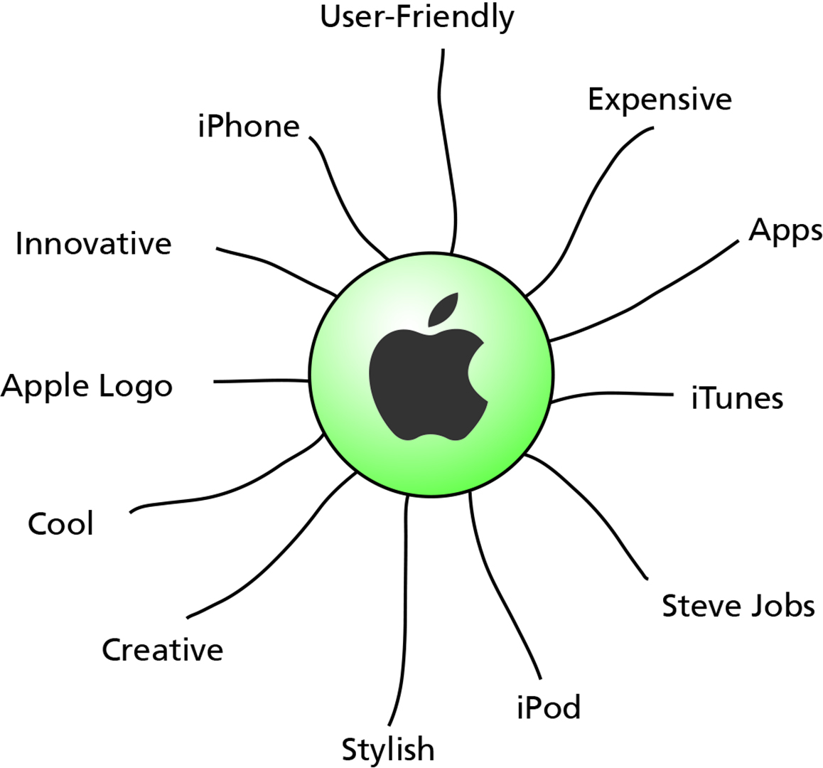
Figure 2-2: Possible Associations with the Apple Brand Name
Notes:
If someone asked you what came to mind when you thought of Apple computers, what would you say? You might reply with associations such as well-designed, easy to use, leading-edge technology, and so forth. This figure displays some commonly mentioned associations for Apple that consumers express. These associations make up a consumer’s brand image for Apple. Through breakthrough products and skillful marketing, Apple has been able to achieve a rich brand image made up of a host of brand associations. Many are likely to be shared by a majority of consumers, so we can refer to the brand image of Apple, but at the same time, we recognize that this image varies, perhaps even considerably, depending on the consumer or market segment.

Slide 13
Sources of Brand Equity
Brand Awareness
Brand Image
Notes:
What causes brand equity to exist? How do marketers create it? Customer-based brand equity occurs when the consumer has a high level of awareness and familiarity with the brand and holds some strong, favorable, and unique brand associations in memory.
Marketers must convince consumers that there are meaningful differences among brands. Consumers must not think that all brands in the category are the same. Establishing a positive brand image in consumer memory—strong, favorable, and unique brand associations—goes hand-in-hand with creating brand awareness to build customer-based brand equity.

Slide 14
Brand Awareness
Brand awareness consists of brand recognition and brand recall performance:
Brand recognition:
Consumer’s ability to confirm prior exposure to the brand when given the brand as a cue
Brand recall:
Consumers’ ability to retrieve the brand from memory when given:
The product category
The needs fulfilled by the category, or
A purchase or usage situation as a cue
Notes:
Research reveals that many consumer decisions are made at the point of sale, where the brand name, logo, packaging, and so on will be physically present and visible, hence brand recognition is very important. If consumer decisions are mostly made in settings away from the point of purchase, on the other hand, then brand recall will be more important. For this reason, creating brand recall is critical for service and online brands: Consumers must actively seek the brand and therefore be able to retrieve it from memory when appropriate.

Slide 15
Brand Awareness
Advantages of brand awareness:
Learning advantages
Consideration advantages
Choice advantages:
Consumer purchase motivation
Consumer purchase ability
Consumer purchase opportunity

Slide 16
Brand Awareness
Anything that causes consumers to experience one of a brand’s element can increase familiarity and awareness of that brand element:
Name, symbol, logo, character, packaging, or slogan, including advertising and promotion, sponsorship and event marketing, publicity and public relations, and outdoor advertising
Repetition increases recognizability:
But improving brand recall also requires linkages in memory to product aspects
Notes:
How do you create brand awareness? In the abstract, creating brand awareness means increasing the familiarity of the brand through repeated exposure, although this is generally more effective for brand recognition than for brand recall. That is, the more a consumer experiences the brand by seeing it, hearing it, or thinking about it, the more likely he or she is to strongly register the brand in memory.

Slide 17
Brand Image
Once a sufficient level of brand awareness is created:
Marketers can put more emphasis on crafting a brand image
Creating a positive brand image:
Takes marketing programs that link strong, favorable, and unique associations to the brand in memory
Brand associations may be either brand attributes or benefits
Notes:
Brand attributes:
Descriptive features that characterize a product or service
Brand benefits:
The personal value and meaning that consumers attach to the product or service attributes

Slide 18
Brand Image
Strength of Brand Associations
More deeply a person thinks about product information and relates it to existing brand knowledge, stronger is the resulting brand association
Favorability of Brand Associations
Is higher when a brand possesses relevant attributes and benefits that satisfy consumer needs and wants
Uniqueness of Brand Associations
“Unique selling proposition” of the product
Provides brands with sustainable competitive advantage

Slide 19
Identifying and Establishing Brand Positioning
Basic Concepts
Target Market
Nature of Competition
Points-of-Parity and Points-of-Difference
Notes:
How should marketers approach brand positioning?

Slide 20
Basic Concepts
Brand positioning:
Act of designing the company’s offer and image so that it occupies a distinct and valued place in the target customers’ minds
Finding the proper “location” in the minds of consumers or market segment
Allows consumers to think about a product or service in the “right” perspective

Slide 21
Target Market
Market segmentation: Divides the market into distinct groups of homogeneous consumers who have similar needs and consumer behavior
Involves identifying segmentation bases and criteria:
Criteria:
Identifiability
Size
Accessibility
Responsiveness

Slide 22
Figure 2-3: Consumer Segmentation Bases
Behavioral
User status
Usage rate
Usage occasion
Brand loyalty
Benefits sought
Demographic
Income
Age
Sex
Race
Family
Psychographic
Values, opinions, and attitudes
Activities and lifestyle
Geographic
International
Regional

Slide 23
Figure 2-4: B2B Segmentation Bases
Nature of Good
Kind
Where used
Type of buy
Buying Condition
Purchase location
Who buys
Type of buy
Demographic
S I C code
Number of employees
Number of production workers
Annual sales volume
Number of establishments

Slide 24
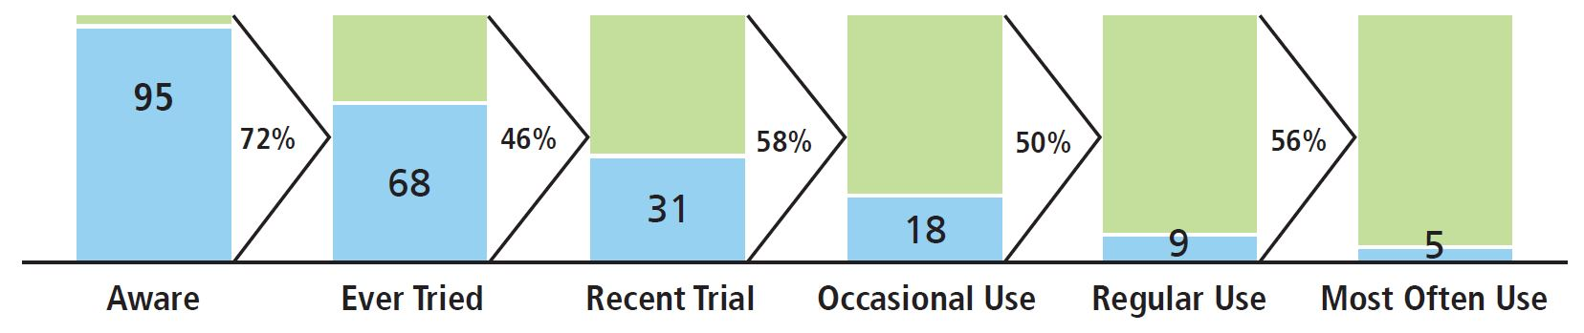
Figure 2-5: Hypothetical Examples of Funnel Stages and Transitions
Notes:
This shows a hypothetical pattern of results. For the purposes of brand building, marketers want to understand both (1) the percentage of target market that is present at each stage and (2) factors facilitating or inhibiting the transition from one stage to the next. In the hypothetical example, a key bottleneck appears to be converting those consumers who have ever tried the brand to those who recently tried, as less than half (46 percent) “convert.” To convince more consumers to consider trying the brand again, marketers may need to raise brand salience or make the brand more acceptable in the target consumer’s repertoire.

Slide 25
Nature of Competition
A competitive analysis considers an array of factors:
Resources, capabilities, and likely intentions of various other firms
This competitive analysis helps marketers to choose markets for their own products or services
When choosing a market, marketers must consider:
Indirect competition
Multiple frames reference
Notes:
Indirect competition:
Even if a brand does not face direct competition in its product category, and thus does not share performance related attributes with other brands, it can still share more abstract associations and face indirect competition in a more broadly defined product category.
Multiple frames of reference:
Result of broader category competition or the intended future growth of a brand

Slide 26
Points of Parity and Points of Difference
A marketer must arrive at the proper positioning:
This requires establishing the correct points-of-difference and points-of-parity associations:
Points-of-difference (P O Ds):
Formally defined as attributes or benefits that consumers strongly associate with a brand
Points-of-parity associations:
Not necessarily unique to the brand but may be shared with other brands
Notes:
Points-of-difference associations:
Attributes or benefits that consumers strongly associate with a brand, positively evaluate, and believe that cannot be found to the same extent with a competitive brand
Functional-performance related considerations
Abstract-imagery related considerations
Points- of-parity associations:
Attributes shared with other brands
Three types of associations are:
Category points-of-parity: necessary conditions for brand choice
Competitive points-of-parity: associations designed to negate competitors’ points-of-difference
Correlational points-of-parity: potential negative associations that arise from the existence of other, more positive associations for the brand
Points-of-parity versus points-of-difference:
Unless certain points-of-parity can be achieved to overcome potential weaknesses, points-of-difference may not even matter.
There is a “zone” or “range of tolerance or acceptance” with points-of-parity.
Points-of-parity are easier to achieve than points-of-differences.

Slide 27
Figure 2-6: Examples of Negatively Correlated Attributes and Benefits
Low price versus high quality
Taste versus low calories
Nutritious versus good tasting
Efficacious versus mild
Powerful versus safe
Strong versus refined
Ubiquitous versus exclusive
Varied versus simple

Slide 28
Positioning Guidelines
Defining and Communicating the Competitive Frame of Reference
Choosing Points-of-Difference
Establishing Points-of-Parity and Points-of-Difference
Straddle Positions
Updating Position Overtime
Developing a Good Positioning

Slide 29
Defining and Communicating the Competitive Frame of Reference
Communicating category benefits:
Marketers use product benefits to announce category membership
Exemplars:
Well-known, noteworthy brands in a category can also be used as exemplars to specify a brand’s category membership
Product descriptor:
Product descriptor that follows a brand name is often a very compact means of conveying category origin

Slide 30
Choosing Points-of-Difference
A brand must offer a compelling and credible reason for choosing it over the other options:
What attribute or benefit can serve as point-of-difference?
Desirability criteria
Deliverability criteria
Differentiation criteria
Notes:
Desirability criteria:
Target consumers must find the POD personally relevant and important. Brands that tap into growing trends with consumers often find compelling PODs. For example, Apple & Eve’s pure natural fruit juices have ridden the wave of the natural foods movement to find success in an increasingly health-minded beverage market.
Deliverability criteria:
The deliverability of an attribute or benefit brand association depends on both a company’s actual ability to make the product or service (feasibility) as well as its effectiveness in convincing consumers of its ability to do so (communicability).
Feasibility
Communicability
Differentiation criteria:
Target consumers must find the POD distinctive and superior. When marketers are entering a category in which there are established brands, the challenge is to find a viable, long-term basis for differentiation. Is the positioning preemptive, defensible, and difficult to attack? Can the brand association be reinforced and strengthened over time? If these are the case, the positioning is likely to last for years.

Slide 31
Establishing Points-of-Parity and Points-of-Difference
The key to branding success is to establish both points-of-parity and points-of-difference
At times, an inverse relationship between P O P and P O D may exist in the minds of consumers:
Approaches to address the problem of negatively correlated P O Ps and P O Ds include:
Separating the attributes
Leveraging equity of another entity
Redefining the relationship

Slide 32
Straddle Positions
Type of positioning where a company is able to straddle two frames of reference:
With one set of points-of-difference and points-of-parity
The points-of-difference in one category:
Become points-of-parity in the other
And vice-versa for points-of-parity
Notes:
While a straddle positioning often is attractive as a means of reconciling potentially conflicting consumer goals and creating a best-of-both-worlds solution, it also carries an extra burden. If the points-of-parity and points-of-difference with respect to both categories are not credible, consumers may not view the brand as a legitimate player in either category.

Slide 33
Updating Positions over Time (1 of 2)
Generally, positioning should be fundamentally changed very infrequently:
And only when circumstances significantly reduce the effectiveness of existing P O Ps and P O Ds
Yet, positioning will evolve to better reflect market opportunities or challenges
P O D or P O P may be refined, added, or dropped as situations dictate

Slide 34
Updating Positions over Time (2 of 2)
Laddering:
Deepening the meaning of a brand to permit further expansion
Often useful to explore underlying consumer motivations
Reacting:
Responding to competitive actions that threaten an existing positioning
Competitive actions are often directed at eliminating points-of-difference to make them points-of-parity:
Or to strengthen or establish new points-of-difference
Notes:
Laddering:
Some attributes and benefits may lend themselves to laddering more easily than others. For example, the Betty Crocker brand appears on a number of different baking products and is characterized by the physical warmth associated with baking. Such an association makes it relatively easy to talk about emotional warmth and the joy of baking or the good feelings that might arise from baking for others across a wide range of baking-related products.
Reacting:
Three primary options:
Do nothing
Go on the defensive
Go on the offensive

Slide 35
Developing a Good Positioning
A good positioning:
Has a foot in the present and a foot in the future:
Needs to be somewhat aspirational so that the brand has room to grow and improve
Is careful to identify all relevant points-of-parity:
Don’t overlook or ignore crucial areas where the brand is potentially disadvantaged
Should reflect a consumer point of view in terms of the benefits that consumers derive from the brand
Recognizes that a duality exists in the positioning of a brand:
Rational and emotional components

Slide 36
Defining a Brand Mantra
Brands may span multiple product categories and may have multiple distinct—yet related—positionings
As brands evolve and expand across categories:
Marketers will want to craft a brand mantra that reflects the essential heart and soul of the brand

Slide 37
Brand Mantra
Short, three-to five-word phrase:
Captures the irrefutable essence or spirit of the brand positioning
Provides guidance about:
What products to introduce under the brand
What ad campaigns to run
Where and how the brand should be sold
Notes:
Designing a brand mantra:
A good brand mantra should provide:
Brand functions: nature of the product or service or the type of experiences or benefits the brand provides
Descriptive modifier: combined with brand functions, helps delineate the brand boundaries
Emotional modifier: determines how a brand provides benefits and in what ways
Implementing brand mantra:
Should be developed at the same time as brand positioning
Requires more internal examination and involves input from a wider range of company employees
Based on core brand associations, a brainstorming session can attempt to identify PODs, POPs, and different brand mantra candidates

Slide 38
Yellow Tail: Clever Brand Positioning Within The American Wine Industry | The Branding Journal
Case Study: BeyondMinds' Branding Journey | The Branding Journal

