Slide 1
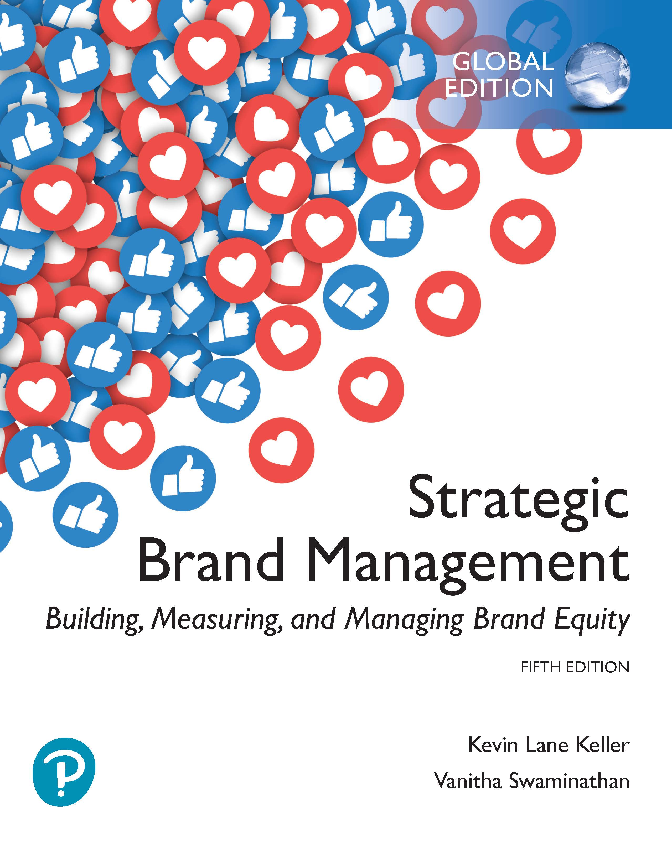
Strategic Brand Management: Building, Measuring, and Managing Brand Equity
Fifth Edition, Global Edition
Chapter 6
Integrating Marketing Communications to Build Brand Equity
Copyright © 2020 Pearson Education Ltd. All Rights Reserved
Notes:
If this PowerPoint presentation contains mathematical equations, you may need to check that your computer has the following installed:
1) MathType Plugin
2) Math Player (free versions available)
3) NVDA Reader (free versions available)

Slide 2
Learning Objectives
6.1 Describe some of the changes in the new media environment
6.2 Outline the major marketing communication options
6.3 Describe some of the key tactical issues in evaluating different communication options
6.4 Identify the choice criteria in developing an integrated marketing communication program
6.5 Explain the rationale for mixing and matching communication options

Slide 3
Marketing Communications
Means by which firms attempt to inform, persuade, and remind consumers about the brands they sell
Can contribute to brand equity by:
Creating awareness of the brand
Linking points-of-parity and points-of-difference associations to the brand in consumers’ memory
Eliciting positive brand judgments or feelings
Facilitating a stronger consumer-brand connection and brand resonance

Slide 4
The New Media Environment (1 of 2)
Has changed dramatically in recent years
Traditional advertising media seem to be losing their grip
Digital revolution has changed the way consumers learn and talk about brands
Changing media landscape has forced marketers to re-evaluate how they should best communicate with consumers

Slide 5
The New Media Environment (2 of 2)
Challenges in Designing Brand-Building Communications
Role of Multiple Communications

Slide 6
Challenges in Designing Brand-Building Communications (1 of 4)
Skilfully designed and implemented marketing communications programs
Should be efficient and effective
Require careful planning and creative knack

Slide 7
Challenges in Designing Brand-Building Communications (2 of 4)
For a person to be persuaded by any form of communication the following steps must occur:
Exposure
Attention
Comprehension
Yielding
Intentions
Behavior
Notes:
For a person to be persuaded by any form of communication (a TV advertisement, newspaper editorial, or blog posting), the following six steps must occur:
Exposure: A person must see or hear the communication.
Attention: A person must notice the communication.
Comprehension: A person must understand the intended message or arguments of the communication.
Yielding: A person must respond favorably to the intended message or arguments of the communication.
Intentions: A person must plan to act in the desired manner of the communication.
Behavior: A person must actually act in the desired manner of the communication.
Consider potential pitfalls in launching a new advertising campaign:
A consumer may not be exposed to an ad because the media plan missed the mark.
A consumer may not notice an ad because of a boring and uninspired creative strategy.
A consumer may not understand an ad because of a lack of product category knowledge or technical sophistication, or because of a lack of awareness and familiarity about the brand itself.
A consumer may fail to respond favorably and form a positive attitude because of irrelevant or unconvincing product claims.
A consumer may fail to form a purchase intention because of a lack of an immediate perceived need.
A consumer may fail to actually buy the product because he or she doesn’t remember anything from the ad when confronted with the available brands in the store.

Slide 8
Challenges in Designing Brand-Building Communications (3 of 4)
From an advertising standpoint, the ideal ad campaign would ensure that:
The right consumer is exposed to the right message at the right place and at the right time
The creative strategy causes consumers to notice and attend to the ad
But does not distract from the intended message
The ad properly reflects the consumer’s level of understanding

Slide 9
Challenges in Designing Brand-Building Communications (4 of 4)
The ad correctly positions the brand in terms of desirable and deliverable points-of-difference and points-of-parity
The ad motivates consumers to consider purchase of the brand
The ad creates strong brand associations to all these stored communication effects
So they have an effect when consumers are considering making a purchase

Slide 10
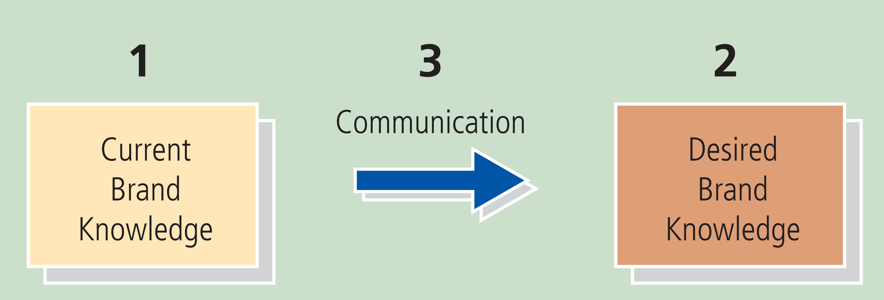
Figure 6-2: Simple Test for Marketing Communication Effectiveness
What is your current brand knowledge? Have you created a detailed mental map?
What is your desired brand knowledge? Have you defined optimal points-of-parity and points-of-difference and a brand mantra?
How does the communication option help the brand get from current to desired knowledge with consumers? Have you clarified the specific effects on knowledge engendered by communications?

Slide 11
Role of Multiple Communications
Advantages of multiple communications
Optimal utilization of monetary and other resources
Different communication options also may target different market segments

Slide 12
Four Major Marketing Communication Options
Marketing Communication
Advertising and Promotion
Interactive Marketing
Events and Experiences
Mobile Marketing
Notes:
There are four vital ingredients to the best brand-building communication programs: (1) advertising and promotion, (2) interactive marketing, (3) events and experiences, and (4) mobile marketing.

Slide 13
Advertising (1 of 2)
Any paid form of nonpersonal presentation and promotion of ideas, goods, or services by an identified sponsor
Powerful means of creating strong, favorable, and unique brand associations and eliciting positive judgments and feelings
Specific effects are difficult to quantify and predict

Slide 14
Advertising (2 of 2)
Television
Radio
Print
Direct Response
Place
Notes:
Television
Advantages
Effective means of vividly demonstrating product attributes and persuasively explaining their corresponding consumer benefits.
Compelling means for dramatically portraying user and usage imagery, brand personality, emotions, and other brand intangibles.
Disadvantages
Consumers can overlook product-related messages and the brand itself.
Large number of ads and nonprogramming material creates clutter that makes it easy for consumers to ignore or forget ads.
Large number of channels creates fragmentation, and the widespread existence of digital video recorders gives viewers the means to skip commercials.
Guidelines
In designing and evaluating an ad campaign, marketers should:
Define the proper positioning to maximize brand equity.
Identify the best creative strategy to communicate or convey the desired positioning.
Effective TV ad should contribute to brand equity in some demonstrable way.
Copy testing can be conducted to evaluate the effectiveness of message and creative strategies.
Radio
Advantages
Is flexible and stations are highly targeted.
Ads are relatively inexpensive to produce and place.
Effective medium in the morning and can effectively complement or reinforce TV ads.
Enables companies to achieve a balance between broad and localized market coverage.
Disadvantage
Lack of visual image.
Relatively passive nature of consumer processing.
Guidelines
Identify your brand early in the commercial.
Identify it often.
Promise the listener a benefit early in the commercial.
Repeat it often.
Print
Advantages
Self-paced, provides detailed product information.
Magazines are particularly effective at building user and usage imager.
Newspapers are more timely and pervasive
Disadvantages
Poor reproduction quality and short shelf life diminish some of the possible impact of newspaper advertising.
Guidelines
Creative guidelines for print ads are that of clarity, consistency, and branding.
Direct response
Advantages
Makes it easier for marketers to establish relationships with consumers.
Allows marketers to explain new developments with their brands to consumers on an ongoing basis.
Allows consumers to provide feedback to marketers about their likes and dislikes.
Guidelines
Develop an up-to-date and informative list of current and potential future customers.
Put forth the right offer in the right manner.
Track the effectiveness of the marketing program.
Precision marketing—Combining data analytics with strategic messages and compelling colors and designs in their communication.
Place
Known as “nontraditional,” “alternative,” or “support” advertising.
Marketers reach out to people in environments, where they work, play, and, of course, shop—billboards or billboard-type posters; through movies, airlines, lounges, and other places; and product placement.
Advantages
Can reach a very precise and captive audience in a cost-effective and increasingly engaging manner.
More effective at enhancing awareness or reinforcing existing brand associations than at creating new ones.
Guidelines
As the audience must process out-of-home ads quickly, the message must be simple and direct.
Marketers must stress on creative means of placing the brand in front of consumers.

Slide 15
Promotion (1 of 3)
Consumer Promotions
Trade Promotions
Notes:
Promotion
Short-term incentives to encourage trial or usage of a product or service.
Designed to change the behavior of the:
Trade so that they carry the brand and actively support it.
Consumers so that they buy a brand for the first time, buy more of the brand, or buy the brand earlier or more often.
Consumer promotions
Designed to change the choices, quantity, or timing of consumers’ product purchases.
Type of consumer promotions:
Customer franchise building promotions such as samples, demonstrations, and educational material.
Noncustomer franchise building promotions such as price-off packs, premiums, sweepstakes, and refund offers.
Customer franchise-building promotions can affect brand loyalty.
Marketers evaluate sales promotions by their ability to contribute to brand equity and generate sales.
Trade promotions
Financial incentives given to channel members to facilitate the sale of a product through slotting allowances, point-of-purchase displays, contests and dealer incentives, training programs, trade shows, and cooperative advertising.
Designed either to secure shelf space and distribution for a new brand, or to achieve more prominence on the shelf and in the store.

Slide 16
Promotion (2 of 3)
Advantages
Permit manufacturers to charge different prices to groups of consumers who vary in their price sensitivity
Convey a sense of urgency to consumers
Can build brand equity through actual product experience
Encourage the trade to maintain full stocks and support the manufacturer’s merchandising efforts

Slide 17
Promotion (3 of 3)
Disadvantages
Decreased brand loyalty and increased brand switching
Decreased quality perceptions and increased price sensitivity
Inhibit the use of franchise
Divert marketing funds sales promotion
Increase the importance of price as a factor in consumer decisions
May subsidize buyers who would have bought the brand anyway

Slide 18
Online Marketing Communication
Twenty-first century created a rush of companies moving into the world of interactive, online marketing communications
Primary advantage of marketing on the Web
Low cost
Level of detail
Degree of customization

Slide 19
Events and Experiences
Focus on engaging the consumers’ senses and imagination as a part of brand building
Event marketing: Public sponsorship of events or activities related to sports, art, entertainment, or social causes
Range from extravagant sponsorship events to a simple local in-store product demonstration
Notes:
Rationale for sponsorship
To identify with a particular target market or lifestyle
To increase awareness of the company or product name
To create or reinforce consumer perceptions of key brand image associations
To enhance corporate image dimensions
To create experiences and evoke feelings
To express commitment to the community or on social issues
To entertain key clients or reward key employees
To permit merchandising or promotional opportunities
Guidelines
Choosing sponsorship opportunities
Sponsor ship events:
Must meet the marketing objectives and communication strategy defined for the brand.
Must have:
Sufficient awareness.
Possess the desired image.
Be capable of creating the desired effects with the target market.
Should closely match the ideal target market in terms of the audience attending the event.
Should be unique but not encumbered with many sponsors.
Designing sponsorship programs
Sponsor should strategically identify itself at an event through banners, signs, and programs.
Measuring sponsorship activities
Supply-side method—Focuses on potential exposure to the brand by assessing the extent of media coverage.
Demand-side method—Focuses on reported exposure from consumers.

Slide 20
Brand Amplifiers
Efforts made to engage consumers and the public via word-of-mouth and public relations and publicity
Amplify the effects created by other marketing activities through:
Public relations and publicity
Word-of-mouth
Public relations and publicity
Word-of-mouth
Notes:
Public relations and publicity
Publicity
Nonpersonal communications such as press releases, media interviews, press conferences, films, and tapes
Public relations
Includes annual reports, fund-raising and membership drives, lobbying, special event management, and public affairs feature articles, newsletters, photographs, films, and tapes
Word-of-mouth
Critical aspect of brand building
Consumers share likes, dislikes, and experiences with each other
Assures greater degree of credibility and relevance
Buzz marketing
Various techniques marketers apply to get people notice and talk about the brand

Slide 21
Developing Integrated Marketing Communication Program
Criteria for I M C Programs
Using I M C Choice Criteria
Notes:
Develop an integrated marketing communication program (IMC) by choosing the best set of marketing communication options and managing the relationships between them. Integrated marketing communications is regarded as a process of strategically managing stakeholders, content, channels, and results of brand communication programs. Our main theme is that marketers should “mix and match” communication options to build brand equity—that is, choose a variety of different communication options that share common meaning and content but also offer different, complementary advantages so that the whole is greater than the sum of the parts.

Slide 22
Criteria For I M C Program
Coverage
Contribution
Commonality
Complementarity
Conformability
Cost
Notes:
Coverage
Proportion of the audience reached by each communication option, as well as how much overlap exists among communication options.
Contribution
Inherent ability of a marketing communication to create the desired response and communication effects from consumers in the absence of exposure to any other communication option.
Commonality
Extent to which common information conveyed by different communication options shares meaning across communication options.
Complementarity
Describes the extent to which different associations and linkages are emphasized across communication options.
Conformability
Extent that a marketing communication option is robust and effective for different groups of consumers.
Types of conformability:
Communication conformability: The ability of the mode of communication to effectively communicate with the diverse group of customers.
Consumer conformability: The ability of the communication option to inform or persuade consumers who vary on dimensions other than communication history.
Cost
To arrive at the most effective and efficient communication program evaluations of marketing communications on all of the preceding criteria must be weighed against their cost.

Slide 23
Figure 6-6: I M C Audience Communication Option Overlap

Slide 24
Using I M C Choice Criteria
I M C choice criteria can provide guidance for designing integrated marketing communication programs
Two key steps are
Evaluating communication options
Establishing priorities and trade-offs
Notes:
Evaluating communication options
Communication types vary in their:
Breadth and depth of audience coverage.
Commonality and conformability according to the number of modalities they employ.
To arrive at a final mix requires making decisions on priorities and tradeoffs among the IMC choice criteria.
Establishing priorities and trade-offs
Three possible tradeoffs with the IMC choice criteria resulting from overlaps in coverage are:
Commonality and complementarity will often be inversely related.
Conformability and complementarity will also often be inversely related.
Commonality and conformability do not share an obvious relationship.

Slide 25
Figure 6-7: General Marketing Communication Guidelines: The “Keller B s” (1 of 2)
Be analytical: Use frameworks of consumer behavior and managerial decision making to develop well-reasoned communication programs.
Be curious: Better understand customers by using all forms of research, and always be thinking of how you can create added value for consumers.
Be single-minded: Focus your message on well-defined target markets (less can be more).
Be integrative: Reinforce your message through consistency and cuing across all communication options and media.

Slide 26
Figure 6-7: General Marketing Communication Guidelines: The “Keller B s” (2 of 2)
Be creative: State your message in a unique fashion; use alternative promotions and media to create favorable, strong, and unique brand associations.
Be observant: Keep track of competition, customers, channel members, and employees through monitoring and tracking studies.
Be patient: Take a long-term view of communication effectiveness to build and manage brand equity.
Be realistic: Understand the complexities involved in marketing communications.

