Slide 1
Chapter 7
Branding in the Digital Era
Notes:
If this PowerPoint presentation contains mathematical equations, you may need to check that your computer has the following installed:
1) MathType Plugin
2) Math Player (free versions available)
3) NVDA Reader (free versions available)

Slide 2
Learning Objectives (1 of 2)
7.1 Describe changes in marketing and consumer behavior in a digital era
7.2 Define brand engagement and understand the brand engagement pyramid and key drivers of brand engagement
7.3 Understand digital communications and the various options available
7.4 Define the role of e-mail marketing and Web site optimization as important components of digital marketing strategy

Slide 3
Learning Objectives (2 of 2)
7.5 Appreciate the pros and cons of various social media channels (e.g., Facebook and Twitter) as digital marketing tools
7.6 Understand the developments within mobile marketing
7.7 Develop a broad understanding of influencer marketing approaches and how word-of-mouth and social influence occurs and can be managed
7.8 Describe content marketing and its role in creating brand awareness and engagement
7.9 Describe changes in brand management organizational structure

Slide 4
Key Issues for Branding in the Digital Era
There are many important developments with branding in this digital era
Findings:
Ninety-seven percent of consumers turn to a search engine like Google when they are buying a product
Ninety-six percent of consumers search for product information from their mobile device
Ninety-five percent of millennials expect brands to have a Facebook presence
Eighty-nine percent of consumers do online research prior to purchasing instore

Slide 5
Table 7-1: Key Digital Era Trends with Implications for Branding and Brand Management
Changes in the consumer decision journey
Sharp increase in buying via online retail channels
Shift in advertising and promotion expenditures toward digital channels
The rise of many-to-many communications
Dramatic increase in consumer touchpoints
Tremendous increase in data availability
The use of digital personalization
A loss of control over the brand message and the co-creation of brand meaning
The role of user experiences
The growth of brands as cultural symbols

Slide 6
Changes in Consumer Decision Journey
Digital marketing and social media has changed the consumer decision journey
Notes:
The view of the consumer decision journey in the digital era diverges from previous journeys undertaken by consumers in many important ways. The implications for brand management are also significant.

Slide 7
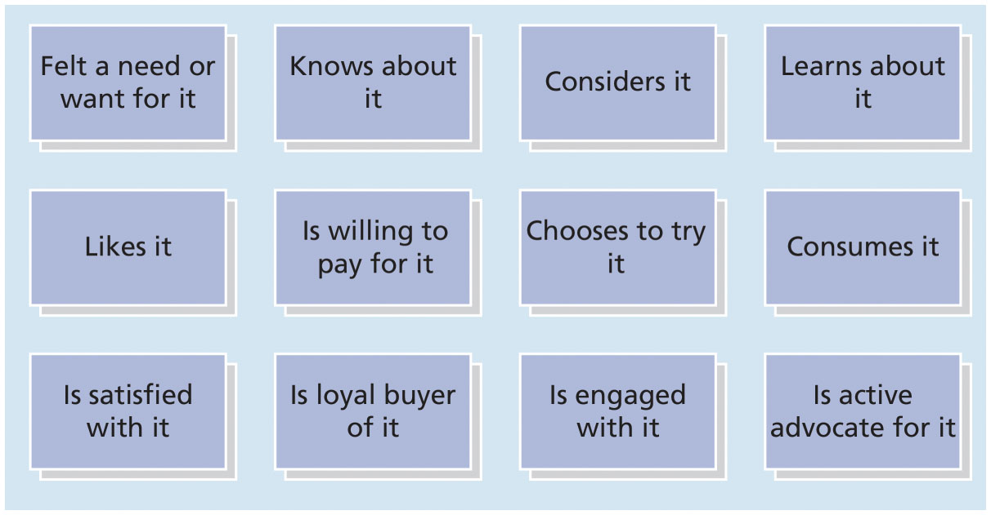
Figure 7-1: Expanded Consumer Decision Journey

Slide 8
Growth of Online Retailing
The popularity of online retailing can be inferred from the following statistics:
Value of ecommerce sales will reach $414 billion in 2018
Sixty percent of adult Americans are happy to not shop in a crowded mall or store
Seventy-one percent of shoppers believe they will get a better deal online than in stores
Forty percent of men and 33 percent of women aged 18 to 34 say they would ideally “buy everything online”
Notes:
One of the most prominent success stories in the online retailing context is that of Amazon. As Amazon continues to disrupt retail through its innovations in drone deliveries and acquisitions (e.g., Whole foods), brands should be mindful of all the changes taking place in online retailing, as it significantly impacts how they merchandise and distribute their products.

Slide 9
Advertising and Promotions Using Digital Channels
Advertising dollars are allocated differently now across online and offline channels
As of 2017, digital media expenditures in the United States exceeded T V advertising expenditures
The growth in digital media is expected to outpace growth of traditional media channels
By 2020, it has been projected that online channels will be almost 50 percent larger than T V advertising

Slide 10
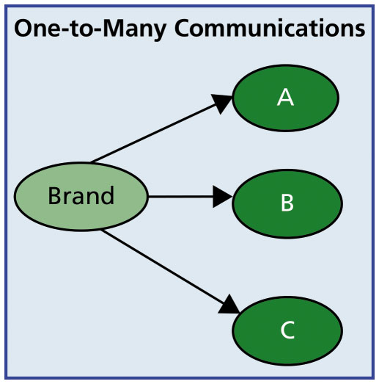
Figure 7-3: Traditional Marketing: One-to-Many Communications
Notes:
The traditional world of marketing involved brand managers relying on mass media channels such as TV, print, and radio advertising to communicate with consumers. The direction of communication was usually from manufacturer to consumer, and limited feedback was provided by consumers to manufacturers in turn. Thus, audiences were generally passive recipients of carefully crafted messages sent by brand marketers. This was particularly true in the case of the one-to-many traditional marketing.

Slide 11
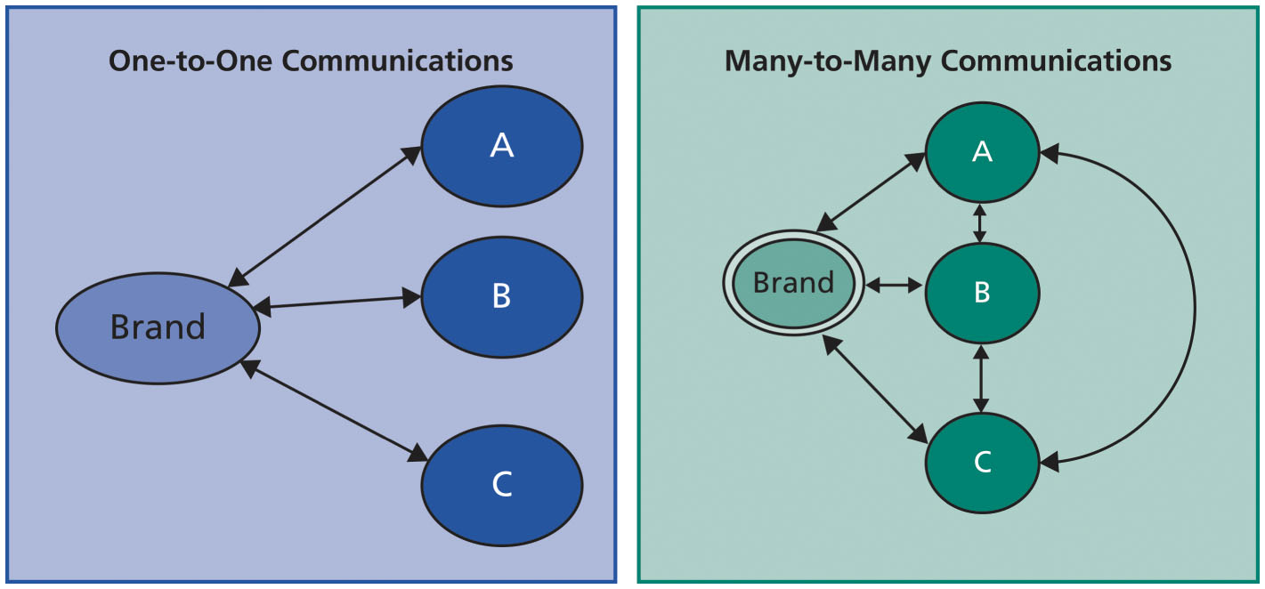
Figure 7-4: New Media Environment: Two-Way and Many-to-Many Communications
Notes:
Over time, the one-to-many channels gave way to a greater emphasis on interactive or one-to-one communications between the brand and the customer. Catalog companies
such as L. L. Bean or J.Crew embraced this direct marketing approach by viewing each customer individually. In recent years, these one-to-many and one-to-one channels are being supplemented or even replaced by many-to-many channels, such as Facebook and Twitter, where consumers have become broadcasters in conversation with each other (many-to-many communications), as well as becoming engaged in a two-way dialogue with brand marketers.

Slide 12
Increase in Consumer Touchpoints
Digital marketing and social media channels and the ability to communicate with each other
Has fueled an increase in touchpoints
Notes:
Having a sharply defined brand positioning and clear guidelines on how a brand should be presented and marketed to consumers is an important step in ensuring that the brand has a consistent theme across all channels. Another key concern of brand managers is to understand which channels are producing the greatest return on the advertising dollar expenditures. This particular set of tasks—called attribution modeling—can be complex and challenging.

Slide 13
Increase in Data Availability
Data, data everywhere!
Clickstream data on users’ browsing behaviors on companies’ Web pages
Advertising metrics
Click-through rates
Cost per clicks
Information regarding the number of unique visitors to a brand’s Web site
Notes:
Marketers now have the ability to use information gathered from customers’ online behavior to tailor their offerings to customer needs. Yet, this quantity of information can quickly become overwhelming if brands don’t invest in tools for transforming all this information into usable bits of knowledge.

Slide 14
Digital Personalization
Targeting individual consumers with varying offers
To try to ensure that they complete a purchase
Digital tools have allowed for unprecedented personalization
Product as well as message
Dynamic pricing
The same product can become available at different prices based on expressed customer interest
Notes:
What are the implications of microtargeting for consumer behavior? While digital personalization offers many advantages from the marketer’s perspective, the efforts can also have a downside. Some researchers have suggested consumers (such as Priyanka Kumar) may react negatively to personalization of offers because of privacy concerns. These reactions could be overcome by reminding consumers of various free services and benefits that are provided to them online, while at the same time seeking their permission to target them or to use their information.
Specifically, three organizational prerequisites for digital personalization to be successful are:
Organizations must invest in a customer data warehouse that provides continuous monitoring and feedback regarding customer needs and wants and how well those are being satisfied through company offerings.
Organizations must deploy cross-functional teams to understand the customer’s decision journey, which may involve a variety of different channels including the company’s Web site, a mobile app, or an in-store experience.
Organizations must employ an iterative process of testing and learning to identify what works and what does not.

Slide 15
Loss of Control over Brand Message and Co-Creation of Brand Meaning
The digital age has created conditions such that brand meaning is primarily coproduced by three different forces:
Firm-generated brand meaning
Consumer-generated brand meaning
Media and cultural influences
Notes:
Firm-generated brand meaning: Through their online and offline marketing activities and programs, and other means, firms attempt to shape the meaning of brands with consumers.
Consumer-generated brand meaning: In the digital age, consumer-to-consumer conversations are enabled through social media platforms—such as Facebook and Twitter—that supplement traditional offline word-of-mouth. These conversations taking place on various digital platforms on a large-scale can significantly shape brand meaning.
Media and cultural influences: A variety of new information intermediaries also play a significant role in co-creating brand meaning. Media channels may themselves contribute to brand meaning. Further, cultural influences are continually evolving and shaping customer conversations and contributing to brand meaning.

Slide 16
User Experience Is the Key to Digital Brand Success
A seamless user experience is crucial to a success of a digital brand
Needs an interface that consumers can effortlessly navigate
To maximize user experience
Notes:
Designing both online and offline interfaces to ensure that Web sites are so easy to navigate that consumers will easily locate what they are looking for, or ensuring that the smartphone app is designed to ensure convenience, will be critical to the success of a brand.

Slide 17
Brands as Cultural Symbols
Brands have greater impact as cultural icons than ever before
Brands help consumers feel a part of something
Allows them to signal and connect with others
Notes:
As brands become increasingly embedded in consumers’ daily online conversations, brand managers must deploy a new set of techniques, to ensure that brands maintain their cultural relevance.

Slide 18
Brand Engagement
Three levels of customer engagement:
Low brand engagement
Moderate brand engagement
High brand engagement
Notes:
Three levels of customer engagement based on the extent to which a customer engages in various types of behaviors:
Low brand engagement: Low levels of engagement may translate into higher frequency of purchasing a product or providing positive feedback about a product or service.
Moderate brand engagement: Calling a company’s 1-800 help line to seek additional information about a product or service, or providing the company with some feedback regarding new flavors may be viewed as moderate brand engagement.
High brand engagement: Positive forms of high brand engagement include joining a brand community or starting a fan page on Facebook dedicated to a brand, evangelizing by troubleshooting customer complaints on a Web site, helping others find the right product variant to suit their needs, and so on. Companies should foster such evangelizing among their customers by offering various monetary and nonmonetary incentives.

Slide 19
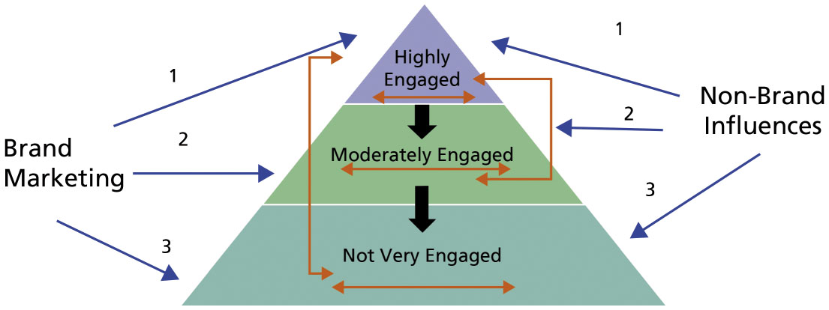
Figure 7-6: Brand Engagement Pyramid
Notes:
There are various questions that marketers need to answer regarding their customers’ level of brand engagement:
What is the shape of the brand engagement pyramid? What is the size of the highly positively engaged group? What is the size of the not engaged versus highly engaged group? How many negatively engaged customers exist and at what levels?
Are there any trickle-down effects—such that those who are highly engaged exert influence among those who are less engaged? Are there any influences of the disengaged group on the engaged group or vice versa? Does this reverse influence of less engaged on highly engaged customers harm the brand and how can marketers stem this direction of influence if it is negative in nature?
What are the flows of information (as well as influence) for a given level of engagement? What does this imply for brand loyalty and purchase behavior?
Among those who are highly engaged, what are the most efficient means of marketing communications? Similarly, among those who are least engaged, how can we leverage marketing communications to strengthen engagement.

Slide 20
Negative Brand Engagement
Hatred and dissatisfaction with a brand
Companies can redress customer grievances
Brand ambassadors
Boycotts or social movements
Brands are more readily ridiculed and parodied due to the online nature of the communication
Notes:
The social media megaphone has provided consumers with unprecedented power to share information with millions of current and future consumers, thereby shifting considerable power into their hands.

Slide 21
Digital Communications (1 of 2)
Paid channel
A marketer typically runs paid advertising
Facebook, T V, print, etc.
Owned channel
Sources of information for consumers about a company’s offerings
YouTube channel
Earned channel
Review sites and reviews posted online typically at no expense
Social media or blog post

Slide 22
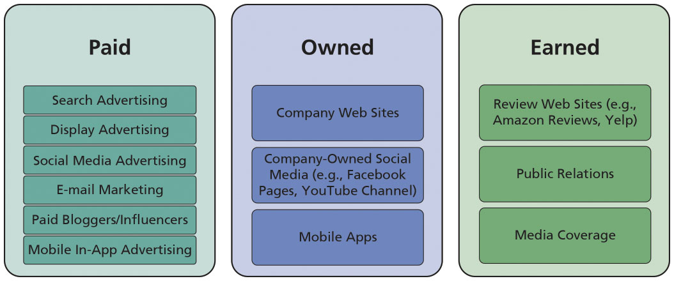
Figure 7-7: Summary of Digital Marketing Communication Channels

Slide 23
Digital Communications (2 of 2)
Company Web Sites
E-mail Marketing
Segmenting, Targeting, and Personalization
E-mail Structure and Subject Line
Timing and Industry Differences
Entertaining and Engaging Content
Testing and Monitoring
Search Advertising
Display Advertising

Slide 24
Overview of Social Media Paid Channels (1 of 2)
Social media channels offer unparalleled access to communities of users with similar demographic, geographic, and psychographic characteristics
Facebook and Twitter, for example
Roles of social media:
Establishing a public voice and online presence
Amplifying marketing message
Helping monitor and obtain feedback from consumers
Promoting customer engagement
Notes:
Social media offers a unique way for marketers to promote dialogue with their audiences, gain feedback and insights, and solicit input regarding their products. However, a caveat is in order. With the brand engagement pyramid, only some consumers want to get involved with only some of their brands and even then maybe only some of the time. Some consumers may view a brand’s presence on social media channels as intrusive and imposing on their privacy. Companies should monitor their social media presence to ensure that it is appropriate and welcomed by consumers.

Slide 25
Overview of Social Media Paid Channels (2 of 2)
Facebook
Twitter
Instagram
Pinterest
Video
Notes:
Facebook
If Facebook were a country, it would be the largest country in the world!
Facebook’s social media platform has 1.6 billion active users.
Metrics:
Reach
Organic reach: number of people who have seen a post in the news feed
Paid reach: the number of unique people who have seen an ad or a sponsored story
Viral reach: number of unique people who have seen a story about a page published by a friend
Followers: number of Facebook followers
Likes and shares: number of Facebook likes is indicative of customer engagement with a particular message; shares indicate how viral a message is
Twitter
Second largest social medium after Facebook
Allows direct communication between customer service and customers and shows a brand’s personality
Instagram
Platform of about 400 million users
Targeted to a younger audience and typically has higher brand engagement levels than other platforms
Pinterest
Allows for sharing and posting of pictures featuring different brands
Particularly conducive to marketing of certain brands that rely on visual imagery
Video
Brand building via video has also become an important medium particularly when brands want to engage in deeper themes and story-telling using their brand

Slide 26
Mobile Marketing
Messaging services
Short messaging service (S M S) and multimedia messaging service (M M S)
Offer customers unique offers based on time and location
In-app advertising
Way by which mobile marketing can help brands touch customers
Proximity systems marketing, or geo-fencing
Involves particular advertising messages delivered to mobile users with a defined geographic area
Notes:
As mobile devices continue to grow in importance to consumers’ daily lives, research has also examined how mobile marketing techniques can contribute to added sales. A few key findings from academic research worth noting include:
Environments may impact the effectiveness of mobile advertising and promotions.
Mobile targeting based on time and location is more effective the closer the promotion is to actual purchase.
Targeting consumers who are closer in physical location to competitors’ locations produces better results than targeting mobile promotions to consumers who are closer to the company’s own locations.
Targeting consumers with mobile promotional coupons can boost overall spending, particularly unplanned spending, if the coupon requires consumers to travel farther than their planned path.

Slide 27
Influencer Marketing and Social Media Celebrities
Influencer marketing involves utilizing key influencers
Sponsored bloggers
Celebrity influencers
Notes:
Marketers have been utilizing influencers for their brands to a greater extent in recent years because of the results they have seen. Sponsored bloggers and celebrity influencers can often hold greater sway over some consumers than any advertiser can. One study reported that audiences exposed to influencer marketing spent more than $639,700 compared to an audience that had not been exposed.

Slide 28
Content Marketing
According to the Content Marketing Institute
“Content marketing is a strategic marketing approach focused on creating and distributing valuable, relevant, and consistent content to attract and retain a clearly defined audience—and, ultimately, to drive profitable customer action.”
A key difference between content marketing and traditional marketing is that
Consumers typically want to consume the posts that form part of a content marketing campaign
Notes:
A good content strategy has to be integrated with a broader public relations and marketing strategy. The goals of the overall marketing strategy in terms of reaching and engaging the audience should be aligned with the content marketing strategy; doing so can help reach the audience, build a brand, increase brand awareness, generate leads, and ensure sales.

Slide 29
Summary of Pros and Cons, Integrating Across Paid Channels
Brand marketers have to make an effort to create integrated digital media campaigns that leverage the benefits of different social media
Notes:
A detailed list of pros and cons of primary paid channels is offered in Table 7-3.

Slide 30
Brand Management Structure
Success factors for strategy-making:
Senior management should be tasked with understanding how products and brands are researched and viewed online
Cross-functional coordination is increasingly important
Data-driven decision-making will become standard operating procedure
A brand or marketing strategy should be viewed as a part of an overall strategy
High-quality data can assist marketers to personalize a given message to an audience
Accessing data on consumers’ conversation can help uncover information that can be useful
Understanding how online and offline communications interact and coordinating with a digital channels strategy is important

Slide 31
Chapter 8
Leveraging Secondary Brand Associations to Build Brand Equity
Notes:
If this PowerPoint presentation contains mathematical equations, you may need to check that your computer has the following installed:
1) MathType Plugin
2) Math Player (free versions available)
3) NVDA Reader (free versions available)

Slide 32
Learning Objectives
8.1 Outline the eight main ways to leverage secondary associations
8.2 Explain the process by which a brand can leverage secondary associations
8.3 Describe some of the key tactical issues in leveraging secondary associations from different entities

Slide 33
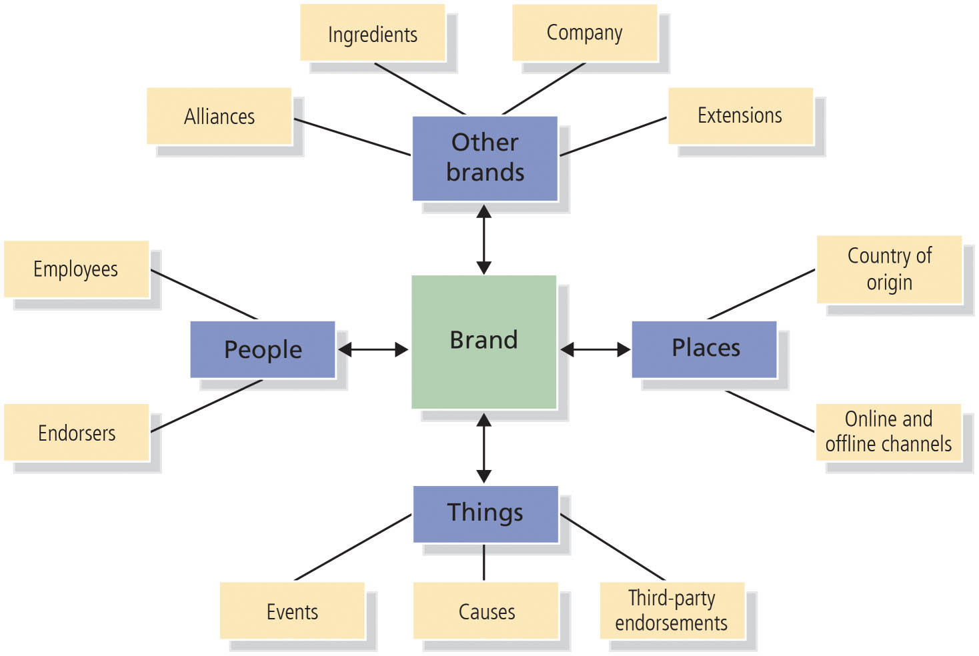
Figure 8-1: Secondary Sources of Brand Knowledge
Notes:
This chapter considers the different means by which we can leverage secondary brand associations by linking the brand to the following:
Companies (through branding strategies)
Countries or other geographic areas (through identification of product origin)
Channels of distribution (through channel strategy)
Other brands (through co-branding)
Characters (through licensing)
Spokespersons (through endorsements)
Events (through sponsorship)
Other third-party sources (through awards or reviews)
The first three entities reflect source factors: who makes the product, where the product is made, and where it is purchased. The remaining entities deal with related people, places, or things.

Slide 34
Effects on Existing Brand Knowledge
Three important factors in predicting the extent of leverage from linking the brand to another entity:
Awareness and knowledge of the entity
Meaningfulness of the knowledge of the entity
Transferability of the knowledge of the entity
Notes:
Awareness and knowledge of the entity: If consumers have no awareness or knowledge of the secondary entity, then obviously there is nothing they can transfer from it. Ideally, consumers would be aware of the entity; hold some strong, favorable, and perhaps even unique associations about it; and have positive judgments and feelings about it.
Meaningfulness of the knowledge of the entity: Given that the entity evokes some positive associations, judgments, or feelings, is this knowledge relevant and meaningful for the brand? The meaningfulness may vary depending on the brand and product context. Some associations, judgments, or feelings may seem relevant to and valuable for the brand, whereas others may seem to consumers to have little connection.
Transferability of the knowledge of the entity: If some potentially useful and meaningful associations, judgments, or feelings exist regarding the entity and could possibly transfer to the brand, how strongly will this knowledge actually become linked to the brand?
In other words, the basic questions we want to answer about transferring secondary knowledge from another entity are: What do consumers know about the other entity? Does any of this knowledge affect what they think about the brand when it becomes linked or associated in some fashion with this other entity?

Slide 35
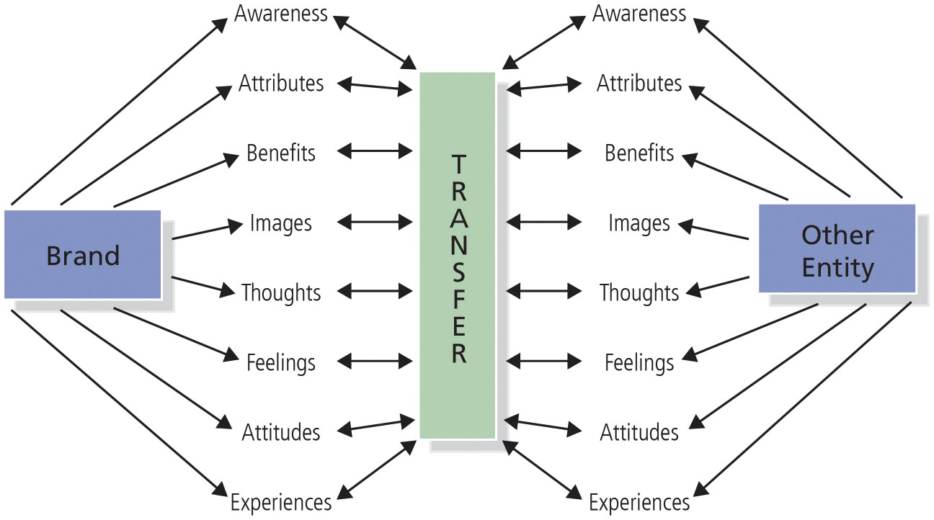
Figure 8-2: Understanding Transfer of Brand Knowledge
Notes:
Theoretically, consumers can infer any aspect of knowledge from other entities to the brand, although some types of entities are more likely to inherently create or affect
certain kinds of brand knowledge than others.

Slide 36
Guidelines
Leveraging secondary brand associations may allow marketers to
Create or reinforce an important point-of-difference or
Create or reinforce a necessary or competitive point-of-parity versus competitors
Commonality leveraging strategy
Makes sense when consumers have associations to another entity that are congruent with the brand
Complementarity branding strategy
Makes sense when entities represent a departure for the brand because there are few if any common or similar associations

Slide 37
Company
Existing brands can be related to a corporate or family brand
Corporate or family brand can be a source of brand equity
Leveraging a corporate brand may or may not be useful
Three main branding options exist for a new product
Create a new brand
Adopt or modify an existing brand
Combine an existing and a new brand
Notes:
Branding strategies are an important determinant of the strength of association from the brand to the company and any other existing brands. There are three main branding options for a new product.

Slide 38
Country of Origin and Other Geographic Areas (1 of 2)
A country of geographic location from which a product originates may
Become linked to the brand
May generate secondary associations
Consumers choose brands originating in different countries based on:
Their beliefs about the quality of certain types of products from certain countries
The image that these brands or products communicate
Notes:
Consider the following strongly linked brands and countries:
Levi’s jeans—United States
Toyota—Japan
Chanel perfume—France
Cadbury—England
Foster’s beer—Australia
Gucci shoes and purses—Italy
Barilla pasta—Italy
Mont Blanc pens—Switzerland
BMW—Germany
Ikea—Sweden
Samsung—South Korea

Slide 39
Country of Origin and Other Geographic Areas (2 of 2)
Other geographic associations besides country of origin are possible
States, regions, cities
Classic U.S. tourism slogans
“I Love New York”
“Virginia Is for Lovers”
Las Vegas’s “What Happens Here, Stays Here”
Notes:
In an increasingly globally connected world, the concept of country-of-origin is likely to become very confusing at times. Governments in some countries have even taken steps to protect their popular industries. Swiss lawmakers have stipulated that local watchmakers can label their products Swiss-made only if non-Swiss parts equal less than 50 percent of the value of the watch’s movement, or motor.

Slide 40
Channels of Distribution
Channels of distribution can directly affect the equity of the brands they sell
Retail stores can indirectly affect brand equity through an “image transfer” process
Retailers have their own brand images in consumers’ minds due to the following associations
Product assortment
Pricing and credit policy
Quality of service
Notes:
A consumer may infer certain characteristics about a brand on the basis of where it is sold. “If it’s sold by Nordstrom, it must be good quality.” Consumers may perceive the same brand differently depending on whether it is sold in a store seen as prestigious and exclusive, or in a store designed for bargain shoppers and having more mass appeal.

Slide 41
Co-Branding (1 of 2)
When two or more existing brands are combined into a joint product or are marketed together in some fashion
Also called brand bundling or brand alliances
Example: Betty Crocker paired with Sunkist Growers to market a lemon chiffon cake mix
Interest in co-branding as a means of building brand equity has increased
Notes:
Advantages
Borrow needed expertise
Leverage equity you don’t have
Reduce cost of product introduction
Expand brand meaning into related categories
Broaden meaning
Increase access points
Source of additional revenue
Disadvantages
Loss of control
Risk of brand equity dilution
Negative feedback effects
Lack of brand focus and clarity
Organizational distraction

Slide 42
Co-Branding (2 of 2)
Brand alliances, such as co-branding, require marketers to ask themselves questions such as:
What capabilities do we not have?
What resource constraints do we face (people, time, money)?
What growth goals or revenue needs do we have?
Notes:
In assessing a joint branding opportunity, marketers will ask themselves:
Is it a profitable business venture?
How does it help to maintain or strengthen brand equity?
Is there any possible risk of dilution of brand equity?
Does it offer any extrinsic advantages such as learning opportunities?
One of the highest-profile brand alliances was that of Disney and McDonald’s, which had the exclusive global rights from 1996 to 2006 in the fast-food industry to promote everything from Disney movies and videos to TV shows and theme parks. Interestingly, because of concerns that the fast-food industry is fueling childhood obesity, Disney ended its exclusive partnership with McDonald’s, although they agreed to continue partnering on some occasional promotions. This example demonstrates some of the downsides of co-branded partnerships, particularly when one partner ceases to be a source of positive brand associations.

Slide 43
Cobranding Examples
What Is Co-Branding? | The Branding Journal

Slide 44
Ingredient Branding
Creates brand equity for materials, components, or parts that are contained within other branded products
Branded ingredients are often a signal of quality
Uniformity and predictability of ingredient brands can reduce risks and reassure consumers
Notes:
Advantages
Firm can generate greater sales at a higher margin
From the standpoint of the manufacturer of the host product, benefit is in leveraging the equity from the ingredient brand to enhance its own brand equity
On the demand side, the host product brands may achieve access to:
New product categories
Different market segments
More distribution channels than otherwise could have been expected
Disadvantages
Costs of a supporting marketing communication programs can be high
Loss of control, because marketing programs for the supplier and manufacturer may have different objectives
The sustainability of the competitive advantage may be somewhat uncertain
Guidelines
Consumers must first perceive that the ingredient matters to the performance and success of the end product.
Consumers must then be convinced that not all ingredient brands are the same and that the ingredient is superior.
A distinctive symbol or logo must be designed to clearly signal to consumers that the host product contains the ingredient.
A coordinated program must be put into place so that consumers understand the importance and advantages of the branded ingredient.

Slide 45
Licensing (1 of 3)
Creates contractual arrangements whereby firms can use:
Names, logos, and characters of other brands to market their own brands for some fixed fee
Can also provide legal protection for trademarks
Notes:
Entertainment licensing has certainly become big business in recent years. Successful licensors include movie titles and logos, such as Harry Potter, Transformers, and Spider-Man; comic strip characters such as Garfield and Peanuts characters; and television and cartoon characters from Sesame Street, The Simpsons, SpongeBob SquarePants, and others. Every summer, marketers spend millions of dollars in movie tie-ins as marketers look for the next blockbuster franchise.
Licensing can be quite lucrative for the licensor. It has long been an important business strategy for designer apparel and accessories, for example. Designers such as Donna Karan, Calvin Klein, Pierre Cardin, and others command large royalties for the right to use their name on a variety of merchandise such as clothing, belts, ties, and luggage.

Slide 46
Licensing (2 of 3)
One danger in licensing
Manufacturers can get caught up in licensing a brand that might be popular at the moment but is only a fad
May produce short-lived sales
Corporate trademark licensing
Licensing of company names, logos, or brands
For use on various, often unrelated products

Slide 47
Licensing (3 of 3)
Firms may license corporate trademarks to:
Generate extra revenue and profits
Protect their trademarks
Increase their brand exposure
Enhance their image
Risk
Product may not live up to the reputation established by the brand
Inappropriate licensing can delete brand meaning
Consumers don’t care about the financial arrangements behind a particular product or service
If the brand is used, the brand promise must be upheld

Slide 48
Celebrity Endorsement (1 of 2)
Using well-known and admired people to promote products
Widespread phenomenon with a long marketing history
Rationale
A famous person can:
Draw attention to a brand
Shape brand perceptions, by virtue of consumers perceptions of the famous person
Notes:
The hope is in using celebrity endorsements is that the celebrities’ fans will also become fans of their products or services. The celebrity must be well enough known to improve
awareness, image, and responses for the brand.

Slide 49
Celebrity Endorsement (2 of 2)
Celebrity endorsers should have
High level of visibility
Rich set of potentially useful associations, judgments, and feelings
Potential problems
Celebrity endorsers can endorse so many products that they lack any specific product meaning
Or are seen as opportunistic or insincere
Must be a reasonable match between celebrity and product
Celebrity endorsers can get in trouble or lose popularity
Notes:
To broaden the appeal and reduce the risks of linking to one celebrity, some marketers have begun to employ several different celebrities or even celebrities who are deceased and therefore a known commodity. For example, dead celebrities such as Michael Jackson (who generates $115 million a year), Elvis Presley (who generates $55 million), and Charles Schulz (creator of the Peanuts characters, who generates $40 million) continue to generate revenues from licensing and endorsements.
To overcome these problems, marketers should strategically evaluate, select, and use celebrity spokespeople. First, choose a well-known and well-defined celebrity whose associations are relevant to the brand and likely to be transferable. Second, there must be a logical fit between the brand and the person. Third, the advertising and communication program should use the celebrity in a creative fashion that highlights the relevant associations and encourages their transfer.

Slide 50
Social Influencers as the New Celebrities
Rapid growth in the use of social media celebrities for advertising brands
Also noncelebrity or micro-influencers who have considerable sway on social media
Notes:
One survey suggested that these micro-influencers may have 10 times more impact on in-store purchases than celebrity influencers, 71 and more than half the respondents suggested that they turned to YouTube reviewers (such as Michelle Phan) to learn more about markets. Today’s customers trust regular people like Phan because their endorsements appear to be driven by genuine expertise, and not just money. A survey of 1,470 women found that 86 percent of them wanted product recommendations from real people and that 58 percent turn to YouTube reviewers to get them. In this way, online social influencers are rapidly taking the place of traditional celebrity
endorsement strategies as more authentic ways of connecting with smaller audiences.

Slide 51
Sporting Cultural or Other Events
Events have their own set of associations
May become linked to a sponsoring brand under certain conditions
Contribute to brand equity by
Becoming associated to the brand and improving brand awareness
Adding new associations
Improving the strength, favorability, and uniqueness of existing associations
Notes:
Sponsored events can contribute to brand equity by becoming associated to the brand and improving brand awareness, adding new associations, or improving the strength, favorability, and uniqueness of existing associations.

Slide 52
Third-Party Sources
Marketers can create secondary associations in a number of different ways
By linking the brand to various third-party sources
Third-party sources can be especially credible sources
Marketers often feature them in advertising campaigns and selling effort
Notes:
As an example, the Good Housekeeping seal has been seen as a mark of quality for decades, offering product replacement or refunds for defective products for up to two years from purchase.
J.D. Power and Associates’ well-publicized Customer Satisfaction Index helped to cultivate an image of quality for Japanese automakers in the 1980s, with a corresponding adverse impact on the quality image of their U.S. rivals. In the 1990s, they began to rank quality in other industries, such as airlines, credit cards, rental cars, and phone service, and top-rated brands in these categories began to feature their awards in ad campaigns. Grey Goose vodka cleverly employed a third-party endorsement to drive sales.

