Slide 1
Chapter 10
Measuring Sources of Brand Equity: Capturing Customer Mind-Set
Notes:
If this PowerPoint presentation contains mathematical equations, you may need to check that your computer has the following installed:
1) MathType Plugin
2) Math Player (free versions available)
3) NVDA Reader (free versions available)

Slide 2
Learning Objectives (1 of 2)
10.1 Describe effective qualitative research techniques for tapping into consumer brand knowledge
10.2 Identify effective quantitative research techniques for measuring brand awareness, image, responses, and relationships
10.3 Outline how big data can help with understanding brand perceptions and brand positioning

Slide 3
Learning Objectives (2 of 2)
10.4 Explain the role of social media monitoring “control rooms” as a marketing research tool
10.5 Profile and contrast some popular brand equity models

Slide 4
Figure 10-1: Understanding Consumer Behavior
Who buys our product or service?
Who makes the decision to buy the product?
Who influences the decision to buy the product?
How is the purchase decision made? Who assumes what role?
What does the customer buy? What needs must be satisfied?
Why do customers buy a particular brand?
Where do they go or look to buy the product or service?
When do they buy? Any seasonality factors?
What are customers’ attitudes toward our product?
What social factors might influence the purchase decision?
Does the customers’ lifestyle influence their decisions?
How is our product perceived by customers?
How do demographic factors influence the purchase decision?
Notes:
This figure presents general considerations in understanding consumer behavior.

Slide 5
Qualitative Research Techniques
Free Association
Projective Techniques
Zaltman Metaphor Elicitation Technique
Neural Research Methods
Brand Personality and Values
Ethnographic and Experiential Methods
Notes:
There are many different ways to uncover the types of associations linked to the brand and their corresponding strength, favorability, and uniqueness. Qualitative research techniques often identify possible brand associations and sources of brand equity. These are relatively unstructured measurement approaches that permit a range of both questions and answers and so can often be a useful first step in exploring consumer brand and product perceptions.

Slide 6
Free Association
Simplest and often most powerful way to profile brand associations
Subjects are asked what comes to mind when they think of a brand
No more specific probe or cue than perhaps the associated product category
Used mainly to identify the range of possible brand associations in consumers’ minds
Answers help marketers clarify the range of possible associations and assemble a brand profile
Notes:
Useful questions include the following:
What do you like best about the brand? What are its positive aspects or advantages?
What do you like least about the brand? What are its negative aspects or disadvantages?
What do you find unique about the brand? How is it different from other brands?
Guidelines
Primary concerns in conducting free association tasks:
What types of probes to give to subjects?
How to code and interpret the resulting data?

Slide 7
Projective Techniques (1 of 2)
Diagnostic tools to uncover the true opinions and feelings of consumers when:
Unwilling or otherwise unable to express themselves on these matters
Present consumers with ambiguous stimulus and ask them to make sense of it
Notes:
For example, it may be difficult for consumers to admit that a certain brand name product has prestige and enhances their self-image. They may instead refer to some particular product feature as the reason they like or dislike the brand. Or they may simply find it difficult to identify and express their true feelings when asked directly, even if they attempt to do so. For either of these reasons, it might be impossible to obtain an accurate portrayal of brand knowledge structures without some rather
unconventional research methods.

Slide 8
Projective Techniques (2 of 2)
Completion and Interpretation Tasks
Classic projective technique
Use incomplete or ambiguous stimuli to elicit consumer thoughts and feelings
Comparison Tasks
Ask consumers to convey impressions by comparing brands to:
People, countries, animals, activities, fabrics, occupations, etc.

Slide 9
Zaltman Metaphor Elicitation Technique (1 of 2)
Uncovers hidden consumers’ knowledge
“a technique for eliciting interconnected constructs that influence thought and behavior”
construct refers to “an abstraction created by the researcher to capture common ideas, concepts, or themes expressed by customers”

Slide 10
Zaltman Metaphor Elicitation Technique (2 of 2)
Z M E T study starts with a group of participants
Asked in advance to think about the research topic
Collect a set of images from their own sources that represent their thoughts and feelings about the research topic
Bring images with them for a one-on-one interview
When interviews are complete
Researchers identify key themes or constructs, code the data, and assemble a consensus map of the most important constructs

Slide 11
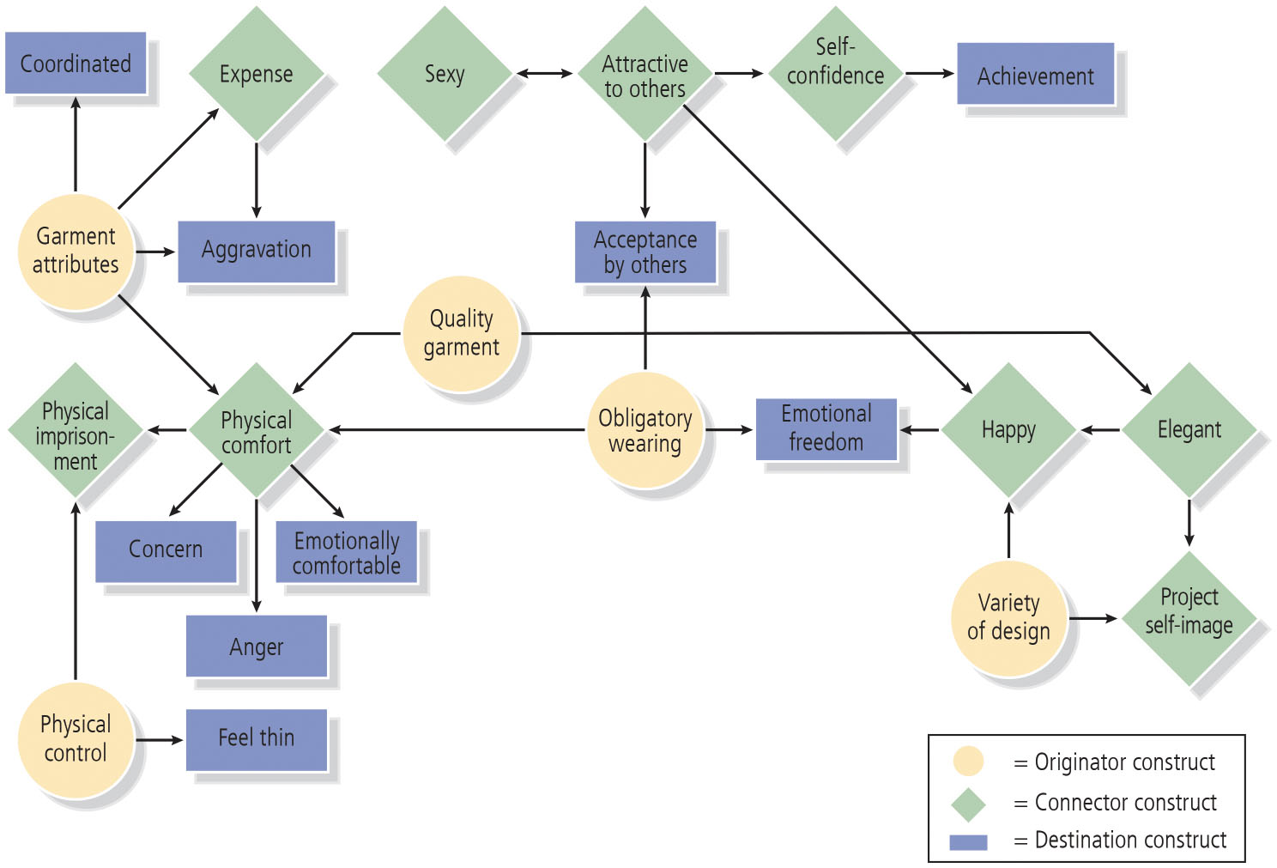
Figure 10-3: Application of Z M E T to Intimate Apparel Market

Slide 12
Neural Research Methods
Neuromarketing
Study of how the brain responds to marketing stimuli, including brands
Research indicates that consumer buying decision is a unconscious habitual process
Some firms apply sophisticated techniques:
E E G (electroencephalogram) technology
Functional magnetic resonance imaging (f M R I)
Notes:
Taking ZMET one step further to dig even deeper into the subconscious, some marketing researchers are bypassing any verbal response from consumers to literally get inside the minds of consumers through various neural research methods.
One major research finding to emerge from neurological consumer research is that many purchase decisions appear to be characterized less by the logical weighing of variables and more “as a largely unconscious habitual process, as distinct from the rational, conscious, information processing model of economists and traditional marketing textbooks.” Even basic decisions, such as the purchase of gasoline, seem to be influenced by brain activity at the subrational level.

Slide 13
Brand Personality and Values
Brand personality
Human characteristics or traits that consumers can attribute to a brand
The big five: factors (with underlying facets) of brand personality:
Sincerity
Excitement
Competence
Sophistication
Ruggedness
Notes:
Based on an extensive data collection of ratings of 114 personality traits on 37 brands in various product categories by more than 600 individuals representative of the U.S. population, she created a brand personality scale that reflected the following five factors (with underlying facets) of brand personality:
Sincerity (down-to-earth, honest, wholesome, and cheerful)
Excitement (daring, spirited, imaginative, and up-to-date)
Competence (reliable, intelligent, and successful)
Sophistication (upper class and charming)
Ruggedness (outdoorsy and tough)

Slide 14
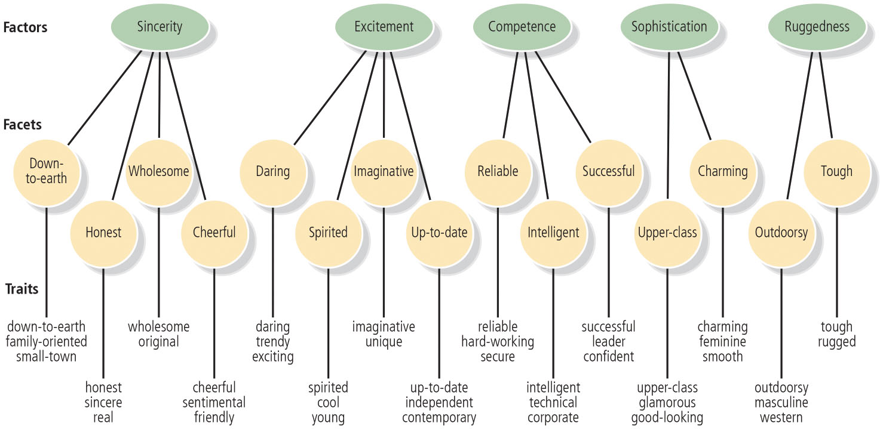
Figure 10-4: Brand Personality Scale Measures
Notes:
This figure depicts the specific trait items that make up the Aaker brand personality scale.

Slide 15
Ethnographic and Experiential Methods
Researchers are tapping more directly into consumers’ actual home, work, or shopping behaviors
This may help elicit more meaningful responses
Ethnographic researches uses “thick description” based on participant observation
Extract and interpret the deep cultural meaning of events and activities
Notes:
There are many advantages in ethnographic research, there are two significant downsides: it is time-consuming and expensive.

Slide 16
Quantitative Research Techniques
Brand Awareness
Brand Image
Other Approaches
Notes:
Although qualitative measures are useful in identifying the range of possible associations with a brand and some initial insights into their strength, favorability, and uniqueness, marketers often want a more definitive portrait of the brand to allow them to make more confident and defensible strategic and tactical recommendations.
Some say qualitative research strives to uncover and discover, while quantitative research aims to prove or disprove. Whereas qualitative research typically elicits some type of verbal response from consumers, quantitative research typically employs various types of scale questions from which researchers can draw numerical representations and summaries.

Slide 17
Brand Awareness
Related to the strength of the brand in memory
Reflected by consumers’ ability to identify various brand elements
Describes the likelihood that a brand will come to mind in different situations
Recognition
Recall
Corrections for guessing
Strategic implications
Notes:
Recognition
Requires consumers to identify the brand under a variety of circumstances
Can rest on the identification of any of the brand elements
Specially important for packaging
Recall
Demonstrated when consumers are able to retrieve a brand element from memory, when given some related probe or cue
Unaided recall
Aided recall
Measures of recall based on product attribute or category cues and situational or usage cues give an indication of breadth and depth of recall
Corrections for guessing
Problem may be especially evident with certain types of aided awareness or recognition measures for the brand
Strategic implications
Yields insight into how brand knowledge is organized in memory
Identifies cues or reminders necessary for consumers to retrieve the brand from memory

Slide 18
Brand Image
Associations that consumers hold for a brand
Useful for marketers to make a distinction between:
Lower-level considerations (performance and imagery)
Higher-level considerations (judgments and feelings)
Beliefs
Descriptive thoughts that a person holds about something
Notes:
Brand association beliefs
Specific attributes and benefits linked to the brand and its competitors
Can be assessed on the basis of three key dimensions:
Strength
Favorability
Uniqueness

Slide 19
Other Approaches
More complicated quantitative technique to assess overall brand uniqueness
Multidimensional scaling (M D S), or perceptual maps
Procedure for determining the perceived relative images of a set of objects, such as products or brands
Transforms consumer judgments of similarity or preference into distances represented in perceptual space

Slide 20
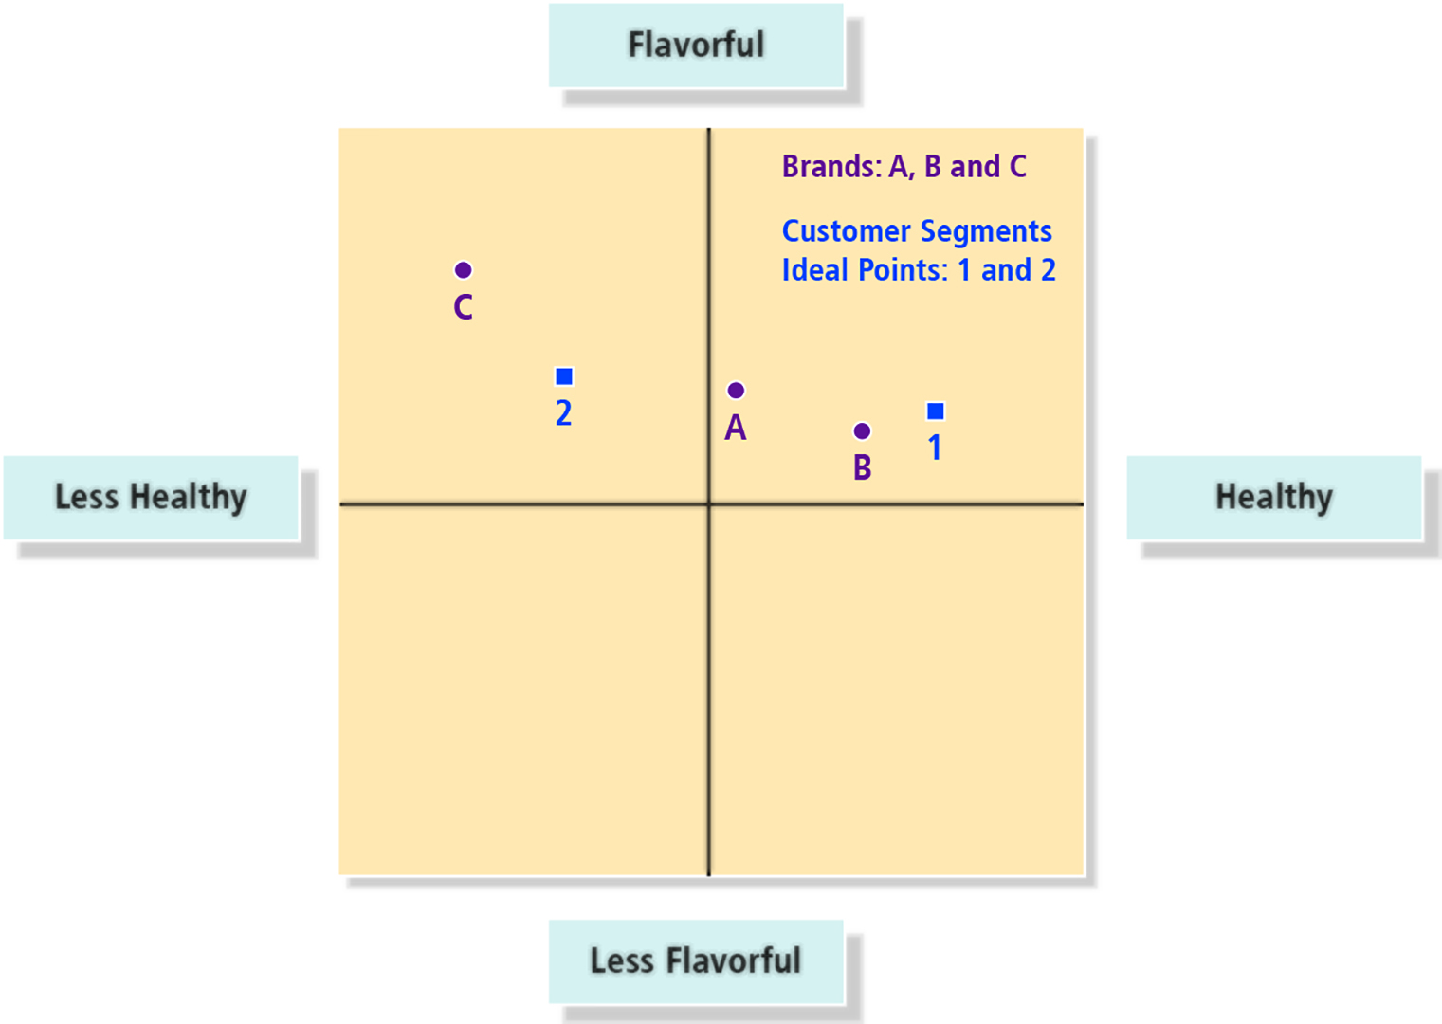
Figure 10-8: Hypothetical Restaurant Perceptual Map

Slide 21
Social Media Listening and Monitoring
Social media monitoring
Fast-growing and increasingly specialized area of marketing research
Dashboard
Summary of key statistics associated with a brand
May include:
Number of engagements of brand messages across various social media platforms
Sentiment associated with social media messages
Topics that are related to a brand
Lists of keywords that are associated with a brand
Notes:
The communications environment has shifted and customers are engaged in conversations with each other, to a larger degree than ever before. With the proliferation of social media and digital communications options, one concern of brand marketers everywhere is understanding the return-on-investment (ROI) of each communication channel.

Slide 22
Brand Responses
Purchase Intentions
Likelihood to Recommend
Notes:
Purchase intentions
Determined by brand attitudes and consideration.
Predictive of actual purchase when there is correspondence between any two of the following factors:
Action (buying for own use or to give as a gift)
Target (specific type of product and brand)
Context (in what type of store based on what prices and other conditions)
Time (within a week, month, or year)
Likelihood to recommend
How likely is it that you would recommend this product or service to a friend or colleague?

Slide 23
Brand Relationships (1 of 2)
Characterized in terms of brand resonance and measures for following key dimensions
Behavioral loyalty
Attitudinal attachment
Sense of community
Active engagement

Slide 24
Brand Relationships (2 of 2)
Behavioral Loyalty
Attitudinal Attachment
Sense of Community
Active Engagement
Fournier’s Brand Relationship Research
Notes:
Behavioral loyalty
To capture reported brand usage and behavioral loyalty marketers can:
Ask consumers past purchase history and future purchase intentions
Make their measures open ended
Force consumers to choose one of two brands
Offer multiple choice or rating scales
Attitudinal attachment
Can be defined in the terms of following underlying constructs
Brand-self connections
Brand prominence
Sense of community
Social currency—The extent to which people share the brand or information about the brand as part of their everyday social lives at work or at home
Active engagement
Extent to which consumers are willing to invest their resources of time, energy, and money on the brand beyond those resources expended during purchase or consumption of the brand
Fournier’s brand relationship research
Six main facets of brand relationship quality:
Interdependence
Self-concept connection
Commitment
Love/passion
Intimacy
Partner quality

Slide 25
Comprehensive Models of Consumer-Based Brand Equity
BrandDynamics
Bonding
Advantage
Performance
Relevance
Presence
Relationship to the C B B E model
Five sequenced stages of Millward Brown’s BrandDynamics model to the four ascending steps of the C B B E model

Slide 26
Figure 10-13: Summary of Qualitative and Quantitative Measure
Qualitative Research Techniques
B. Brand Image
Open-ended and scale measures of specific brand attributes and benefits
Strength
Favorability
Uniqueness
Overall judgments and feelings
Overall relationship measures
Intensity
Activity
Free association
Adjective ratings and checklists
Projective techniques
Photo sorts
Bubble drawings
Story telling
Personification exercises
Role playing
Experiential methods
Quantitative Research Techniques
A. Brand Awareness
Direct and indirect measures of brand recognition
Aided and unaided measures of brand recall

Slide 27
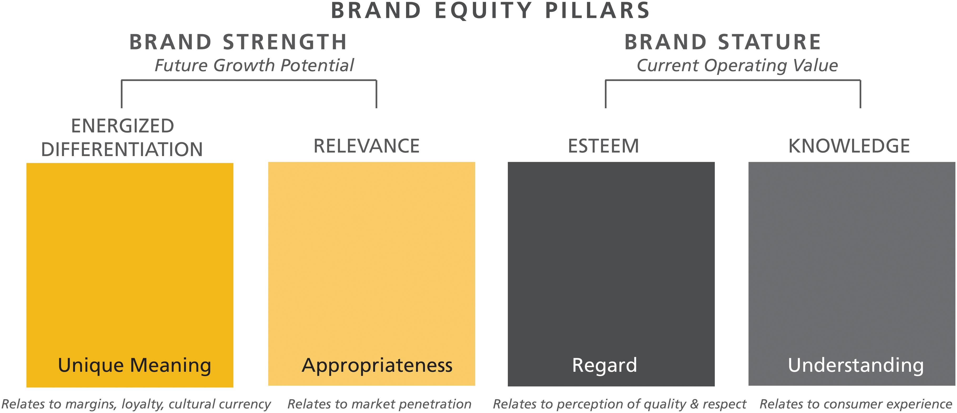
Figure 10-14: Four Pillars Assess Brand Health, Development, and Momentum
Notes:
In the chapter, Brand Focus 10.0 presents a detailed account of arguably the most successful and influential industry branding model, Young and Rubicam’s Brand Asset Valuator.

Slide 28
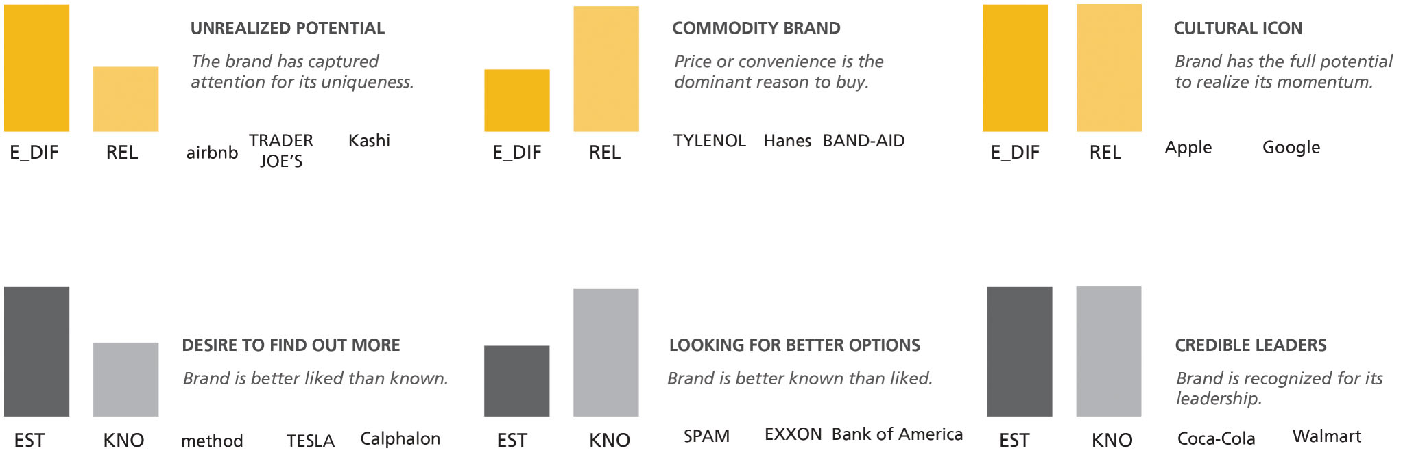
Figure 10-15: Pillar Patterns Tell a Story
Source: BrandAsset Consulting. Used with permission.

Slide 29
Chapter 11
Measuring Outcomes of Brand Equity: Capturing Market Performance
Slides in this presentation contain hyperlinks. JAWS users should be able to get a list of links by using INSERT+F7
Notes:
If this PowerPoint presentation contains mathematical equations, you may need to check that your computer has the following installed:
1) MathType Plugin
2) Math Player (free versions available)
3) NVDA Reader (free versions available)

Slide 30
Learning Objectives
11.1 Recognize the multidimensionality of brand equity and the importance of multiple methods to measure it
11.2 Contrast different comparative methods to assess brand equity
11.3 Explain the basic logic of how conjoint analysis works
11.4 Review different holistic methods for valuing brand equity
11.5 Describe the relationship between branding and finance

Slide 31
Comparative Methods
Brand-Based Comparative Approaches
Marketing-Based Comparative Approaches
Conjoint Analysis
Notes:
Comparative methods are research studies or experiments that examine consumer attitudes and behavior toward a brand to directly estimate specific benefits arising from having a high level of awareness and strong, favorable, and unique brand associations.

Slide 32
Brand-Based Comparative Approaches
Competitive brands used as benchmarks by consumers
Exemplar: Category leader or some other brand that consumers feel is representative of the category, like their most preferred brand
Applications
Classic example is blind testing research
Consumers examine or use a product with or without brand identification
Differences typically emerge
Critique
Learning is limited by the number of different applications examined
Notes:
Applications
Consumption research for new or existing products.
Useful to determine brand equity benefits related to price margins and premiums.
Critique
Advantages
Isolates the value of a brand in a very real sense.
Applicable when the marketing activity under consideration represents a change from past marketing of the brand.
Achievement of realism.
Disadvantage
Simulations and concept statements may highlight the particular product characteristics enough to make them more salient than they would otherwise be, distorting the results.

Slide 33
Marketing-Based Comparative Approaches
Hold the brand fixed
Examine consumer response based on changes in the marketing program
Applications
Long academic and industry tradition of exploring price premiums using marketing-based comparative approaches
Variations to derive similar types of demand curves
Many firms now try to assess price sensitivity and willingness-to-pay thresholds for different brands
Critique
May be difficult to discern whether consumer responses to changes in the marketing stimuli are being caused by brand knowledge or by more generic product knowledge
Notes:
Applications
Dollar-metric measure of brand commitment.
Assessing consumer response to different advertising strategies.
Explore potential brand extensions by collecting consumer evaluations of a range of concept statements.
Critique
Advantage
Ease of implementation.
Disadvantage
Difficult to discern whether consumer responses to changes in the marketing stimuli are being caused by brand knowledge or by more generic product knowledge.

Slide 34
Figure 11-1: Reactions to Proposed Planters Extensions
Average Scale Rating* | Proposed Extensions
10 | Peanuts
9 | Snack mixes, nuts for baking
8 | —
7 | Pretzels, chocolate nut candy, caramel corn
6 | Snack crackers, potato chips, nutritional granola bars
5 | Tortilla chips, toppings (ice cream/dessert)
4 | Lunchables/lunch snack packs, dessert mixes (cookie/cake/brownie)
3 | Ice cream/ice cream bars, toppings (salad/vegetable)
2 | Cereal, toaster pastries, Asian entrees/sauces, stuffing mix, refrigerated dough, jams/jellies
1 | Yogurt
*Consumers rated hypothetical proposed extensions on an 11-point scale anchored by 0 (definitely would not expect Planter’s to sell it) and 10 (definitely would expect Planter’s to sell it).
Notes:
Marketers can explore potential brand extensions by collecting consumer evaluations of a range of concept statements describing brand extension candidates. For example, the results of a consumer survey conducted at one time examined reactions to hypothetical extensions of the Planters nuts brand. Contrasting those extensions provides some indication of the equity of the brand. This figure displays the results of a consumer survey conducted at one time to examine reactions to hypothetical extensions of the Planters nuts brand. Contrasting those extensions provides some indication of the equity of the brand.

Slide 35
Conjoint Analysis
Survey-based multivariate technique that enables marketers to profile the consumer decision process with respect to products and brands
Part worth: The value consumers attach to each attribute level, as statistically derived by the conjoint formula
Applications
Allows study of different brands and different aspects of the product or marketing program simultaneously
Product composition, price, distribution outlets, etc.
Critique
Marketing profiles may violate consumers’ expectations based on what they already know about brands
Notes:
Application
Assess advertising effectiveness and brand value.
Explore how brand names interact with physical product features to affect the possibility of extending brand names to new product categories.
Determination of the company attributes relevant to customers.
Critique
Advantage
Study different brands and different aspects of the product or marketing program simultaneously.
Disadvantages
Marketing profiles may violate consumers’ expectations based on what they already know about brands.
Difficult to specify and interpret brand attribute levels.

Slide 36
Holistic Methods (1 of 2)
Residual Approach
Examines the value of the brand by subtracting consumers’ preferences for the brand from their overall brand preferences
Valuation Approach
Places a financial value on brand equity
Notes:
Holistic methods place an overall value on the brand in either abstract utility terms or concrete financial terms. Thus, holistic methods attempt to “net out” various considerations to determine the unique contribution of the brand.

Slide 37
Holistic Methods (2 of 2)
Residual approach
Examines the value of the brand by subtracting consumers’ preferences for the brand from their overall brand preferences
Based on physical product attributes alone
Valuation approach
Places financial value on brand equity for
Accounting purposes, mergers and acquisitions, or other such reasons

Slide 38
Residual Approaches (1 of 2)
Scanner Panel
Choice Experiments
Multi-Attribute Attitude Models
Notes:
Scanner panel
Researchers have focused on analysis of brand value based on data sets from supermarket scanners of consumer purchases.
Some of the models used by researchers:
Estimate that aspect of brand preference that is unique to a brand and not currently duplicated by competitors.
Employ actual retail sales data to calculate a “revenue premium” as an estimate of brand equity.
Use store-level scanner data to track brand equity and key drivers of brand equity over time.
Choice experiments
Equalization price: Equates the utility of a brand to the utilities that could be attributed to a brand in the category where no brand differentiation occurred.
Multi-attribute attitude models
Reveals the relative sizes of different bases of brand equity by dividing brand equity into three components:
Brand awareness
Attribute perception biases: Difference between subjectively perceived attribute values and objectively measured attribute values.
Consumer reports
Nonattribute preference: Difference between subjectively perceived attribute values and overall preference.
Model for decomposing attribute ratings of a brand into two components:
Brand-specific associations, meaning features, attributes, or benefits that consumers link to a brand.
General brand impressions based on a more holistic view of a brand.

Slide 39
Residual Approaches (2 of 2)
Residual approach is most suited for brands with many product-related attribute associations
Cannot distinguish between different types of nonproduct-related attribute associations
Generally take a static view of brand equity
Notes:
The disadvantage of residual approaches is that they are most appropriate for brands with a lot of product-related attribute associations, because these measures are unable to distinguish between different types of nonproduct-related attribute associations. Consequently, the residual approach’s diagnostic value for strategic decision making in other cases is limited.

Slide 40
Valuation Approaches (1 of 2)
Widely held belief is that much of corporate value of it is wrapped up in the value of a brand
Company | Brand Value (in $ billions)* | Total Value (in $ billions)** | Brand Value as a Percentage of Overall Value
Apple | 184.1 | 868.88 | 21%
Google | 141.7 | 729.1 | 19%
Microsoft | 79.9 | 659.9 | 12%
Coca-Cola | 69.7 | 195.5 | 36%
Amazon | 64.7 | 563.5 | 11%
Samsung # | 56.2 | 300 | 19%
Toyota | 50.3 | 188.2 | 27%
Facebook | 48.2 | 420.8 | 11%
Mercedes | 47.8 | 79.3 | 60%
I B M | 46.8 | 142 | 33%
*Source: Data are for 2017; http://interbrand.com/best-brands/best-global-brands/2017/ranking/
**Source: Market Capitalization information based on data from C R S P Monthly
# Samsung market capitalization converted to U S Currency from South Korean Won
Notes:
Based on a number of different analyses, a widely held belief is that much of the corporate value of many companies is wrapped up in the value of their brands.
The recognition of the important role of brand names has spurred much research on valuation. The ability to put a specific price tag on a brand’s value is useful for a number of reasons:
Mergers and acquisitions: Both to evaluate possible purchases as well as to facilitate disposal.
Brand licensing: Internally for tax reasons and to third parties.
Fund raising: As collateral on loans or for sale or leaseback arrangements; to establish to current and future investors how the firm’s efforts have resulted in valuation creation, as demonstrated by the valuations of the brands owned by the firm.
Brand portfolio decisions: To develop brand strategy of a portfolio of brands based on their brand valuation.
Internal resource allocation decisions and understanding return on investment (ROI): Capital allocation decisions within a firm could revolve around the valuations of different brands. The valuation of brand names could help in establishing the return on investment of marketing expenditures.

Slide 41
Valuation Approaches (2 of 2)
Accounting Background
Historical Perspectives
General Approaches
Notes:
Accounting background
Tangible assets: Property, plant, and equipment; current assets; and investments in stocks and bonds.
Intangible assets: Augment the earning power of a firm’s physical assets.
Goodwill
Historical perspectives
British firms used brand values primarily to boost their balance sheets.
Recording brand value as an intangible asset from the firm’s perspective is a means to increase the asset value of the firm.
General approaches
Cost approach: Brand equity is the amount of money that would be required to reproduce or replace the brand.
Market approach: The amount an active market would allow so that the asset would exchange between a willing buyer and willing seller.
Income approach: Brand equity is the discounted future cash flow from the future earnings stream for the brand.
Capitalizing royalty earnings from a brand name.
Capitalizing the premium profits that are earned by a branded products.
Capitalizing the actual profitability of a brand after allowing for the costs of maintaining it and the effects of taxation.

Slide 42
Brand Valuation: A Review of Major Approaches
Academic approaches
Seminal academic research study proposed estimating a firm’s brand equity derived from financial market estimates of brand-related profits
Three additional well-established brand valuation approaches
Interbrand
Brand Z
Brand finance
Notes:
There have been many approaches suggested by academic researchers to systematically value brands. One seminal academic research study proposed a technique for estimating a firm’s brand equity derived from financial market estimates of brand-related profits. The methodology defined brand equity as the incremental cash flows accruing to branded products over and above the cash flows that would result from the sale of unbranded products. This fundamentally assumed that the market value of the firm’s securities would provide an unbiased estimate of the future cash flows attributable to all the firm’s assets. Further, brand equity was regarded as an intangible asset contributing to firm value. By taking into consideration factors such as the age of the brand, order of entry in the category, and current and past advertising share, the approach was able to estimate brand equity.
Aside from such academic approaches, there are a few well-established brand valuation approaches that derive from industry, and we review three of them here. All three approaches—Interbrand, BrandZ, and Brand Finance—combine brand equity measurement and financial valuation in deriving estimates of brand value.

Slide 43
Interbrand
Leading brand valuation firm
How a brand benefits an organization
Internally and externally
Three key components:
Financial forecast
Role of brand
Strength analysis
Notes:
Financial forecast
The basic principle underlying this step is that the worth of brands—like any other asset owned by a firm or the firm’s overall value—can be calculated based on the estimates of present value of its future cash flows. For each of the segments identified as important to a brand, the valuation process involves identifying and forecasting the net revenues (or potential cash flows).
Role of brand
Role of brand measures the portion of the customer decision to purchase that is attributable to brand—exclusive of other purchase drivers such as price or product features.
Strength analysis
Brand strength measures the ability of the brand to secure the delivery of expected future earnings. Brand strength is reported on a scale of 0 to 100 based on an evaluation across 10 dimensions of internal and external aspects.

Slide 44
Brand Z (1 of 2)
Based on the Meaningfully Different Framework
Suggests brands create value if they offer three key benefits:
They are meaningful
They are different
They are salient
Notes:
Meaningfully Different Framework:
They are meaningful (they meet customer needs)
They are different (they are unique and they set trends); and
They are salient (they are top of mind)
These benefits translate into power (by increasing sales), premium (by commanding a high price), and potential (by helping to sustain future growth). Their findings indicate that meaningfully different brands capture significantly higher volume (five times as much), have a 13 percent price premium, and are more likely to increase their share of value.

Slide 45
Brand Z (2 of 2)
Key steps in the Brand Z valuation include:
Calculating financial value
Calculating brand contribution
Calculating brand value

Slide 46
Brand Finance
Based on the “relief from royalty” approach
Brand’s value is based on the royalties that a company would have paid for licensing that brand from a third party
Assuming it was not the brand owner
Notes:
The net present value of the projected royalty stream becomes the estimate of brand value. The approach can be summarized as follows. First, Brand Finance calculates the brand strength on a scale of 1 to 100 using data from the Brand Asset Valuator database, which results in a Brand Strength Index (or BSI score). Second, the methodology involves assessing the brand royalty rate by applying the BSI score to the royalty rates that are applicable to a given industry. These industry-specific royalty rates are identified through databases containing comparable licensing agreements. For example, if the industry royalty rates range between 1 to 5 percent, and the brand has a strength score of 80 out of 100, the appropriate royalty rate for the brand in this industry would be 4 percent. Third, these royalty rates when applied to forecasted revenues, help determine brand value. Revenue forecasts are further generated based on a combination of historic revenues, equity analyst forecasts as well as economic growth rates. Finally, brand value is determined by discounting forecasted revenues to net present value terms.

Slide 47
Comparing the Major Brand Valuation Approaches (1 of 4)
All three approaches are based on some variation of the income-based approach to brand valuation
All are based on projections of income
All three methods compute the present value of projected future earnings
Based on an estimate of brand strength, and
An application of a discount rate

Slide 48
Comparing the Major Brand Valuation Approaches (2 of 4)
All three approaches use available financial and market data
And compute the economic value added
Types of data used to measure brand perceptions vary across the three approaches
Notes:
Despite having some similarities in their approaches, the three methods have enough differences to produce some fairly significant differences in estimates of brand value for the same brand, causing considerable criticism regarding the validity of these approaches. The comparisons of the three valuation approaches for a sample of 68 brands for which real financial transaction data was available, revealed significant anomalies, with all approaches overestimating value by nearly two or three times. Further, these approaches are also inconsistent with each other.

Slide 49
Comparing the Major Brand Valuation Approaches (3 of 4)
Comparisons of Brand Values in 2016 ($ millions)
Blank | Interbrand | Brand Z | Brand Finance
Google | 133,252 | 245,581 | 109,470
Apple | 178,119 | 234,671 | 107,141
Amazon | 50,338 | 139,286 | 106,396
Coca-Cola | 73,102 | 78,142 | 31,885
Toyota | 53,580 | 28,660 | 46,255
Notes:
This table shows the comparison of the three approaches—and the variations in their assessments of brand value—for five major brands.

Slide 50
Comparing the Major Brand Valuation Approaches (4 of 4)
Spend Wisely
Focus and be creative
Look for Benchmarks
Examine competitive spending levels and historical company norms
Be Strategic
Apply brand equity models
Be Observant
Track both formally and informally
Notes:
Guidelines for creating and measuring ROI from brand marketing activities
Spend wisely: Investing in distinctive and well-designed marketing activities increases the chance for a more positive and discernible ROI.
Look for benchmarks: Understand the target market before entering.
Be strategic: Use a structured approach to planning, implementing, and interpreting marketing activity.
Be observant: Qualitative and quantitative insights can help in understanding brand performance.

