Slide 1
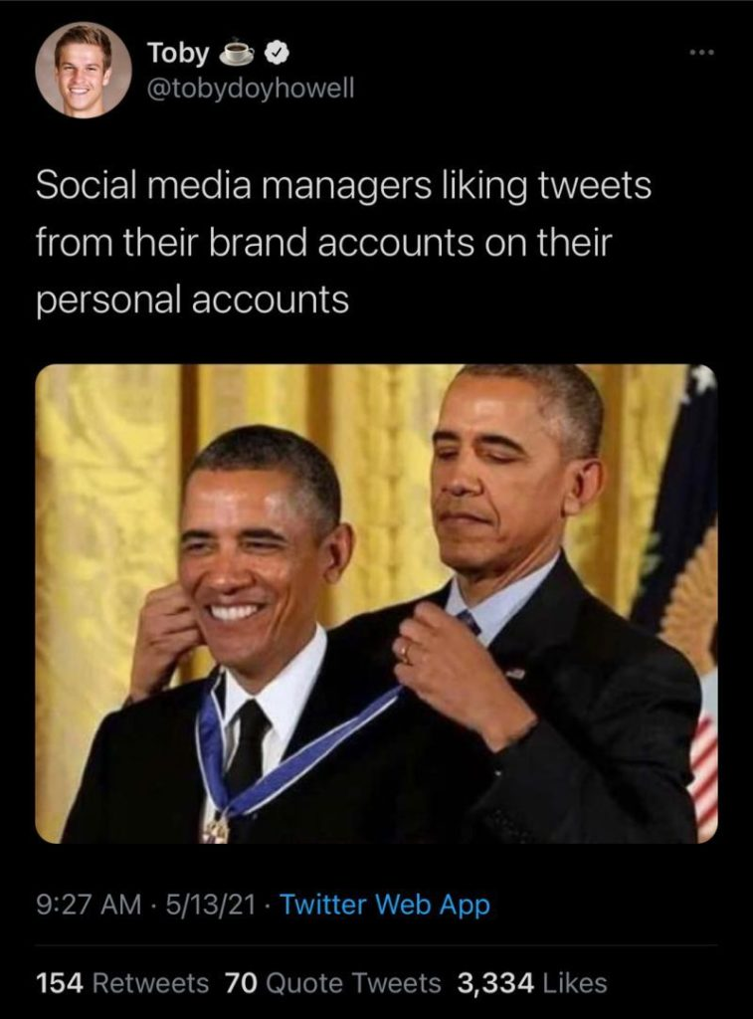
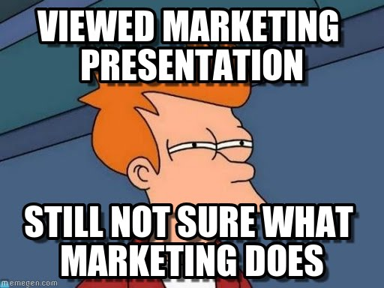
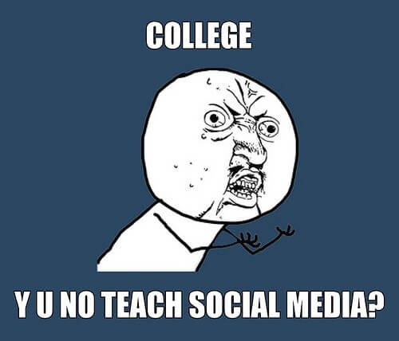
Am I in the right class?

Slide 2
Course Overview

Slide 3
Agenda
Introduction
Install iClicker reef- name, Mizzou email
Discussion 1: Intro about yourself (on Canvas):
A fun fact about you
Structure of the class
Syllabus
Attendance & class participation on iClicker
Case Discussion
Term Project
Weekly Quiz
Name
Hometown
Notes:
Please post your introduction on Canvas so your classmates and I can get to know you. And it can also serve as a basis form groups later on.
These questions have been inspired by professor Alyssa Carlson
https://www.youtube.com/watch?v=0D7hFHfLEyk
What is your name? State your name and where you are from
What is your quest? What year are you (e.g., junior, senior)? What would you like to do at the end of your program (e.g., sales agent, marketing consultant, etc.)?
What is your favorite color? Tell an interesting fact, hobby, or experience you have.
What is the airspeed velocity of an unladen swallow? Some questions are just hard! What question would you like to be able to answer at the end of this course? In other words, what would you like to learn about marketing research?

Slide 4

Instructor Bio
Name: Mike Nguyen
Office: Room 417
Office Hour: 11:00 AM – 11:30 AM (Monday) or by appointment
Email: mikenguyen@mail.missouri.edu
Mizzou bio
Personal Website: https://mikenguyen.netlify.app/
Notes:
My name is Mike Nguyen. I am extremely happy that y’all are here today. I am really excited to accompany you throughout this semester in this Marketing Research class.
You can call me Mike, professor Mike, or professor Nguyen. I’ll answer pretty much everything.
My background is in economics, finance, marketing, and statistics.
You can find out more info about me on my Mizzou page or on my personal website
My office is 417
And my office hour is
You can also reach me via email at

Slide 5
Syllabus
Access to materials
Canvas: publish a week before
All tests and quizzes are on Canvas
Syllabus
Notes:
On Canvas, all the materials will be posted a week before so you can have time to prepare it early if you wish
There might some be typos or broken Links. Please let me know if you can’t access the materials.
And you can just interrupt me if you have a question.
Now, we can go over the syllabus together.
All tests and quizzes will be on Canvas.
You can pull up the syllabus and we will through it.

Slide 6
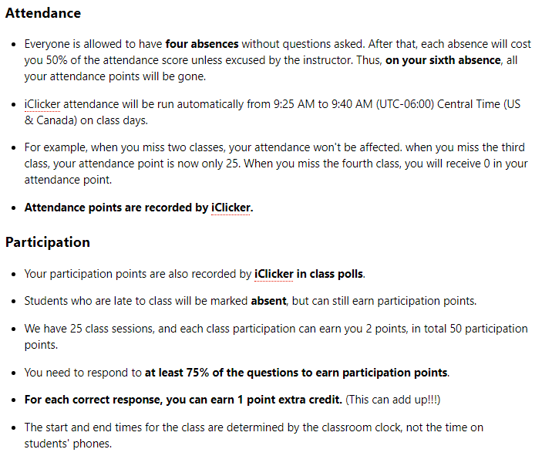
Attendance, Participation points, and Professionalism
Notes:
This is straight from the syllabus, so if you guys can pull up on your computer, your phone or print it out, it would be easier to follow along.
It would come in handy later when you want to refer back to these policies.
Every day, you will receive attendance points just by being in class and answer questions.
But to receive participation points, you have to answer at least 75% of the questions posted in class, which usually consists of
1 to 2 questions that recap materials from the last class.

Slide 7

IClicker Reef
Make sure you are registered by the end of this class
First class, I do not take any attendance or participation points
Notes:
I see that most of you already have iclicker account, just make sure you are in the class.
And I will run participation questions to let you familiarize yourself with iclicker
If you can’t figure out how to register your iclicker, please talk to me after class

Slide 8
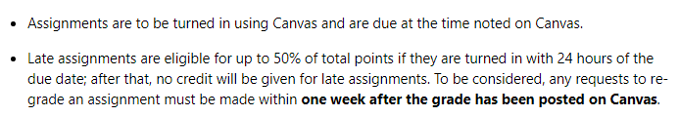
Assignments

Slide 9
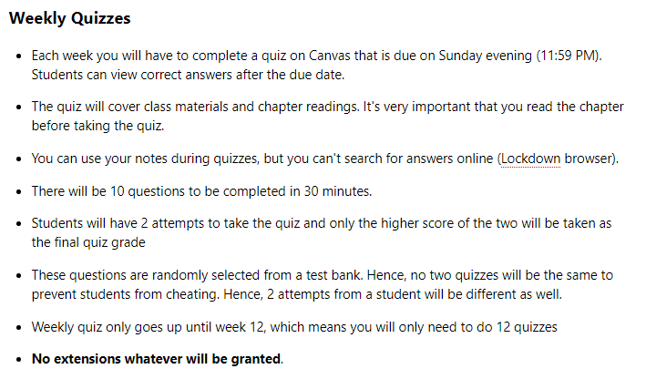
Weekly Quizzes
Notes:
Please remember to read up on the chapter materials. I don’t want to waste your time by just repeating everything from the book in class because I can safely assume that you guys read the chapter, and go to class for more information and new materials.
Quizzes are based on both in-class and chapter materials.
Remember, quizzes require you to have lockdown browser.
And please do the practice quiz before doing a real one (go to practice quiz)
More specifically, (go into the slide)

Slide 10


Lockdown Browser
Notes:
https://etopics.missouri.edu/support/solutions/articles/1000185802-respondus-lockdown-browser-at-mizzou
Lockdown browser is a browser. Hence, please do not use Chrome or any other browser, you have to access your quiz via Lockdown browser in order to take the quizzes and exams.

Slide 11

Lockdown Browser
Open Lockdown Browser
Log in Canvas
Proceed to take quizzes or exams
Computer Lab
Lockdown Browser 2 Lab
This Photo by Unknown Author is licensed under CC BY
Notes:
It’s a browser, so don’t use Google Chrome, Safari, or Firefox.
In case you don’t have Lockdown browser on your computer, or if your computer acts up, the computer lab on the basement also has Lockdown Browser, but it’s called Lockdown Browser 2 Lab.
You can just go there and take your quizzes and exams when there isn’t research being conducted.
This is why I strongly recommend you to take the quiz early in case you have problem.
Sometimes, I can’t answer your email right away, so keep that in mind.

Slide 12
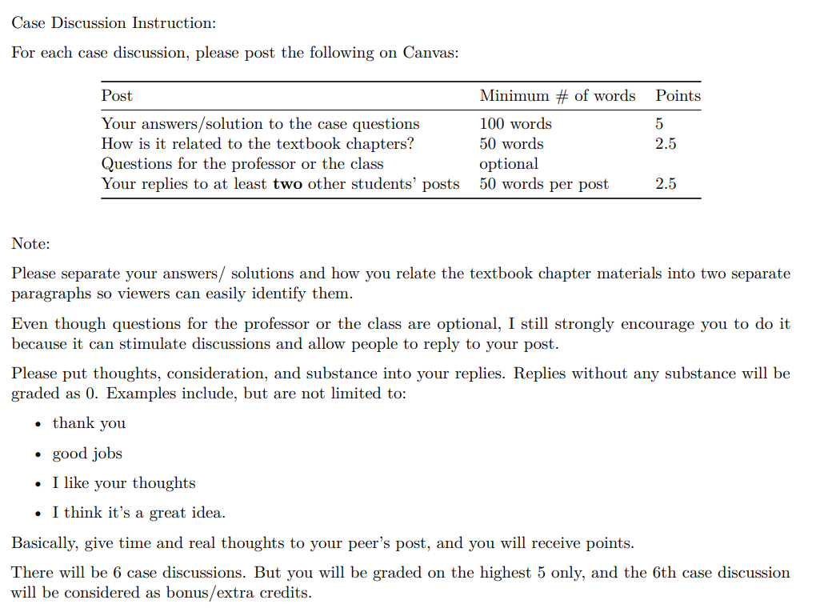
Case Dicussion
Notes:
Each post consists of 4 parts:

Slide 13
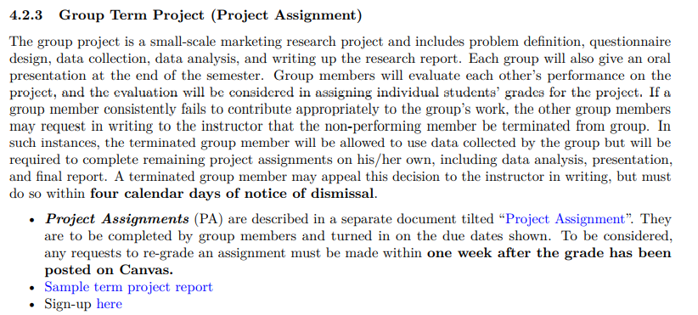
Group Term Project
Notes:
This is a small-scale group project that you have a chance to work on from the beginning till the end of a marketing research project. There will be 13 assignments in total
To access the project assignments document, you can simply click on the URL in your syllabus.
(Now go to the project assignments)
Let students mingle (5 mins).
Since we have 32 students, a group can have up to 5 or 6 people.

Slide 14
Journal Article Reading
Notes:
A typical approach to reading journal articles is
understand the study's motivation by reading the introduction and literature review
skim through the method and results section
read the discussion and conclusion section to understand the implications of the study
write a short summary (for the exams)

Slide 15
Exams
2 Exams
Multiple choice questions
Same format as quizzes

Slide 16
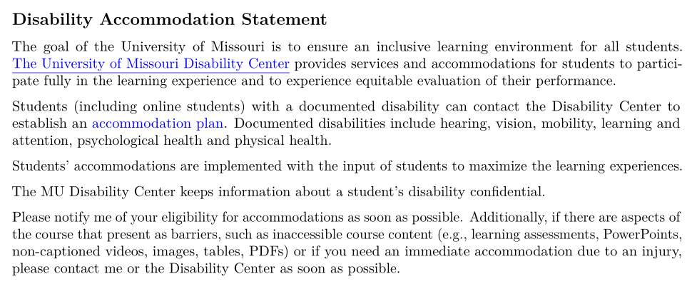
Covid
Disability Center
Notes:
If your want to request remote access because they are immunocompromised or for other disability reasons associated with the COVID-19 pandemic, please refer to the Disability Center.
For your confidentiality, and to make sure your full needs are met, you need to first establish accommodations with the Disability Center. They will guide you through the process and inform me of what accommodations you should receive in my class

Slide 17
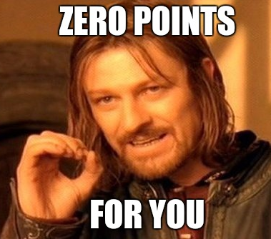
Policy on Discrimination
Notes:
Here at Mizzou, we do not tolerate discrimination

Slide 18
5-min Snippet
Text Analysis/ Mining:
Wordcloud
Sentiment Analysis
Agent-based Modeling
Network Analysis
Notes:
This section is the most exciting part for me in this class.
I call this the 5-min snippet, which means that at the end of every class, about 5 minutes, I will show you some of the most interesting (at least in my opinion) and state-of-the-art research methods in marketing and various social science disciplines. Since I cannot teach you these materials formally and I have to adhere strictly to the marketing research textbook, this is my way to rebel. However, I understand why our program requires you guys to learn the basic (bread and butter) of marketing research. But since this is the only marketing research you’re required to take before graduation, I don’t think you have a chance to learn more methods. Hence, I hope at least I can introduce that there are more out there that you can learn to be more competitive on the job market.
Mostly, we will cover text mining, agent-based modeling, and network analysis in this section.
Later you will have a taste of what this section is all about

Slide 19
Course Overview

Slide 20
Chapter 1
Brands and Brand Management

Slide 21
Learning Objectives
Define “brand”
State how a brand differs from a product
Define brand equity?
Summarize why brands are important
Explain how branding principles can be applied to everything
Describe the main branding challenges and opportunities
Identify the steps in the strategic brand management process

Slide 22
What is a Brand?
Brand Elements
Brands versus Products
Notes:
Brand
According to the American Marketing Associate (AMA), a brand is a “name, term, sign, symbol, or design, or a combination of them, intended to identify the goods and services of one seller or group of sellers and to differentiate them from those of competition.”
Whenever a marketer creates a new name, logo, or symbol for a new product, a brand has been created.
Creates a certain amount of awareness, reputation, prominence, and so on in the marketplace.

Slide 23
Brand Elements
The key to creating a brand:
Able to choose a name, logo, symbol, package design, or other associations with a product
Distinguishes it from other products
Components that identify and differentiate a brand are brand elements

Slide 24
Brands Versus Products
Five levels of meaning for a product
Core benefit level
Generic product level
Expected product level
Augmented product level
Potential product level
Notes:
Five levels of meaning for a product:
Core benefit level: Fundamental need or want that consumers satisfy by consuming the product or service.
Generic product level: Basic version of the product containing only those attributes or characteristics absolutely necessary for its functioning but with no distinguishing features.
Expected product level: Set of attributes or characteristics that buyers normally expect and agree to when they purchase a product.
Augmented product level: Additional product attributes, benefits, or related services that distinguish the product from competitors.
Potential product level: All the augmentations and transformations that a product might ultimately undergo in the future.

Slide 25
Brands Versus Products
A product is anything we can offer to a market for attention, acquisition, use, or consumption:
That might satisfy a need or want t
Physical goods like cereal, tennis racquet, or car
A brand is more than a product since it can have dimensions that differentiate it from other products
Notes:
Product
A physical good: cereal, tennis racquet, or automobile
A service: an airline, bank, or insurance company
A retail outlet: department store, specialty store, or super market
A person: political figure, professional entertainer, or athlete
A place: city or country
An idea or a social cause
Brand
Is more than a product
Can have dimensions that differentiate it in some way
May be rational and tangible—related to product performance of the brand—or more symbolic, emotional, and intangible—related to what the brand represents
A branded product may be:
A physical good like Kellogg’s corn flakes cereal, Prince tennis racquets, or Ford Mustang automobiles
A service such as Delta Airlines, Bank of America, or Allstate insurance

Slide 26
Brands Versus Products
Differences between a product and a brand may be
Rational and tangible:
Related to product performance of the brand
Or may be more symbolic, emotional, and intangible:
Related to what the brand represents

Slide 27
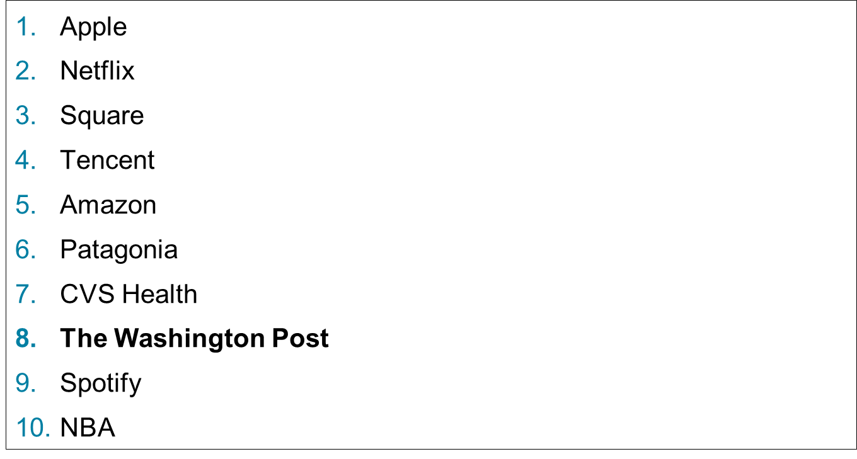
Figure 1-2: Ten Firms Rated Highly in Innovation
Source: Based on Fast Company’s 2018 List of Most Innovative Companies.

Slide 28
Why Do Brands Matter?
Consumers
Firms
Retailers and Distributors
Notes:
Why are brands important? What functions do they perform that makes them so valuable to marketers?

Slide 29
Consumers
Functions provided by brands to consumers:
Identify the source or maker of the product
Simplify product decisions
Lower the search costs for products internally and externally
Helps set reasonable expectations about what consumers may not know about the brand
Risk reducer
Promise, bond, or pact with product maker
Symbolic device
Signal of quality

Slide 30
Consumers
Brand can signal product characteristics and attributes:
On the basis of attributes products can be classified as
Search goods
Experience goods
Credence goods
Notes:
Products can be classified by their associated attributes or benefits
Search goods:
Evaluated on the basis of attributes such as sturdiness, size, color, style, design, weight, and ingredient composition by visual inspection.
Example - Grocery
Experience goods:
Evaluated on the basis of features such as durability, service quality, safety, and ease of handling.
Example - Automobile tires
Credence goods:
Consumers may rarely learn attributes.
Example - Insurance

Slide 31
Consumers
Brands can reduce risks in product decision:
These risk can be categorized as
Functional, physical, financial, social psychological, and time
Notes:
Risks:
Functional risk—Product does not perform up to expectations.
Physical risk—Product poses a threat to the physical well-being or health of the user or others.
Financial risk—Product is not worth the price paid.
Social risk—Product results in embarrassment from others.
Psychological risk—Product affects the mental well-being of the user.
Time risk—Failure of the product results in an opportunity cost of finding another satisfactory product.

Slide 32
Firms
Brands provide valuable functions to a firm:
Simplify product handling and tracing
Help organize inventory and account records
Offer the firm legal protection for unique features or aspects of the product
Provide predictability and security of demand for the firm and creates barriers of entry for competitors
Provide a powerful means to secure a competitive advantage
Means of endowing products with unique associations
Source of competitive advantage
Source of financial returns

Slide 33
Retailers and Distributors
Can generate consumer interest, patronage, and loyalty
Create an image and establish positioning within an industry
Yield higher price margins, increased sales volumes, and greater profits

Slide 34
Retailers and Distributors
Retailers can introduce their own brands by
Using their store name
Creating new names
Some combination of the two
Many distributors, especially in Europe, have introduced their won brands
Products bearing these store brands or private lable brands offer another way for retailers to increase customer loyalty and generate higher margins and profits
Notes:
In 2016, store brand dollar sales volume amounted to about 118.1 billion U.S. dollars, which is about 15 percent of the overall consumer packaged goods sales in the United States. In Britain, five or six grocery chains selling their own brands account for roughly half the country’s food and packaged goods sales, led by Sainsbury and Tesco. Another top British retailer, Marks & Spencer, sells only its own-brand goods, under the label of St. Michael. Several U.S. retailers also emphasize their own brands.

Slide 36
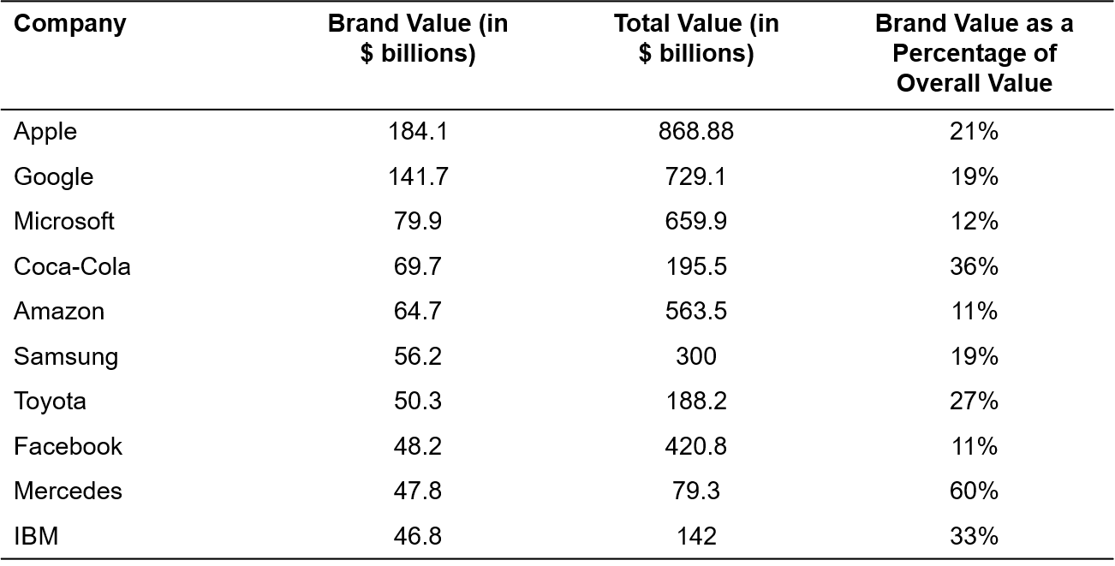
Figure 1-4: Brand Value as a Percentage of Market Capitalization
Sources: Based on Inter-brand, “Best Global Brands 2010.” Yahoo! Finance, February 11.

Slide 37
Can Anything Be Branded?
Physical Goods
Services
Notes:
Brands clearly provide important benefits to both consumers and firms. How, then, are brands created? How do you “brand” a product?

Slide 38
Can Anything Be Branded?
To brand a product, it is necessary to teach consumers “who” the product is:
Giving it a name and using other brand elements to help identify it
What the product does and why consumers should care
Marketers must give consumers a label for the product and provide meaning for the brand
Marketers can benefit from branding whenever consumer are in a choice situation
Notes:
Branding creates mental structures and helps consumers organize their knowledge about products and services in a way that clarifies their decision making and, in the process, provides value to the firm. The key to branding is that consumers perceive differences among brands in a product category. These differences can be related to attributes or benefits of the product or service itself, or they may be related to more intangible image considerations.

Slide 39
Physical Goods
Physical goods are what are traditionally associated with brands
Mercedes-Benz
Lexus
Sony
Branding has been adopted in a variety of industries:
Industrial B2B products
Technologically intensive “high-tech” products
Notes:
Business-to-business (B2B) products:
Example of B2B brand: Caterpillar
Guidelines for marketers of B2B brands:
Ensure that entire organization supports branding and brand management.
Adopt a corporate branding strategy if possible and create a well-defined brand hierarchy.
Frame value perceptions.
Link relevant non-product-related brand associations.
Find relevant emotional associations for the brand.
Segment customers carefully both within and across companies.
High-tech products:
Struggle with branding due to lack of branding strategy.
Have realised that financial success is no longer driven by product innovation alone.
Marketing skills play an important role in the adoption and success of high-tech products.
Guidelines for high-tech branding:
Understand your brand hierarchy and manage it appropriately over time.
Know who your customer is and build an appropriate brand strategy.
Realize that building brand equity and selling products are two different exercises.
Brands are owned by customers, not engineers.
Brand building on a small budget necessitates leveraging every possible positive association.
Technology categories are created by customers and external forces, not by companies themselves.
The rapidly changing environment demands that you stay in tune with your internal and external environment.
Invest the time to understand the technology and value proposition and do not be afraid to ask questions.

Slide 40
Services
Branding a service can be an effective way to signal to consumers that a firm has designed a particle service offering that is special and deserving of its name:
American Express
British Airways
Merrill Lynch
FedEx
Notes:
Role of branding with services:
Challenges in marketing services:
Less tangible than products and vary in quality.
Depends on the particular person or people providing them.
Branding addresses problems related to intangibility and variability.
Brand symbols help make abstract nature of the services more concrete.
Provides competitive edge to the services.
Professional services:
Offer specialized expertise and support to other businesses and organizations.
Combination of B2B and traditional consumer services branding.
Challenges:
Greater variability
Harder to standardize
Threat from greater equity of employees

Slide 41
Digital Brands
Some of the strongest brands in recent years have been born online:
FAANG (Facebook, Amazon, Apple, Netflix, Google).
Twitter, Instagram, TikTok
Brand building has become more important in recent years to online marketers:
It’s critical to create unique aspects of the brand
Brand needs to perform satisfactorily as well
Notes:
Online products and services:
To build successful brands, online marketers should:
Create unique aspects of the brand on dimensions that are important to consumers:
Example: convenience, price, and variety
Perform satisfactorily in areas, such as customer service, credibility, and personality.
Find unique ways to satisfy consumers’ unmet needs.
Offer unique features and services to consumers.
Offer unique value propositions to geographically dispersed customer groups.

Slide 42
People and Organizations
A product category can be a person or an organization:
Naming of this branding is usually straightforward
Usually is accompanied by well-defined images that are easily understood by consumers
The key to a person or organization as a brand is that people outside your industry know who you are and recognize your skills, talents, and attitude:
Lady Gaga
The American Red Cross
Notes:
People and organizations:
Product category is people or organization competing for public approval or acceptance.
Have well-defined images that are easily understood and liked (or disliked) by others.
The idea of brand in this category is not limited to famous and well known personalities, an individual who builds his name and reputation in a business context is essentially creating his own brand.
Right awareness and image is invaluable in shaping the way people treat and interpret words, actions, and deeds.

Slide 43
Sports, Arts, and Entertainment
A special case of marketing people and organizations as brands exists in the sports, arts, and entertainment industries:
Sprots marketing has become highly sophisticated
Branding plays has become an especially valuable function in the arts
Movies have become famous for their marketing and branding
For years, some of the most valuable movie franchises have featured recurring characters and ongoing stories – a classic application of branding
Notes:
Sports, arts, and entertainment:
Sports teams:
Market themselves through a creative combination of advertising, promotions, sponsorship, direct mail, digital, and other forms of communication.
Build awareness, image, and loyalty to meet ticket sales targets regardless of the team’s actual performance.
Art and entertainment:
An example of experience goods, that is, prospective buyers cannot judge quality by inspection and must use cues such as the particular people involved, the concept or rationale behind the project, and word-of-mouth and critical reviews.
A strong brand is valuable in the entertainment industry because of the fervent feelings that names generate as a result of pleasurable past experiences.

Slide 44
Geographic Locations
What has contributed to the rise in place marketing?
Increased mobility of people
Increased mobility of businesses
Growth in tourism
Cities, states, regions, and countries actively promote through advertising, direct mail, and other tools
Notes:
Geographic locations:
Increased mobility of people and businesses and growth in the tourism industry have contributed to the rise of place marketing.
Refers to actively promoting cities, states, and countries through advertising, direct mail, and other communication tools.
Aim is to create awareness and a favorable image of a location that will entice temporary visits or permanent moves from individuals and businesses.

Slide 45
Issues and Causes
Numerous ideas and causes have been branded
Especially by nonprofit organizations
May be captured in a phrase or slogan or represented by a symbol:
AIDS ribbons
Notes:
Ideas and causes:
Branding helps make ideas and causes more visible and concrete.
Branding can provide much value to an organization.

Slide 46
What are the Strongest Brands?
Brands that are the “strongest” are the brands that are:
Best known
Most highly regarded
Maintaining brand relevance and differentiation are important to the success of a brand
Notes:
As much as 50 percent of the value of a firm could be attributed to intangible assets such as brands. Many brands endure the test of time. For example, many brands that were number one in the United Kingdom in 1933 remain strong today: Hovis bread, Stork margarine, Kellogg’s Corn Flakes, Cadbury’s chocolates, Gillette razors, Schweppes mixers, Brooke Bond tea, Colgate toothpaste, and Hoover vacuum cleaners. Many of these brands have evolved over the years, however, and made a number of changes. Most of them barely resemble their original forms.
At the same time, some seemingly invincible brands, including Montgomery Ward, Polaroid, and Xerox, have run into difficulties and seen their market preeminence challenged or even lost.

Slide 47
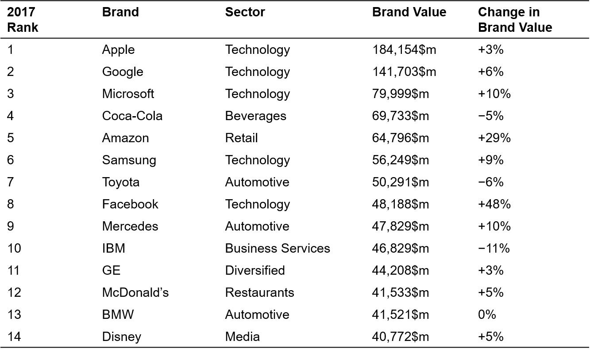
Most Valuable global Brands
Sources: Based on Inter-brand, “The 100 Most Valuable Global Brands,” 2017.

Slide 48
Branding Challenges and Opportunities
Opportunities
Unparalleled access to info and new technologies
Sharing info and goods
Media transformation
Challenges
Downward pressure on prices
Ubiquitous connectivity and the consumer backlash
Unexpected sources of competition
Disintermediation and reintermediation
Alternative sources of info about product quality
Winner-takes-all markets
The Importance of customer-centricity
Notes:
Although brands may be as important as ever to consumers, in reality, brand management may be more difficult than ever. These are some of the recent developments that have significantly complicated marketing practices and pose challenges for brand managers.

Slide 49
Unparallel Access to Info and New Tech
Technology has created vast amounts of info
Over time, as technology becomes more standard, brand marketers may find opportunities:
Utilizing innovative features in designing better brand experiences for their customers

Slide 50
Downward Pressure on Prices
As search costs for info become lower, consumers can compare prices more easily:
Thus, they can switch to a different brand more easily
This may cause more commodification of products and services
This creates challenges for brand marketers

Slide 51
Ubiquitous Connectivity and the Consumer Backlash
As digital and electronic connectivity become ubiquitous, consumers’ attention is lessened, and are more vulnerable to intrusions:
Backlash may come as consumers become increasingly resistant to marketers’ attempts to gain access to them
Software may come available that thwarts marketers’ efforts to reach consumers

Slide 52
Sharing Info and Goods
Technology has offered 2 phenomena related to branding
Social media platforms:
While they offer a way for consumer to connect and communicate their preferences for goods or services, the platforms face increased scrutiny by regulatory agencies
Many of the platforms have traditionally not had to obtain permissions for use of customer data
Peer-to-peer sharing:
Airbnb, Zipcar, Napster?
Notes:
Has anyone here known about Napster?

Slide 53
Unexpected Sources of Competition
The digital world allows easier entry into new markets:
Increased competition
When Amazon Movies began offering streaming services, it faced competition from Netflix, Apple iTunes

Slide 54
Disintermediation and Reintermediation
Disintermediation:
Reduction or elimination of intermediaries
Reintermediation:
Introduction of new intermediaries that perform some of the same functions or have additional roles in the channel of distribution
Notes:
E.g., the travel industry has experienced a significant decline in the need for travel agencies: Once offered advisory services and helped make bookings in return for a small fee or commission
E.g., Yelp (online consumer guides like Consumer Reports.com, and influential bloggers.

Slide 55
Alternative Sources of Info about Product Quality
The Internet offers consumers new ways to learn about new products and product quality:
This has reduced the reliance on brands as signals of quality
Reviews?
Brands now have to do more:
Have to be translators of trends, acting on info about changing customer tastes and desire almost instantaneously

Slide 56
Winner-Takes-All Markets
A winter-take-all-market is likely to permeate other industries and categories outside of sports and entertainment:
Brands which are market leaders within categories are likely to be chosen at an even greater rate

Slide 57
Media Transformation
The erosion and fragmentation of traditional advertising media have coincided with
The emergence of interactive and nontraditional media, promotion, and other communication alternatives
Marketers are spending more on nontraditional forms of communication:
On new and emerging forms of communication
Social media
Paid Influencers
Sponsored bloggers

Slide 58
The Importance of Customer-Centricity
Brand equity can be vulnerable to destruction if product and service claims are not verified by actual experience:
Review forums
Review from peers
Online WOM

Slide 59
The Brand Equity Concept
Principles of branding and brand equity
Differences in outcomes arise from the “added value” endowed to a product The added value can be created for a brand in many different ways
Brand equity provides a common denominator for interpreting marketing strategies and assessing the value of a brand
There are many different ways in which the value of a brand can be exploited to benefit the firm

Slide 60
Strategic Brand Management Process
Identifying and Developing Brand Plans
Designing and Implementing Brand marketing Programs
Measuring and Interpreting Brand performance
Growing and Sustaining Brand Equity
Notes:
The strategic brand management process as having four main steps:
Identifying and developing brand plans
Designing and implementing brand marketing programs
Measuring and interpreting brand performance
Growing and sustaining brand equity

Slide 61
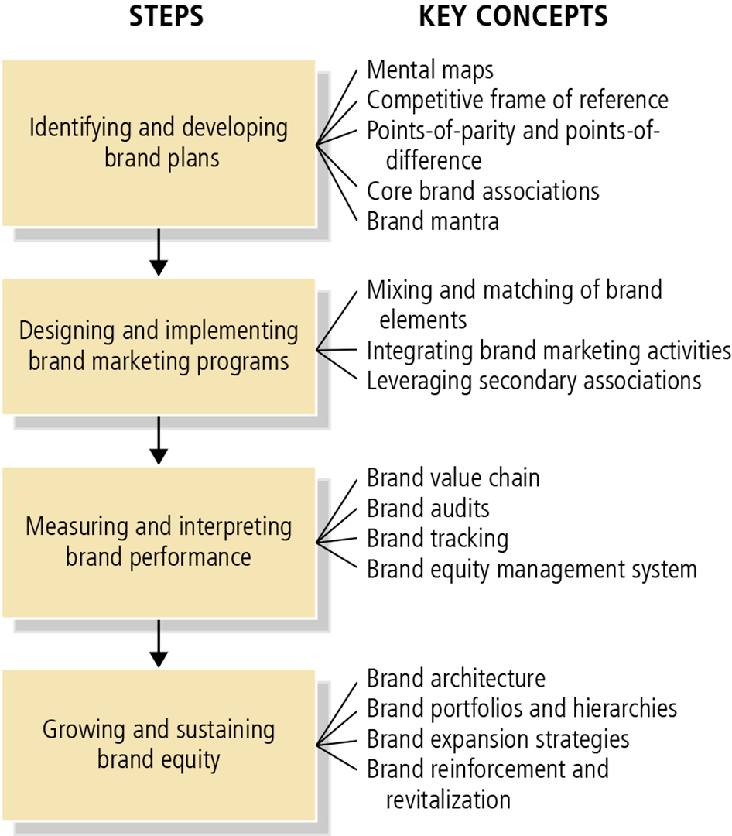
Figure 1-10: Strategic Brand Management Process

Slide 62
Designing and Implementing Brand Marketing Programs
Choosing Brand Elements
Integrating the Brand into Marketing Activities and the Supporting Marketing Program
Leveraging Secondary Associations
Notes:
Choosing brand elements:
The best test of the brand-building contribution of a brand element is what consumers would think about the product or service if they knew only its brand name or its associated logo or other element.
Integrating the brand into marketing activities and the supporting marketing program:
Although the judicious choice of brand elements can make some contribution to building brand equity, the biggest contribution comes from marketing activities related to the brand.
Leveraging secondary associations:
Because the brand becomes identified with another entity, even though this entity may not directly relate to the product or service performance, consumers may infer that the brand shares associations with that entity, thus producing indirect or secondary associations for the brand.

Slide 63
Measuring and Interpreting Brand performance
To manage brands profitably, managers must implement brand equity measurement system
Brand equity measurement system involves
Brand audits
Brand tracking studies
Brand equity management system
Notes:
Brand equity measurement system:
A set of research procedures designed to provide timely, accurate, and actionable information for marketers so that they can make the best possible tactical decisions in the short run and the best strategic decisions in the long run:
Brand audits: Comprehensive examination of a brand to assess its health, uncover its sources of equity, and suggest ways to improve and leverage that equity.
Brand tracking studies: Collect information from consumers on a routine basis over time, typically through quantitative measures of brand performance on a number of key dimensions marketers can identify in the brand audit or other means.
Brand equity management system: Set of organizational processes designed to improve the understanding and use of the brand equity concept within a firm.
Three steps that help implement a brand equity management system are:
Creating brand equity charters,
Assembling brand equity reports, and
Defining brand equity responsibilities.

Slide 64
Growing and Sustaining Brand Equity
Defining Brand Architecture
Managing brand Equity over Time
Managing brand Equity over Geographic Boundaries, Cultures, and market Segments
Notes:
Defining brand architecture:
Provides general guidelines about branding strategy and the brand elements to be applied across all the different products sold by the firm.
Two key concepts in defining brand architecture are:
Brand portfolio: Set of different brands that a particular firm offers for sale to buyers in a particular category.
Brand hierarchy: Displays the number and nature of common and distinctive brand components across the firm’s set of brands.
Managing brand equity over time:
A long-term perspective of brand management recognizes that any changes in the supporting marketing program for a brand may affect the success of future marketing programs.
Produces proactive strategies designed to enhance customer-based brand equity and reactive strategies to revitalize a brand that encounters problems.
Managing brand equity over geographic boundaries, cultures, and market segments:
In expanding a brand overseas, managers need to build equity by relying on specific knowledge about the experience and behaviors of those market segments.

