Slide 1
Good Morning
Take your name tag
Check-in

Slide 2
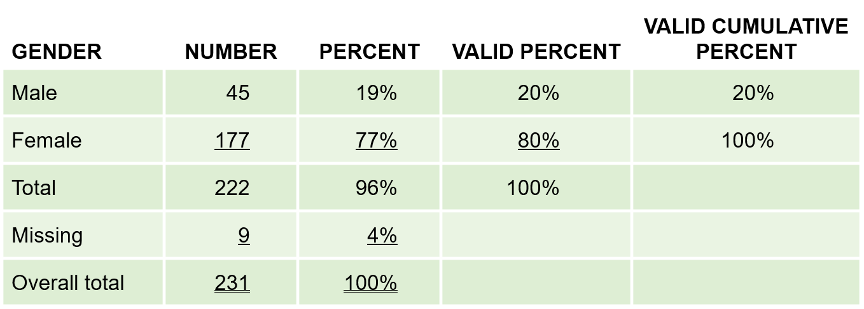
iClicker Question
A
B
C
Which percent do researchers typically use and are interested in?
A
B
C

Slide 3
iClicker Question
What are common approaches to convert continuous variables to categorical variables?
Median Split
Cumulative % breakdowns
Two-box technique
A and B
All of the above

Slide 4
iClicker Question
What is the regression line?
The best-fitting line through the scatterplot
The linear trend between two variables
Both A and B

Slide 5
iClicker Question
What does R-squared tell us?
(i.e., How do we interpret the R-squared?)
How much variation in the dependent variable is explained by the independent variable
It’s the correlation between the dependent variable and the independent variable
Both A and B are correct

Slide 6




Multiple Regression Basics

Slide 7

Multiple Regression
The relationship between the independent variable (x) and the dependent variable (y) can be represented by:
$y=ax+b$
What if we anticipate (hypothesize) that there are multiple independent variables (x’s) affecting the dependent variable (y)?
$y=a_{1}x_{1}+a_{2}x_{2}+…+a_{n}x_{n}+b$
Notes:
Go over the Multiple regression doc

Slide 8
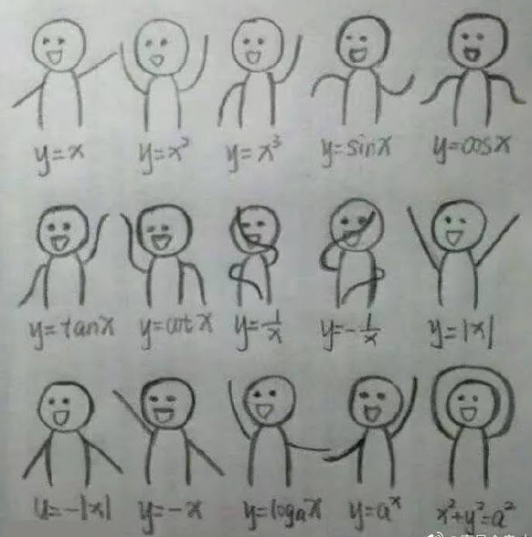
Celebration: Math Function Dance

Slide 9
Presentation Guidelines

