Slide 1




Review for Second Exam

Slide 2
Second Exam
Chapters 16, 17, 18, 20, with a heavy emphasis on chapters 17, and 18
25 questions (200 points) with 2 extra credit questions (16 points) in 75 mins
Notes are allowed
Lockdown Browser is required
1 attempt only
Online
Notes:
You can either take it wherever you want. However, I strongly encourage you to come to class with your laptop to take the exam. I will be in class to answers any questions if you have during the exam. But I can’t answer it if you are elsewhere, so keep it in minds.
It will be open from 7: 55 AM to 9:30 AM on December 6th.

Slide 3
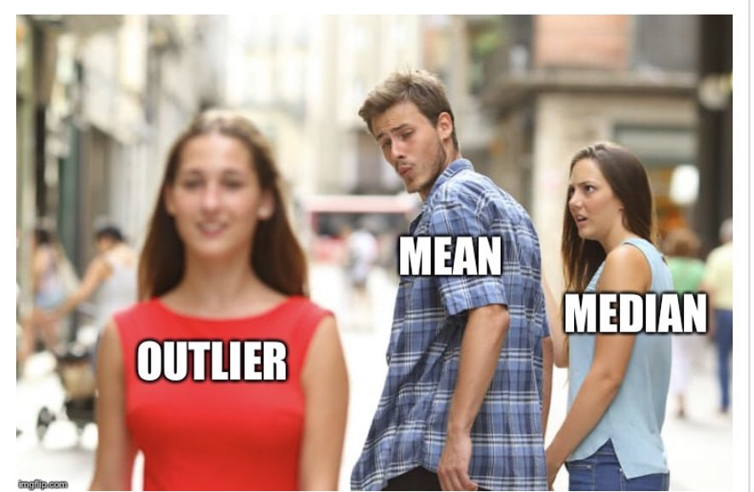
Measures of Central Tendency
Average (Arithmetic mean): the average value characterizing a set of numbers
Mode: The value in a string of numbers that occurs most often
Median: the value whose occurrence lies in the middle of a set of order values
Geometric mean: the central number in a geometric progression (n-th root of a product of n numbers) such as interest rate, human population.
Notes:
These are measure of central tendency, which we covered already but I just want to remind you the definition.
I just want to caution you the difference between geometric and arithmetic means again since we have quite a few got it incorrectly in our previous iclicker question.
Geometric mean is the n-th root of a product of n numbers, while arithmetic mean is the sum of n numbers divided n.

Slide 4
Level of Measurement for analysis variable
 | Nominal/ Ordinal (Categorical) | Interval/ Ratio (Continuous)
One variable (Descriptive RQ) | Percent, Median (ordinal), confidence interval | Average, confidence interval
Two variables (Difference RQ) | Cross-tabulation; two-way Chi-squared | Mean comparison; Independent t-test
Notes:
For difference RQ, you will choose the analysis method based on your analysis variable's level of measurement
The principle is to use the most succinct way to summarize the data
Interval and ratio can also use the same descriptive statistics as Nominal and Ordinal (with some transformation/ re-code in data analysis) but not vice versa.

Slide 5
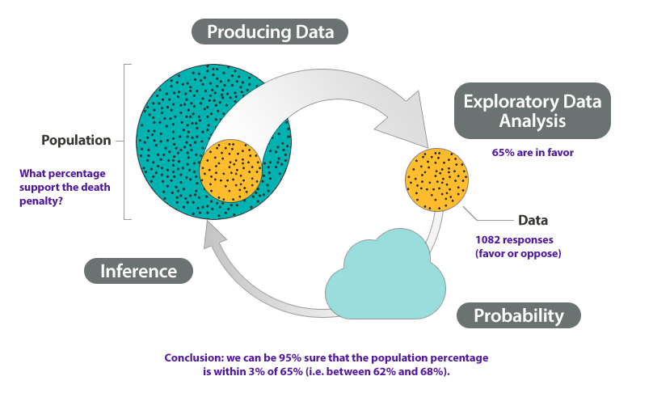
Statistical Inference
A set of procedures in which the sample size and sample statistics (e.g., sample average and sample standard deviation) are used to make estimates of population parameters
Notes:
this is study of statistics. Formally, statistical inference is a set of …
In this preliminary class, we can only cover so much. Hence, we have sample average and standard deviation. There are more sample statistics beyond these two, such as proportion.
Talk about the example

Slide 6
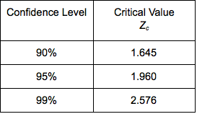
Parameter Estimation
Confidence Interval:
Mean: $\overline{x}±t_{\left\{critical\right\}} ∗SE$
Mean: 𝑥 ̅±𝑡_{𝑐𝑟𝑖𝑡𝑖𝑐𝑎𝑙} ∗𝑆𝐸
Standard error = $\frac{SD}{√n}$
Standard error = 𝑆𝐷/(√𝑛)
Proportion: $p±t_{critical} ∗SE$
Proportion: 𝑝±𝑡_𝑐𝑟𝑖𝑡𝑖𝑐𝑎𝑙 ∗𝑆𝐸
Standard error = $√(p∗q/n)$ where p = 1- q
Standard error = √(𝑝∗𝑞/𝑛) where p = 1- q
This Photo by Unknown Author is licensed under CC BY
Notes:
This is the formula to calculate the confidence interval for mean and proportion.
As mentioned in the last slide, mean is used for continuous variables, while proportion is used for categorial variables
You need to be careful to choose the type of descriptive statistics that you want to report.
After you have your formula, you also have to decide at what level of confidence do you want to calculate
I think most of you have seen this table of translation between confidence and critical value of Z, or t
Because t with large sample resemble z distribution
In this sense, we might use the two interchangeably in some cases. But you should know the difference
We will go into examples in excel. (confidence interval file) and also the excel help sheet
And also in R
https://rstudio.cloud/project/2980145

Slide 7
iClicker 1
Those who dine out on Wednesday’s, spend on an average $45.2, SD = 20, n = 500, 95% confidence (t = 1.96)
Notes:
Formula:
For percentage, p + t*SE, p – t*SE
For mean, xbar + t*SE, xbar – t*SE
p is the sample percent. xbar is the sample mean.
SE: standard error
For percentage: square root (p*q/n) note: p = 1-q
For mean: SD/square root(n) note: SD is standard deviation
t value @ difference confidence level: @90%: 1.65 @95%: 1.96 @99%: 2.58
Question: a) why do we need confidence interval? why can’t we just use the descriptive statistics - mean or percent?

Slide 8
Answers
Compute Confidence Intervals
Mean = 45.2, SD = 20, n = 500
[45.2 +/- 1.96*20/SQRT(500)]
$43.45 - $46.95
Conclusion:
We are 95% confident that in population the people who dine out on Wednesday spend between $43.45 to $46.95

Slide 9
iClicker 2
30% people say they dine out on Wednesday’s, n =500, 95% confidence (i.e., t = 1.96)
Notes:
Formula:
For percentage, p + t*SE, p – t*SE
For mean, xbar + t*SE, xbar – t*SE
p is the sample percent. xbar is the sample mean.
SE: standard error
For percentage: square root (p*q/n) note: p = 1-q
For mean:SD/square root(n) note: SD is standard deviation
t value @ difference confidence level: @90%: 1.65 @95%: 1.96 @99%: 2.58
Question: a) why do we need confidence interval? why can’t we just use the descriptive statistics - mean or percent?

Slide 10
Answer
Compute Confidence Intervals
p = 30%,n =1,000, t=1.96
26.0% -34.0%
[30-1.96*SQRT(30*70/500), 30+1.96*SQRT(30*70/500)]
Conclusion:
We are 95% confident that in population, 26% to 34% of people dine out on Wednesday.

Slide 11
Independent t-test
Hypothesis tests use samples to infer properties of entire population
T-test compare means
2 sample t-tests compare the means of 2 groups
Are two population means different?
Null and Alternative Hypotheses
Null: The two-group means are equal
Alternative: The two-group means are NOT equal
Statistically results: Reject the null hypothesis when the p-value < significance level
The formula for the independent t-test depends on the two samples’ variances
Equal variance
Unequal variance
For formal formulas: visit here
Notes:
The one sample t-test is rarely used with mean value, because we usually don’t have a good estimate or prior knowledge.
This t-test is equivalent to the coefficient t-test that we will cover later in regression. But we know we turn our attention to 2 independent samples t-test
Since all group have a difference research question between 1 categorial variable and 1 continuous variable, I’ll cover independent sample t-test
But we will not cover two-way chi-square test, which is for 2 categorical variables.
Other sessions do not cover either but I think this test is critical for you to understand and be able to present difference research questions.
Other sessions just do descriptive statistics that I do not think yield as much value as formal statistical tests.
And just a quick note for you that there is another type of t-test besides independent t-test and one sample t-test, which is paired t-test
Which is used in cases like you have before and after treatment, or twin study.
Start reading the slide

Slide 12
iClicker

Slide 13
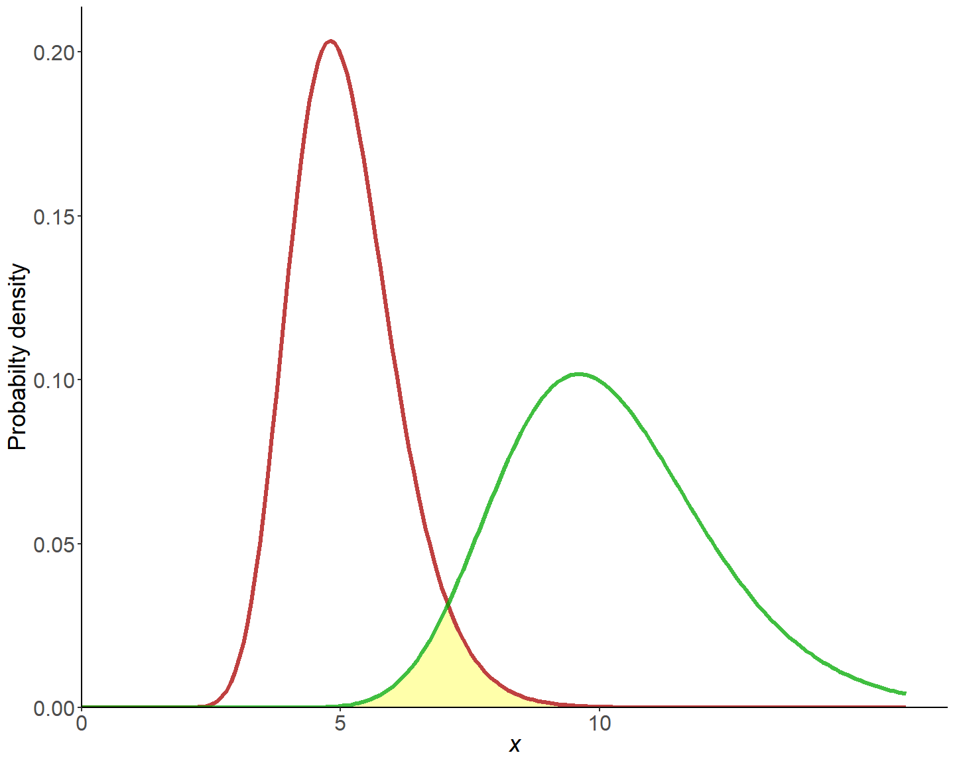
F-test for 2 Variances
H0: $σ_{x}^{2}=σ_{Y}^{2}$
H1: $σ_{x}^{2}≠σ_{Y}^{2}$
The shape of the 2 distributions can affect the mean hypothesis testing.
Notes:
Before we get to the t-test, we have to know whether the two samples’ variances are equal. Hence, we can use the F-test for 2 variances to figure this out.
I do not expect you to memorize the formula, but at least know how to use the software to derive at your result.
I can give you an intuitive understanding here.

Slide 14
iClicker

Slide 15
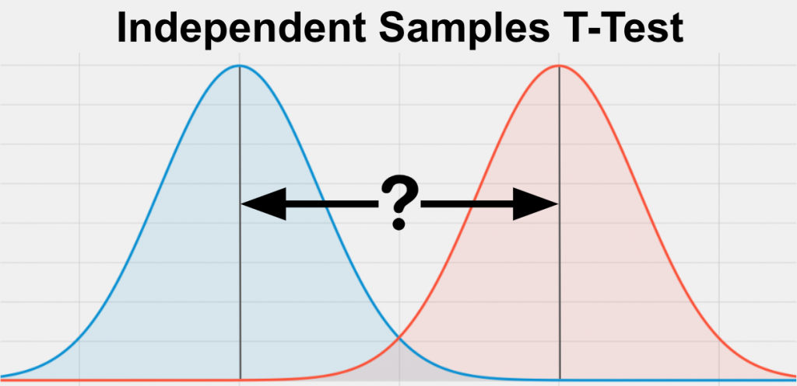
Two-sample independent t-test
H0: $μ_{x}=μ_{y}$
H1: $μ_{x}≠μ_{y}$
Based on whether you reject or accept the assumption that the two samples’ variances are equal, then you can select the appropriate test
Notes:
Go to Rscript first, then excel

Slide 16

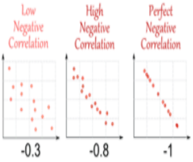
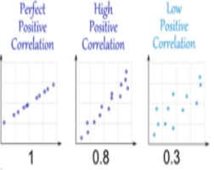
Correlation visualization
If income and age correlation coefficient is 0.8.
Conclusion: We would claim that income is highly and positively correlated with age, when age increases the income increases.
X-axis: income
Y-axis: age
Notes:
And then, after running your analysis you find that your correlation coefficient is 0.8
Your conclusion would be…
Here are some examples for correlation visualization
Notice that we do not claim that higher age causes higher income or vice versa, because correlation does not mean causation.
Does anybody remember what the other two conditions to establish causality besides correlation?
Go to Word docs (correlation)
Then go to excel to do analysis
Then to R for visualization

Slide 17
Correlation
a) what a scatter plot looks like and what it represents
b) what a nonlinear relationship looks like on a scatter plot
c) how to interpret correlation coefficients when there is a positive association, negative association, or no association between two variables
d) why correlation does not indicate causation

Slide 18
iClicker

Slide 19
Simple Regression
e) what the dependent and independent variables are in a regression model
f) what a regression line is, and what it means that a regression line is “best fitting”
g) what the intercept and slope coefficient in a regression model represent
h) how to interpret the slope coefficient in a regression model
i) understand that regression models don’t predict anything, but instead describe something that has already happened
j) what the requirements are for a valid regression model
k) why the relevant range for a model is important, and how it is determined
l) what “error” is in a regression model, and how you can tell whether a model fits the actual data well
Notes:
Go over 7-Correlation and regression practice

Slide 20
iClicker

Slide 21
Multiple Regression
m) what kind of variables (based on level of measurement) are eligible for inclusion in a regression model
n) how to create estimates from a multiple regression model
o) how to interpret multiple regression slope coefficients
p) interpreting intercepts can be a little tricky sometimes—information about intercept interpretation has been provided, but it isn’t always easy to tell when it is or is not meaningful to interpret the intercept, so you won’t be tested on this
q) how to interpret R2 and “percentage of variation explained” means

Slide 23
iClicker

Slide 24
What you get out of this class
Correlation is not causation
The difference between constructs and variables
Descriptive, Correlation, Regression Analysis
F-test, independent t-test
Bar plot, scatterplot, box plot

