Slide 1




Correlation

Slide 2

Agenda
Reading statistical program output
The last statistical test – correlation
Next class: Final exam review & Q&A
Extra credit PA

Slide 3
Correlation Sheet
Notes:
Open Correlation docx and go over it

Slide 4
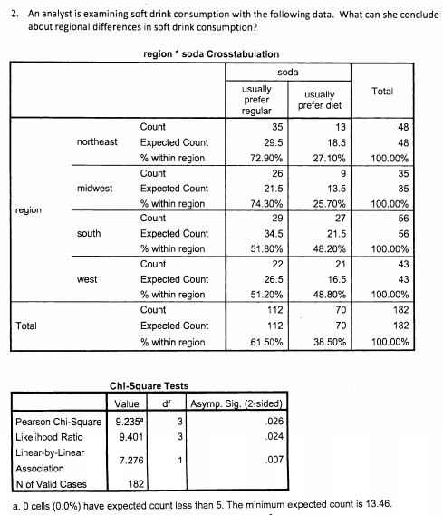
Breakout room - iClicker
Step1: Hypothesis set up
H0:
Ha:
Step2: calculate the test statistics for chi-square test
Using alpha rather than critical value for 95% confidence level
if the test significance probability is smaller than alpha then there is a difference
Step3: draw conclusion
Is there a difference in population?
If there is, how do the groups differ on the analysis variable?

Slide 5
Breakout room - iClicker
Step1: Hypothesis set up
H0:
Ha:
Step2: calculate the test statistics for chi-square test
Using alpha rather than critical value for 99% confidence level
if the test significance probability is smaller than alpha then there is a difference
What’s your NEW conclusion?
Step3: draw conclusion
Is there a difference in population?
If there is, how do the groups differ on the analysis variable?
Notes:
What if I want to be 99% confidence. alpha = 0.01. Is it still significant?

Slide 6

Correlation test
Example
Level of measurement for BOTH analysis variable: interval or ratio
Association RQ: Does workers’ incomes increase as their ages increase?
Questionnaire questions:
Q1: What’s your age?
Q2: What’s your income?

Slide 7

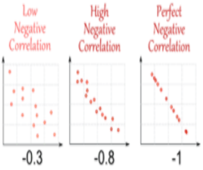
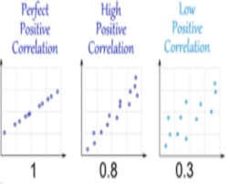
Correlation visualization
if income and age correlation coefficient is 0.8. Conclusion: We would claim that income is highly and positively correlated with age, when age increases the income increases.
X-axis: income. Y-axis: age
Notes:
Note:
> |0.8| high correlation
> |0.3| moderate correlation
<|0.3| low correlation

Slide 8
Recap
Reading statistical program output
Signfiance probability value vs. alpha value
Three steps of hypothesis tesing
Association test
Direction of the association (positive, negative) Strength of the association

