Slide 1




Review for Second Exam

Slide 2
Second Exam
Chapters 16, 17, 18, 20, with a heavy emphasis on chapters 17, and 18
36 questions (200 points) with 3 extra credit questions in 75 mins
Notes are allowed
Lockdown Browser is required
1 attempt only
Online
Notes:
In our last survey, you indicate that you prefer more questions with each question worth less points.
Since you ask and I answer. Now we have 36 questions in total of 200 points with 3 extra credit questions in 75 mins.
Average of 6 points per question, and still over 200 points.
The average time for the last exam was 38 minutes for 25 questions. (about 1.5 minute per question) For this one we will have 35 questions, and if it takes you the same amount of time, then it should take you guys about 50 minutes to finish the second exam.
Again,
You can either take it wherever you want. However, I strongly encourage you to come to class with your laptop to take the exam. I will be in class to answers any questions if you have during the exam. But I can’t answer it if you are elsewhere, so keep it in minds.
It will be open from 7: 55 AM to 9:30 AM on December 6th.
Is there any questions?

Slide 3

Poll
Do you prefer to have the second exam before the presentation?
I prefer to take the exam first
I prefer to present first
I have no preference

Slide 4
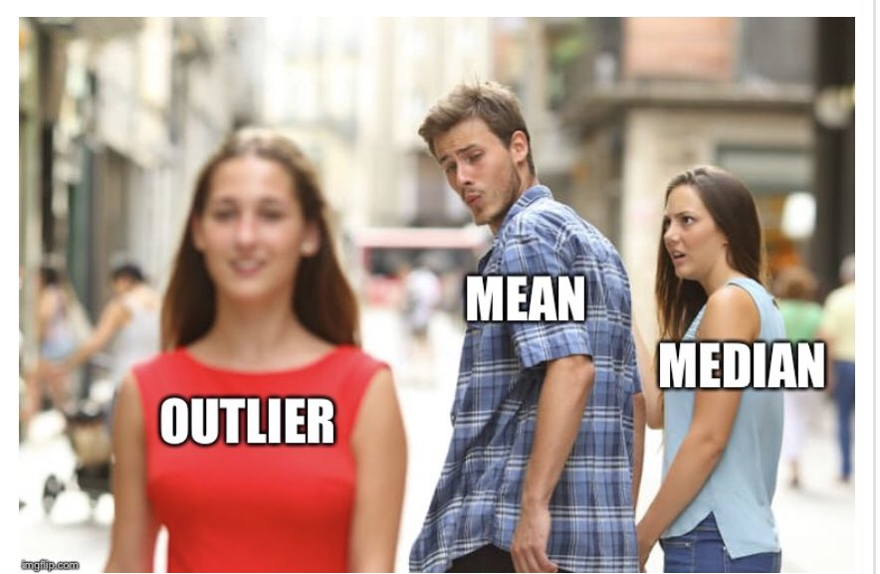
Measures of Central Tendency
Average (Arithmetic mean): the average value characterizing a set of numbers
Mode: The value in a string of numbers that occurs most often
Median: the value whose occurrence lies in the middle of a set of order values
Geometric mean: the central number in a geometric progression (n-th root of a product of n numbers) such as interest rate, human population.
Notes:
These are measures of central tendency, which we already covered but I just want to remind you the definition.
I just want to caution you the difference between geometric and arithmetic means again since we have quite a few got it incorrectly in our previous iclicker question.
Geometric mean is the n-th root of a product of n numbers, while arithmetic mean is the sum of n numbers divided n.

Slide 5
Level of Measurement
 | Nominal/ Ordinal (Categorical) | Interval/ Ratio (Continuous)
One variable (Descriptive RQ) | Percent, Median (ordinal), confidence interval | Average, confidence interval
Two variables (Difference RQ) | Cross-tabulation; two-way Chi-squared | Mean comparison; Independent t-test
Notes:
This slide reviews the level of measurement
Talk about the table
Interval and ratio can also use the same descriptive statistics as Nominal and Ordinal (with some transformation/ re-code in data analysis) but not vice versa.
The only thing that we didn’t cover from this table is the two-way Chi-squared in which case you have both your analysis and difference variables as categorical

Slide 6
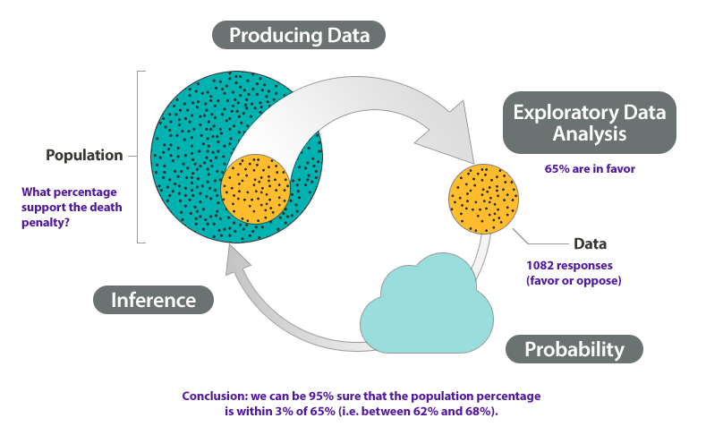
Statistical Inference
A set of procedures in which the sample size and sample statistics (e.g., sample average and sample standard deviation) are used to make estimates of population parameters
Notes:
I also want to remind what statistical inference is
It’s a set of procedures in which the …

Slide 7
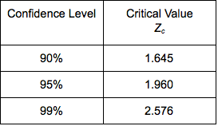
Parameter Estimation
Confidence Interval:
Mean: $\overline{x}±t_{\left\{critical\right\}} ∗SE$
Mean: 𝑥 ̅±𝑡_{𝑐𝑟𝑖𝑡𝑖𝑐𝑎𝑙} ∗𝑆𝐸
Standard error = $\frac{SD}{√n}$
Standard error = 𝑆𝐷/(√𝑛)
Proportion: $p±t_{critical} ∗SE$
Proportion: 𝑝±𝑡_𝑐𝑟𝑖𝑡𝑖𝑐𝑎𝑙 ∗𝑆𝐸
Standard error = $√(p∗q/n)$ where p = 1- q
Standard error = √(𝑝∗𝑞/𝑛) where p = 1- q
This Photo by Unknown Author is licensed under CC BY
Notes:
This is the formula to calculate the confidence interval for mean and proportion.
Mean is used for continuous variables, while proportion is used for categorial variables
You need to be careful to choose the type of descriptive statistics that you want to report.

Slide 8
Practice Question 1
Those who dine out on Wednesday’s, spend on an average $45.2, SD = 20, n = 500, 95% confidence (t = 1.96)
Notes:
Formula:
For percentage, p + t*SE, p – t*SE
For mean, xbar + t*SE, xbar – t*SE
p is the sample percent. xbar is the sample mean.
SE: standard error
For percentage: square root (p*q/n) note: p = 1-q
For mean: SD/square root(n) note: SD is standard deviation
t value @ difference confidence level: @90%: 1.65 @95%: 1.96 @99%: 2.58
Question: a) why do we need confidence interval? why can’t we just use the descriptive statistics - mean or percent?

Slide 9
Answers
Compute Confidence Intervals
Mean = 45.2, SD = 20, n = 500
[45.2 +/- 1.96*20/SQRT(500)]
$43.45 - $46.95
Conclusion:
We are 95% confident that in population the people who dine out on Wednesday spend between $43.45 to $46.95

Slide 10
Practice Quesiton 2
30% people say they dine out on Wednesday’s, n =500, 95% confidence (i.e., t = 1.96)
Notes:
Formula:
For percentage, p + t*SE, p – t*SE
For mean, xbar + t*SE, xbar – t*SE
p is the sample percent. xbar is the sample mean.
SE: standard error
For percentage: square root (p*q/n) note: p = 1-q
For mean:SD/square root(n) note: SD is standard deviation
t value @ difference confidence level: @90%: 1.65 @95%: 1.96 @99%: 2.58
Question: a) why do we need confidence interval? why can’t we just use the descriptive statistics - mean or percent?

Slide 11
Answer
Compute Confidence Intervals
p = 30%,n =1,000, t=1.96
26.0% -34.0%
[30-1.96*SQRT(30*70/500), 30+1.96*SQRT(30*70/500)]
Conclusion:
We are 95% confident that in population, 26% to 34% of people dine out on Wednesday.

Slide 12
Independent t-test
Hypothesis tests use samples to infer properties of entire population
T-test compare means
2 sample t-tests compare the means of 2 groups
Are two population means different?
Null and Alternative Hypotheses
Null: The two-group means are equal
Alternative: The two-group means are NOT equal
Statistically results: Reject the null hypothesis when the p-value < significance level
The formula for the independent t-test depends on the two samples’ variances
Equal variance
Unequal variance
For formal formulas: visit here
Notes:
Start reading the slide

Slide 13

iClicker
How do we test if the two samples’ variances are equal?
Two-way Chi-square test
One-sample t-test
F-test

Slide 14
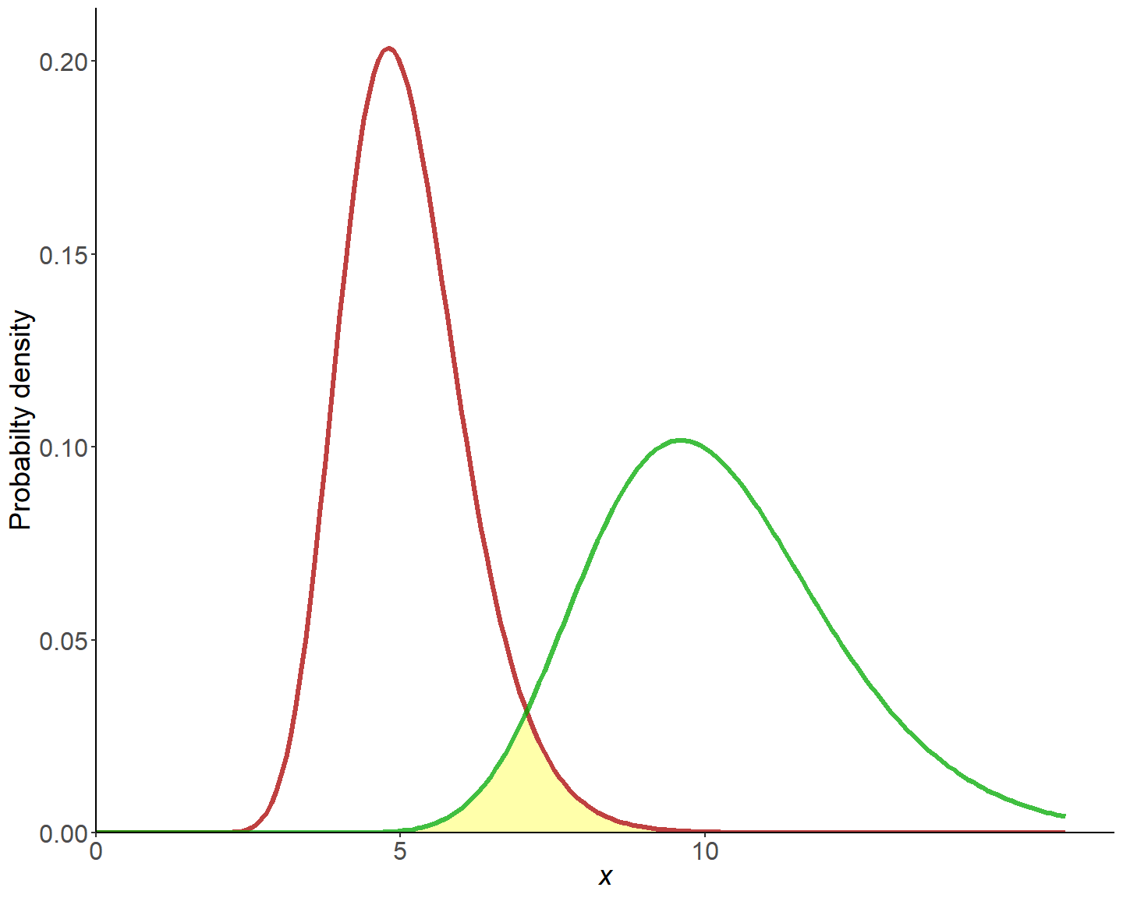
F-test for 2 Variances
H0: $σ_{x}^{2}=σ_{Y}^{2}$
H1: $σ_{x}^{2}≠σ_{Y}^{2}$
The shape of the 2 distributions can affect the mean hypothesis testing.
Notes:
Before we get to the t-test, we have to know whether the two samples’ variances are equal. Hence, we can use the F-test for 2 variances to figure this out.
The null …

Slide 15

iClicker
What is the null hypothesis for the independent t-test?
The two means are equal
The two means are not equal

Slide 16
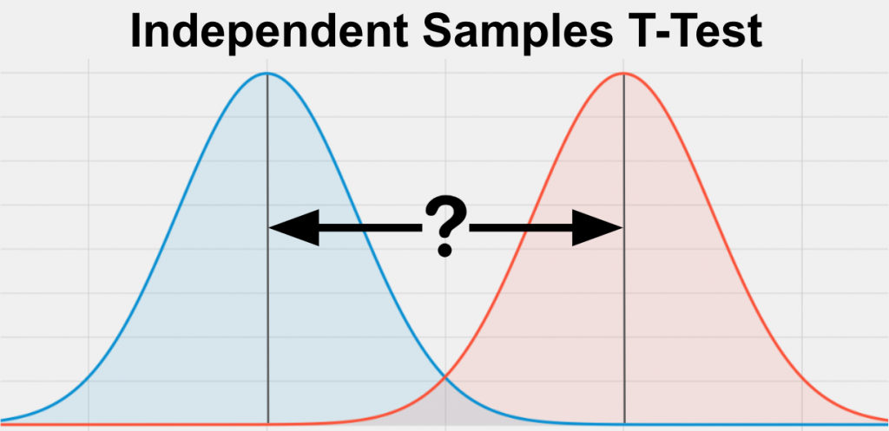

Two-sample independent t-test
H0: $μ_{x}=μ_{y}$
H1: $μ_{x}≠μ_{y}$
Based on whether you reject or accept the assumption that the two samples’ variances are equal, then you can select the appropriate test
Notes:
Stop here for Monday class

Slide 17

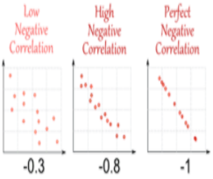
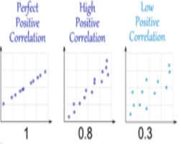
Correlation visualization
If income and age correlation coefficient is 0.8.
Conclusion: We would claim that income is highly and positively correlated with age, when age increases the income increases.
X-axis: income
Y-axis: age
Notes:
And then, after running your analysis you find that your correlation coefficient is 0.8
Your conclusion would be…
Here are some examples for correlation visualization
Notice that we do not claim that higher age causes higher income or vice versa, because correlation does not mean causation.
Does anybody remember what the other two conditions to establish causality besides correlation?
Go to Word docs (correlation)
Then go to excel to do analysis
Then to R for visualization

Slide 18
Correlation
What a scatter plot looks like and what it represents
What a nonlinear relationship looks like on a scatter plot
How to interpret correlation coefficients when there is a positive association, negative association, or no association between two variables
Why correlation does not indicate causation

Slide 19
iClicker

Slide 20
Simple Regression
e) what the dependent and independent variables are in a regression model
f) what a regression line is, and what it means that a regression line is “best fitting”
g) what the intercept and slope coefficient in a regression model represent
h) how to interpret the slope coefficient in a regression model
i) understand that regression models don’t predict anything, but instead describe something that has already happened
j) what the requirements are for a valid regression model
k) why the relevant range for a model is important, and how it is determined
l) what “error” is in a regression model, and how you can tell whether a model fits the actual data well
Notes:
Go over 7-Correlation and regression practice

Slide 21
iClicker

Slide 22
Multiple Regression
m) what kind of variables (based on level of measurement) are eligible for inclusion in a regression model
n) how to create estimates from a multiple regression model
o) how to interpret multiple regression slope coefficients
p) interpreting intercepts can be a little tricky sometimes—information about intercept interpretation has been provided, but it isn’t always easy to tell when it is or is not meaningful to interpret the intercept, so you won’t be tested on this
q) how to interpret R2 and “percentage of variation explained” means

Slide 24
iClicker

Slide 25
What you get out of this class
Correlation is not causation
The difference between constructs and variables
Descriptive, Correlation, Regression Analysis
F-test, independent t-test
Bar plot, scatterplot, box plot

