Slide 1
Happy Monday
Take your name tag
Check-in

Slide 2

iClicker Question
The null hypothesis of the F-test for 2 variances is
Two samples’ variances are equal
Two samples’ variances are not equal
One sample’s variance is less than the other’s variance
All of the above

Slide 3
iClicker Question
Why do we need to care about the F-test before implementing the 2-sample independent t-test?
Because we want to make sure the two variables’ variances are similar
Because we want to make sure the shape of the two distributions (of the two variables) are similar
Both of the above

Slide 4
iClicker Question
The null hypothesis of the 2-sample independent t-test is
The two variables’ means are equal
The two variables’ means are NOT equal

Slide 5




Correlation

Slide 6

Agenda
Reading statistical program output
The last statistical test – correlation
Next class: Final exam review & Q&A
Extra credit PA

Slide 7
Correlation Sheet
Notes:
Open Correlation docx and go over it

Slide 8
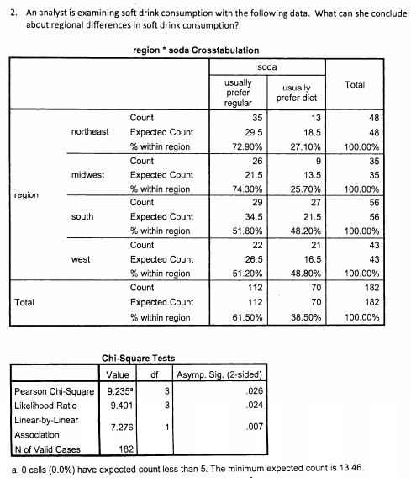
Breakout room - iClicker
Step1: Hypothesis set up
H0:
Ha:
Step2: calculate the test statistics for chi-square test
Using alpha rather than critical value for 95% confidence level
if the test significance probability is smaller than alpha then there is a difference
Step3: draw conclusion
Is there a difference in population?
If there is, how do the groups differ on the analysis variable?

Slide 9
Breakout room - iClicker
Step1: Hypothesis set up
H0:
Ha:
Step2: calculate the test statistics for chi-square test
Using alpha rather than critical value for 99% confidence level
if the test significance probability is smaller than alpha then there is a difference
What’s your NEW conclusion?
Step3: draw conclusion
Is there a difference in population?
If there is, how do the groups differ on the analysis variable?
Notes:
What if I want to be 99% confidence. alpha = 0.01. Is it still significant?

Slide 10

Correlation test
Example
Level of measurement for BOTH analysis variable: interval or ratio
Association RQ: Does workers’ incomes increase as their ages increase?
Questionnaire questions:
Q1: What’s your age?
Q2: What’s your income?

Slide 11

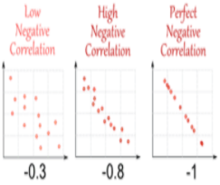
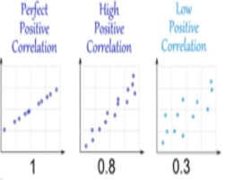
Correlation visualization
if income and age correlation coefficient is 0.8. Conclusion: We would claim that income is highly and positively correlated with age, when age increases the income increases.
X-axis: income. Y-axis: age
Notes:
Note:
> |0.8| high correlation
> |0.3| moderate correlation
<|0.3| low correlation

Slide 12
Recap
Reading statistical program output
Signfiance probability value vs. alpha value
Three steps of hypothesis tesing
Association test
Direction of the association (positive, negative) Strength of the association

Slide 13
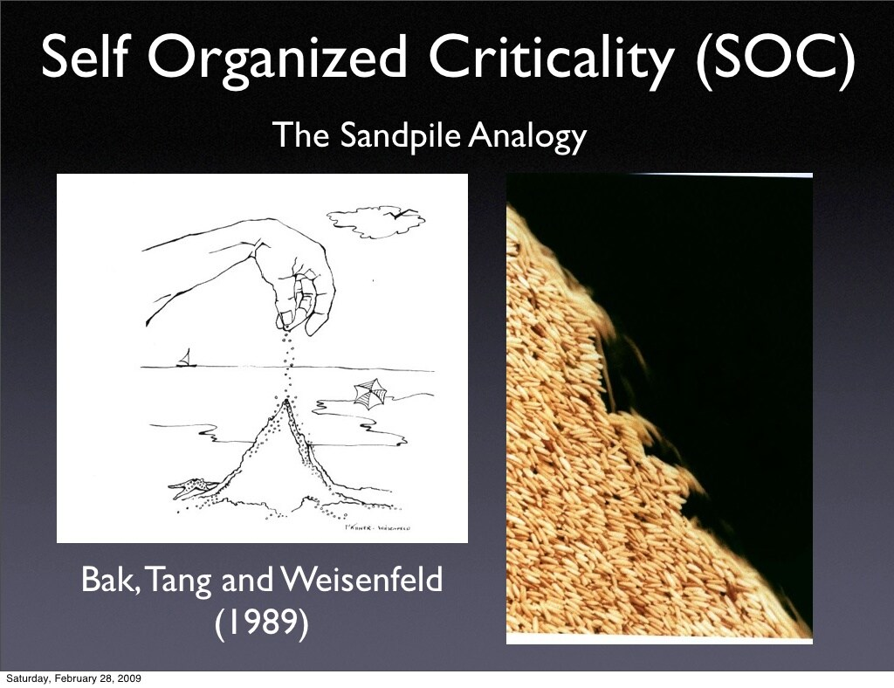
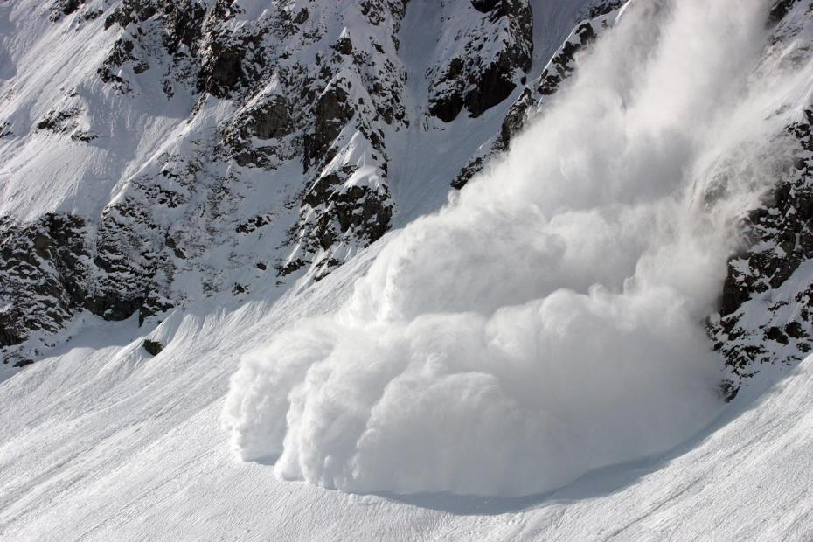
5-min Snippet – self-organized Criticality
Books
The Tipping Point
Why most things fail?
Ubiquity
Critical Mass
Terms:
Critical point/mass
Turning/Inflection/Tipping point
Notes:
Example: Critical mass is the point at which a growing company becomes self-sustaining and no longer needs additional investment to remain economically viable
A Turning Point is a critical time in your life where big decisions could lead to big change, both in work and in life
This model illustrates a phenomenon known as self-organized criticality. The world is filled with sand organized in columns. Falling sand stacks on top of the sand that is already there. Eventually a column will fall over because it gets too high, and the sand will spill into the surrounding area. This is called a cascade. When a falling column causes other columns to fall, the series of cascades is called an avalanche. The size of an avalanche is the number of cascades that occur from one grain of sand falling.
The graph illustrates the relationship between the logarithm of the size of cascades and the logarithm of the frequency of their occurrence. Per Bak and others pointed out that in this model this graph would eventually become a straight line. A straight line on a log-log graph is indicative of a power law, which means that the relationship between the x and y axes is of the form y = A^Bx. The fact that this power law occurs regardless of the starting circumstances and despite the fact that the process is random is what Per Bak called self-organized criticality.

