Slide 1
Good Morning
Take your name tag
Check-in

Slide 2
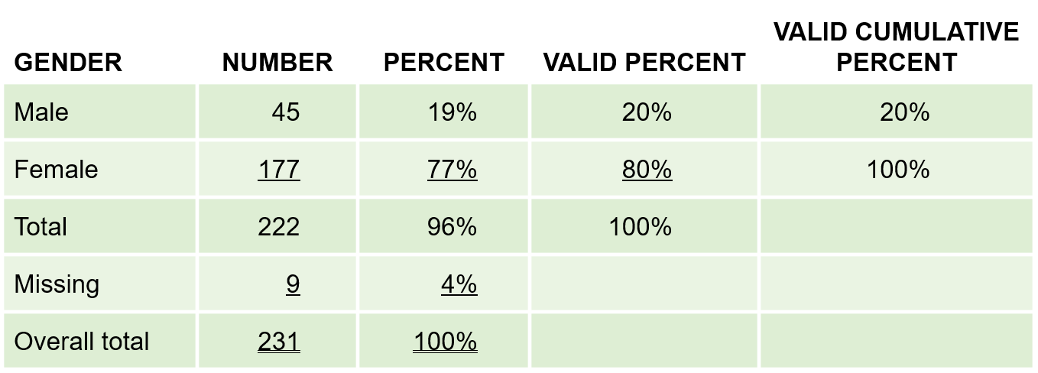
iClicker Question
A
B
C
Which percent do researchers typically use and are interested in?
A
B
C

Slide 3
iClicker Question
What are common approaches to convert continuous variables to categorical variables?
Median Split
Cumulative % breakdowns
Two-box technique
A and B
All of the above

Slide 4
iClicker Question
What is the regression line?
The best-fitting line through the scatterplot
The linear trend between two variables
Both A and B

Slide 5
iClicker Question
What does R-squared tell us?
(i.e., How do we interpret the R-squared?)
How much variation in the dependent variable is explained by the independent variable
It’s the correlation between the dependent variable and the independent variable
Both A and B are correct
Notes:
Need to talk about R^2 before letting students answer this one

Slide 6




Multiple Regression Basics

Slide 7

Multiple Regression
The relationship between the independent variable (x) and the dependent variable (y) can be represented by:
$y=ax+b$
What if we anticipate (hypothesize) that there are multiple independent variables (x’s) affecting the dependent variable (y)?
$y=a_{1}x_{1}+a_{2}x_{2}+…+a_{n}x_{n}+b$
Notes:
Go over the Multiple regression doc

Slide 8
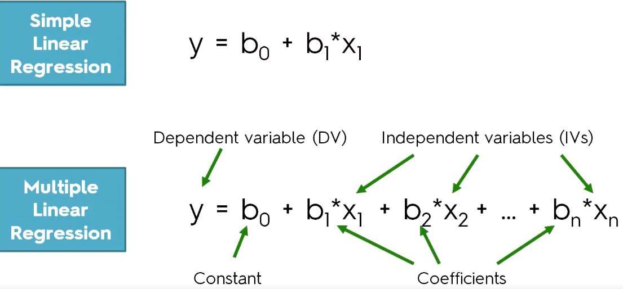
Multiple Regression

Slide 9
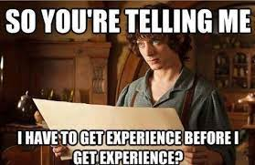
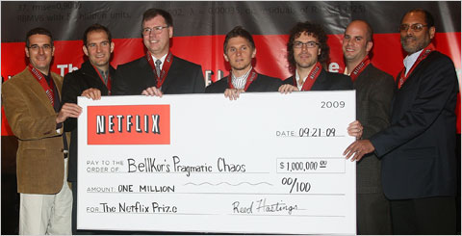
Multiple Regression
Multiple regression is a powerful analytical tool with many applications in business. For example, it can be used to....
Screen job applicants
Identify successful locations
Factors associated with video streaming service use
Notes:
Ask students to think of the possible independent variables that will affect
Screen job applicants: Multiple regression can be used to build a mathematical model to identify applicants that are more likely to do well in a particular job
The model would simultaneously consider multiple factors such as work experience, college major, GPA, and performance on screening tests, to “predict” success
This model won’t actually predict whether a particular applicant will do well. It will simply describe what characteristics have been associated with success for past applicants who were hired
Identify successful locations: Multiple regression can be used to build a model to estimate/predict which retail locations are most likely to be successful for a sandwich shop
Variables in the model might be amount of foot traffic, amount of auto traffic, proximity of competitors, demographic characteristics of nearby residents, local economic conditions, etc.
Again, this model won’t actually predict success, but is a guide describing what’s been successful in the past that helps the company make guesses for the future
Factors associated with video streaming service use: Multiple regression can be used to identify the characteristics of people who are heavy users of video streaming services
Variables in the model might include age, hours of paid employment per week, availability of alternative entertainment options nearby, marital or dating status, and whether the person has children living at home
This model will indicate which characteristics are most strongly associated with video streaming service use at the time the data were collected; if the environment changes, the model would no longer be valid
2006, Netflix announced their competition to come up with a recommendation software that could do a better job accurately predicting the movies customers would like than Netflix’s in-house software
https://bits.blogs.nytimes.com/2009/09/21/netflix-awards-1-million-prize-and-starts-a-new-contest/
Interestingly, the algorithm has never been used due to engineering costs (https://www.wired.com/2012/04/netflix-prize-costs/)

Slide 10
Multiple Regression
The dependent variable (the thing we try to “predict”) must be
Interval or Ratio (this class covers)
Technically, Ordinal and Ordinal (e.g., logistic regression)
The independent variables must be
Binary Variables (technically more!!!)
Interval or Ratio
Notes:
Kinds of variables we can include in multiple regression analysis
Ask students:
Can somebody remind me what the levels of measurements are and their examples?
Reviewing levels of measurement
Nominal variables are composed of categories that have no order to them:
the state a business is located in
a student’s major in college
location of a pharmacy (a free standing store, in a strip mall, or inside a grocery store)
Binary variables are a type of nominal variable that has two categories:
yes/no
college graduate/not a college graduate
has coding experience/doesn’t have coding experience
mall store location/free-standing store location
offers delivery/doesn’t offer delivery
Ordinal variables have ordered categories:
age categories (18-25, 26-35, 36-45, 46-60, 60+)
movie ratings (G, PG, PG-13, R, NC-17)
clothing sizes (small, medium, large)
Interval variables are scaled variables with equal distances between scale points:
Job performance evaluation, where 1 = far below expectations and 10 = outstanding performance
Taste evaluation scale, where 1 = tastes terrible and 7 = tastes delicious
A variable like the income measure below, which has equal distances between categories
––– less than $25,000
––– $25,000 - $49,999
––– $50,000 - $74,999
––– $75,000 - $99,999
––– $100,000 - $124,999
––– $125,000 - $149,999
Ratio variables have specific quantities, such as
number of employees
number of years of work experience
points on a test
price of a pair of jeans
Only binary, interval, and ratio level variables can be used in regression analysis

Slide 11
Multiple Regression
Prime Fit is a chain of 72 fitness centers on the west coast. An analyst at the company is developing a model to identify the characteristics of gym locations that are most effective in retaining members.
Dependent variable: percentage of members who renew their membership after their first 12-month contract.
Which ones would be suitable to include in the model and which would not? (In other words, which ones have the proper level of measurement for inclusion?)
Potential independent variables
size of the gym in square feet
number of personal trainers employed by the gym
number of miles to the closest competitor gym
gym identification number
whether the gym is free-standing or located within a strip mall
score on the most recent inspection report (graded 1 through 10)
the state in which the gym is located
Notes:
Now we will do an example to show how to identify suitable independent variables
below is a list of the variables the analyst has data for.
Which of the above variables should not be included in the regression model because of level of measurement?
Ask for each independent variable, the level of measurement
4 and 7

Slide 12
Multiple Regression
A major fast-food franchise wants to identify the factors related to the frequency of fast-food restaurant visits by consumers.
The dependent variable is the number of fast-food restaurant visits a person makes per month.
The independent variables are
• number of hours working outside the home per day
• monthly income (in thousands of dollars; $000)
• presence of children at home (binary variable; 0 = children not present, 1 = children present)
# of visits = 2.1 + .68 (# of hours worked) - .11 (monthly income) + .51 (if children present)
Notes:
An analyst used regression to develop the model below.

Slide 13
Multiple Regression
# of visits = 2.1 + .68 (# of hours worked) - .11 (monthly income) + .51 (if children present)
For a person who works 6 hours a day outside the home, makes $3,500 per month, and has children, the model would estimate the number of visits to be:
2.10 + .68 (6) -.11 (3.5) +. 51 (1) = 6.37 visits per month
Notes:
So can some tell me if a person …

Slide 14
Multiple Regression
# of visits = 2.1 + .68 (# of hours worked) - .11 (monthly income) + .51 (if children present)
The estimate for a person with the same work schedule and income, but with no children:
2.10 + .68 (6) -.11 (3.5) +. 51 (0) = 5.86 visits per month
Notes:
What if for a person with … , what the estimate would be?

Slide 15
Multiple Regression
# of visits = 2.1 + .68 (# of hours worked) - .11 (monthly income) + .51 (if children present)
The estimate for a person who doesn’t work outside the home, has a monthly income of $6,000, and has children:
2.10 + .68 (0) -.11 (6.0) +. 51 (1) = 2.01 visits per month
Notes:
For the last inquiry, for a person who …, what would be his or her estimate?

Slide 16
Coefficients Interpretation
# of visits = 2.10 + .68 (# of hours worked) - .11 (monthly income) +. 51 (if children present)
Theoretically, this number represents how many visits a person in the sample made to fast food restaurants if they worked outside the home 0 hours per week, had 0 monthly income, and had no children in the home. Because the data didn’t include any people with 0 income, this situation is outside the relevant range of the model and not of practical interest.
This is the coefficient for number of hours worked outside the home per week. For each additional hour worked outside the home, the number of fast-food visits per month by people in the sample increased by .68 (on average).
This is the coefficient for monthly income (in thousands of dollars). For each additional $1,000 in income, the number of fast-food visits per month by people in the sample decreased by .11 visits (on average).
This is the coefficient for the binary variable representing the presence of children. The number of fast-food visits per month was .51 visits higher (on average) for people in the sample who had children in the household.
Notes:
How can we interpret the first coefficient?
After mechanically interpret our last result, how should you think of this coefficient.

Slide 17
Model Fit and Usefulness
Example = Simple
Reality = Complex
Demographic variables
Info about alternative food sources
Attitudes about nutrition
Etc.
R-squared = .14 Interpretation? Good or bad?
Notes:
This is a very simple example model.
In a real application, the model would be much more complex
What would be some other variables that could help you predict the number of visits to the fast-food chain?
and include many more independent variables, including additional demographic variables, information about alternative food sources available to the consumer, and attitudes about nutrition and convenience, and more.
R² for this model is .14, how would we interpret this number?
meaning that 14 percent of the variation in fast food visits is accounted for by this model.
Do you think this is a good percentage to have?
This isn’t a very good fit. A model that included more information like that described in the preceding paragraph would have a better fit. Models that have poor fit are less useful than models with good fit.

Slide 18
Multiple Regression
Midwest Veterinary is a wholesaler that provides equipment and supplies to veterinary offices. Sales management is interested in finding a model that would identify the factors associated with the size of monthly purchases by customers
The dependent variable is prior month purchases by each of the current customers (in dollars)
There are three independent variables:
veterinary practice size (number of employees)
how satisfied the customer is with service provided by Midwest Veterinary on a 10-point rating scale
whether the practice is located in a rural or suburban area (1 = rural, 0 = suburban)
Purchases = 708.81 + 329.96 (# of employees) + 449.35 (satisfaction rating) – 317.39 (if a rural location)
Notes:
We will go through another example, but I would expect you to help me with this example

Slide 19
Multiple Regression
Purchases = 708.81 + 329.96 (# of employees) + 449.35 (satisfaction rating) – 317.39 (if a rural location)
Among current customers, a veterinary practice with 7 employees that rated their satisfaction with Midwest Vet as a 5 and has a rural location, the model estimates their monthly purchases, on average, to be:
708.81 + 329.96 (7) + 449.35 (5) - 317.39 (1) = $4,947.88 monthly purchases
Notes:
So among current customers, …

Slide 20
Multiple Regression
Purchases = 708.81 + 329.96 (# of employees) + 449.35 (satisfaction rating) – 317.39 (if a rural location)
The estimate for a customer with 15 employees, a satisfaction assessment of 9, and in a suburban location:
708.81 + 329.96 (15) + 449.35 (9) - 317.39 (0) = $9,702.35 monthly purchases
Notes:
What if a customer with …

Slide 21
Multiple Regression
Purchases = 708.81 + 329.96 (# of employees) + 449.35 (satisfaction rating) – 317.39 (if a rural location)
The estimate for a customer with the same situation as the preceding customer but in a rural location:
708.81 + 329.96 (15) + 449.35 (9) - 317.39 (1) = $9,384.96 monthly purchases
Notes:
For the last one, what if we have ….
Then what is the only different thing about this inquiry?

Slide 22
Coefficients Interpretation
Purchases = 708.81 + 329.96 (# of employees) + 449.35 (satisfaction rating) – 317.39 (if a rural location)
Theoretically, this number represents purchase amount by a veterinary practice that has 0 employees, a satisfaction rating of 0, and is in a suburban location. This situation is outside the relevant range (the data, for obvious reasons, didn’t include any veterinary practices with 0 employees) and therefore is not of practical interest.
This is the coefficient for number of employees. For each additional employee in a veterinary practice, the dollar value of purchases per month increased $329.96, on average, among Midwest Vet’s customers.
This is the coefficient for satisfaction rating. For each additional one-point increase in their satisfaction rating, the dollar value of purchases increased $449.35, on average, among Midwest Vet’s customers.
This is the coefficient for the binary variable representing the customer’s location (rural or suburban). Monthly purchases were $317.39 lower, on average, for customers whose practice was in a rural location.
Notes:
I think now you know how the interpret the coefficients already, if you need more practice, you can review this slide later.

Slide 23
Model Fit and Usefulness
R-squared = .57 Interpretation? Good or bad?
Notes:
R² for this model is .57,
How would you interpret this number?
meaning that 57 percent of the variation in monthly purchases is accounted for by this model. 43 percent of the variation in purchase size is explained by other variables not in the model.

Slide 24
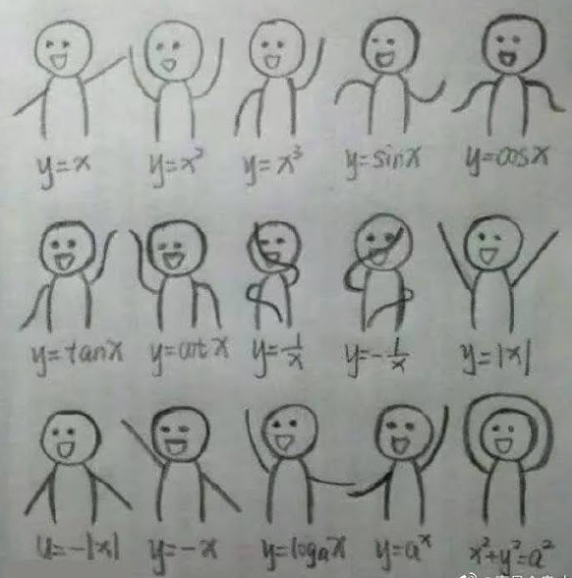
Celebration: Math Function Dance
Notes:
So we are done with the most technical material in this class.

Slide 25
Presentation Guidelines
Pointers on Presentation
Format: PowerPoint (recommended), Google Slides, Prezi
No back monitor (to resemble a business setting)
Slide tips
Sample Slides
Time: 15 minutes (under or over = 1 point deduction)
Q&A: 5 minutes
Grade is based on Presentation Evaluation Form (next class)
Notes:
You don’t need suit and tie, but since this is a business presentation, hence professional dress is expected.
Update about the order of presentation. I’ve checked with the syllabus, and the two dates are November 17th and 29th instead of November 29th and December 8th
But in either case, there shouldn’t be a problem since all of you will be in class anyway. And the order of presentation for the two dates remain constant.
Please let me know if your group would like to change the order, I can ask other groups if they want to change with you.
Go over the sample slides link (cover expectation as well)
You are responsible for practicing your presentation on the classroom equipment before presentation day and making sure that everyone in the group is familiar with how the equipment works.
On presentation day, you must be set up and ready to go before the beginning of class. If you are not ready at that time, there will be point deductions and you may be asked to give your presentation at another time. Class time is very tightly scheduled during presentation days, and it is necessary that all groups be ready to present at the appointed time.

Slide 26
10-min Group Discussion
Assignment 8: Initial Data Analysis: Please ask me questions if you are uncertain
Assignment 10: Presentation

Slide 27
Up next
More Multiple Regression
Assignment 8: Initial Data Analysis

