Slide 1
Good Morning
Take your name tag
Check-in

Slide 2
iClicker Question

Slide 3
iClicker Question

Slide 4
iClicker Question

Slide 5
iClicker Question

Slide 6




Multiple Regression Basics

Slide 7
Agenda
Difference test:
For mean-comparison: Independent t-test
Hypothesis testing
PA7 revision (optional) due this Friday
Notes:
In I still need to cover independent t-test and chi-squared

Slide 8
Hypothesis testing Comprising means for two groups – Independent T-test
Example: You want to compare if there is difference between male and female in terms of number of days eating breakfast in a week
Type of RQ: Difference RQ
Level of measurement of analysis variable: interval or ratio
Which statistical test?
Questionnaire quesitosn for the analysis variable:
Q1: What’s your gender? () Male () Female
Q2: How often do you eat breakfast per week? _
Male
X̅₁ = 3.93 times a week
n1 = 14
SD1 = 2.67
Female
X̅₂ = 5.06 times a week
n2 = 16
SD2 = 1.73

Slide 9
Formula and Intuition
difference in X_bar: ( X̅₁ – X̅₂ )
SE (standard error):√(SD1²/n₁ + SD2²/n₂ )
Critical value method:
t =( X̅₁ – X̅₂ ) / SE
* The larger the |t|, the higher the confidence that there is a difference in population average.
* make sure to take absolute value of t before comparing with t_critical
t_critical@90% = 1.64 , t_critical@95% = 1.96 , t_critical@99% = 2.58
(if n is large)

Slide 10
T critical value with degree of freedom
Look up the t table
Degree of freedom = (n₁ - 1) + (n₂ - 1) = 14-1 + 16-1 = 28
Confidence level@90%,95%, 99%. 1 - CI = alpha = 10%, 5%, and 1%
t_{critical@90%} = 1.7
If t > t_{critical} then you reject the null hypothesis (i.e., null = no difference), meaning the difference is big enough/ statistically significant

Slide 11
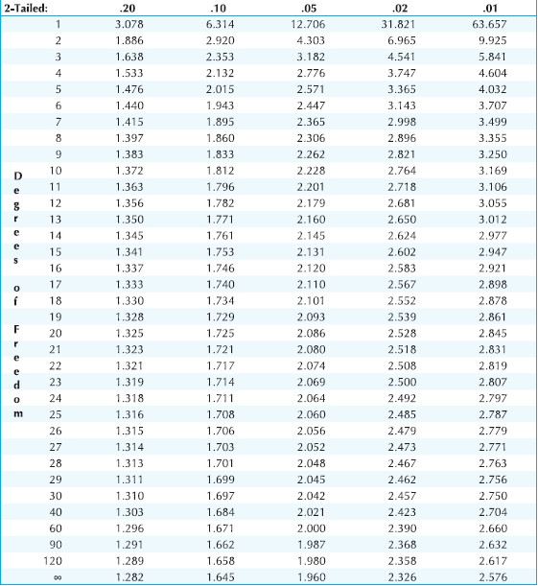
T distribution: degree of freedom confidence level

Slide 12
Critical value method
t =|( X̅₁ – X̅₂ ) / SE|
SE (standard error):√(SD₁²/n₁ + SD₂²/n₂ )
Sample mean difference = X̅₁ - X̅₂ = 3.93 - 5.06 = -1.13
Standard Error = Square root(02.67^2/14 + 1.73^2/16)
t = |( X̅₁ – X̅₂ ) / SE| = |-1.13/0.83| = 1.35
Hypothesis testing steps:
H0: μ1 – μ2 =0, Ha: μ1 – μ2 <> 0 (note: you can also write in English)
t = 1.35 NOT > tcritical@90% confidence, df = 28 = 1.7 Thus, we cannot reject the null hypothesis.
There is no enough evidence to say there is difference between male and female in terms of their frequency of eating breakfast in the population at 90% confidence level.

Slide 13
Hypothesis testing steps
Formula the null and alternative hypothesis. Null is always Statement of no difference. H0: μ1 – μ2 =0 , Ha: μ1 – μ2 <> 0 Note: µ is population mean but you use the sample mean X̅₁ - X̅₂ to infer the population mean.
Calculate using confidence interval or critical value method. Reject the null hypothesis that there is no difference if test statistics (t) is larger than the critical value (t critical)
Conclusion:
If we cannot reject the null hypothesis: there is not enough evidence to say there is a difference in the population average between male and female in terms of # of times eating breakfast at 90% confidence level.
If reject the null: we are 90% confident that there is a difference in population average between male and female in terms of # of times eating breakfast in a week.

Slide 14
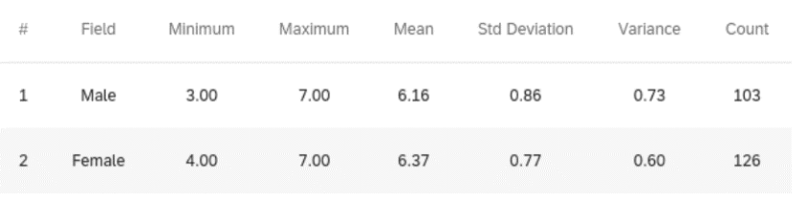
Practice question – Qualtrics example write out the three steps of hypothesis test
Do men and women differ in how satisfied they are with their gift shopping experiences?
Critical value method:
t =|( X̅₁ – X̅₂ ) / SE|
SE/standard error:√(SD1²/n₁ + SD2²/n₂ ) ; Df = n1-1 + n2 -1
t_{critical@90%} = ? hypothesis? t =? conclusion =?

Slide 15
T distribution: degree of freedom confidence interval

Slide 16
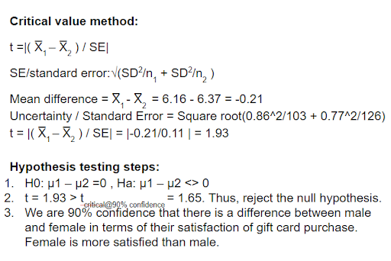
Critical value method
Notes:
95% confidence, critical value. 1.96 is 95% CI critical value. t < t-critical at 95% CI, → cannot reject the null. there is no enough evidence to say there is difference between male and female in terms satisfaction on gift card purchase at 95% confidence level.

Slide 17
t statistics vs. t critical value judgement rule
Since the t statistics that you calculated from the practice question above is 1.93, when the
t_critical@90% = 1.645 , thus t test statistics = 1.93 > t_critical@90%. You can reject the null hypothesis and claim a difference between the population means at the 90% confidence level.
when t_critical@95% = 1.96, thus t test statistics = 1.93 NOT > t_critical@95%. You can NOT reject the null hypothesis. You will claim there is NO difference between the population means at the 95% confidence level.
when t_critical@99% = 2.58, what’s your conclusion? thus t test statistics = 1.93 NOT > t_critical@99% (2.58). accept the null or There is no difference.
(any n larger than 120, you can use the last row in the t table or n is infinite)
Notes:
b) the hypothesized value is outside the confidence interval

Slide 18
What’s degree of freedom?
X + Y + Z = 10
How many variable can be changed? 3 variable – 1 = 2 degree of freedom
Thus, for linear n – 1 = 2
Notes:
b) the hypothesized value is outside the confidence interval

Slide 19

Celebration: Math Function Dance

Slide 20
Recap - Difference test
For mean-comparison: Independent t-test
hypothesis testing 3 steps
Look up critical value in t table
Which group’s average is higher?
For cross-tabulation: two-way chi-square
calculate expected value
look up critical value in chi-square table
Which group’s percent is higher?

