Slide 1
Chapter 1: The Role of Marketing Research
© 2018 Cengage Learning. All Rights Reserved.

Slide 2
Learning Objectives
Define marketing research.
Discuss different kinds of firms that conduct marketing research.
List some of the skills that are important for careers in marketing research.
List three reasons for studying marketing research.

Slide 3
The Problem
Marketers need information about the environments in which they operate.

Slide 4
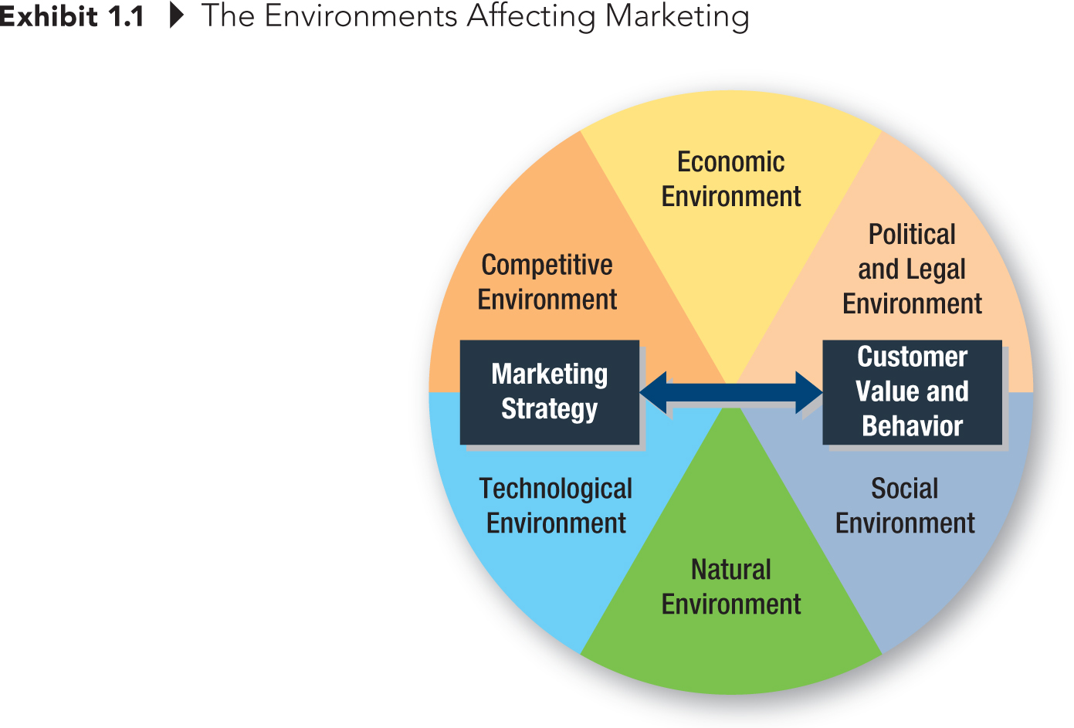
The Environments Affecting Marketing

Slide 5
Definition of Marketing Research
The process of gathering and interpreting data for use in developing, implementing, and monitoring the firm’s marketing plans.

Slide 6
Could marketing research be used to investigate the following? How? (1 of 3)
What percentage of our target market remembers our brand name?
Should we advertise more in local print or broadcast media?
Which of two advertising campaigns produces greater ad recall?
Do consumers think our price is too high relative to the competition?

Slide 7
Could marketing research be used to investigate the following? How? (2 of 3)
Are there more efficient channels of distribution for our products?
Which brand name projects the image we want for our product?
What kinds of firms use our services?
What is the most effective trade promotion program?
What is our reputation with government regulatory agencies?

Slide 8
Could marketing research be used to investigate the following? How? (3 of 3)
What is our reputation with government regulatory agencies?

Slide 9
How might each of these organizations use marketing research?
An outdoor advertising firm
A local bank
A dairy farm
An athletic department
A nature conservation group
An alternative rock band
A steel manufacturer
The Food and Drug Administration
A movie theater
A university
A direct seller of cosmetics
A hospital

Slide 10
Why do Marketing Research?
Solid marketing research is becoming more important as the world moves to a global economy.
John Deere tractors: Interviews with growers from around the world led the development of the 8R tractor line

Slide 11
Who Does Marketing Research?
Producers of Products and Services
Advertising Agencies
Marketing Research Companies
Others

Slide 12

Job Opportunities in Marketing Research
41% projected growth rate for marketing research analysts through the year 2020.
Source: “Market Research Analysts,” Bureau of Labor Statistics, U.S. Department of Labor, Occupational Outlook Handbook, 2012-13 Edition, downloaded from http://www.bls.gov/ooh/business-and-financial/market-research-analysts.htm on August 14, 2012.

Slide 13
Marketing Research Companies
Exhibit 1.3 The World’s 10 Largest Marketing Research Firms
RANK/ORGANIZATION | PARENT COUNTRY | WORLDWIDE RESEARCH REVENUE (U.S. $ IN MILLIONS)
1. Nielsen Holdings N.V. | United States | 6,172.0
2. Kantar | United Kingdom | 3,710.0
3. IMS Health Inc. | United States | 2,921.0
4. Ipsos SA | France | 1,980.9
5. GfK SE | Germany | 1,712.6
6. IRI | United States | 981.0
7. dunnhumby | United Kingdom | 970.5
8. Westat | United States | 509.6
9. INTAGE Holdings Inc. | Japan | 375.7
10. comScore | United States | 368.8

Slide 14
Why Study Marketing Research?
Some students eventually become marketing researchers (that is, information detectives).
Everyone needs to be a smarter consumer of marketing research.
Every manager needs to understand what marketing research CAN and CANNOT do.

