Slide 1
Chapter 2: The Research Process and Ethical Concerns
© 2018 Cengage Learning. All Rights Reserved.

Slide 2
Learning Objectives (1 of 3)
Outline the marketing research process.
Describe the general approaches to marketing research.

Slide 3
Learning Objectives (2 of 3)
Cite the most critical error in marketing research. Total error is more critical than any error, regardless of size, that might occur at any given stage.

Slide 4
Learning Objectives (3 of 3)
Highlight the main difference between the utility, justice, and rights approaches to ethical reasoning.
Describe types of research that should be avoided.

Slide 5
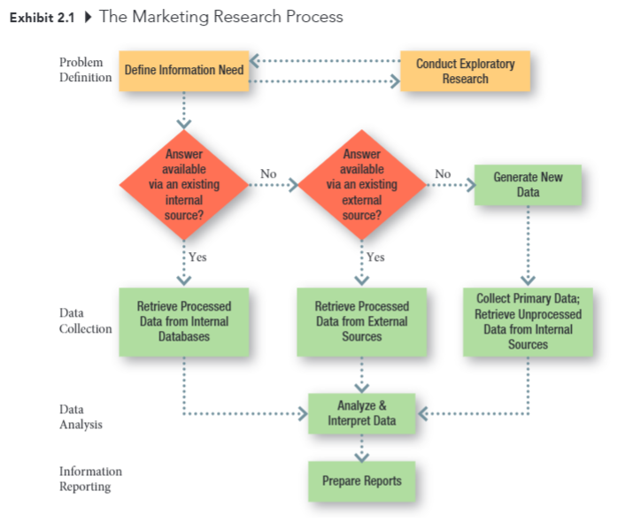
The Marketing Research Process

Slide 6
Stage One: Problem Definition (Chapters 3 and 4) (1 of 2)
Some key questions:
What is the purpose of the study?
Is additional background information necessary?
What is the source of the problem?
Is the research discovery- or strategy-oriented?

Slide 7
Stage One: Problem Definition (Chapters 3 and 4) (2 of 2)
Some key questions:
What information is needed to make the decision?
How much is already known?
Can a hypothesis be formulated?

Slide 8
Stage Two: Data Collection (Chapters 5 to 15) (1 of 5)
Some key questions:
Can existing data be retrieved from internal sources?
Can existing data be retrieved from external sources?
What is to be measured? How?
What is the source of the data to be collected?

Slide 9
Stage Two: Data Collection (Chapters 5 to 15) (2 of 5)
Some key questions:
Can observation techniques be used to gather data?
How should observations be taken?
Can objective answers be obtained by asking people?
How should people be questioned?

Slide 10
Stage Two: Data Collection (Chapters 5 to 15) (3 of 5)
Some key questions:
How should questionnaires be administered?
Should structured or unstructured items be used?
Should the purpose of the study be made known?
What specific behaviors should be recorded?

Slide 11
Stage Two: Data Collection (Chapters 5 to 15) (4 of 5)
Some key questions:
What criteria define the population?
Is a list of population elements available?
Is a probability sample desirable?
How large should the sample be?

Slide 12
Stage Two: Data Collection (Chapters 5 to 15) (5 of 5)
Some key questions:
Who will gather the data?
How long will the data gathering take?

Slide 13
Stage Three: Data Analysis (Chapters 16 to 18)
Some key questions:
Who will handle the editing of the data?
How will the data be coded?
What analysis techniques will be used?

Slide 14
Stage Four: Information Reporting (Chapters 19 and 20) (1 of 2)
Some key questions:
Who will read the report?
What is their technical level of sophistication?
What is their involvement with the project?
Are managerial recommendations called for?

Slide 15
Stage Four: Information Reporting (Chapters 19 and 20) (2 of 2)
Some key questions:
What will be the format of the written report?
Is an oral report necessary?
How should the oral report be structured?

Slide 16
Gathering Marketing Intelligence
The Project Approach (FLASHLIGHT)
Collecting data to address specific problems
The Systems Approach (CANDLE)
Putting systems in place to provide marketing intelligence on an ongoing basis

Slide 17
Marketing Research Ethics

Slide 18
Marketing Research Ethics
Marketing ethics:
The principles, values, and standards of conduct followed by marketers.
ETHICS MATTER!

Slide 19
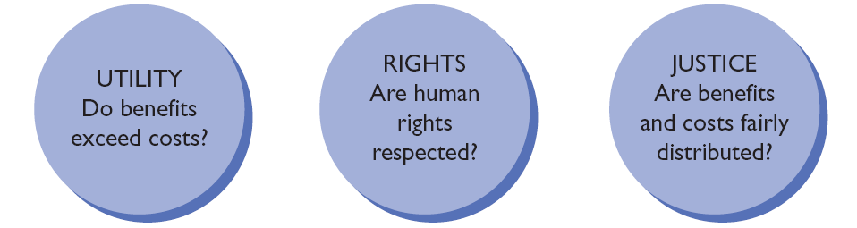
Three Methods of Ethical Reasoning
Source: Adapted from Anne T. Lawrence and James Weber, Business and Society: Stakeholders, Ethics, Public Policy, 12th ed. (New York: McGraw-Hill Irwin, 2008), p. 106.

Slide 20
Ethics at the Grocery Store… (1 of 2)
You have been hired to help a large producer of vegetables understand how consumers shop for produce in grocery stores. The company is considering different methods of displaying nutritional content because managers believe that if more people understood the nutritional value of their products they would make better decisions about what they eat. You have decided to use observational research—you will observe shoppers without their knowledge so that they won’t change their shopping behaviors.

Slide 21
Ethics at the Grocery Store… (2 of 2)
Was the use of disguise ethical using the utility approach?
Was the use of disguise ethical using the justice approach?
Was the use of disguise ethical using the rights approach?

Slide 22
Practical Guidelines for Ethical Analysis
Exhibit 2.6 Practical Guidelines for Ethical Analysis
ETHICAL TEST | PRACTICAL ETHICAL GUIDELINE
Common Sense | If proposed course of action violates your “common sense,” don’t do it.
One’s Best Self | If the proposed course of action is not consistent with your perception of yourself at your “best,” don’t engage in it.
Making Something Public | If you would not be comfortable with people knowing you did something, don’t do it.
Ventilation | Expose your proposed course of action to others’ opinions. Don’t keep your ethical dilemma to yourself. Get a second opinion.
Purified Idea | Don’t think that others, such as an accountant or lawyer, can “purify” your proposed action by saying they think it is okay. You will still be held responsible.
Big Four | Don’t compromise your action or decision by greed, speed, laziness, or haziness.
Gag Test | If you “gag” at the prospect of carrying out a proposed course of action, don’t do it.

Slide 23
Research Respondent Rights
right to choose right to safety right to be informed right to be heard

Slide 24
Research to Avoid (1 of 2)
when the research is unethical
(for example, competitive intelligence that goes too far; falsifying data; advocacy research; sugging)
when the research results would not be used
(for example, “I know better” managers)

Slide 25
Research to Avoid (2 of 2)
when the manager specifies what the results should be
when you’re tempted to take short cuts: “death wish” research
when the costs of the research outweigh its potential benefits (and “costs” go beyond money)

