Slide 1
Chapter 3: Problem Formulation
© 2018 Cengage Learning. All Rights Reserved.

Slide 2
Learning Objectives (1 of 3)
Specify the key steps in problem formulation.
Discuss two goals of the initial meeting with the research client.
Discuss the two general sources of marketing problems/opportunities.

Slide 3
Learning Objectives (2 of 3)
Explain why the researcher must be actively involved in problem formulation.
Distinguish between two types of decision problems.

Slide 4
Learning Objectives (3 of 3)
Distinguish between a decision problem and a research problem.
Describe the research request agreement.

Slide 5
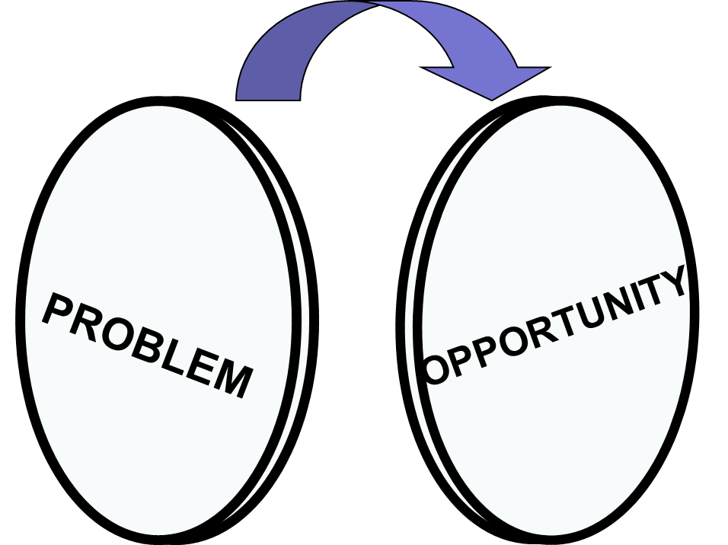
Problems or Opportunities?

Slide 6
Key Steps in Problem Formulation
Step One: Meet with Client
Step Two: Clarify Problem / Opportunity
Step Three: State Manager’s Decision Problem
Step Four: Develop Full Range of Possible Research Problems
Step Five: Select Research Problem(s)
Step Six: Prepare Research Request Agreement

Slide 7
Step One: Meet with Client (1 of 2)
What is the problem or opportunity you’re facing?
What caused you to notice the problem?
Why do you think this situation has occurred?
What is likely to happen if nothing changes in the next 12 months?

Slide 8
Step One: Meet with Client (2 of 2)
Is it likely to be an ongoing problem?
What do you hope to accomplish using marketing research?
What actions will you take depending upon the answers?
Why?

Slide 9

Planned change versus Unplanned change

Slide 10
Sources of Problems/Opportunities (1 of 2)
Unplanned changes in the environment, serendipity
What has happened? (discovery)
Why has it happened? (discovery)
What should we do about the problem or opportunity? (strategy)

Slide 11
Sources of Problems/Opportunities (2 of 2)
Planned changes
What can happen? (discovery)
Why could it happen? (discovery)
How should we implement the change? (strategy)

Slide 12
Step Two: Clarify the Problem/Opportunity
One of the most important things that a researcher provides a client is a set of “new eyes.”
Formulating the true problem or opportunity is often difficult unless you can break away from “normal” thinking and question assumptions.

Slide 13
Step Three: State the Manager’s Decision Problem (1 of 3)
DECISION PROBLEM
The problem facing the decision maker for which the research is intended to provide answers.
A well-stated decision problem…
takes the manager’s perspective.
is as simple as possible.
is stated in the form of a question.

Slide 14
Step Three: State the Manager’s Decision Problem (2 of 3)
DISCOVERY-ORIENTED DECISION PROBLEM
A decision problem that typically seeks to answer what or why questions about a problem/opportunity. The focus is generally on generating useful information.

Slide 15
Step Three: State the Manager’s Decision Problem (3 of 3)
STRATEGY-ORIENTED DECISION PROBLEM
A decision problem that typically seeks to answer how questions about a problem/opportunity. The focus is generally on selecting alternative courses of action.

Slide 16
Step Four: Develop Possible Research Problems (1 of 2)
RESEARCH PROBLEM
A restatement of the decision problem in research terms.
Investigate current customer satisfaction.
Assess target market perceptions.
Determine target market awareness.

Slide 17
Step Four: Develop Possible Research Problems (2 of 2)
There will often be MANY research problems associated with a single manager’s decision problem.

Slide 18
Relationship Between Decision Problems & Research Problems
Exhibit 3.3 Examples of the Relationship Between Decision Problems and Research Problems
DECISION PROBLEMS | POSSIBLE RESEARCH PROBLEMS
Discovery-Oriented (What? Why?) Why are store revenues so low? | Investigate current customer satisfaction. Assess target market perceptions of store and competitors. Determine target market awareness.
What needs do our customers have that currently are not being met? | Investigate customer lifestyles. Determine customer problems with existing products. Measure customer satisfaction.
Strategy-Oriented (How?) How do we increase store traffic? | Investigate effectiveness of different sales promotions. Determine consumer response to two proposed ad campaigns. Measure consumer preferences for new store layouts.
How should we introduce a new product? | Run test market to determine consumer preferences for different package sizes. Determine if at least 80% of test market purchasers are satisfied with product. Determine if product sampling promotion leads to 15% initial purchase rate.

Slide 19
Step Five: Select the Research Problem(s) to be Addressed
Researchers normally can’t do everything. It is better to address one or two research problems fully than to try to do too many things at once.
Trade-off: Value of the information to be obtained versus the costs of obtaining it.

Slide 20
Step Six: Prepare Research Request Agreement (1 of 2)
RESEARCH REQUEST AGREEMENT
A document prepared by the researcher after meeting with the decision maker that summarizes the problem and the information that is needed to address it.

Slide 21
Step Six: Prepare Research Request Agreement (2 of 2)
The purpose of the Research Request Agreement is to make certain that everyone understands the problem to be addressed and what the research is to accomplish.
(HINT: For an example, see pages 53-54 of text)

Slide 22
Sections of a Research Request Agreement (1 of 2)
Background
Decision problem
Research problem(s)
Use

Slide 23
Sections of a Research Request Agreement (2 of 2)
Population and subgroups
Logistics

Slide 24
Research Proposal
RESEARCH PROPOSAL
A written statement that describes the marketing problem, the purpose of the study, and a detailed outline of the research methodology.
The research proposal differs from the research request agreement because it includes the proposed research method and is much more detailed.

Slide 25
Research Proposal Outline
Problem Definition and Background
Research Design and Data Sources
Sampling Plan
Data Collection Forms
Analysis
Time Schedule
Personnel Requirements and Cost Estimate
Appendices

Slide 26
Choosing a Research Supplier
REQUEST-FOR-PROPOSAL (RFP)
A document that describes, as specifically as possible, the nature of the problem for which research is sought and that asks providers to offer proposals, including cost estimates, about how they would perform the job.

