Slide 1
Chapter 5:
Decision Support Systems: Introduction
© 2018 Cengage Learning. All Rights Reserved.

Slide 2
Learning Objectives (1 of 3)
Define the difference between secondary data and primary data. Secondary data are statistics not gathered for the immediate study, but for other purpose. Primary data are originated by the researcher for the purpose of the investigation at hand.

Slide 3
Learning Objectives (2 of 3)
List the advantages and disadvantages of working with secondary data.
Define what is meant by a marketing information system (MIS) and a decision support system (DSS).

Slide 4
Learning Objectives (3 of 3)
Identify the components of a decision support system.
Discuss knowledge management.

Slide 5
Marketing Research Process
Once the problem has been defined, the next step is to determine if the information needed to solve the problem already exists.

Slide 6
Exhibit 2.1 The Marketing Research Process

Slide 7
Secondary Data
Data that have already been collected, often for some other purpose or by some other organization.

Slide 8
Primary Data (1 of 2)
Information collected specifically for the investigation at hand.

Slide 9
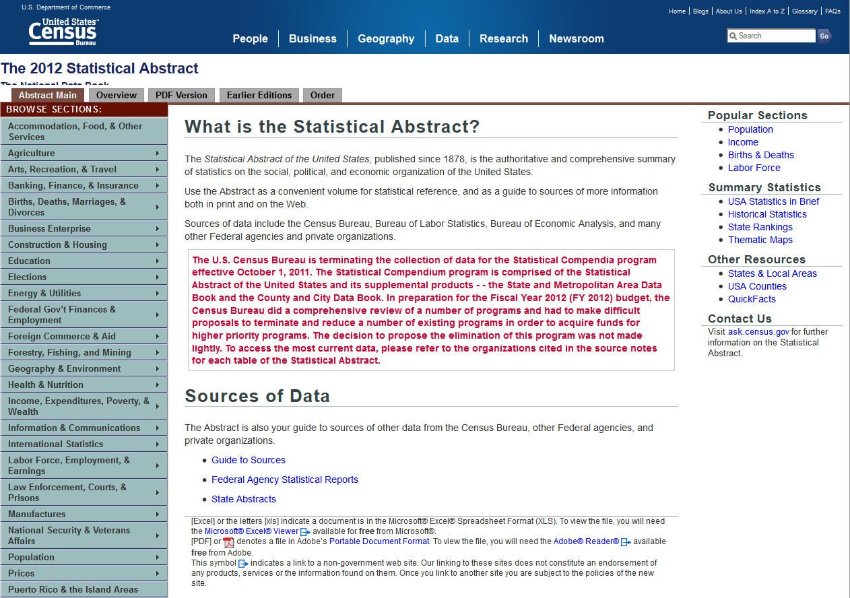
Primary Data (2 of 2)

Slide 10
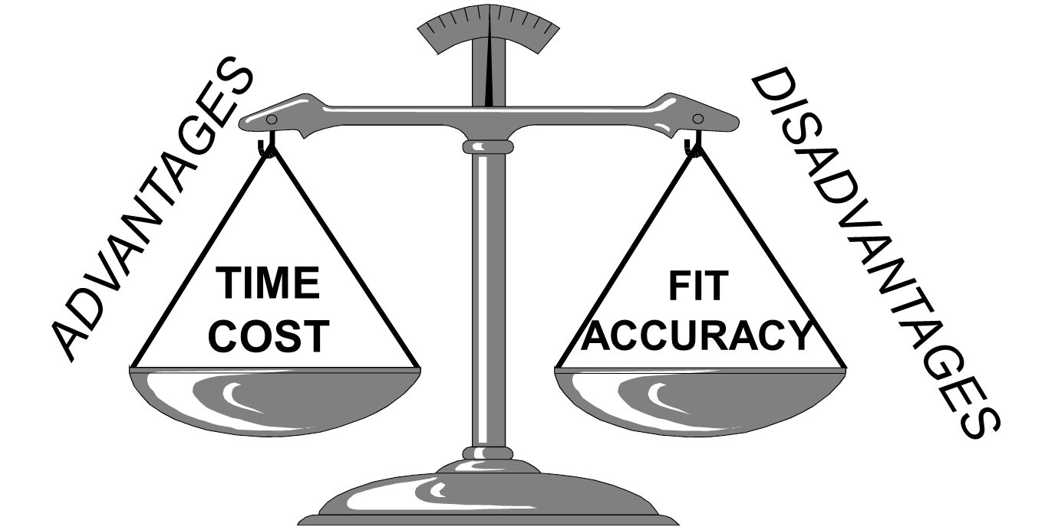
The Balancing Act with Secondary Data

Slide 11
Assessing the Accuracy of Secondary Data (1 of 3)
Primacy of Source
  Primary Source: the originating source of secondary data.
  Secondary Source: a source of secondary data that did not originate the data but rather secured them from another source.

Slide 12
Assessing the Accuracy of Secondary Data (2 of 3)
(2) Sponsor of the Research
    Advocacy Research: research conducted to support a position rather than to find the truth about an issue.

Slide 13
Assessing the Accuracy of Secondary Data (3 of 3)
(3) Evidence of Quality
    Look for evidence that the researchers did a competent job. This usually means that they will have provided enough details about how the research was conducted.
    If they didn’t… be careful!

Slide 14
Traditional Types of Internal Secondary Data (1 of 2)
Transaction Data
  For example, B2B sales invoices, retail receipts, online transactions, shopping card data
Customer Communications
  For example, inquiries, complaints via telephone, online, mail, in-person

Slide 15
Traditional Types of Internal Secondary Data (2 of 2)
Marketing Research Tracking Studies
  For example, satisfaction, awareness, image studies
Other Sources
  For example, call reports, expense receipts, customer records, financial records, credit memos, warranty cards

Slide 16
The Evolution & Design of Information Systems (1 of 4)
MARKETING INFORMATION SYSTEM (MIS)
  A set of procedures and methods for the regular, planned collection, analysis, and presentation of information for use in making marketing decisions.

Slide 17
The Evolution & Design of Information Systems (2 of 4)
DECISION SUPPORT SYSTEM (DSS)
  A system that combines data, models for guiding decision, and a user interface that allows users to interact with the system to produce customized information.

Slide 18
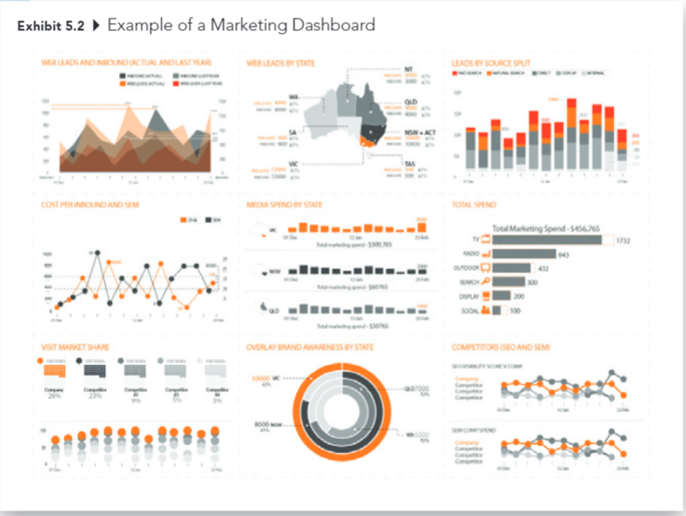
The Evolution & Design of Information Systems (3 of 4)

Slide 19
The Evolution & Design of Information Systems (4 of 4)
CUSTOMER RELATIONSHIP MANAGEMENT (CRM)
  A system that gathers all relevant information about a company’s customers and makes it available to the employees that interact with the customers.

Slide 20
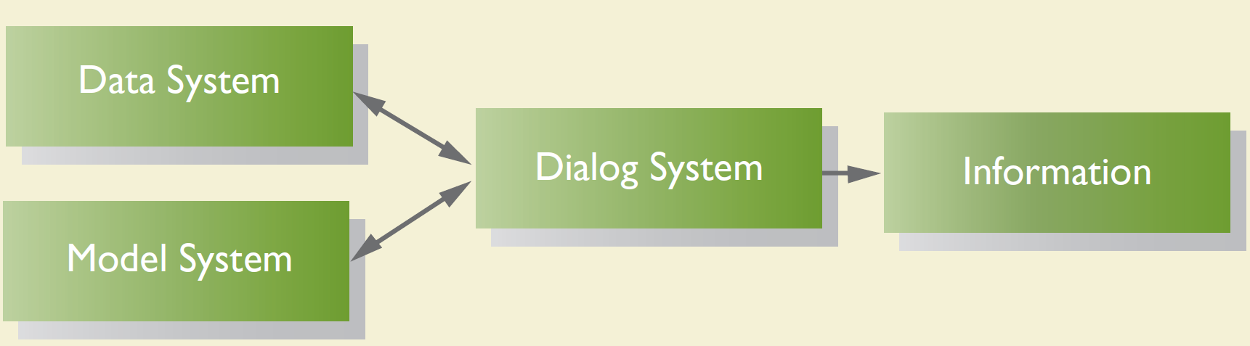
Components of a Decision Support System (1 of 4)

Slide 21
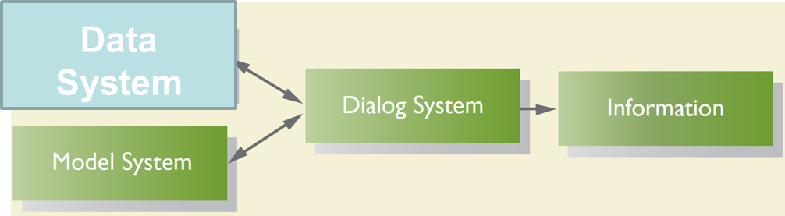
Components of a Decision Support System (2 of 4)
The part of a decision support system that includes the processes used to capture and the methods used to store data coming from a number of external and internal sources. It is the creation of a database.

Slide 22
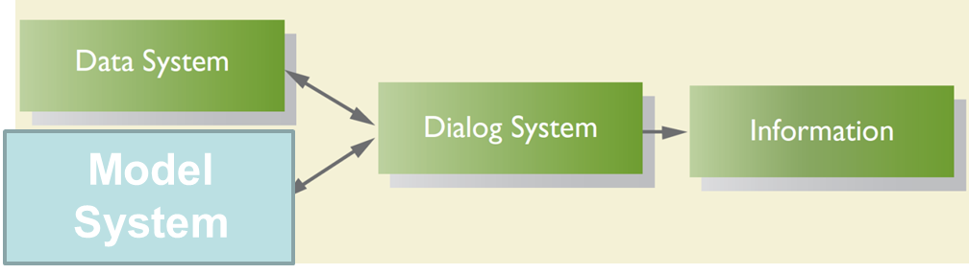
Components of a Decision Support System (3 of 4)
The part of a decision support system that includes all the routines that allow the user to manipulate the data so as to conduct the kind of analysis the individual desires. It is the collection of analytical tools to interpret the database.

Slide 23
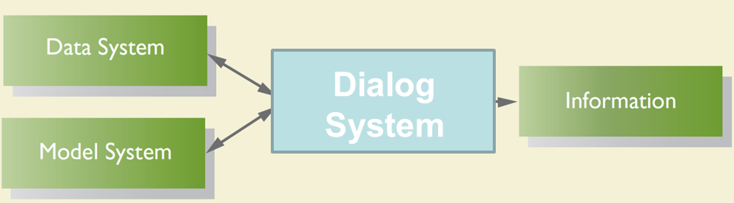
Components of a Decision Support System (4 of 4)
The part of a decision support system that includes all the routines that allow the user to manipulate the data so as to conduct the kind of analysis the individual desires. It is the collection of analytical tools to interpret the database.

Slide 24
Chief Information Officer
KNOWLEDGE MANAGEMENT
  The systematic collection of employee knowledge about customers, products and processes, and the marketplace.

Slide 25
Limitations of the Systems Approach (1 of 2)
Managers won’t always share their decision-making processes
Differing data needs across managers
Time costs

Slide 26
Limitations of the Systems Approach (2 of 2)
Monetary costs
Data availability—analysis is limited to the data that are in the system

