Slide 1
Chapter 6: Decision Support Systems: Working with “Big Data”
© 2018 Cengage Learning. All Rights Reserved.

Slide 2
Learning Objectives (1 of 2)
Identify the four Versus of “big data.”
Contrast structured and unstructured data.
Describe the three sources of “big data” for marketers.

Slide 3
Learning Objectives (2 of 2)
Compare descriptive, predictive, and prescriptive analytical approaches.
List and discuss the key challenges of “big data” integration.

Slide 4
“Big Data” Definition
The process of capturing, merging, and analyzing large and varied data sets for the purpose of understanding current business practices and seeking new opportunities to enhance future performance.

Slide 5
The Four V’s of Big Data
VOLUME
The sheer amount of data being collected in “big data” systems.
VELOCITY
The pace of data flow, both into and out of a firm.

Slide 6
The Three V’s of Big Data
VARIETY
The combination of structured and unstructured data collected in “big data” systems.
VERACITY
The accuracy and trustworthiness of data collected in “big data” systems

Slide 7
The Fifth V: Value (1 of 2)
Improving Customer Retention Rates
Dealing with Negative Word of Mouth
Enhancing Health Care

Slide 8
The Fifth V: Value (2 of 2)
Creating Personalized Promotions
Research Window 6.1: Target, Big Data, and You

Slide 9
The Value of “Big Data” (1 of 2)
Companies around the world are investing in big data analytics to improve services and increase revenues.

Slide 10
The Value of “Big Data” (2 of 2)
In a 2012 study of business executives and managers across 18 countries…
91% of companies were working with big data.
75% planned to make additional investments.
73% had increased revenues due to big data.

Slide 11
The Value of “Big Data” to Best Western International
BWI uses both structured data (survey responses) and unstructured data (social media, travel websites) to gauge customer response to its hotels. When something negative pops up in social media, the information is matched to the particular hotel, and the manager is notified.

Slide 12
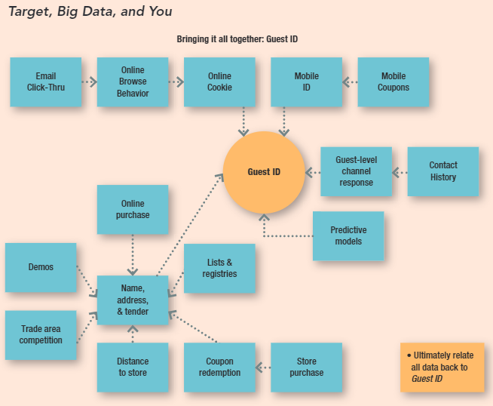
Target, Big Data, and You

Slide 13
Sources of “Big Data” (1 of 2)
STRUCTURED DATA
Data that can be written into rows on a spreadsheet or database based on standard column headings.
Examples: transactional data, customer profile information obtained from registration materials or other sources

Slide 14
Sources of “Big Data” (2 of 2)
UNSTRUCTURED DATA
Data that take the form of social media comments, blog posts, other text-based communication, photos, video, audio, or any other form that is not easily arranged in structured format.

Slide 15
Key Types of Unstructured Data: Social Data
“Voice of the Customer” Data: unstructured posts on social media networks such as Facebook, Twitter, Google+, YouTube, Instagram, LinkedIn, Tumblr, Pinterest, etc.
Social Network Analysis: a popular tool for studying the social connections between people.

Slide 16
Key Types of Unstructured Data: Mobile Data
Smartphone and Tablet Data: data from texting, photo sharing, in-store shopping.
Location-based Services: geo-targeted text messages, mapping services, location-sharing, and location data from call records.

Slide 17
Key Types of Unstructured Data: Omni-channel Transactional Data
Data that are connected to a particular purchaser across multiple purchasing channels. Data across different platforms in potentially different formats are collected and tied together.

Slide 18
Types of “Big Data” Analyses (1 of 3)
DESCRIPTIVE ANALYSIS
Designed to enhance understanding of available data to benefit firm performance.
Examples: data mining, data fusion, neural network analysis, visualization

Slide 19
Types of “Big Data” Analyses (2 of 3)
PREDICTIVE ANALYSIS
Designed to aid both explanatory and forecasting abilities for the betterment of the firm.
Examples: regression analysis, time series analysis, simulation

Slide 20
Types of “Big Data” Analyses (3 of 3)
PRESCRIPTIVE ANALYSIS
Designed to optimize the various courses of action available to enhance firm performance.
Examples: optimization tools

Slide 21
Key Challenges of “Big Data” Integration
Access to and retrieval of data (including data integration)
Analytic skills
Firm integration of big data

