Slide 1
Chapter 7: Using External Secondary Data
© 2018 Cengage Learning. All Rights Reserved.

Slide 2
Learning Objectives (1 of 2)
Describe the process of searching for published external secondary data.
List three common uses of the information supplied by standardized marketing information services.
Define geodemography.

Slide 3
Learning Objectives (2 of 2)
Describe the use of diary panels and scanner data for assessing product sales.
Discuss the purpose and operation of people meters.
Define single‑source data.

Slide 4
Marketing Research Process (1 of 2)
In Chapter 7, we shift our focus onto retrieving existing information from external sources. Some of this external information may end up in the company’s DSS; some of it may also be in the form of “big data.”

Slide 5
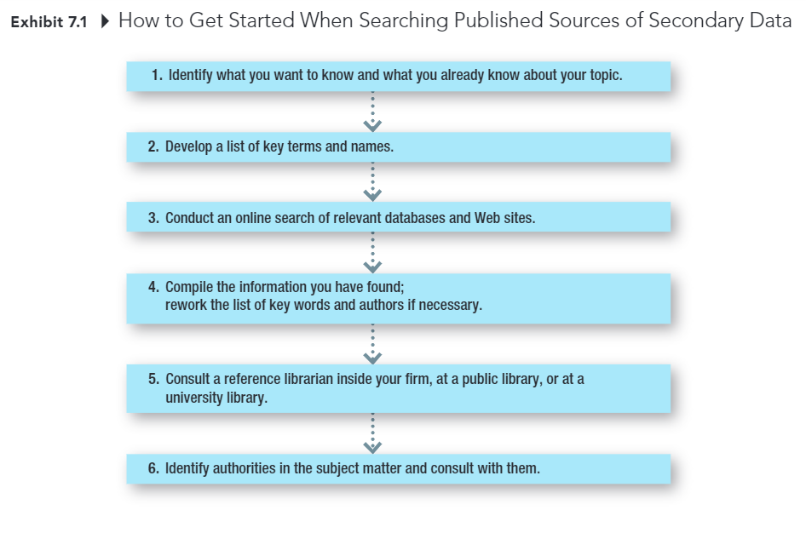
Marketing Research Process (2 of 2)

Slide 6
Standardized Marketing Information
STANDARDIZED MARKETING INFORMATION
Secondary data collected by companies that sell the data to multiple companies, allowing the costs of collecting, editing, coding, and analyzing them to be shared. The data are standardized so that they can be used by multiple companies rather than customized for a specific company.

Slide 7
Standardized Marketing Information: Profiling Customers (1 of 2)
GEODEMOGRAPHY
The availability of demographic, consumer behavior, and lifestyle data by arbitrary geographic boundaries that are typically quite small.

Slide 8
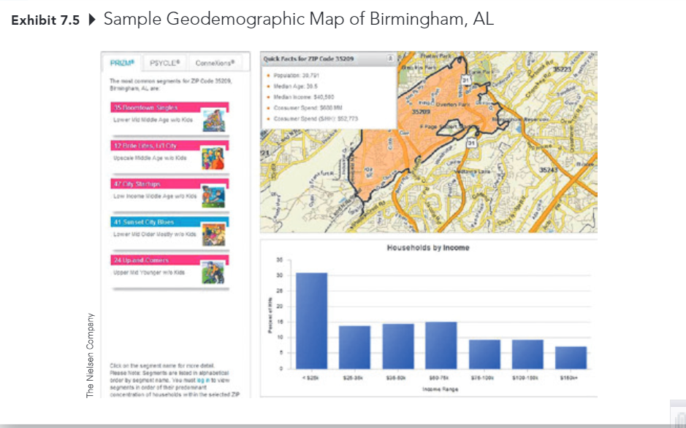
Standardized Marketing Information: Profiling Customers (2 of 2)

Slide 9
Standardized Marketing Information: Measuring Product Sales, Market Share
(Online) Diary Panels
Scanners

Slide 10

Standardized Marketing Information: Measuring Advertising Exposure and Effectiveness (1 of 3)
Television and Radio
Nielsen TV ratings
Arbitron radio ratings
People Meter

Slide 11
Standardized Marketing Information: Measuring Advertising Exposure and Effectiveness (2 of 3)
Print Media
Starch Ad Readership (magazine)
Internet
Nielsen Digital Voice
ComScore Mobile Metrix

Slide 12
Standardized Marketing Information: Measuring Advertising Exposure and Effectiveness (3 of 3)
Cross-platform Services
Simmons National Consumer Study
GfK MRI
comScore, WebTrends, Nielsen

Slide 13
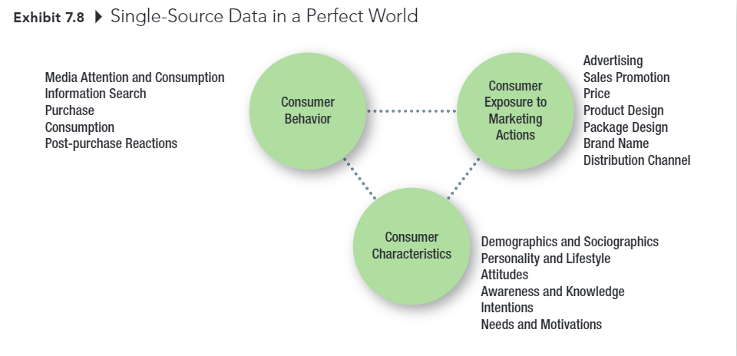
Single-Source Data in a Perfect World

