Slide 1
Chapter 8: Conducting Causal Research
© 2018 Cengage Learning. All Rights Reserved.

Slide 2
Learning Objectives (1 of 3)
Discuss the three general types of primary data research.
Clarify the difference between laboratory experiments and field experiments.

Slide 3
Learning Objectives (2 of 3)
Explain which of the two types of experiments has greater internal validity and which has greater external validity.
List the three major considerations in test marketing.

Slide 4
Learning Objectives (3 of 3)
Distinguish between a standard test market and a controlled test market.
Discuss the advantages and disadvantages of simulated test marketing.

Slide 5
Three Types of Primary Data Research (1 of 5)
Exploratory Research
(explore)
Descriptive Research
(describe)
Causal Research
(establish cause and effect)

Slide 6
Three Types of Primary Data Research (2 of 5)
EXPLORATORY RESEARCH
Research conducted to gain ideas and insights to better define the problem or opportunity confronting a manager.

Slide 7
Three Types of Primary Data Research (3 of 5)
DESCRIPTIVE RESEARCH
Research in which the major emphasis is on describing characteristics of a group or the extent to which variables are related.

Slide 8
Three Types of Primary Data Research (4 of 5)
CAUSAL RESEARCH
Type of research in which the major emphasis is on determining cause-and-effect relationships.

Slide 9
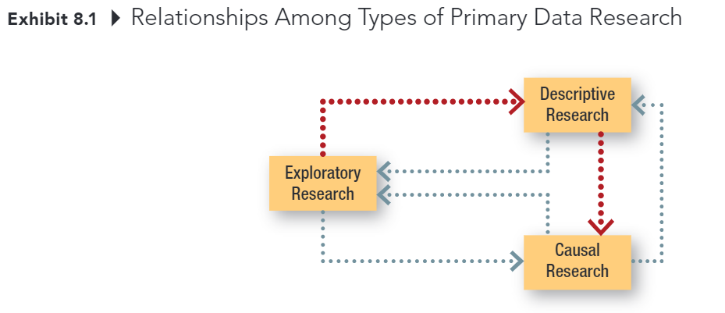
Three Types of Primary Data Research (5 of 5)

Slide 10

Causal Research
The purpose of causal research is to test cause and effect relationships:
condition X causes event Y

Slide 11
Evidence of Causality (1 of 3)
Consistent variation—evidence of the extent to which X and Y occur together or vary together in the way predicted by the hypothesis

Slide 12
Evidence of Causality (2 of 3)
Time order—evidence that shows X occurs before Y
Elimination of other explanations—evidence that allows the elimination of factors other than X as the cause of Y
X—the cause
Y—the effect

Slide 13
Evidence of Causality (3 of 3)
Because we can never know for certain that we have eliminated all other possible causes of an effect, we can never state with certainty that X caused Y.

Slide 14
Experiment (1 of 3)
EXPERIMENT
Scientific investigation in which an investigator manipulates one or more independent variables and observes the degree to which the dependent variables change.

Slide 15
Experiment (2 of 3)
The basic point of an experiment is to change the levels of one or more X variables and examine the resulting impact on Y while at the same time controlling (holding constant) other variables that might impact Y.

Slide 16
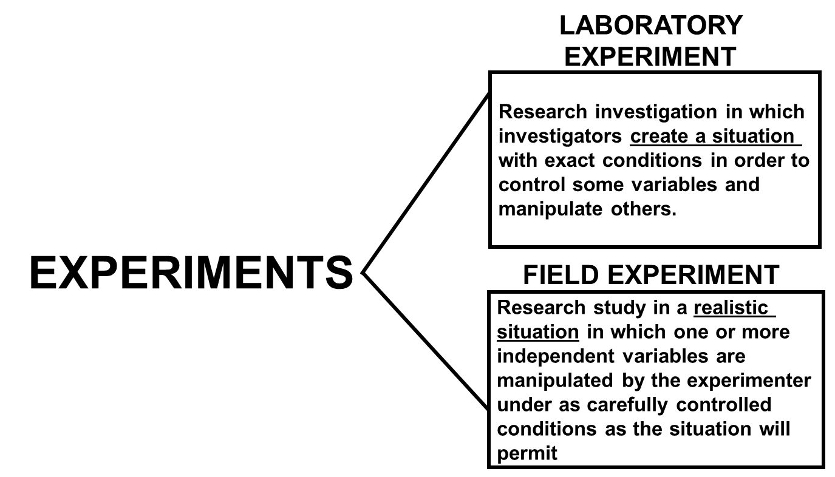
Experiment (3 of 3)

Slide 17
Internal Validity versus External Validity (1 of 3)
Internal Validity The degree to which an outcome can be attributed to an experimental variable and not to other factors. Lab experiments tend to have higher levels of internal validity.

Slide 18
Internal Validity versus External Validity (2 of 3)
External Validity The degree to which the results of an experiment can be generalized, or extended, to other situations. Field experiments tend to have higher levels of external validity.

Slide 19
Internal Validity versus External Validity (3 of 3)
Online retailers are in an ideal position for conducting field experiments by testing different types or levels of marketing variables simultaneously and examining actual customer response.

Slide 20
Types of Test Markets (1 of 4)
MARKET TESTING
A controlled experiment done in a limited but carefully selected sector of the marketplace.

Slide 21
Types of Test Markets (2 of 4)
Standard Test Market A test market in which the company sells the product through its normal distribution channels.

Slide 22
Types of Test Markets (3 of 4)
Controlled Test Market An entire test program conducted by an outside service in a market in which it can guarantee distribution.

Slide 23
Types of Test Markets (4 of 4)
Simulated Test Market A study in which consumer ratings are obtained along with likely or actual purchase data often obtained in a simulated store environment; the data are fed into computer models to produce sales and market share predictions.

Slide 24
Virtual Test Markets (1 of 2)

Slide 25
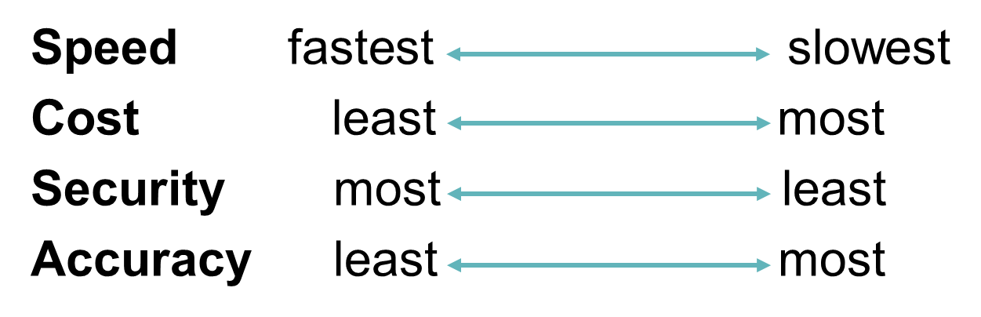
Virtual Test Markets (2 of 2)
Simulated
Test Market
Controlled
Test Market
Standard
Test Market

