Slide 1
Chapter 9: Collecting Descriptive Primary Data
© 2018 Cengage Learning. All Rights Reserved.

Slide 2
Learning Objectives (1 of 3)
Cite three major purposes of descriptive research.
List the six specifications of a descriptive study.

Slide 3
Learning Objectives (2 of 3)
Discuss the difference between cross‑sectional and longitudinal designs.
Explain what is meant by a panel in marketing research, and explain the difference between a continuous

Slide 4
Learning Objectives (3 of 3)
Describe the emphasis in sample surveys.
List the kinds of demographic and socioeconomic characteristics that interest marketers.
Cite the three main approaches used to measure awareness.

Slide 5
Three Purposes of Descriptive Research (1 of 2)
Describe the characteristics of certain groups
Estimate the proportion of people who behave in a certain way
Make specific predictions

Slide 6
Three Purposes of Descriptive Research (2 of 2)
Exploratory research is very flexible; descriptive research is MUCH more rigid
Descriptive research requires the clear specification of…
WHO, WHAT, WHEN, WHERE, WHY, and HOW
… before data collection can begin.

Slide 7
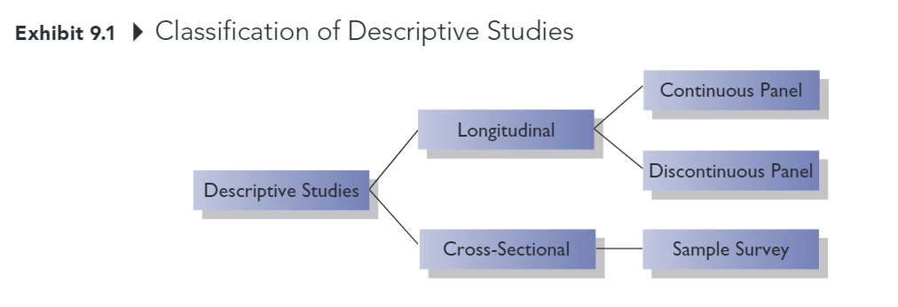
Classification of Descriptive Studies (1 of 5)

Slide 8
Classification of Descriptive Studies (2 of 5)
LONGITUDINAL STUDY
Investigation involving a fixed sample of elements that is measured repeatedly through time.

Slide 9
Longitudinal Panels: Two Types (3 of 5)
CONTINUOUS PANEL
A fixed sample of respondents who are measured repeatedly over time with respect to the same variables.
DISCONTINUOUS PANEL
A fixed sample of respondents who are measured repeatedly over time but on variables that change from measurement to measurement.

Slide 10
Classification of Descriptive Studies (4 of 5)
CROSS-SECTIONAL STUDY
Investigation involving a sample of elements selected from the population of interest that are measured at a single point in time.

Slide 11
Classification of Descriptive Studies (5 of 5)
SAMPLE SURVEY
Cross-sectional study in which the sample is selected to be representative of the target population and in which the emphasis is on the generation of summary statistics such as averages and percentages.

Slide 12
Types of Primary Data (1 of 3)
Demographic/socioeconomic characteristics
Personality/lifestyle characteristics
Attitudes
Awareness/knowledge

Slide 13
Types of Primary Data (2 of 3)
Intentions
Motivation
Behavior

Slide 14
Demographic/Socioeconomic Characteristics
Often used to divide a population into groups (for example, for market segmentation purposes)
Some commonly measured variables:
Age
Education
Income
Gender
Occupation
Ethnicity

Slide 15
Personality/Lifestyle Characteristics
PERSONALITY Normal patterns of behavior exhibited by an individual; the attributes, traits, and mannerisms that distinguish one individual from another
LIFESTYLE How individuals live, what interests them, their values, and what they like.

Slide 16
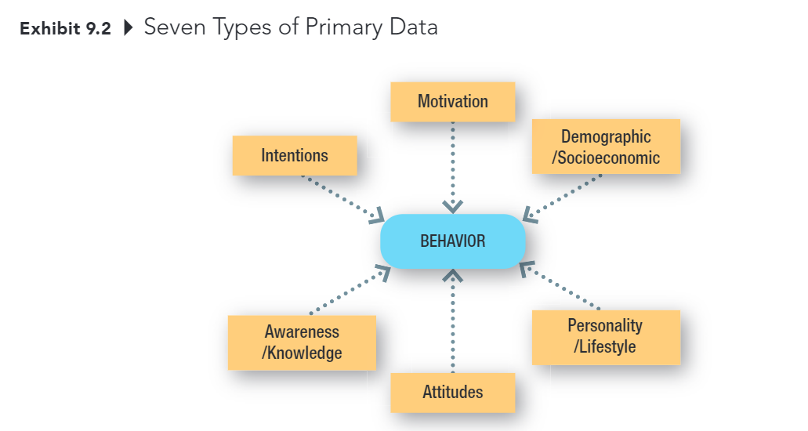
Types of Primary Data (3 of 3)

Slide 17
Attitudes
An attitude is an individual’s overall evaluation of something.
Marketers often measure people’s attitudes toward companies, products, and services. They also measure many “attitude-like” variables including value, quality, and satisfaction.

Slide 18
Awareness/Knowledge
Insight into, or understanding of facts about, some object or phenomenon.
Marketers often want to know what individuals know or believe about products, brands, companies, advertisements, and so on.

Slide 19
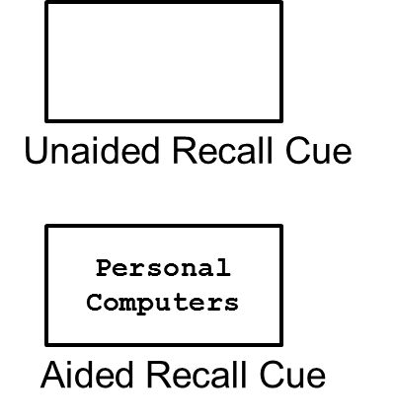
Measuring Awareness (1 of 2)
Unaided Recall:
“For what products and brands do you remember seeing ads?”
Aided Recall:
“Do you remember seeing ads for personal computers?”

Slide 20

Measuring Awareness (2 of 2)
Recognition:
“Do you remember seeing this ad for Dell Computers?”

Slide 21
Intentions (1 of 2)
Anticipated or planned future behavior.
Marketers often need this type of information to assess demand for a product or service.

Slide 22
Intentions (2 of 2)
Estimating demand for products and services accurately is one of the most difficult tasks a marketing researcher faces.

Slide 23
Motivation
A need, a want, a drive, a wish, a desire, an impulse, or any inner state that energizes, activates, moves, directs, or channels behavior toward goals.
If we understand what drives consumer behavior, we are in better position to anticipate consumer needs and offer products and services that satisfy those needs.

Slide 24
Behavior
What subjects have done or are doing.
Behavioral data might be obtained by observing behaviors or by asking consumers to remember and report their past behaviors.

