Slide 1
Chapter 10: Collecting Data by Observation
© 2018 Cengage Learning. All Rights Reserved.

Slide 2
Learning Objectives (1 of 4)
Describe the two basic means of obtaining primary data.
State the specific advantages of each method of data collection.

Slide 3
Learning Objectives (2 of 4)
List the important considerations in the use of observational methods of data collection.
Explain the difference between structured and unstructured observation.

Slide 4
Learning Objectives (3 of 4)
Cite the main reason researchers may choose to disguise the presence of an observer in a study.
Explain the advantages and disadvantages of conducting an observational experiment in a laboratory.

Slide 5
Learning Objectives (4 of 4)
List several approaches to mechanical observation.

Slide 6
Two Methods of Data Collection (1 of 2)
COMMUNICATION
A method of data collection involving questioning respondents to secure the desired information using a data collection instrument called a questionnaire.

Slide 7
Two Methods of Data Collection (2 of 2)
OBSERVATION
A method of data collection in which the situation of interest is watched and the relevant facts, actions, or behaviors are recorded.

Slide 8
Communication versus Observation
ATTRIBUTE | Communication | Observation
Versatility | 4
Speed | 4
Cost | 4
Objectivity |  | 4
Accuracy |  | 4

Slide 9
Why Use Observation Research? (1 of 2)
Observation is often the best method for generating valid data about individuals’ behavior.

Slide 10
Why Use Observation Research? (2 of 2)
For example, using communication methods we can ask a consumer to estimate how many jars of peanut butter he purchased at a particular store in the past year. With observation research, we can KNOW how many jars he purchased at that store in the past year.

Slide 11
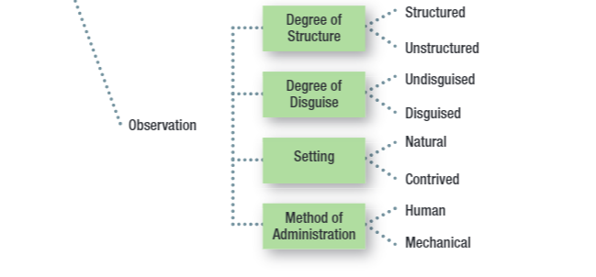
Key Issues for Collecting Information by Observation

Slide 12
Structured Observation (1 of 2)
STRUCTURE
The degree of standardization used with the data collection instrument.

Slide 13

Structured Observation (2 of 2)
Method of observation in which the phenomena to be observed (typically behaviors) can be defined precisely along with the categories used to record the phenomena.

Slide 14
Unstructured Observation (1 of 2)
Method of observation in which the researcher has a great deal of flexibility in terms of what to note and record.

Slide 15
Unstructured Observation (2 of 2)

Slide 16
Disguise
DISGUISE
The amount of knowledge people have about a study in which they are participating.

Slide 17
Disguised versus Undisguised Observation (1 of 2)
With disguised observation, subjects are not aware that they are being observed.
Ethical considerations → Debriefing

Slide 18
Disguised versus Undisguised Observation (2 of 2)
With undisguised observation, subjects are aware that they are being observed.

Slide 19
Mystery Shopping: Disguised Observation
Mystery shoppers might be used to gauge the aesthetics and appeal of baked goods displays.

Slide 20
Natural Setting
Subjects are observed in the environment where the behavior normally takes place.
Shopping in a store
Using or consuming a product at home

Slide 21
Contrived Setting
Subjects are observed in an environment that has been specially designed for recording their behavior.
“fake” store
computer simulation

Slide 22
Human versus Mechanical Observation (1 of 2)
With human observation, individuals are trained to systematically observe a phenomenon and to record on the observational form the specific events that take place.

Slide 23
Human versus Mechanical Observation (2 of 2)
With electrical or mechanical observation, an electrical or mechanical device observes a phenomenon and records the events that take place.

Slide 24
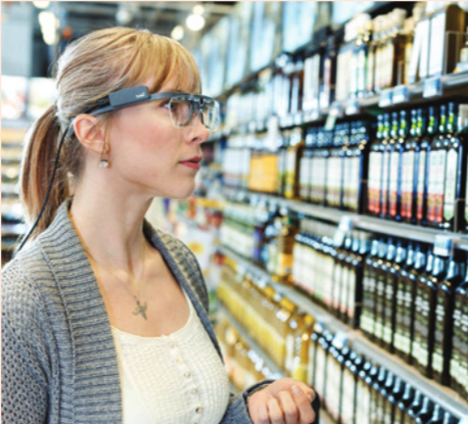
Examples of Mechanical Observation
Video cameras
Bar code scanners
Response latency
Galvanometer
Voice-pitch analysis
Eye camera

