Slide 1
Chapter 11: Collecting Data by Communication
© 2018 Cengage Learning. All Rights Reserved.

Slide 2
Learning Objectives (1 of 3)
Explain the concept of structure as it relates to questionnaires.
Cite the drawbacks of using high degrees of structure.

Slide 3
Learning Objectives (2 of 3)
Explain what is meant by disguise in a questionnaire.
Discuss two situations in which disguise might be desirable.

Slide 4
Learning Objectives (3 of 3)
Differentiate among the main methods of administering questionnaires.
Discuss three important aspects used to compare the four different methods of administering questionnaires.

Slide 5
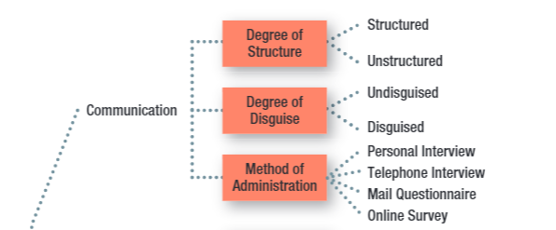
Key Issues for Collecting Information by Communication (1 of 4)

Slide 6
Key Issues for Collecting Information by Communication (2 of 4)
STRUCTURE
The degree of standardization used with the data collection instrument.

Slide 7
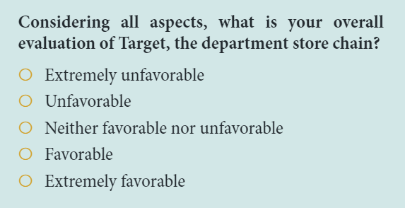
Key Issues for Collecting Information by Communication (3 of 4)
FIXED-ALTERNATIVE QUESTIONS
Questions in which the responses are limited to stated alternatives.

Slide 8
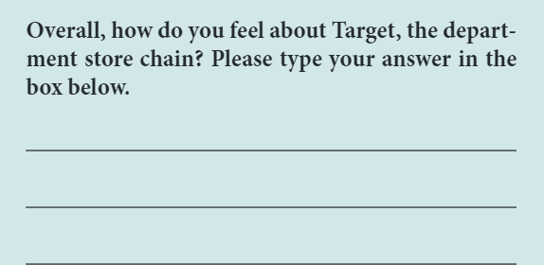
Key Issues for Collecting Information by Communication (4 of 4)
OPEN-ENDED QUESTION
A question in which respondents are free to reply in their own words rather than being limited to choosing from among a set of alternatives.

Slide 9
High Structure: Advantages and Disadvantages
ATTRIBUTE | Disadvantage | Advantage
Ease of Administration |  | 4
Ease of Coding and Analysis |  | 4
Measure Reliability |  | 4
Response Bias:
Forced choice | 4
Omitted response | 4
Precision of response | 4

Slide 10
The Ethics of Disguise (1 of 2)
DISGUISE
The amount of knowledge people have about a study in which they are participating.
Disguise is especially useful when…
…knowing the purpose or sponsor is likely to bias respondents’ answers.
…re-creating the natural environment is necessary, particularly in experimental research.

Slide 11
The Ethics of Disguise (2 of 2)
Under the rights model of ethics, the use of disguise amounts to a violation of the respondent’s right to know.
DEBRIEFING: The process of providing appropriate information to respondents after data have been collected using disguise.

Slide 12
Primary Methods of Administration
Personal Interviews
Telephone Interviews
Mail Surveys
Online Surveys

Slide 13
Personal Interview
PERSONAL INTERVIEW
Direct, face-to-face conversation between a representative of the research organization, the interviewer, and a respondent or interviewee.
Can be conducted in lots of different locations (including malls using mall intercepts)
Generally strong sampling control (including higher response rates)
Great flexibility, but higher levels of interviewer bias
Time- and cost-intensive

Slide 14
Survey Types (1 of 2)
RANDOM-DIGIT DIALING (RDD)
A technique used in studies using telephone interviews, in which the numbers to be called are randomly generated.
IN-BOUND SURVEYS
A method of data collection in which respondents access a survey by telephone or on the Web to respond to survey items.

Slide 15
Survey Types (2 of 2)
EXHIBIT 11.1 Percentage of Corporate Marketing Researchers Using Each Method
Personal Interviews | 67%
Telephone Interviews | 61%
Paper-based Surveys | 32%
Online Surveys | 97%

Slide 16
Mail Survey (1 of 2)
MAIL SURVEY
A survey administered by mail to designated respondents with an accompanying cover letter. The respondents return the questionnaire by mail to the research organization.

Slide 17
Mail Survey (2 of 2)
Lower degree of sampling control (mailing lists often available, but no control over who completes survey, and often low response rates)
No interviewer bias and can offer anonymity, but less flexibility (no explanation or follow-up, no complex materials)
Lower cost than personal or telephone interviews

Slide 18
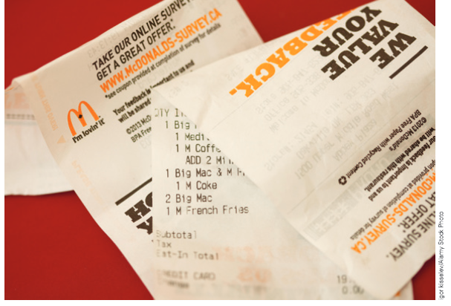
Online Survey (1 of 3)
ONLINE SURVEY
A method of administration that relies on the Web for completing the survey.

Slide 19
Online Survey (2 of 3)
Explosion in use over the past decade
Email lists and panels are readily available, but it’s difficult to know who you are really contacting; response rates are often very low
Good flexibility; visuals and complex material possible
Usually quick and inexpensive

Slide 20
Online Survey (3 of 3)
EXHIBIT 11.4 Primary Communication Methods of Data Collection: Relative Advantages (+) and Disadvantages (−)
 | PERSONAL INTERVIEWS | TELEPHONE INTERVIEWS | PAPER-BASED SURVEYS | ONLINE SURVEYS
SAMPLING CONTROL
Ability to secure list of population members |  | + | + | −
Ability to secure correct respondent | + | + | − | −
Response rate | +
INFORMATION CONTROL
Ability to probe for detailed answers | ++ | + | − | −
Ability to handle complex information | + |  | − | +
Ability to clarify questions | ++ | + | − | −
Amount of information obtained | + | −
Flexibility of question sequencing | + | + | − | +
Protection from interviewer bias |  | − | + | +
Ability to obtain personal information | − | − | ++ | +
Ability to show visual displays | + | − | +
Ability to offer anonymity | − | − | ++ | +
ADMINISTRATIVE CONTROL
Time requirements |  | + | − | ++
Cost requirements | − |  | + | ++
Quality control/supervisory requirements |  | − | + | +
Computer support |  | + | − | ++

