Slide 1
Chapter 12: Asking Good Questions
© 2018 Cengage Learning. All Rights Reserved.

Slide 2
Learning Objectives (1 of 3)
Define the term measurement as it is used in marketing research.
List the four scales (levels) of measurement.

Slide 3
Learning Objectives (2 of 3)
Name some widely used attitude scaling techniques in marketing research.
List some other key decisions to be made when designing scales.

Slide 4
Learning Objectives (3 of 3)
Explain the concept of validity as it relates to measuring instruments.

Slide 5
Measurement (1 of 7)
“rules for assigning numbers to objects in such a way as to represent quantities of attributes”
Source: Peter D. Bennett, ed., Dictionary of Marketing Terms, 2nd ed. (Chicago: American Marketing Association, 1995), p. 173.

Slide 6
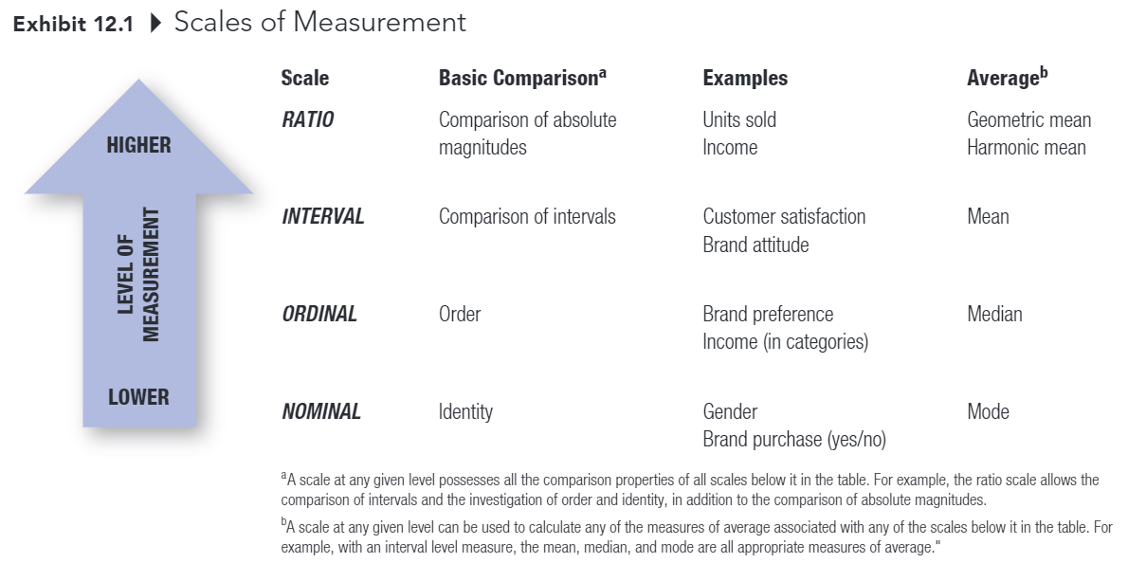
Measurement (2 of 7)

Slide 7
Measurement (3 of 7)
Higher levels of measurement have all the properties of lower levels of measurement.

Slide 8
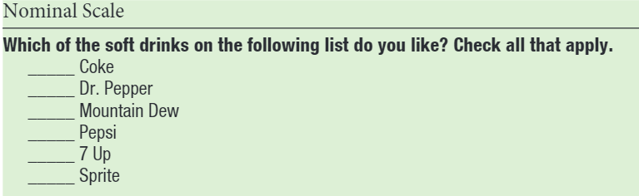
Measurement (4 of 7)
NOMINAL SCALE
Measurement in which numbers are assigned to objects or classes of objects solely for the purpose of identification.

Slide 9
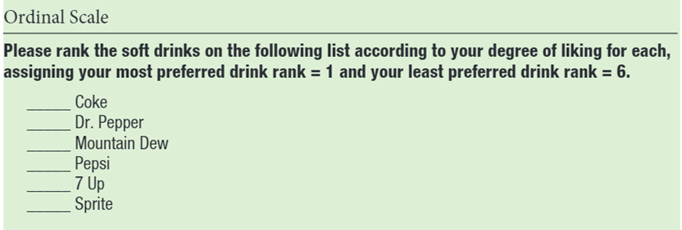
Measurement (5 of 7)
ORDINAL SCALE Measurement in which numbers are assigned to data on the basis of some order (for example, more than, greater than) of the objects.

Slide 10
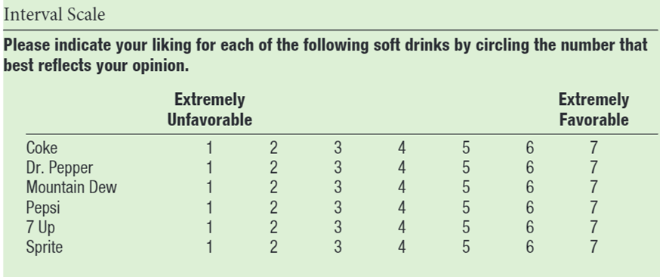
Measurement (6 of 7)
INTERVAL SCALE
Measurement in which the assigned numbers legitimately allow the comparison of the size of the differences among and between members.

Slide 11
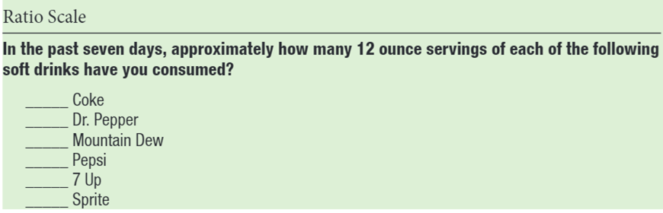
Measurement (7 of 7)
RATIO SCALE Measurement that has a natural, or absolute, zero and therefore allows the comparison of absolute magnitudes of the numbers.

Slide 12
Measuring Attitudes and Other Unobservable Concepts
SELF-REPORT A method of assessing attitudes in which individuals are asked directly for their beliefs about or feelings toward an object or class of objects.
Most common approach to measuring attitudes

Slide 13
Three General Types of Self-Report Attitude Scales (1 of 9)
Itemized-Ratings Scales
Graphic-Ratings Scales
Comparative-Ratings Scales

Slide 14
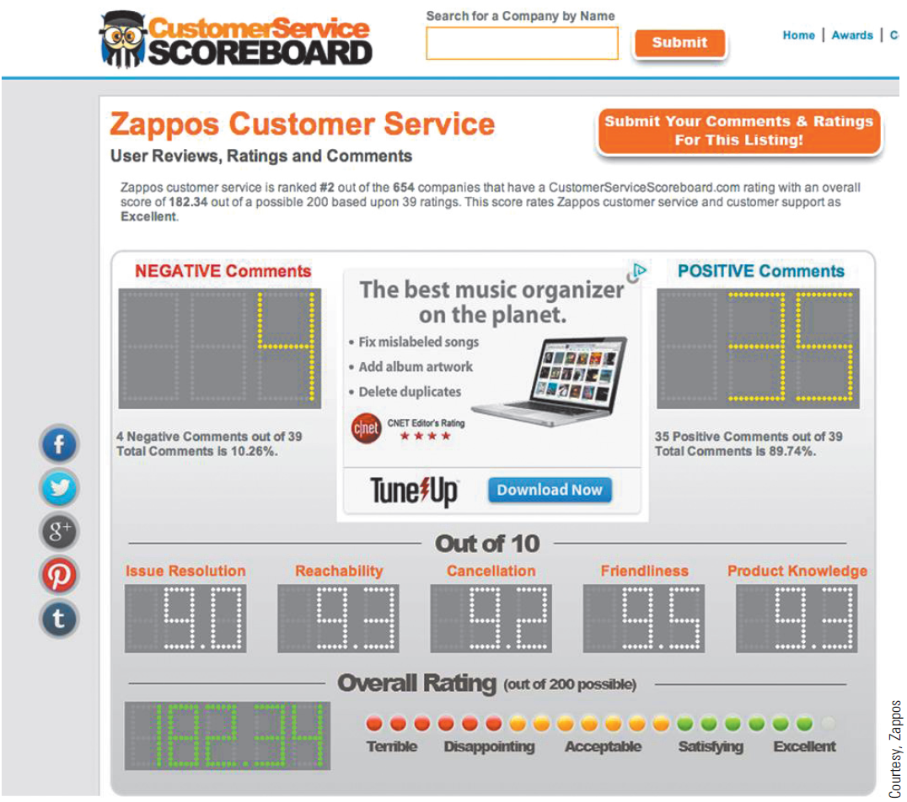
Three General Types of Self-Report Attitude Scales (2 of 9)

Slide 15
Three General Types of Self-Report Attitude Scales (3 of 9)
ITEMIZED-RATINGS SCALES A scale on which individuals must indicate their ratings of an attribute or object by selecting the response category that best describes their position on the attribute or object.
EXAMPLES: Likert Summated-Ratings Scales Semantic Differential Scales

Slide 16
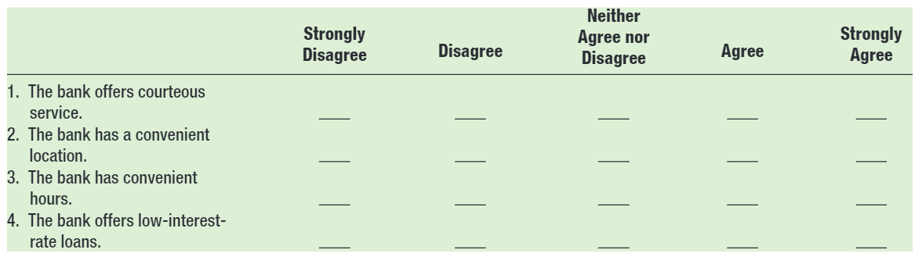
Three General Types of Self-Report Attitude Scales (4 of 9)
Summated-ratings Scale A self-report technique for attitude measurement in which respondents indicate their degree of agreement or disagreement with each of a number of statements.

Slide 17
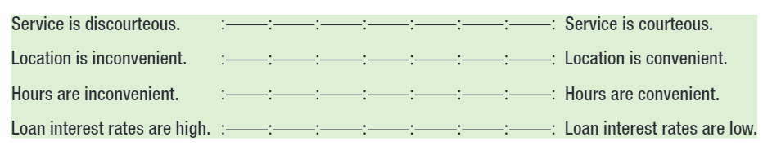
Three General Types of Self-Report Attitude Scales (5 of 9)
Semantic-differential Scale A self-report technique for attitude measurement in which the subjects are asked to check which cell between a set of bipolar adjectives or phrases best describes their feelings toward the object.

Slide 18
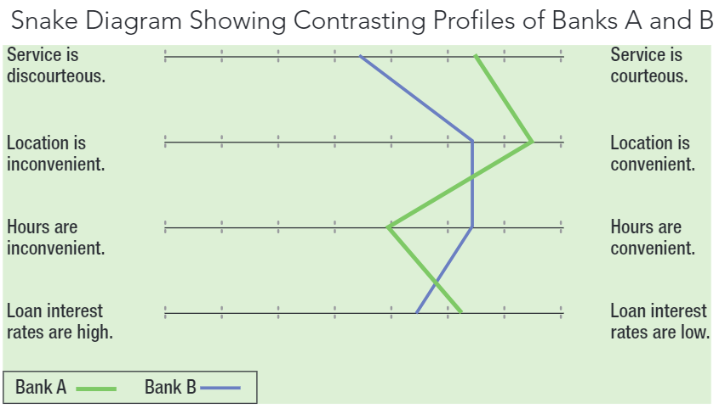
Three General Types of Self-Report Attitude Scales (6 of 9)

Slide 19
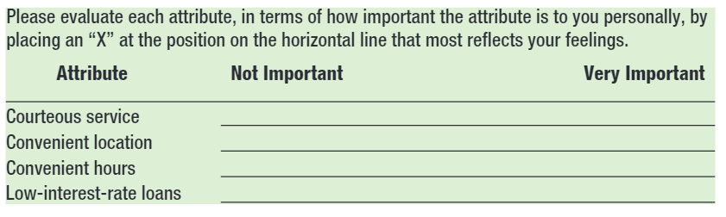
Three General Types of Self-Report Attitude Scales (7 of 9)
GRAPHIC-RATINGS SCALES A scale in which individuals indicate their ratings of an attribute typically by placing a check at the appropriate point on a line that runs from one extreme of the attribute to the other.

Slide 20
Three General Types of Self-Report Attitude Scales (8 of 9)
COMPARATIVE-RATINGS SCALES A scale requiring subjects to make their ratings as a series of relative judgments or comparisons rather than as independent assessments.

Slide 21
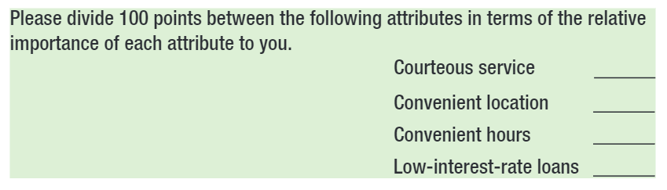
Three General Types of Self-Report Attitude Scales (9 of 9)
Constant-sum Method A comparative-ratings scale in which an individual divides some given sum among two or more attributes on a basis such as importance or favorability.

Slide 22
Other Considerations in Designing Scales
Number of items in a scale
Global measures versus composite measures
Number of scale positions
Odd or even number?
Including a “don’t know” or “not applicable” response category

Slide 23
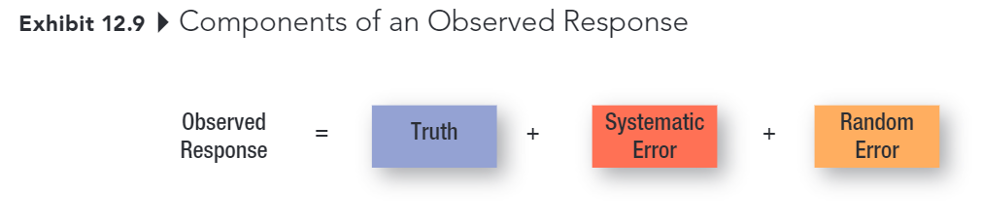
Establishing the Validity and Reliability of Measures (1 of 7)

Slide 24
Establishing the Validity and Reliability of Measures (2 of 7)
SYSTEMATIC ERROR
Error in measurement that is also known as constant error because it affects the measurement in a constant way.
RANDOM ERROR
Error in measurement due to temporary aspects of the person or measurement situation that affects the measurement in irregular ways.

Slide 25
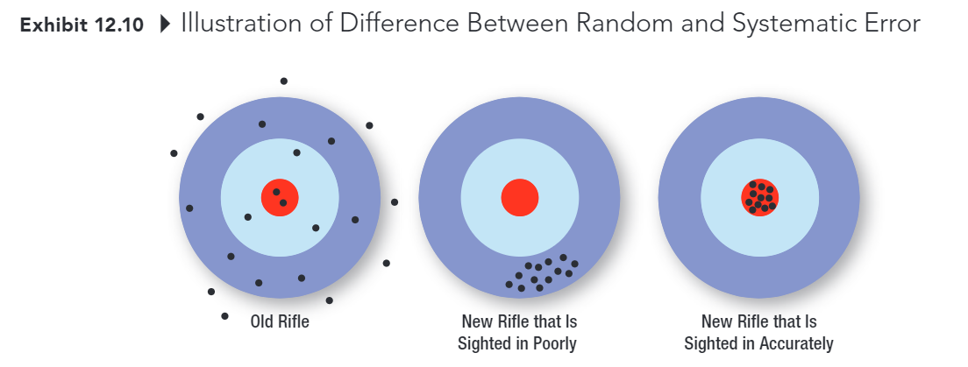
Establishing the Validity and Reliability of Measures (3 of 7)
RANDOM ERROR
SYSTEMATIC ERROR

Slide 26
Establishing the Validity and Reliability of Measures (4 of 7)
RELIABILITY
Ability of a measure to obtain similar scores for the same object, trait, or construct across time, across different evaluators, or across the items forming the measure.

Slide 27
Establishing the Validity and Reliability of Measures (5 of 7)
VALIDITY
The extent to which differences in scores on a measuring instrument reflect true differences among individuals, groups, or situations in the characteristic that it seeks to measure or true differences in the same individual, group, or situation from one occasion to another, rather than systematic or random errors.

Slide 28

Establishing the Validity and Reliability of Measures (6 of 7)
Unreliable Not Valid
Reliable Not Valid
Reliable Valid

Slide 29
Establishing the Validity and Reliability of Measures (7 of 7)
A measure can be reliable but not valid.
A valid measure must be reliable.

