Slide 1
Chapter 13: Designing the Data Collection Form for Communication Data
© 2018 Cengage Learning. All Rights Reserved.

Slide 2
Learning Objectives (1 of 4)
Define telescoping error and recall loss and explain how they affect a respondent's ability to answer questions accurately.
List some techniques that researchers use to secure respondents’ cooperation in answering sensitive questions.

Slide 3
Learning Objectives (2 of 4)
List some of the primary rules researchers should keep in mind in trying to develop bias‑free questions.
Explain what the funnel approach to question sequencing is.

Slide 4
Learning Objectives (3 of 4)
Explain what a branching question is and discuss when it is used.
Explain the difference between target information and classification information and tell which should be asked first in a questionnaire.

Slide 5
Learning Objectives (4 of 4)
Explain the role of pretesting in the questionnaire development process.

Slide 6
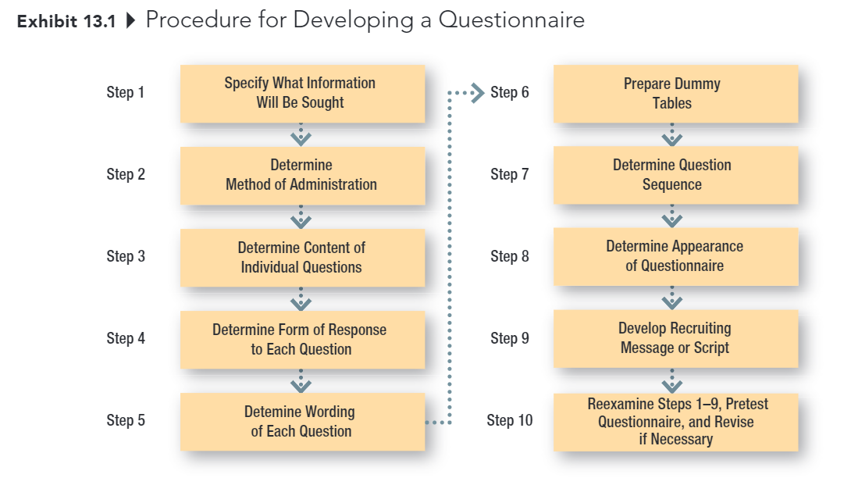
Developing the Data Collection Form

Slide 7
STEP 1: Specify What Information Will Be Sought
The first step should be relatively easy, assuming that the researchers have done a good job at earlier stages in the research process.
Hypotheses, dummy tables, etc., make it clear what information is needed.

Slide 8
STEP 2: Determine Method of Administration
The degree of structure and disguise influence this decision, as does the specific research situation.
Personal Interview
Telephone Interview
Mail Survey
Online Survey

Slide 9
STEP 3: Determine Content of Individual Questions (1 of 3)
Some key issues:
Is the question necessary?
Are several questions needed instead of one?
Do respondents have the necessary information?
Will respondents give the information?

Slide 10
STEP 3: Determine Content of Individual Questions (2 of 3)
FILTER QUESTION
A question used to determine if a respondent is likely to possess the knowledge being sought; also used to determine if an individual qualifies as a member of the defined population.
“Do you do the grocery shopping for your family?”
“Have you eaten at Mickey’s restaurant, located at Sixth Street and Manvel Avenue, within the past six months?”
“Did you vote in the last presidential election?”

Slide 11
STEP 3: Determine Content of Individual Questions (3 of 3)
TELESCOPING ERROR
A type of error resulting from the fact that most people remember an event as having occurred more recently than it did.
RECALL LOSS
A type of error caused by a respondent’s forgetting that an event happened at all.

Slide 12
Handling Sensitive Questions (1 of 2)
Don’t ask unless absolutely necessary!
Guarantee anonymity
Place sensitive questions near end
Include a counter biasing statement

Slide 13
Handling Sensitive Questions (2 of 2)
Ask about how others might feel
Ask for general, rather than specific, information (for example, categories for answers)
Use randomized response model

Slide 14
Counterbiasing Statement
Recent studies show that one of every four households has trouble meeting its monthly financial obligations. Is your household currently experiencing financial difficulties?
◻ Yes
◻ No

Slide 15
STEP 4: Determine Form of Response to Each Question
Open-Ended Questions
versus
Closed-Ended Questions

Slide 16
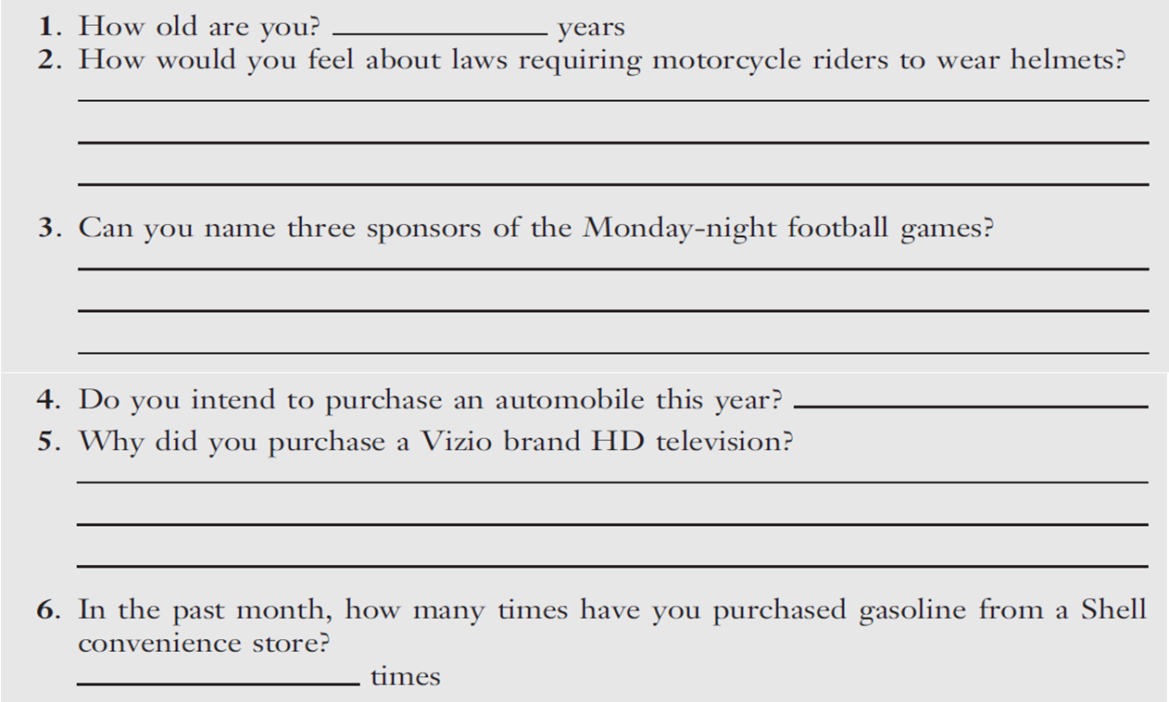
Open-Ended Questions

Slide 17
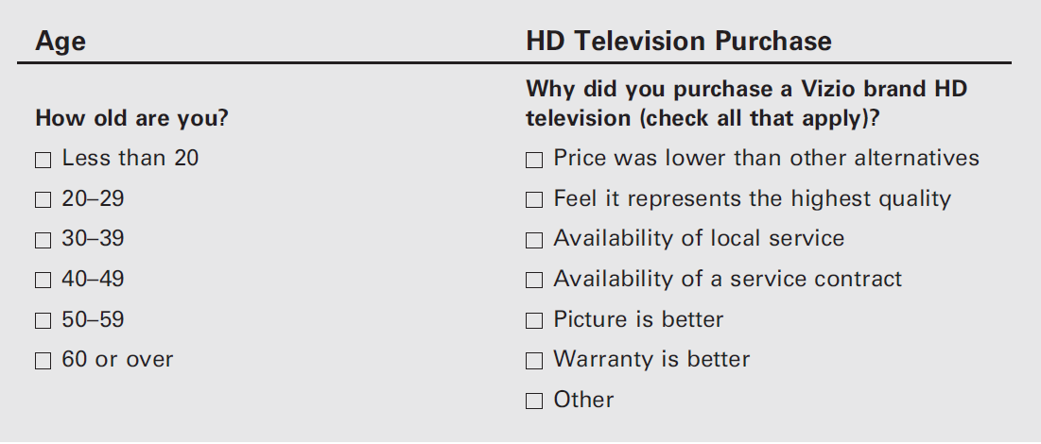
Closed-Ended Questions (1 of 2)

Slide 18
Closed-Ended Questions (2 of 2)
With closed-ended questions, the response categories must be exhaustive; all reasonable responses must be included.
In addition, response categories must be mutually-exclusive, except in special cases where more than one answer is acceptable (for example, check all that apply)

Slide 19
Response Order Bias
RESPONSE ORDER BIAS
An error that occurs when the response to a question is influenced by the order in which the alternatives are presented.

Slide 20
Split-Ballot Technique
SPLIT-BALLOT TECHNIQUE
A technique for combatting response bias in which researchers use multiple versions of a survey, with different wordings of an item or different orders of response options.
(Version A) Do you think gasoline will be more expensive or less expensive next year than it is now?
◻ More expensive
◻ Less expensive
(Version B) Do you think gasoline will be more expensive or less expensive next year than it is now?
◻ Less expensive
◻ More expensive

Slide 21
STEP 5: Determine Wording of Each Question (1 of 2)
Use simple words
Language used should be driven by the ability level of the population; err on the side of simplicity

Slide 22
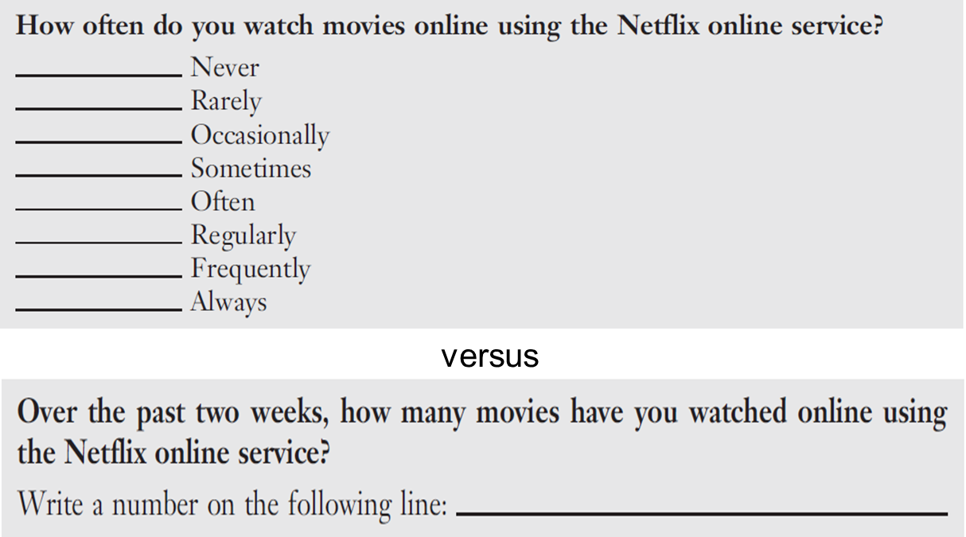
STEP 5: Determine Wording of Each Question (2 of 2)
Avoid Ambiguous Words and Questions

Slide 23
Some Problem Words: Be Careful!
All
Always
And
Dinner
Feel
Government
If
Never
Occasionally
Often
Or
Rarely
Regularly
Sometimes
Usually
Where
You

Slide 24
STEP 5: Determine Wording of Each Question
Avoid Leading Questions

Slide 25
REMINDER: No Advocacy Research!
Reputable media outlets provide (a) the actual questions, (b) a description of the study, and (c) information about the sample

Slide 26
Words that Might Signal Leading Questions
Allege, allude, arbitrary, blame, claim, demand, error, failure, fault, ignore, ill-advised, ill-informed, incompetence, ineptness, insist, just, maintain, misinformed, must, neglected, one-sided, only, overreact, peremptory, purport, questionable, rejection, rigid, so-called, unfortunately, unilateral, unreasonable
Source: “Guide to Writing Survey Questions,” Management Analysis and Development, downloaded from http://www.mad.state.mn.us/ on October 25, 2012.

Slide 27
Things to be Avoid (1 of 6)
Avoid Unstated Alternatives
An alternative answer that is not expressed in a question’s options.
Thorough exploratory research and questionnaire pre-testing is the answer!
19% said “no” “Would you like to have a job, if this were possible?”
versus
68% said “no” “Would you prefer to have a job, or do you prefer to do just your housework?”

Slide 28
Things to be Avoid (2 of 6)
Avoid Assumed Consequences
When a question is not framed to clearly state the consequences and thus generates different responses from individuals who assume different consequences.

Slide 29
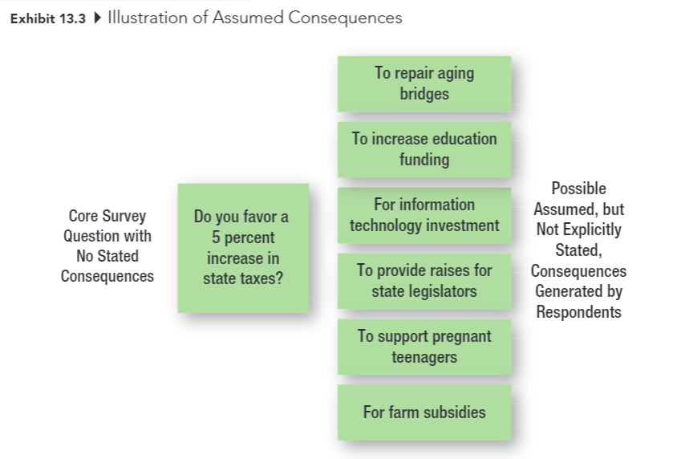
Things to be Avoid (3 of 6)

Slide 30
Things to be Avoid (4 of 6)
Another Example of Assumed Consequences:
Would you like to double the number of job offers you receive as a senior?
◻ Yes  ◻ No
Would you like to double the number of job offers you receive as a senior if that means devoting an additional 10 hours per week to studying so as to raise your grade point?
◻ Yes  ◻ No

Slide 31
Things to be Avoid (5 of 6)
Avoid Generalizations and Estimates
Questions should always be asked in specific, rather than general, terms.
When asking about the frequency of behaviors (for example, shopping, purchase), use an appropriate time frame that doesn’t force respondents to make estimates.

Slide 32
Things to be Avoid (6 of 6)
Avoid Double-Barreled Questions
Watch out for and and or…

Slide 33
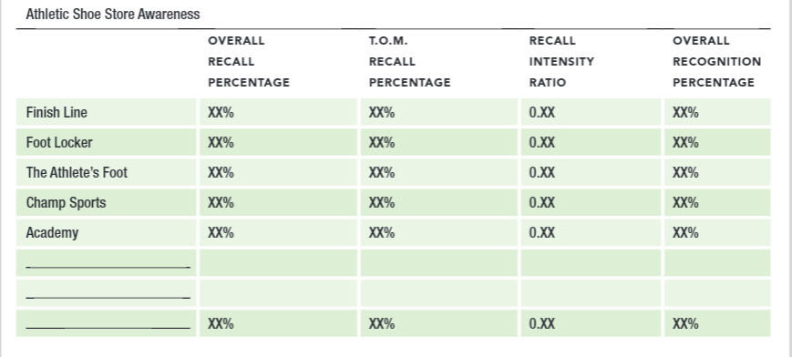
STEP 6: Prepare Dummy Tables
DUMMY TABLE
A table (or figure) used to show how the results of an analysis will be presented.

Slide 34
STEP 7: Determine Question Sequence (1 of 4)
Use simple and interesting opening questions
Use the funnel approach
Start with broad questions and progressively narrow the scope
Question Order Bias: The tendency for earlier questions on a questionnaire to influence respondents’ answers to later questions.

Slide 35
STEP 7: Determine Question Sequence (2 of 4)
Design branching questions with care
Branching questions direct respondents to different places in a questionnaire, based on their responses to the question at hand

Slide 36
STEP 7: Determine Question Sequence (3 of 4)
Ask for classification information last
Target Information: The basic information that addresses the subject of the study
Classification Information: Information used to classify respondents, typically for demographic breakdowns

Slide 37
STEP 7: Determine Question Sequence (4 of 4)
Place difficult or sensitive questions late in the questionnaire

Slide 38
STEP 8: Determine Appearance of Questionnaire (1 of 2)
No clutter!
Keep it as short as possible
Use care with branching questions
Use graphics as needed to improve appearance

Slide 39
STEP 8: Determine Appearance of Questionnaire (2 of 2)
Number questions within sections
For example, 1-1, 2-1, 3-1, 2-1, 2-2, etc.
Include an organization name (sometimes fictitious) and project title
Go easy on instructions, unless they are absolutely necessary

Slide 40
STEP 9: Develop Recruiting Message or Script
Good cover letters and scripts are NOT written in a hurry.
The usual things to include:
Who you are
Why you are contacting them
Promise of anonymity or confidentiality
The request for help
How long it will take
Any incentives

Slide 41
STEP 10: Reexamine Steps 1-9, Pretest (1 of 2)
Developing a questionnaire is a VERY difficult process. It normally requires several revisions of the data collection form.
PRETEST
Use of a questionnaire (or observation form) on a trial basis in a small pilot study to determine how well the questionnaire (or observation form) works.

Slide 42
STEP 10: Reexamine Steps 1-9, Pretest (2 of 2)
The real test of a questionnaire is how it performs under actual conditions of data collection.
Data collection should NEVER begin until you have pretested–and probably revised again–the questionnaire.

Slide 43
Observation Forms
Decisions about…
WHO should be observed?
WHAT aspects should be reported?
WHERE should the observation be made?
WHEN should the observation be made?

