Slide 1
Chapter 14: Developing the Sampling Plan
© 2018 Cengage Learning. All Rights Reserved.

Slide 2
Learning Objectives (1 of 3)
Explain the difference between a parameter and a statistic.
Explain the difference between a probability sample and a nonprobability sample.

Slide 3
Learning Objectives (2 of 3)
List the primary types of nonprobability samples.
List the primary types of probability samples.
Discuss the concept of total sampling elements (TSE).

Slide 4
Learning Objectives (3 of 3)
Cite three factors that influence the necessary sample size.
Explain the relationship between population size and sample size.

Slide 5
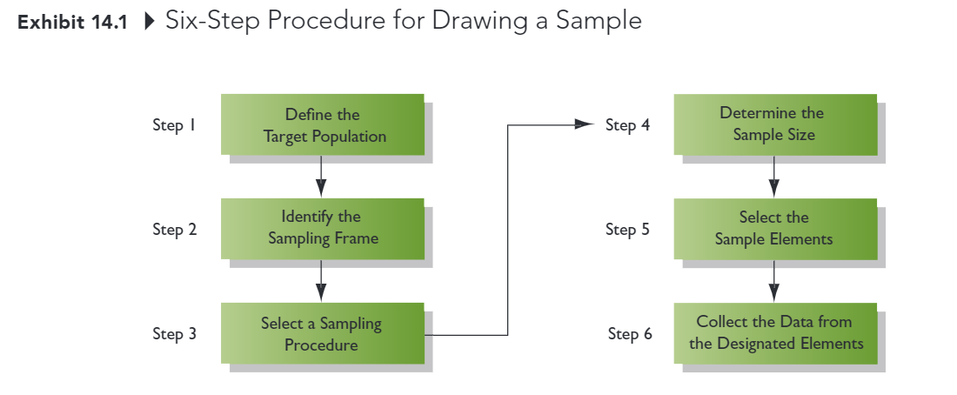
Developing the Sampling Plan

Slide 6
STEP 1: Define the Target Population (1 of 3)
POPULATION
All cases that meet designated specifications for membership in the group.
Researchers must be very clear and precise in defining the population.
Households in the city limits of Sacramento, California, with one or more children under the age of 18 living at home.

Slide 7
STEP 1: Define the Target Population (2 of 3)
CENSUS A type of sampling plan in which data are collected from or about each member of a population.
SAMPLE Selection of a subset of elements from a larger group of objects.

Slide 8
STEP 1: Define the Target Population (3 of 3)
PARAMETER
A characteristic or measure of a population.
STATISTIC
A characteristic or measure of a sample.
We calculate statistics from sample data in order to estimate population parameters

Slide 9
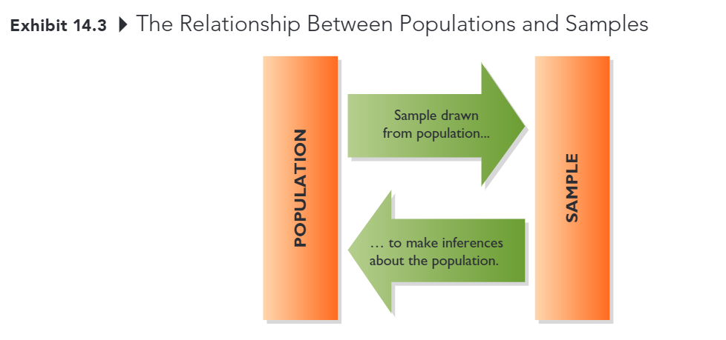
Population versus Samples

Slide 10
Sampling Error
The difference between results obtained from a sample and results that would have been obtained had information been gathered from or about every member of the population.
Decreased by increasing sample size
Can be estimated (assuming probability sample)
Usually less troublesome than other kinds of error

Slide 11
STEP 2: Identify the Sampling Frame
SAMPLING FRAME
The list of population elements from which a sample will be drawn; the list could consist of geographic areas, institutions, individuals, or other units.
Commonly used sampling frames
Customer database, member directories Lists developed by data compilers Others

Slide 12
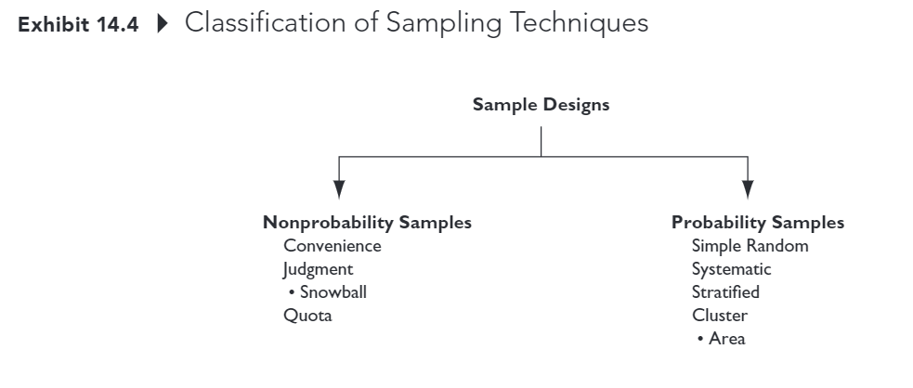
STEP 3: Select a Sampling Procedure (1 of 5)

Slide 13
STEP 3: Select a Sampling Procedure (2 of 5)
NONPROBABILITY SAMPLE
A sample that relies on personal judgment in the element selection process.
With nonprobability samples, sampling error cannot be estimated and we cannot calculate the margin of sampling error.
Convenience
Judgment (for example, snowball)
Quota

Slide 14
STEP 3: Select a Sampling Procedure (3 of 5)
CONVENIENCE SAMPLE
A nonprobability sample in which population elements are included in the sample because they were readily available.
Sometimes referred to as “accidental” sampling; population elements are sampled simply because they are in the right place at the right time.
easy to conduct, but no way to know if sample is representative of the population (that is, cannot statistically assess sampling error).

Slide 15
STEP 3: Select a Sampling Procedure (4 of 5)
JUDGMENT SAMPLE
A nonprobability sample in which the sample elements are handpicked because they are expected to serve the research purpose.
the researcher may believe that the sample elements are representative of the larger population or that they can offer the information needed
a snowball sample is one form of judgment sample

Slide 16
STEP 3: Select a Sampling Procedure (5 of 5)
QUOTA SAMPLE
A nonprobability sample chosen so that the proportion of sample elements with certain characteristics is about the same as the proportion of the elements with the characteristics in the target population.
a “quota” representing these characteristics is established (for example, 25 males between the ages of 20 and 29; 25 females between the ages of 20 and 29; 35 males between the ages of 30 and 39; etc.) so that when the sample is complete it will mirror the population on the key characteristics

Slide 17

Quota Sampling Example (1 of 2)
Research Problem:
Investigate undergraduate student attitudes toward controversial technology fee.
Known population parameters: class (30% FR, 20% SO, 30% JR, 20% SR) and gender (50% male, 50% female)
10 students will interview 10 friends each
What should be the composition (class and gender) of those 100 students?

Slide 18
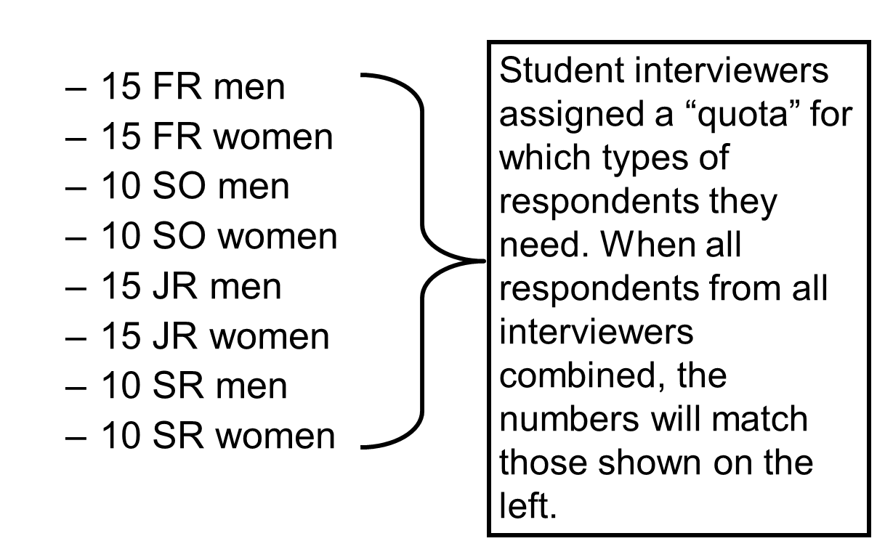
Quota Sampling Example (2 of 2)

Slide 19
Probability
PROBABILITY SAMPLE
A sample in which each target population element has a known, nonzero chance of being included in the sample.
With probability samples there is a random component to which elements are selected; sampling error can be estimated.
Simple Random
Systematic
Stratified
Cluster (including area)

Slide 20

Why Use Probability Sampling?
…because the analyst can statistically assess the level of sampling error and make projections to the population.
(just don’t forget that sampling error is only one kind of error… and it usually isn’t the biggest problem)

Slide 21
Simple Random Sample
SIMPLE RANDOM SAMPLE
A probability sampling plan in which each unit included in the population has a known and equal chance of being selected for the sample.
if a digital version of the sampling frame is available, implementing a simple random sample is relatively easy

Slide 22
Systematic Sample
SYSTEMATIC SAMPLE
A probability sampling plan in which every kth element in the population is selected from the sample pool after a random start.
if a digital version of the sampling frame is NOT available, but a list of population members exists, this is a useful approach

Slide 23
Sample Interval Formula
SAMPLING INTERVAL (k)
The number of population elements to count (k) when selecting the sample members in a systematic sample.

Slide 24
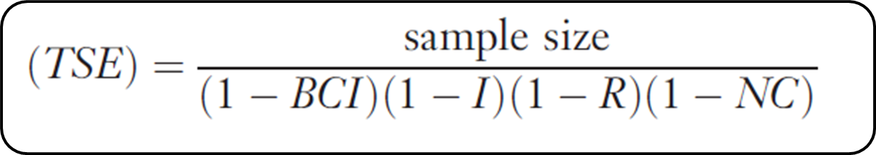
Total Sampling Elements
TOTAL SAMPLING ELEMENTS (TSE)
The number of population elements that must be drawn from the population and included in the initial sample pool in order to end up with the desired sample size.
BCI = proportion of bad contact information, I = proportion of ineligible elements, R = proportion of refusals, and NC = proportion that cannot be contacted after repeated attempts.

Slide 25
TSE EXAMPLE
You will be conducting an telephone survey of university students who are 21 years of age or older. You have determined that a sample size of 250 will allow reasonable precision and confidence for your estimates of important population parameters. Let’s assume that 15% of the telephone numbers aren’t working, 2% of students you contact are ineligible because they have working telephone numbers but have left the school, about 20% of students will refuse to participate, and you will be unable to reach 30% of those selected for the sample (BCI=0.1, I=0.02, R=0.20, NC=0.30).
How many sampling elements should you include in the project?

Slide 26
TSE Formula

Slide 27
Systematic Sampling Example (1 of 2)
Knowing that you need a sample pool of 536 students to ultimately get about 250 students in your sample, you are in position to draw a systematic sample from the student directory at your university. Further, 5,000 students are listed in the directory.
What is the sampling interval?

Slide 28
Systematic Sampling Example (2 of 2)
Randomly select one of the first 9 students and then select every 9th student after to be in the initial sampling pool.

Slide 29
Stratified Sample
STRATIFIED SAMPLE
A probability sample in which (1) the population is divided into mutually exclusive and exhaustive subsets, and (2) a probabilistic sample of elements is chosen independently from each subset.
most appropriate when strata are homogeneous within but heterogeneous between with respect to key variable(s)
decreased variance within strata on key variable(s) means increased precision
ability to ensure that important strata are represented

Slide 30
Cluster Sample
CLUSTER SAMPLE
A probability sample in which (1) the parent population is divided into mutually exclusive and exhaustive subsets, and (2) a random sample of one or more subsets (clusters) is selected.
strata should be heterogeneous within, homogeneous between
an AREA SAMPLE is a form of cluster sampling in which areas (for example, census tracts, blocks) serve as the primary sampling units

Slide 31
STEP 4: Determine the Sample Size (1 of 2)
To determine the necessary sample size, we need three pieces of information:
how homogeneous (similar) the population is on the characteristic to be estimated
how much precision is needed in the estimate
how confident we need to be that the true value falls within the precision range established

Slide 32
STEP 4: Determine the Sample Size (2 of 2)
PRECISION
The degree of error in an estimate of a population parameter.
CONFIDENCE
The degree to which one can feel confident that an estimate approximates the true value.
Precision and confidence are inversely related; as one increases, the other decreases, all else equal.

Slide 33
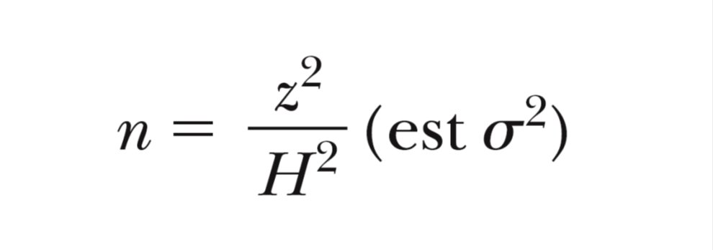
Determining Sample Size When Estimating Means (1 of 5)
Where n = required sample size, z = z-score corresponding to the desired degree of confidence, H = half-precision (or how far off the estimate can be in either direction), and σ² = variance of the variable in the population.

Slide 34
Determining Sample Size When Estimating Means (2 of 5)
When is it meaningful to calculate a mean?
INTERVAL SCALES
RATIO SCALES

Slide 35
Determining Sample Size When Estimating Means (3 of 5)
You have been asked to determine the average amount that fishermen spend per year on food and lodging while on fishing trips in a certain state. Your estimate is to be within + / − $25 of the population mean; the confidence level is to be 95%; and the estimated standard deviation for the amount spent is $125 based on prior research. Thus…

Slide 36
Determining Sample Size When Estimating Means (4 of 5)
H = $25
z = 1.96
σ = $125
HOW LARGE A SAMPLE DO YOU NEED?

Slide 37
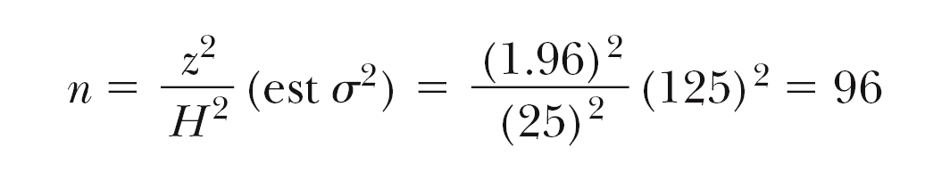
Determining Sample Size When Estimating Means (5 of 5)

Slide 38
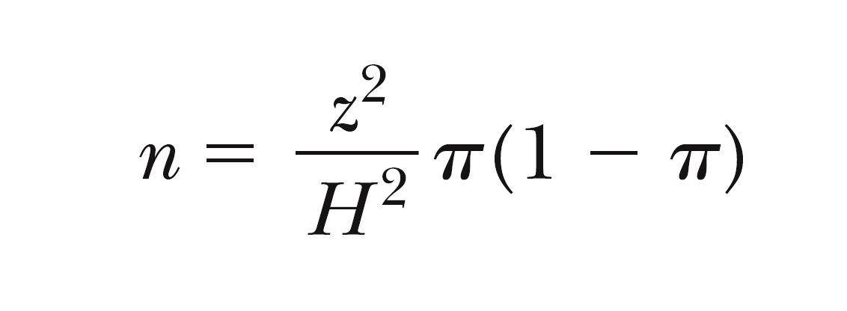
Determining Sample Size When Estimating Proportions (1 of 5)
Where n = required sample size, z = z-score corresponding to the desired degree of confidence, H = half-precision (or how far off the estimate can be in either direction), and π = estimated population proportion.

Slide 39
Determining Sample Size When Estimating Proportions (2 of 5)
When do we use the proportion formula for sample size calculation?
NOMINAL SCALES
ORDINAL SCALES

Slide 40
Determining Sample Size When Estimating Proportions (3 of 5)
You have been asked to determine the proportion of all out-of-state fishermen who took at least one overnight fishing trip in the past year. Your estimate is to be within + / − 2% of the population mean; the confidence level is to be 95%; and the best guess is that 25% of out-of-state respondents have taken at least one overnight fishing trip. Thus…

Slide 41
Determining Sample Size When Estimating Proportions (4 of 5)
H = 2%
z = 1.96
π = 25%
HOW LARGE A SAMPLE DO YOU NEED?

Slide 42
Determining Sample Size When Estimating Proportions (5 of 5)

Slide 43
Population Size and Sample Size
Unless the sample will be more than 5-10% of the population size, the size of the population does not enter into the calculation of the size of the sample.
Many people, including managers, have trouble with this idea.

Slide 44
Finite Population Sample Size
(For use when sample size > 10% of population size)
for means:
for proportions:

Slide 45
Other Approaches to Determining Sample Size
Size of research budget
Anticipated analyses
Historical practice

Slide 46
Basics of the Sampling Distribution
EXHIBIT 14A.1 Population
POPULATION ELEMENT | MONTHLY INCOME (DOLLARS)
1 A | $ 5,600
2 B | 6,000
3 C | 6,400
4 D | 6,800
5 E | 7,200
6 F | 7,600
7 G | 8,000
8 H | 8,400
9 I | 8,800
10 J | 9,200
11 K | 9,600
12 L | 10,000
13 M | 10,400
14 N | 10,800
15 O | 11,200
16 P | 11,600
17 Q | 12,000
18 R | 12,400
19 S | 12,800
20 T | 13,200
Population Mean (μ) = $9400

Slide 47
Basics of the Sampling Distribution (1 of 4)
DERIVED POPULATION
All possible samples that can be drawn from the population under a given sampling plan.

Slide 48
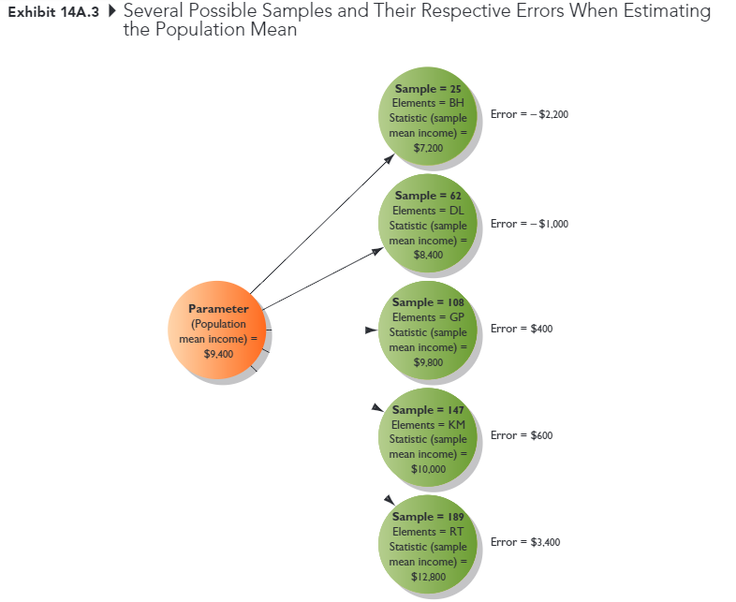
Basics of the Sampling Distribution (2 of 4)

Slide 49
Basics of the Sampling Distribution (3 of 4)
The mean of all possible sample means is equal to the population mean.
The variance of sample means is related to the population variance.

Slide 50
Basics of the Sampling Distribution (4 of 4)
The sampling distribution is mound shaped.
consistent with the Central-Limit Theorem, regardless of the shape of the distribution of the variable in the population, with a sample size of 30 (and sometimes a lot less), the distribution of sample means becomes normally distributed

