Slide 1
Chapter 15: Data Collection: Enhancing Response Rates while Limiting Errors
© 2018 Cengage Learning. All Rights Reserved.

Slide 2
Learning Objectives
Describe the five types of error that can enter a study.
Give the general definition for response rate.
Discuss several ways in which response rates might be improved.

Slide 3
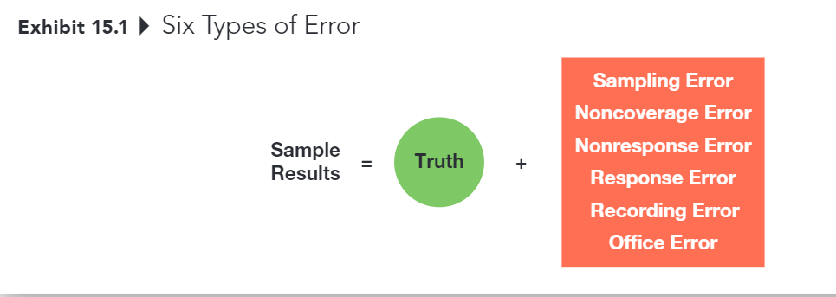
Six Types of Error (1 of 7)

Slide 4
Five Types of Error
SAMPLING ERROR
The difference between results obtained from a sample and results that would have been obtained had information been gathered from or about every member of the population.
Decreased by increasing sample size
Can be estimated (assuming probability sample)
Usually less troublesome than other kinds of error

Slide 5
Six Types of Error (2 of 7)
HOWEVER, sampling error usually isn’t the biggest problem – it’s all the other things that contribute error to a project.
And these other sources of error can’t be accounted for statistically…

Slide 6
Six Types of Error (3 of 7)
NONCOVERAGE ERROR
Error that arises because of failure to include qualified elements of the defined population in the sampling frame.
noncoverage error is essentially a sampling frame problem

Slide 7
Six Types of Error (4 of 7)
NONRESPONSE ERROR
Error from failing to obtain information from some elements of the population that were selected and designated for the sample.
This is a potential problem that only occurs when those who respond are systematically different in some important way from those who don’t respond

Slide 8
Six Types of Error (5 of 7)
Suppose that a university wanted to assess the success of its graduates, based on their annual salaries, five years after graduation.
Which graduates are more
likely to return a survey? (those who are happy with their salaries)
Which graduates are less likely to return a survey? (those who are not happy with their salaries)

Slide 9
The Primary Sources of Nonresponse Error
Refusals
Not-at-Homes
It is better to work hard at generating responses from a smaller sampling pool than to start with a much larger sampling pool and ignore potential nonresponse error, even if the resulting sample size is smaller.
Pay attention to the response rates delivered by different online panel companies. The completion rate is not the same thing as the overall response rate!

Slide 10
Three Methods for Diagnosing Nonresponse Error
(1) Contact a sample of nonrespondents
(2) Compare respondent demographics against known demographics of population
(3) Conduct an analysis of late responders versus early responders

Slide 11
Six Types of Error (6 of 7)
RESPONSE ERROR
Error that occurs when an individual provides an inaccurate response, consciously or subconsciously, to a survey item.

Slide 12
Key Considerations with Response Error (1 of 2)
Does the respondent understand the question?
Does the respondent know the answer to the question?
Source: Weiers (1988)

Slide 13
Key Considerations with Response Error (2 of 2)
Is the respondent willing to provide the true answer to the question?
Is the wording of the question or the situation in which it is asked likely to bias the response?
Source: Weiers (1988)

Slide 14
Six Types of Error (7 of 7)
OFFICE ERROR
Error due to data editing, coding, or analysis errors.

Slide 15
Total Error is the Key
The goal is to decrease overall error, not any one source of error.
Sampling Error
Noncoverage Error
Nonresponse Error
Response Error
Office

Slide 16
Calculating Response Rates (1 of 7)
RESPONSE RATE
The number of completed interviews with responding units divided by the number of eligible responding units in the sample.

Slide 17
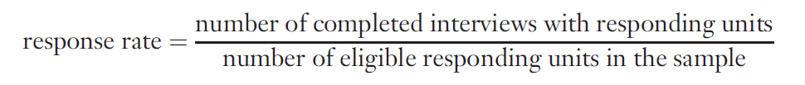
Calculating Response Rates (2 of 7)
General Formula:

Slide 18
Calculating Response Rates (3 of 7)
Online and Mail Surveys
(No Eligibility Requirement)

Slide 19
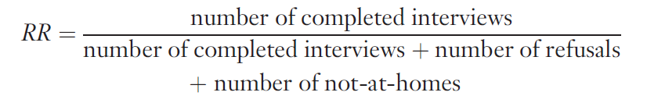
Calculating Response Rates (4 of 7)
Telephone Surveys
(No Eligibility Requirement)

Slide 20
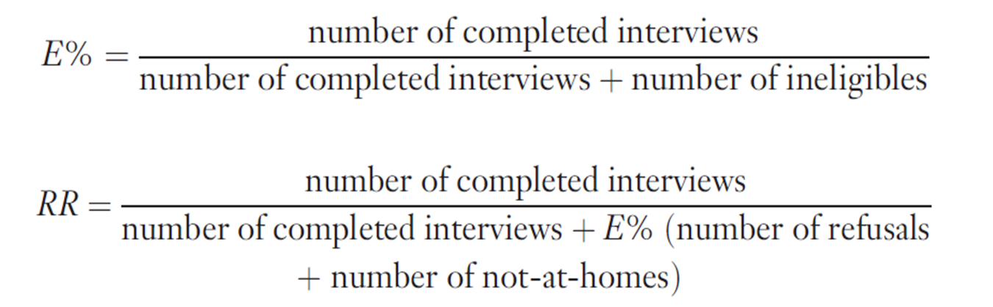
Calculating Response Rates (5 of 7)
Mail Surveys, Online Surveys,
and Telephone Interviews (With Eligibility Requirement)

Slide 21
Calculating Response Rates (6 of 7)
EXAMPLE
You’ve conducted an online survey, attempting to contact 500 people; the 500 sample elements have been classified as follows:
completed surveys: 250
refusals: 200
ineligibles: 50
What was your response rate?

Slide 22
Calculating Response Rates (7 of 7)

Slide 23
Improving Response Rates (1 of 5)
The response rate on a project serves as an indicator of the overall quality of a data collection effort. It also provides insight into the likely influence of nonresponse error on the project.
Researchers must strive to obtain the highest response rates possible in a given situation.

Slide 24
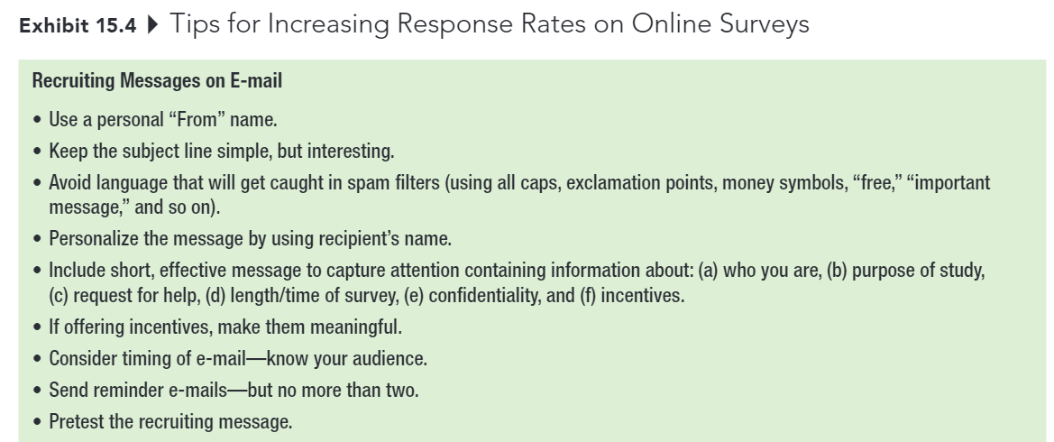
Improving Response Rates (2 of 5)

Slide 25
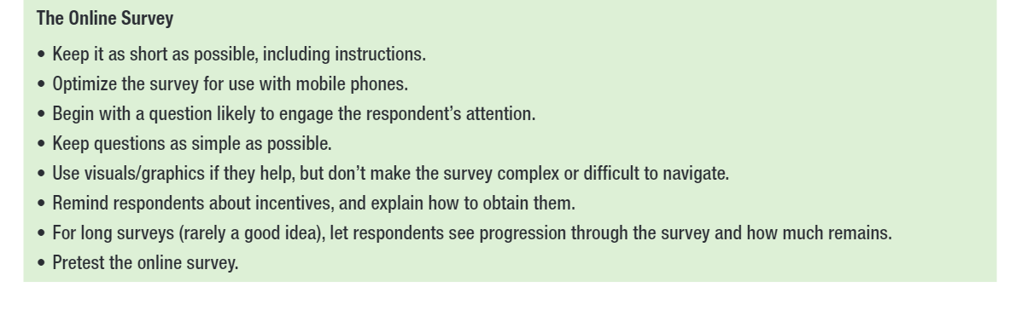
Improving Response Rates (3 of 5)

Slide 26
Improving Response Rates (4 of 5)
Respondent interest in topic
Survey length
Guarantee of confidentiality or anonymity
Interviewer characteristics and training

Slide 27
Improving Response Rates (5 of 5)
Personalization
Response incentives
Follow-up surveys

