Slide 1
Chapter 16: Data Preparation for Analysis
© 2018 Cengage Learning. All Rights Reserved.

Slide 2
Learning Objectives (1 of 2)
Explain the purpose of the editing process.
Define what coding is.
Describe the kinds of information contained in a codebook.

Slide 3
Learning Objectives (2 of 2)
Describe common methods for cleaning the data file.
Discuss options for dealing with missing data in analyses.

Slide 4
Primary Tasks in the Editing Process (1 of 3)
EDITING
The inspection and correction of the data received from each element of the sample (or census).

Slide 5
Primary Tasks in the Editing Process (2 of 3)
Convert all responses to consistent units
Assess degree of nonresponse
Where possible check for consistency across responses

Slide 6
Primary Tasks in the Editing Process (3 of 3)
Look for evidence that the respondent wasn’t really thinking about his or her answers
Verify that branching questions were followed correctly
Add any needed codes

Slide 7
Coding Closed-Ended Items (1 of 5)
CODING
The process of transforming raw data into symbols (usually numbers).

Slide 8
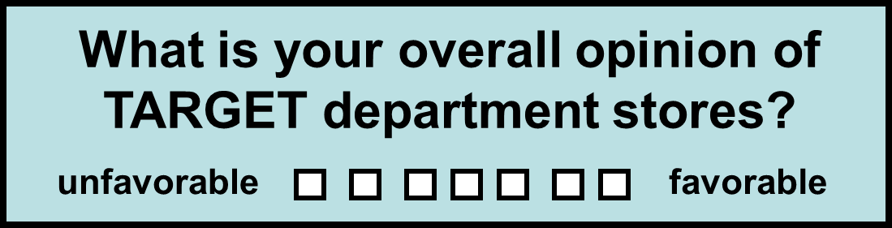
Coding Closed-Ended Items (2 of 5)
(Typical coding: 1 2 3 4 5 6 7 )

Slide 9
Coding Closed-Ended Items (3 of 5)
How did you learn about Brown Furniture Company? (check all that apply)
newspaper advertising
radio advertising
billboard advertising
recommended by others
drove by store
other: _______________
TYPICAL CODING:
6 different variables
(1 if checked; 0 if not)
(1 if checked; 0 if not)
(1 if checked; 0 if not)
(1 if checked; 0 if not)
(1 if checked; 0 if not)
(1 if checked; 0 if not)

Slide 10
Coding Closed-Ended Items (4 of 5)
Factual open-ended items seeking concrete responses are relatively easy to code. Numeric answers are typically recorded as given by the respondent, while other types of responses are given a specific code number.
In what year were you born? (code year)
How many times have you eaten at Streeter’s Grill in the last month? (code number)
Name the first 3 coffee shops located in Tampa that come to mind. (code as 3 separate variables; assign numbers to represent each coffee shop mentioned)

Slide 11
Coding Closed-Ended Items (5 of 5)
Exploratory open-ended items seeking less structured responses are much more difficult to code.
In your own words, give us two or three reasons why you prefer to leave the state after graduation.
___________________________________________
___________________________________________
___________________________________________
___________________________________________

Slide 12
Process for Coding Exploratory Open-Ended Questions
Identify usable responses
Develop categories for responses
Sort responses into categories, using multiple coders; compare results
Assess the degree of agreement between coders

Slide 13
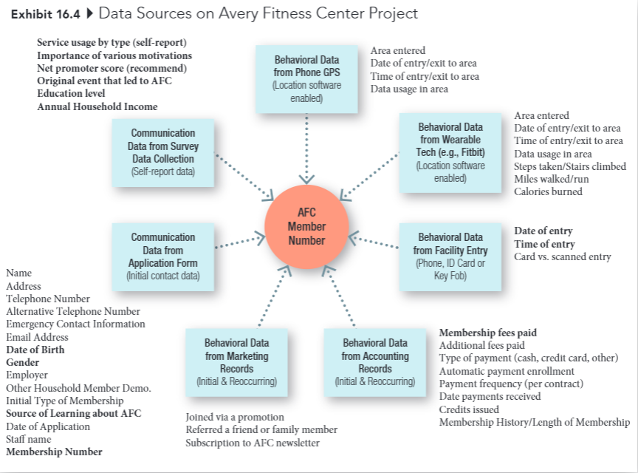
Avery Fitness Center Project

Slide 14
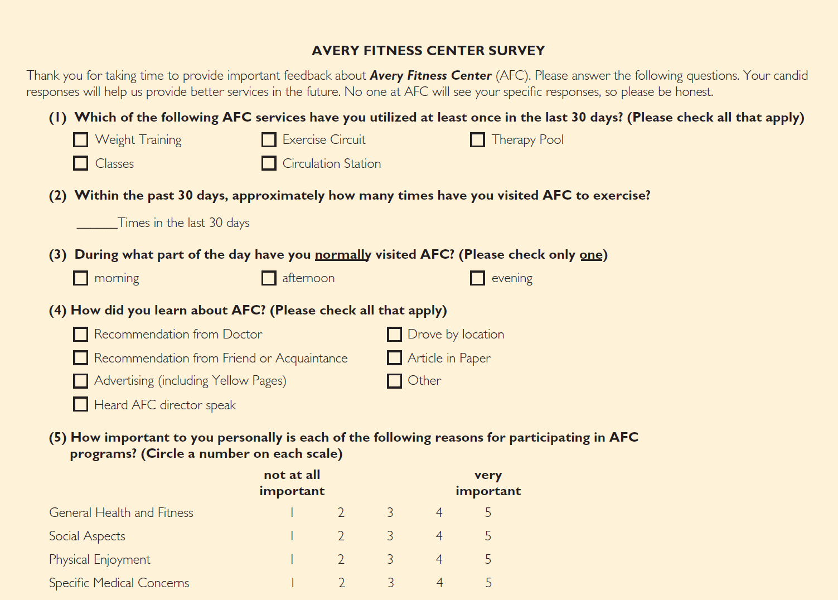
Avery Fitness Center Survey (1 of 2)

Slide 15
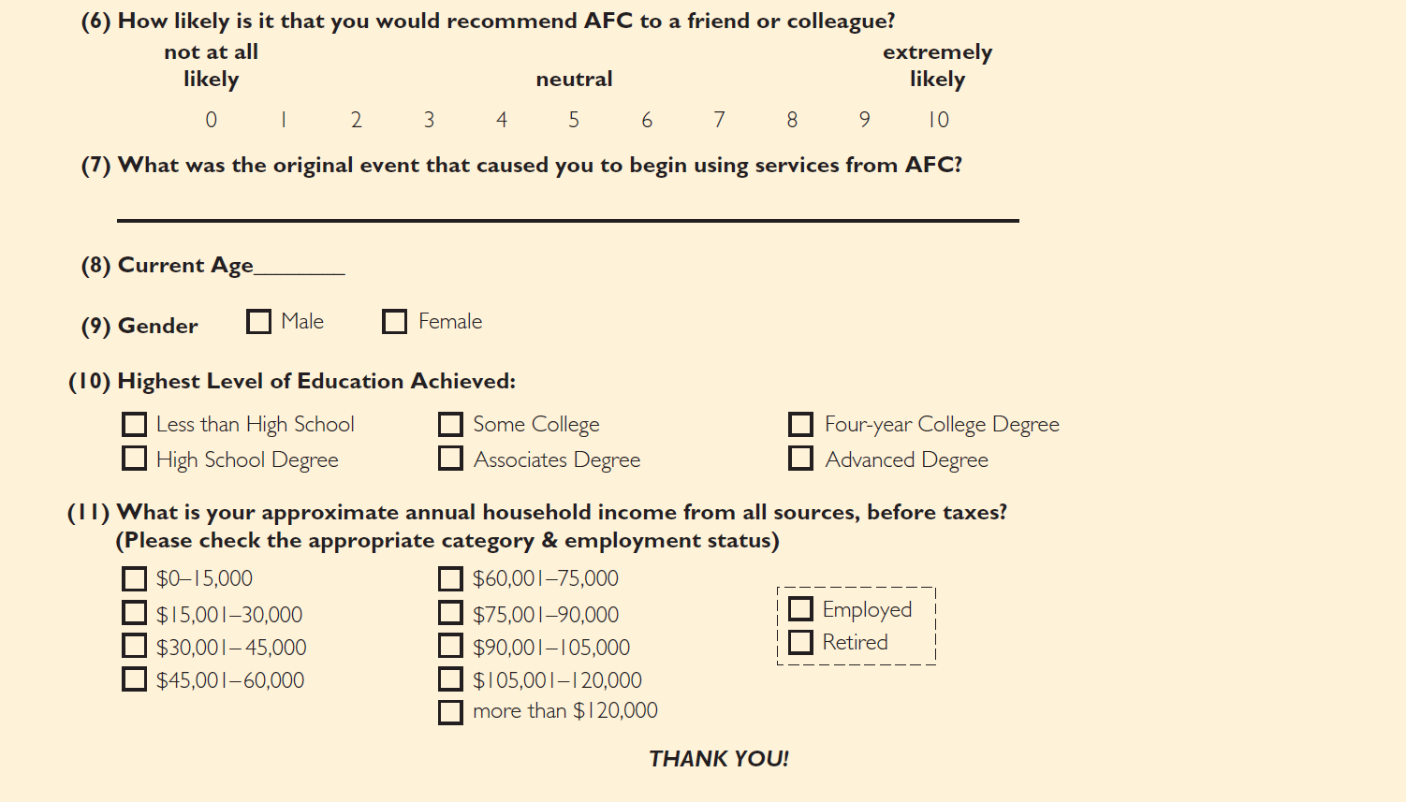
Avery Fitness Center Survey (2 of 2)

Slide 16
Developing a Codebook (1 of 3)
CODEBOOK
A document that contains explicit directions about how data from data collection forms are coded in the data file.

Slide 17
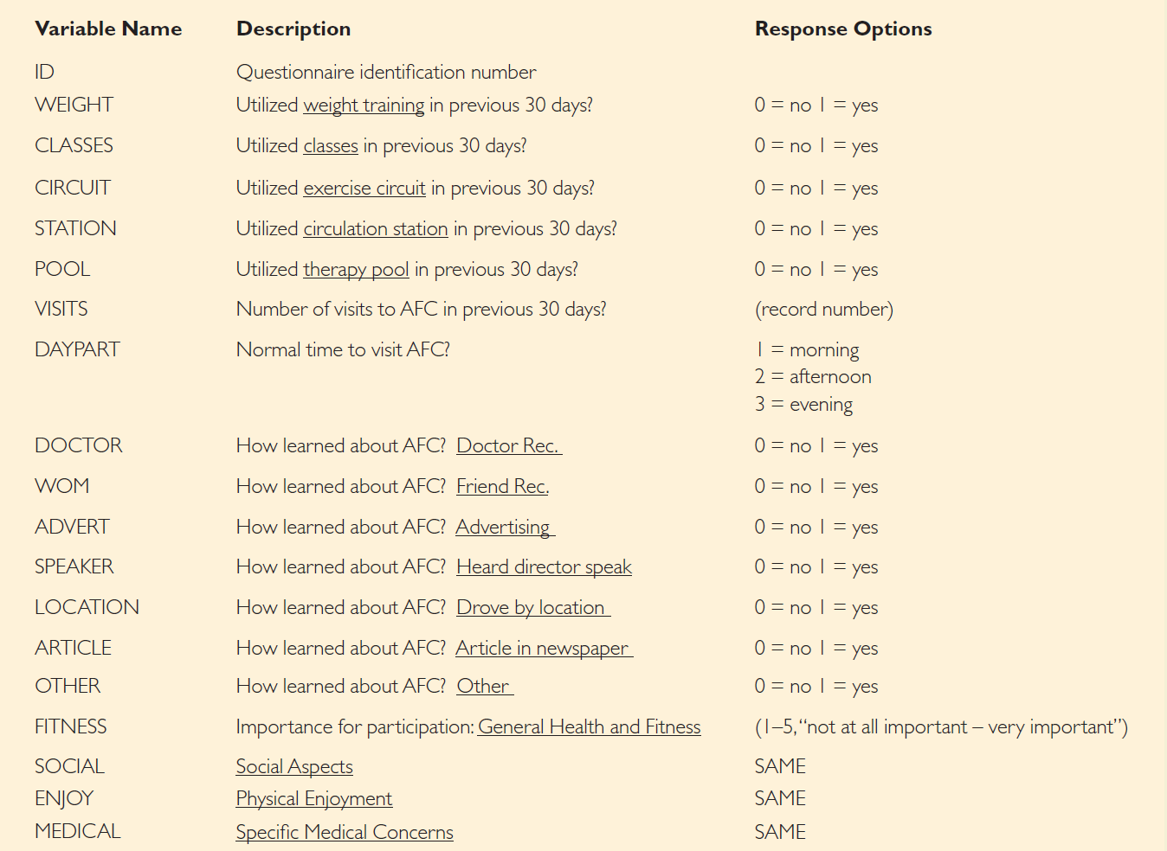
Developing a Codebook (2 of 3)

Slide 18
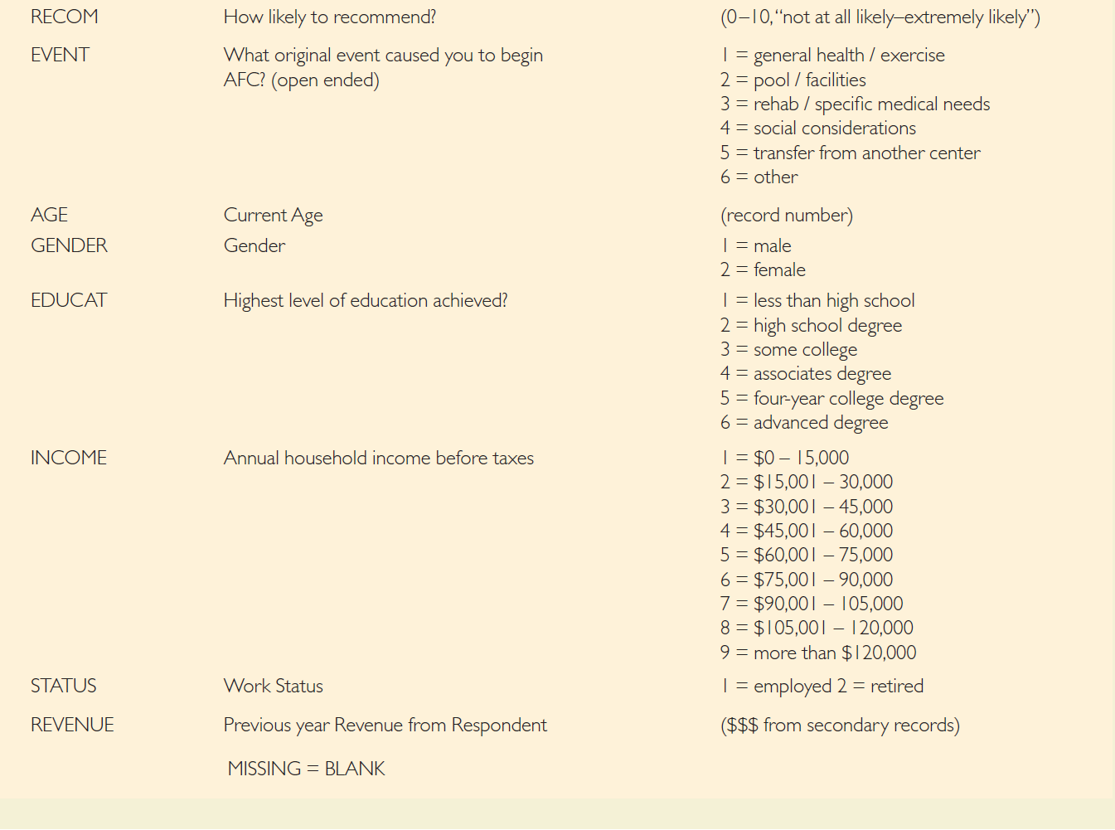
Developing a Codebook (3 of 3)

Slide 19
Cleaning the Data (1 of 2)
BLUNDER
An error that arises during editing, coding, or data entry.
blunders are usually due to researcher carelessness

Slide 20
Cleaning the Data (2 of 2)
How to identify blunders:
Run frequency analysis on all variables
Check a sample of questionnaires
against the data file
Double-entry of data (preferred)

Slide 21
Handling Missing Data
ITEM NONRESPONSE
A source of error that arises when a respondent agrees to an interview but refuses, or is unable, to answer specific questions.
If a particular case has a significant amount of item nonresponse, it should probably be eliminated during the editing process.

Slide 22
Alternative Strategies for Handling Missing Data
Eliminate the case with the missing item(s) from all further analyses
Eliminate the case with the missing item in analyses using the variable
Substitute values for the missing items
Contact the respondent again

