Slide 1
Chapter 17: Analysis and Interpretation: Individual Variables Independently
© 2018 Cengage Learning. All Rights Reserved.

Slide 2
Learning Objectives (1 of 2)
Distinguish between univariate and multivariate analyses.
Describe frequency analysis.
Describe descriptive statistics.

Slide 3
Learning Objectives (2 of 2)
Discuss confidence intervals for proportions and means.
Overview the basic purpose of hypothesis testing.

Slide 4
Data Analysis: Two Key Considerations (1 of 2)
Is the variable to be analyzed by itself (univariate analysis) or in relationship to other variables (multivariate analysis)?
What level of measurement was used?
If you can answer these two questions, data analysis is easy...

Slide 5
Data Analysis: Two Key Considerations (2 of 2)
CATEGORICAL MEASURES
A commonly used expression for nominal and ordinal measures.
CONTINUOUS MEASURES
A commonly used expression for interval and ratio measures.

Slide 6
The Avery Fitness Center (AFC) Project (1 of 3)
RESEARCH PROBLEMS
Discover existing member demographics and usage patterns (including fees paid)
Investigate how members initially learn about AFC

Slide 7
The Avery Fitness Center (AFC) Project (2 of 3)
Population: AFC members who had visited AFC at least once in the prior 12 months
Simple random sample

Slide 8
The Avery Fitness Center (AFC) Project (3 of 3)
Mail survey; 231 usable responses (58% response rate)
Primary data matched to secondary data (that is, fees paid over prior 12 months)

Slide 9
Basic Univariate Statistics: Categorical Measures
FREQUENCY ANALYSIS
A count of the number of cases that fall into each of the possible response categories.
…an incredibly common and useful type of analysis

Slide 10
The Avery Fitness Center (AFC)
Exhibit 17.1 Avery Fitness Center: Gender
GENDER | NUMBER | PERCENT | VALID PERCENT | VALID CUMULATIVE PERCENT
Male | 45 | 19% | 20% | 20%
Female | 177 | 77% | 80% | 100%
Total | 222 | 96% | 100%
Missing | 9 | 4%
Overall total | 231 | 100%

Slide 11
Use of Percentages
Percentages are very useful for interpreting the results of categorical analyses and should be included whenever possible.
Unless your sample size is VERY large, however, report percentages as whole numbers (i.e., no decimals)

Slide 12
Frequency Analysis (1 of 2)
Researchers almost always work with “valid” percentages which are simply percentages after taking out cases with missing data on the variable being analyzed.

Slide 13
Frequency Analysis (2 of 2)
Exhibit 17.1 Avery Fitness Center: Gender
GENDER | NUMBER | PERCENT | VALID PERCENT | VALID CUMULATIVE PERCENT
Male | 45 | 19% | 20% | 20%
Female | 177 | 77% | 80% | 100%
Total | 222 | 96% | 100%
Missing | 9 | 4%
Overall total | 231 | 100%

Slide 14
Presenting Frequency Analysis Results
GENDER | number | percent
male | 45 | 20%
female | 177 | 80%
total | 222 | 80%
(missing = 9)

Slide 15
Uses of Frequency Analysis (1 of 5)
Univariate categorical analysis
Identify blunders and cases with excessive item nonresponse
Identify outliers
Identify the median

Slide 16
Uses of Frequency Analysis (2 of 5)
OUTLIER
An observation so different in magnitude from the rest of the observations that the analyst chooses to treat it as a special case.

Slide 17
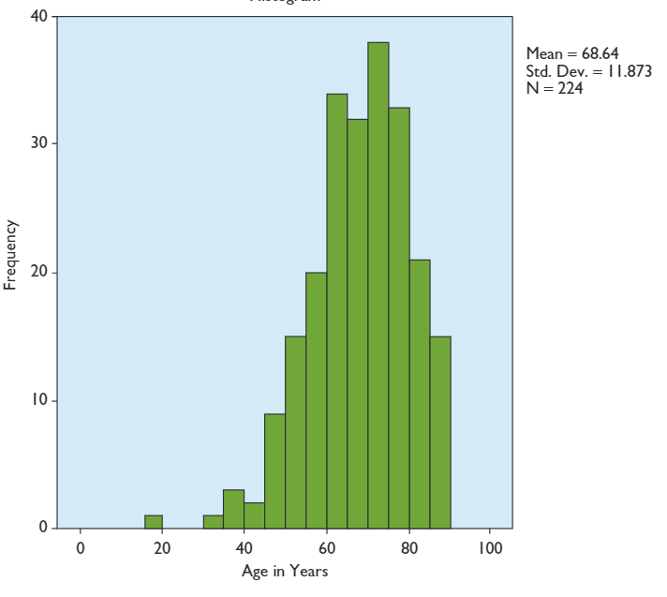
Uses of Frequency Analysis (3 of 5)

Slide 18
Uses of Frequency Analysis (4 of 5)
HISTOGRAM
A form of bar chart on which the values of the variable are placed along the x-axis and the absolute or relative frequency of the values is shown on the y-axis.

Slide 19
Uses of Frequency Analysis (5 of 5)
The MEDIAN level of education is found by identifying the level that contains the 50th percentile in the frequency distribution.
Exhibit 17.2 Avery Fitness Center: Level of Education
LEVEL OF EDUCATION ACHIEVED | NUMBER | VALID PERCENT | CUMULATIVE PERCENT
Less than high school | 4 | 2% | 2%
High school degree | 34 | 15% | 17%
Some college | 46 | 20% | 37%
Associate’s degree | 7 | 3% | 40%
Four-year college degree | 52 | 23% | 64%
Advanced degree | 62 | 36% | 100%
Total | 225 | 100%

Slide 20
Confidence Intervals for Proportions (Categorical Measures) (1 of 2)
CONFIDENCE INTERVAL
A projection of the range within which a population parameter will lie at a given level of confidence, based on a statistic obtained from a probabilistic sample.
This is why you need to draw a probability sample!

Slide 21
Confidence Intervals for Proportions (Categorical Measures) (2 of 2)
where z = z score associated with the desired level of confidence; p = the proportion obtained from the sample; and n = the number of valid cases overall on which the proportion was based.
CONFIDENCE INTERVAL:

Slide 22
Question: What percentage of AFC members are women? (1 of 3)
Solution: Compute the 95% confidence interval based on the proportion of respondents in the sample that indicated that they were women.

Slide 23
Question: What percentage of AFC members are women? (2 of 3)
Based on the sample result, our best guess is that 80% of the population are women…
Exhibit 17.1 Avery Fitness Center: Gender
GENDER | NUMBER | PERCENT | VALID PERCENT | VALID CUMULATIVE PERCENT
Male | 45 | 19% | 20% | 20%
Female | 177 | 77% | 80% | 100%
Total | 222 | 96% | 100%
Missing | 9 | 4%
Overall total | 231 | 100%

Slide 24
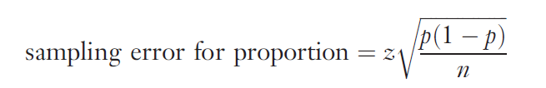
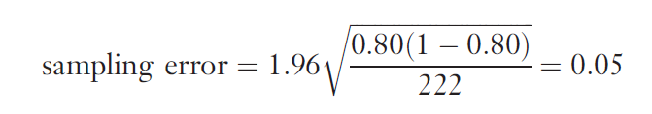
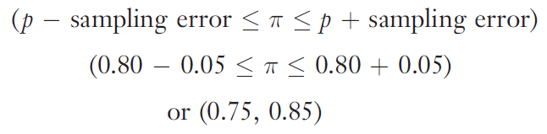
Question: What percentage of AFC members are women? (3 of 3)
Therefore, we would be 95% confident that the proportion of women in the AFC population lies between .75 and .85, inclusive.

Slide 25
CAUTION in Interpreting Confidence Intervals
The confidence interval only takes sampling error into account.
It DOES NOT account for other common types of error (e.g., response error, nonresponse error).
The goal is to reduce TOTAL error, not just one type of error.

Slide 26
Basic Univariate Statistics: (1 of 3)
DESCRIPTIVE STATISTICS
Statistics that describe the distribution of responses on a variable. The most commonly used descriptive statistics are the mean and standard deviation.

Slide 27
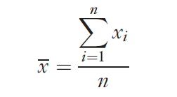
Basic Univariate Statistics: (2 of 3)
SAMPLE MEAN
The arithmetic average value of the responses on a variable.

Slide 28
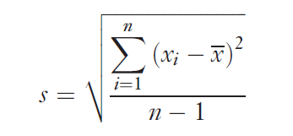
Basic Univariate Statistics: (3 of 3)
SAMPLE STANDARD DEVIATION
A measure of the variation of responses on a variable. The standard deviation is the square root of the calculated variance on a variable.

Slide 29
Why worry about the Sample Standard Deviation?
Case--the New Sauce Product:
The mean score on a measure of how hot consumers preferred a new sauce to be suggested that they wanted it moderately hot. Unfortunately, most consumers either wanted it mild or hot, with relatively little demand for a moderate sauce.

Slide 30

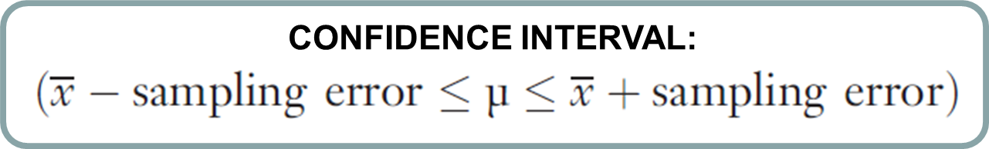
Confidence Intervals for Means (Continuous Measures)
where z = z score associated with the desired level of confidence; s = the sample standard deviation; and n = the total number of cases used to calculate the mean.

Slide 31
Question: How many times per month do AFC members visit the center? (1 of 2)
Solution: Compute the 95% confidence interval based on the mean number of visits to the Center reported by sample respondents.
Based on the responses of 198 AFC members, we learn that the mean number of trips was 10.0, with a standard deviation of 7.3

Slide 32
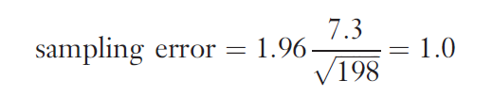
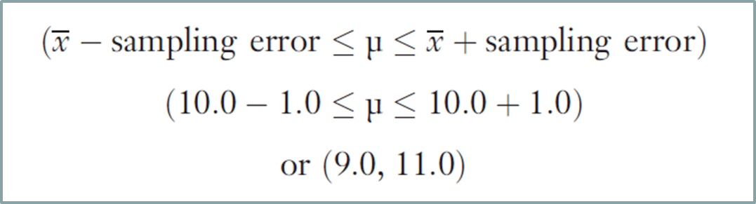
Question: How many times per month do AFC members visit the center? (2 of 2)
Therefore, we would be 95% confident that the mean number of trips per month in the AFC population lies between 9 and 11, inclusive.

Slide 33
Converting Continuous Measures to Categorical Measures
Sometimes it is useful to convert continuous measures to categorical measures.
This is legitimate because measures at higher levels of measurement (in this case, continuous measures) have all the properties of measures at lower levels of measurement (categorical measures).
Why do this? Ease of interpretation

Slide 34
Common Approaches (1 of 10)
COMMON APPROACHES
judgment
median split
cumulative % breakdowns
two-box technique

Slide 35
Common Approaches (2 of 10)
MEDIAN SPLIT
A technique for converting a continuous measure into a categorical measure with two approximately equal-sized groups. The groups are formed by “splitting” the continuous measure at its median value.

Slide 36

Common Approaches (3 of 10)
The MEDIAN level of education is found by identifying the level that contains the 50th percentile in the frequency distribution.
Exhibit 17.2 Avery Fitness Center: Level of Education
LEVEL OF EDUCATION ACHIEVED | NUMBER | VALID PERCENT | CUMULATIVE PERCENT
Less than high school | 4 | 2% | 2%
High school degree | 34 | 15% | 17%
Some college | 46 | 20% | 37%
Associate’s degree | 7 | 3% | 40%
Four-year college degree | 52 | 23% | 64%
Advanced degree | 62 | 36% | 100%
Total | 225 | 100%

Slide 37
Common Approaches (4 of 10)
Using a median split will result in two education groups, a lower education group (64%; less than high school, high school degree, some college, associate’s degree, four-year college degree) and a higher education group (36%; advanced degree).
An alternative approach that would produce a more even split of AFC respondents would be to combine those with a four-year or advanced degree as the higher education group.

Slide 38
Common Approaches (5 of 10)
CUMULATIVE PERCENTAGE BREAKDOWN
A technique for converting a continuous measure into a categorical measure. The categories are formed based on the cumulative percentages obtained in a frequency analysis.

Slide 39
Common Approaches (6 of 10)
If we wanted three approximately equal-sized education groups instead of six, we could use the cumulative percentage breakdown to construct the groups.

Slide 40
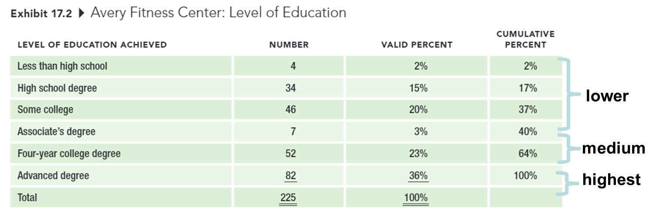
Common Approaches (7 of 10)

Slide 41
Common Approaches (8 of 10)
TWO-BOX TECHNIQUE
A technique for converting an interval-level rating scale into a categorical measure, usually used for presentation purposes. The percentage of respondents choosing one of the top two positions on a rating scale is reported.

Slide 42
Common Approaches (9 of 10)
Exhibit 17.6 Avery Fitness Center: Reasons for Participation “How important to you personally is each of the following reasons for participating in AFC programs?”
Number (Percentage) of Respondents Selecting Each Response Category
 | NOT AT ALL IMPORTANT |  |  |  | VERY IMPORTANT
General health and fitness | 5 (2) | 2 (1) | 4 (2) | 26 (11) | 192 (84)
Social aspects | 27 (13) | 34 (17) | 59 (29) | 48 (24) | 35 (17)
Physical enjoyment | 8 (4) | 10 (5) | 43 (21) | 67 (33) | 74 (37)
Specific medical concerns | 17 (8) | 8 (4) | 22 (11) | 62 (30) | 100 (48)

Slide 43
Common Approaches (10 of 10)
Exhibit 17.7 Avery Fitness Center: Two-Box Results, With Descriptive Statistics
 | TWO-BOX | MEAN | (S.D.) | N
General health and fitness | 95% | 4.7 | (0.7) | 229
Social aspects | 41% | 3.2 | (1.3) | 203
Physical enjoyment | 70% | 3.9 | (1.1) | 202
Specific medical concerns | 78% | 4.1 | (1.2) | 209

Slide 44
Hypothesis Testing (1 of 4)
THE ISSUE: How can we tell if a particular result in the sample represents the true situation in the population… or simply occurred by chance?

Slide 45
Hypothesis Testing (2 of 4)
HYPOTHESIS
Unproven propositions about some phenomenon of interest.
NULL HYPOTHOSIS: The hypothesis that a proposed result is not true for the population.
ALTERNATIVE HYPOTHESIS: The hypothesis that a proposed result is true for the population.

Slide 46
Hypothesis Testing (3 of 4)
SIGNIFICANCE LEVEL (α)
The acceptable level of error selected by the researcher, usually set at 0.05. The level of error refers to the probability of rejecting the null hypothesis when it is actually true for the population.

Slide 47
Hypothesis Testing (4 of 4)
p-VALUE
The probability of obtaining a given result if in fact the null hypothesis were true in the population. A result is regarded as statistically significant if the p-value is less than the chosen significance level of the test.

Slide 48

Common Misinterpretations of What “Statistically Significant” Means (1 of 3)
Viewing p-values as if they represent the probability that the results occurred because of sampling error (e.g., p = .05 implies that there is only a .05 probability that the results were caused by chance).

Slide 49
Common Misinterpretations of What “Statistically Significant” Means (2 of 3)
Assuming that statistical significance is the same thing as managerial significance.

Slide 50
Common Misinterpretations of What “Statistically Significant” Means (3 of 3)
Viewing the α or p levels as if they are somehow related to the probability that the research hypothesis is true (e.g., a p-value such as p>.001 is “highly significant” and therefore more valid than p<.05).

Slide 51
Testing Hypotheses about Individual Variables (1 of 3)
Categorical Variables
CHI-SQUARE GOODNESS-OF-FIT TEST
A statistical test to determine whether some observed pattern of frequencies corresponds to an expected pattern.

Slide 52
Testing Hypotheses about Individual Variables (2 of 3)
Exhibit 17.8 AFC Customer Education Level Versus Education Level in Trade Area
LEVEL OF EDUCATION ACHIEVED | AFC NUMBER | AFC VALID PERCENT | TRADE AREA NUMBER | TRADE AREA VALID PERCENT
Less than high school | 4 | 2% | 147 | 10%
High school degree | 34 | 15% | 294 | 20%
Some college | 46 | 20% | 412 | 28%
Associate’s degree | 7 | 3% | 59 | 4%
Four-year college degree | 52 | 23% | 368 | 25%
Advanced degree | 82 | 36% | 191 | 13%
Total | 225 | 100% | 1,471 | 100%
(Χ² = 118.38, 5 d.f., p < .001)

Slide 53
Testing Hypotheses about Individual Variables (3 of 3)
Continuous Variables
A one-sample t-test can be used to compare a sample mean against an external standard. The analysis is easy to implement in a standard statistical software analysis package.

