Slide 1
Chapter 18: Analysis and Interpretation Multiple Variables Simultaneously
© 2018 Cengage Learning. All Rights Reserved.

Slide 2
Learning Objectives (1 of 3)
Discuss why a researcher might conduct a multivariate analysis.
Explain the purpose and importance of cross tabulation.
Describe a technique for comparing groups on a continuous dependent variable.

Slide 3
Learning Objectives (2 of 3)
Explain the difference between an independent sample t-test for means and a paired sample t-test for means.
Discuss the Pearson product-moment correlation coefficient.

Slide 4
Learning Objectives (3 of 3)
Describe a technique for examining the influence of one or more predictor variables on an outcome variable.

Slide 5
Why Use Multivariate Analysis?
Multivariate analyses allow researchers a closer look at their data than is possible with univariate analyses.

Slide 6
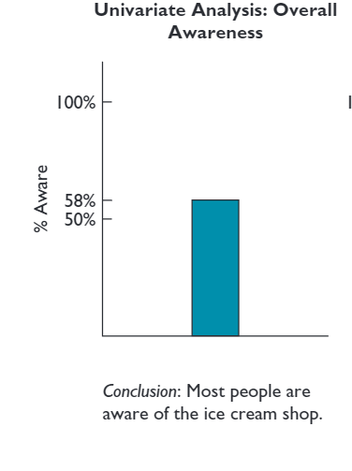
A Univariate Analysis Result

Slide 7
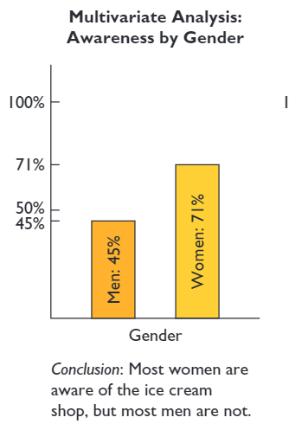
Multivariate Analysis Results: Enhanced Meaning (1 of 2)

Slide 8
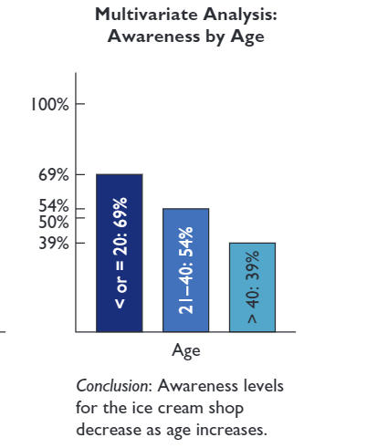
Multivariate Analysis Results: Enhanced Meaning (2 of 2)

Slide 9
Cross Tabulation
CROSS TABULATION
A multivariate technique used for studying the relationship between two or more categorical variables. The technique considers the joint distribution of sample elements across variables.

Slide 10

Back to the AFC Project… (1 of 5)
QUESTION: Does being referred by a doctor to AFC lead to greater usage of the therapy pool?

Slide 11
Back to the AFC Project… (2 of 5)
Two Categorical Variables:
Doctor referral (yes, no)
Pool Usage (yes, no)
In this situation, doctor referral would be considered the independent, or causal, variable, and pool usage would be considered the dependent, or outcome, variable.
This is an ideal situation for cross tabulation analysis

Slide 12
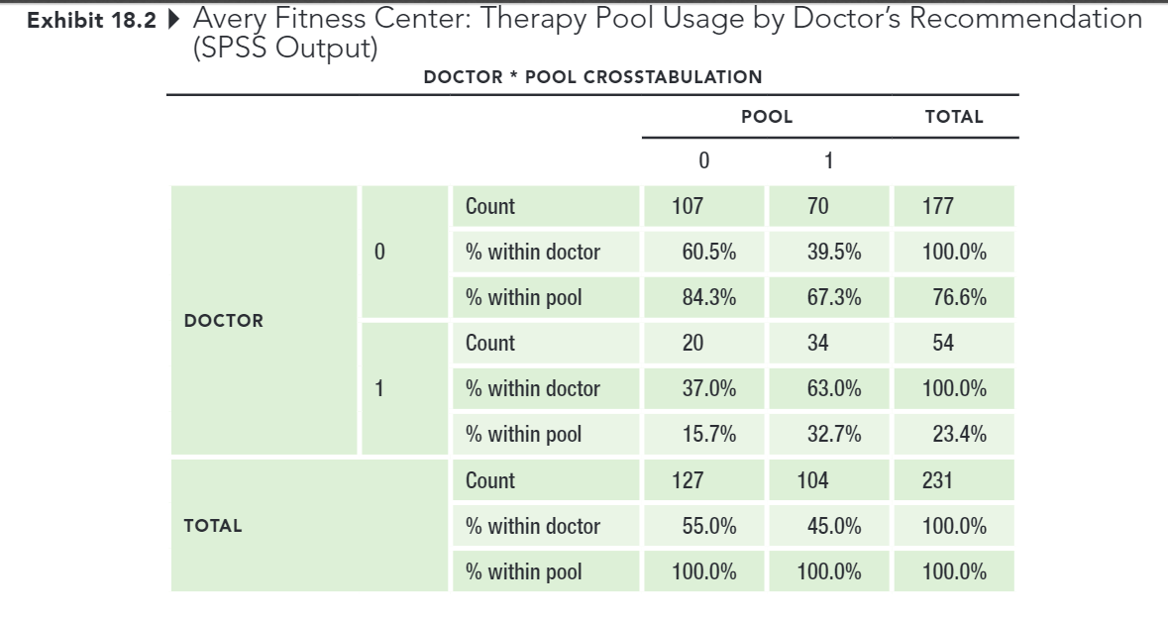
Back to the AFC Project… (3 of 5)
RAW SPSS OUTPUT

Slide 13
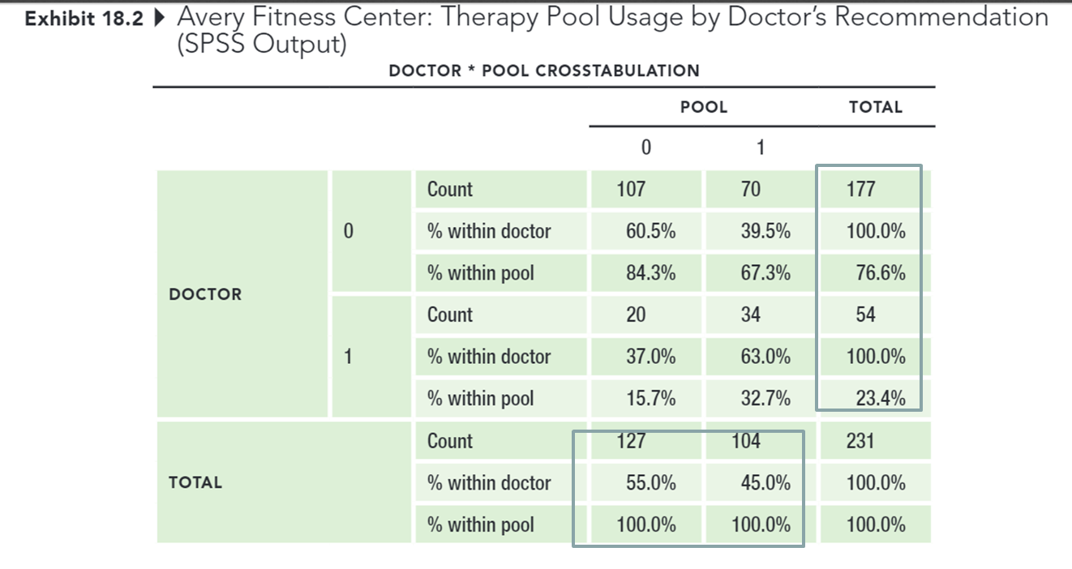
Back to the AFC Project… (4 of 5)
MARGINAL TOTALS

Slide 14
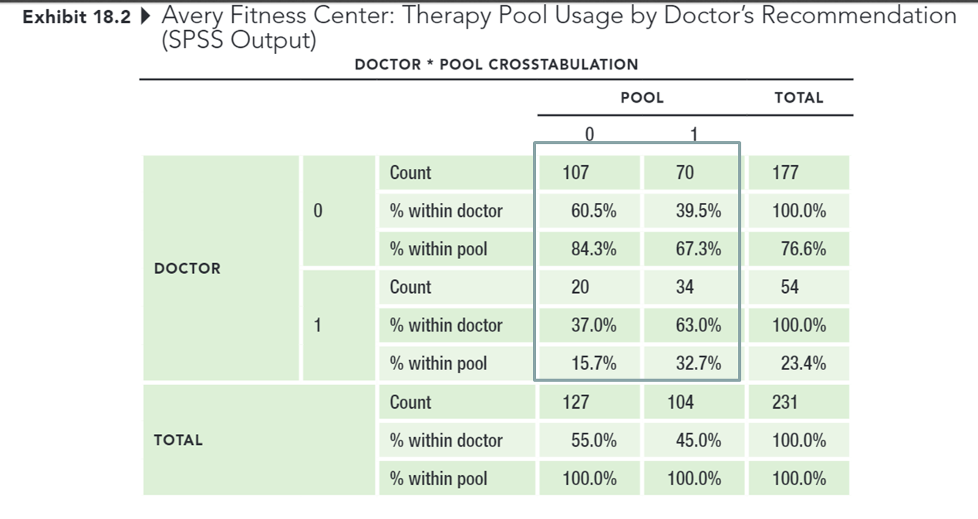
Back to the AFC Project… (5 of 5)
CELLS

Slide 15
“Which Percentages Should I Use?”
Always calculate percentages in the direction of the causal variable.
Hint:
Which variable might have caused the other to occur?

Slide 16
Presenting the Results (1 of 3)
Doctor Recommendation?
Utilized Therapy Pool?
 | No | Yes | total
No | 107 (61%) | 70 (40%) | 177
Yes | 20 (37%) | 34 (63%) | 54
total | 127 | 104 | 231

Slide 17
Presenting the Results (2 of 3)
BANNER
A series of cross tabulations between an outcome, or dependent variable, and several (sometimes many) explanatory variables in a single table.

Slide 18
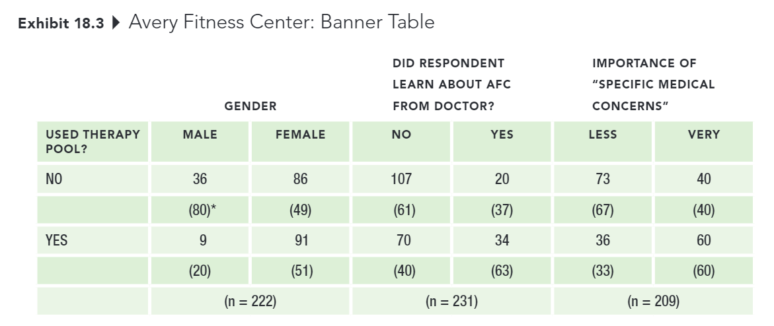
Presenting the Results (3 of 3)

Slide 19
Cross-tabs: Testing for Statistical Significance (1 of 16)
PEARSON CHI-SQUARE (χ²) TEST OF INDEPENDENCE
A commonly used statistic for testing the null hypothesis that categorical variables are independent of one another.

Slide 20
Cross-tabs: Testing for Statistical Significance (2 of 16)
INDEPENDENT SAMPLES T-TEST FOR MEANS
A technique commonly used to determine whether two groups differ on some characteristic assessed on a continuous measure.
EXAMPLES
Satisfaction ratings, men vs. women
Age in years, customers vs. noncustomers

Slide 21
Cross-tabs: Testing for Statistical Significance (3 of 16)
Does utilizing the exercise circuit (categorical independent variable) lead to increased number of visits to the center (continuous dependent variable)?

Slide 22
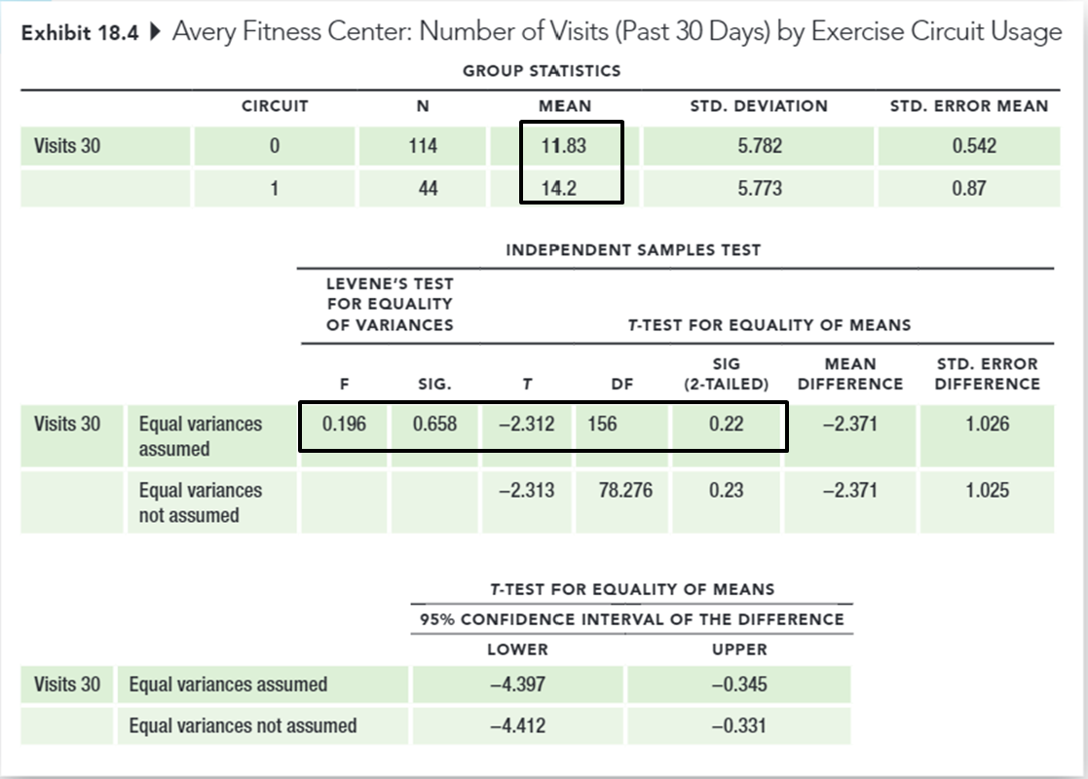
Cross-tabs: Testing for Statistical Significance (4 of 16)

Slide 23
Cross-tabs: Testing for Statistical Significance (5 of 16)
PAIRED SAMPLE T-TEST
A technique for comparing two means when scores for both variables are provided by the same sample.
EXAMPLES
Before and after measures
Applying same measure to different objects

Slide 24
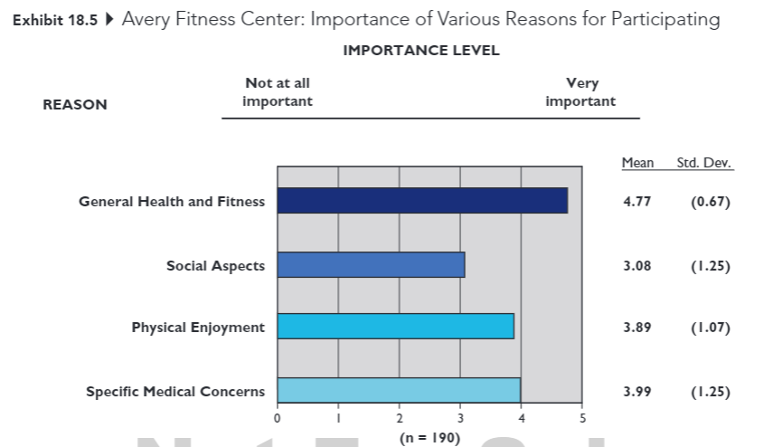
Cross-tabs: Testing for Statistical Significance (6 of 16)

Slide 25
Cross-tabs: Testing for Statistical Significance (7 of 16)
Do the mean attribute importance levels, provided by the same respondents, differ from one another?

Slide 26
Cross-tabs: Testing for Statistical Significance (8 of 16)
Exhibit 18.6 Avery Fitness Center: Paired Sample t-Tests (SPSS Output)
PAIRED SAMPLES STATISTICS
 |  | MEAN | N | STD. DEVIATION | STD. ERROR MEAN
PAIR 1 | social fitness | 3.08 4.77 | 190 190 | 1.253 0.672 | 0.091 0.049
PAIR 2 | social enjoy | 3.08 3.89 | 190 190 | 1.253 1.074 | 0.091 0.078
PAIR 3 | social medical | 3.08 3.99 | 190 190 | 1.253 1.249 | 0.091 0.091

Slide 27
Cross-tabs: Testing for Statistical Significance (9 of 16)
PEARSON PRODUCT-MOMENT CORRELATION COEFFICIENT
A statistic that indicates the degree of linear association between two continuous variables. The correlation coefficient can range from −1 to +1.

Slide 28
Cross-tabs: Testing for Statistical Significance (10 of 16)
Is there a correlation between age (continuous independent variable) and fees paid (continuous dependent variable)?

Slide 29
Cross-tabs: Testing for Statistical Significance (11 of 16)
Exhibit 18.7 Avery Fitness Center: Correlation Between Age and Revenues (SPSS Output)
CORRELATIONS
 |  | AGE | REVENUE
AGE | Pearson Correlation Sig. (2-tailed) N | 1 224 | 0.246** 0.000 224
REVENUE | Pearson Correlation Sig. (2-tailed) N | 0.246** 0.000 224 | 1 231
** Correlation is significant at the 0.01 level (2-tailed).

Slide 30
Cross-tabs: Testing for Statistical Significance (12 of 16)
Ice cream purchases and murder rates are positively correlated.
Thankfully, correlation is not the same thing as causation.

Slide 31
Cross-tabs: Testing for Statistical Significance (13 of 16)
REGRESSION ANALYSIS
A statistical technique used to derive an equation representing the influence of a single (simple regression) or multiple (multiple regression) independent variables on a continuous dependent, or outcome, variable.

Slide 32
Cross-tabs: Testing for Statistical Significance (14 of 16)
QUESTION: What are some of the factors that drive revenues at AFC?
Regress revenues on (1) member age and the importance of (2) general health and fitness, (3) social aspects, (4) physical enjoyment, and (5) specific medical concerns as reasons for visiting AFC.

Slide 33
Cross-tabs: Testing for Statistical Significance (15 of 16)
COEFFICIENT OF MULTIPLE DETERMINATION (R²)
A measure representing the relative proportion of the total variation in the dependent variable that can be explained or accounted for by the fitted regression equation. When there is only one predictor variable, this value is referred to as the coefficient of determination.

Slide 34
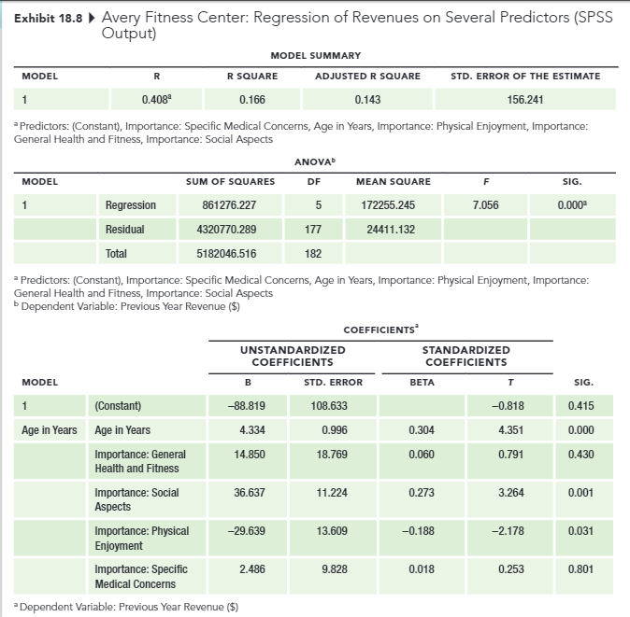
Cross-tabs: Testing for Statistical Significance (16 of 16)

Slide 35
Key Steps in Interpreting Multiple Regression Results (1 of 2)
Step 1. Does the set of predictors explain a statistically significant portion of variation in the dependent variable? (look at the ANOVA table results)
Step 2. How much of the variation in the dependent variable does our set of predictors explain? (look at the coefficient of multiple determination)
Step 3. Which of the individual predictors explain variation in the dependent variable, and what is the direction of the relationship (positive or negative)? (look at the t-values and p-values of the individual predictors)

Slide 36
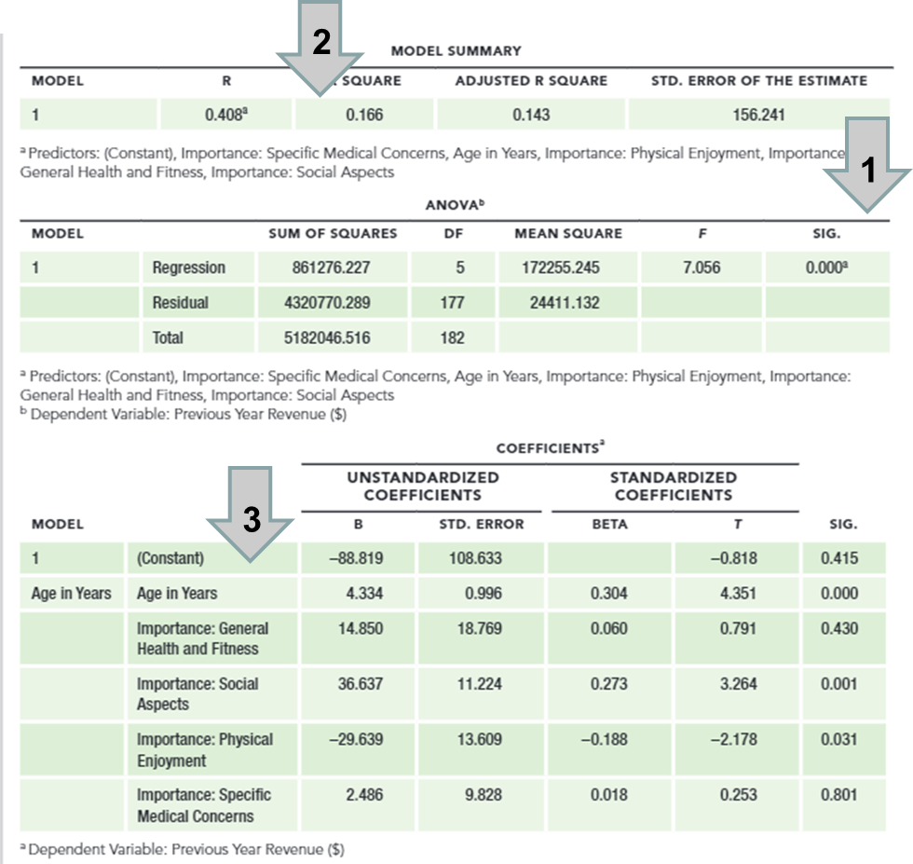
Key Steps in Interpreting Multiple Regression Results (2 of 2)

