Slide 1
Chapter 19: The Oral Research Presentation
© 2018 Cengage Learning. All Rights Reserved.

Slide 2
Learning Objectives (1 of 2)
Discuss two fundamental rules for making good oral presentations.
Explain how the time allotted for an oral presentation should be organized.

Slide 3
Learning Objectives (2 of 2)
List some of the different kinds of charts that can be used in presenting study results.

Slide 4

The Oral Report
The goal is to communicate to the audience at hand.
A quality presentation can disguise poor research, but quality research cannot improve a poor presentation.

Slide 5
OPEN UP!
THE EXCEPTIONAL PRESENTER IS:
Organized
Passionate
Engaging
Natural
Understand Your Audience
Practice
AS AN EXCEPTIONAL PRESENTER, YOU MUST:

Slide 6
Preparing the Oral Report
Duration: 1/3-1/2 allotted time for formal presentation
Remainder for question-and-answer interaction
Structure: General Purpose
Research Problems
Evidence
Conclusions
General Purpose
Research Problems
Conclusions
Evidence
or
Content: Definitions and Bulleted List--Show what
Maps--Show where
Diagrams--Show how
Tables and Figures--Show how much
Tools: PowerPoint
Keynote
Prezi

Slide 7
Ten Tips for Preparing Effective Presentation Slides (1 of 3)
Keep them simple
Use lots of slides as you talk
Aim for one minute per slide
Highlight and emphasize significant points

Slide 8
Ten Tips for Preparing Effective Presentation Slides (2 of 3)
Make the slides easy to read
Be careful with the use of color
Be careful with the use of slide backgrounds
Build complex thoughts sequentially

Slide 9
Ten Tips for Preparing Effective Presentation Slides (3 of 3)
Prepare copies of slides
Number the slides or pages in the handout

Slide 10
Preparing Effective Presentation Slides (1 of 2)
Nervous about giving a presentation? Here’s the secret…
TWO FUNDAMENTAL RULES
Know your stuff.
Know your audience.

Slide 11
Preparing Effective Presentation Slides (2 of 2)
ALWAYS do a practice run to make certain that the technology is working correctly.

Slide 12
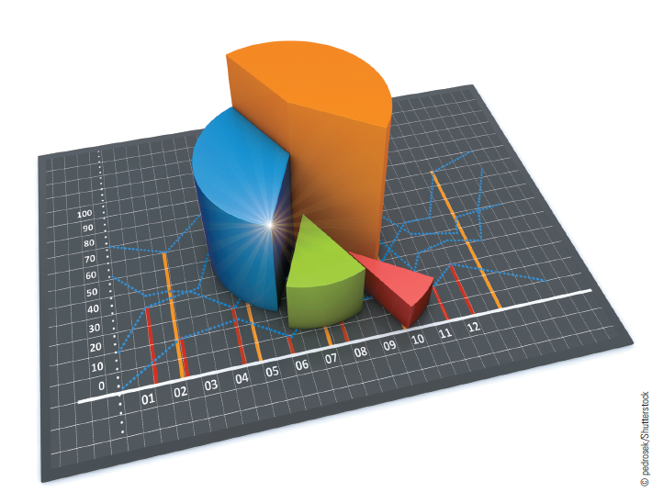
Graphic Presentation of Results (1 of 3)
A picture can be worth a thousand words when it is appropriate to the presentation and well designed.

Slide 13
Graphic Presentation of Results (2 of 3)
Exhibit 19.3 Personal Consumption Expenditures for a Recent 12-Year Period (Billions of Dollars)
YEAR | TOTAL PERSONAL CONSUMPTION EXPENDITURES | DURABLE GOODS | NONDURABLE GOODS | SERVICES
Year 1 | $3,659.3 | $480.3 | $1,193.7 | $1,983.3
Year 2 | 3,887.7 | 446.1 | 1,251.5 | 2,190.1
Year 3 | 4,095.8 | 480.4 | 1,290.7 | 2,324.7
Year 4 | 4,378.2 | 538.0 | 1,339.2 | 2,501.0
Year 5 | 4,628.4 | 591.5 | 1,394.3 | 2,642.7
Year 6 | 4,957.7 | 608.5 | 1,475.8 | 2,873.4
Year 7 | 5,207.6 | 634.5 | 1,534.7 | 3,038.4
Year 8 | 5,433.7 | 657.4 | 1,619.9 | 3,156.7
Year 9 | 5,856.0 | 693.2 | 1,708.5 | 3,454.3
Year 10 | 6,246.5 | 755.9 | 1,830.1 | 3,660.5
Year 11 | 6,683.7 | 803.9 | 1,972.9 | 3,906.9
Year 12 | 6,987.0 | 835.9 | 2,041.3 | 4,109.9

Slide 14
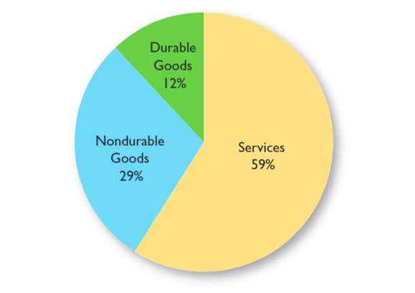
Graphic Presentation of Results (3 of 3)
Pie Chart

Slide 15
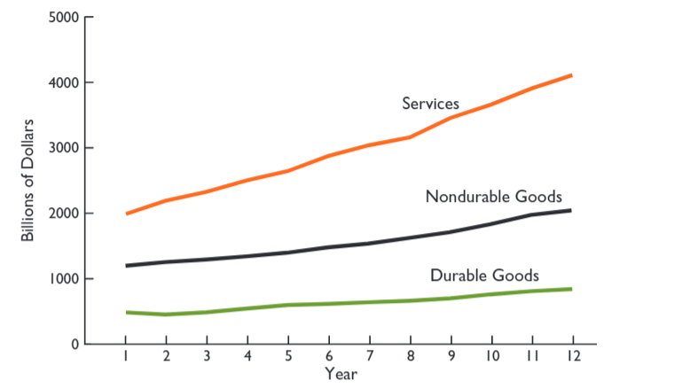
Line Chart

Slide 16
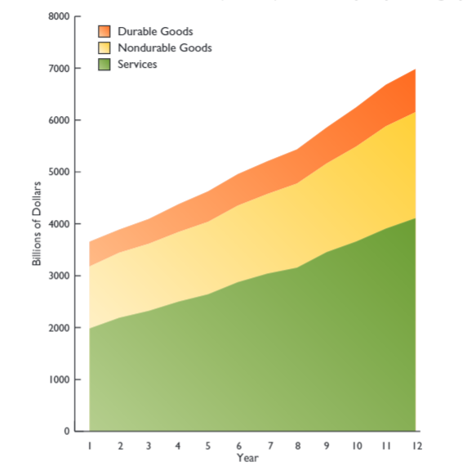
Stratum Chart

Slide 17
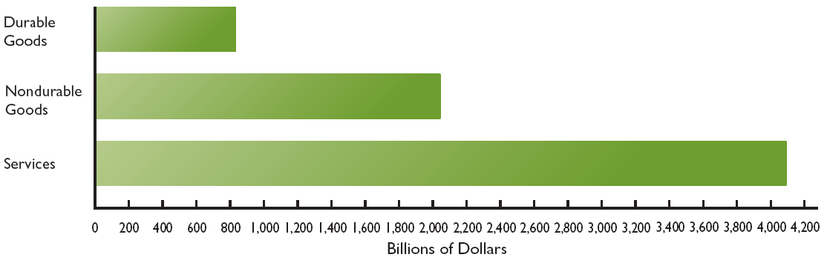
Bar Chart

Slide 18
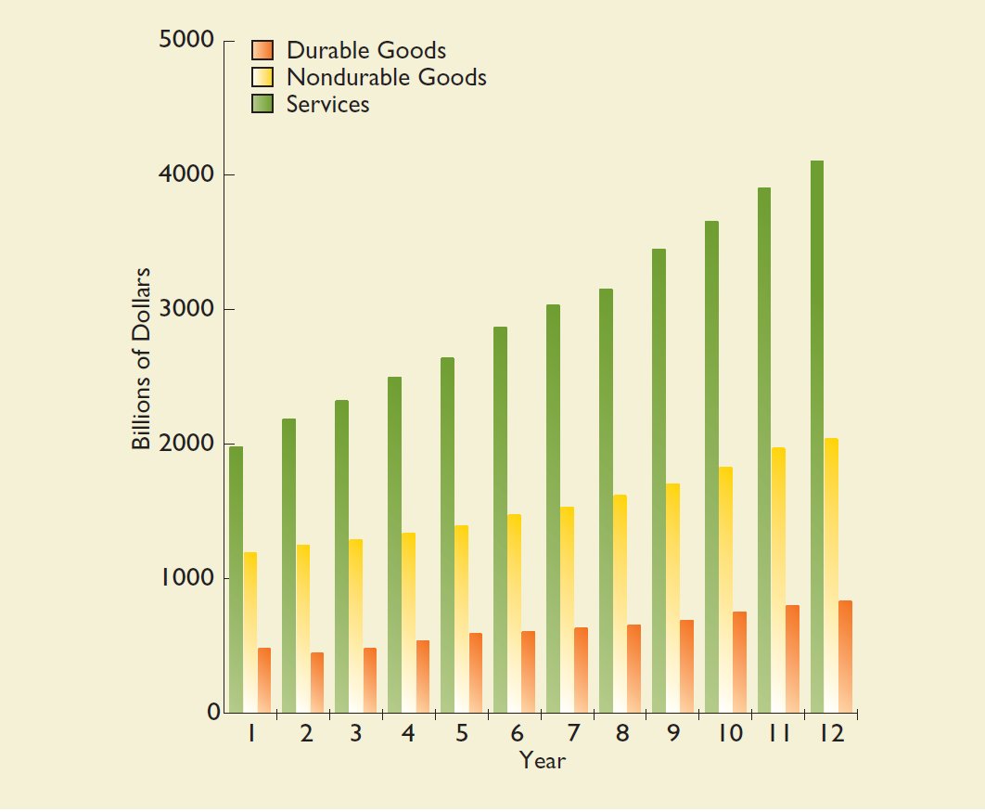
Grouped-Bar Chart

Slide 19
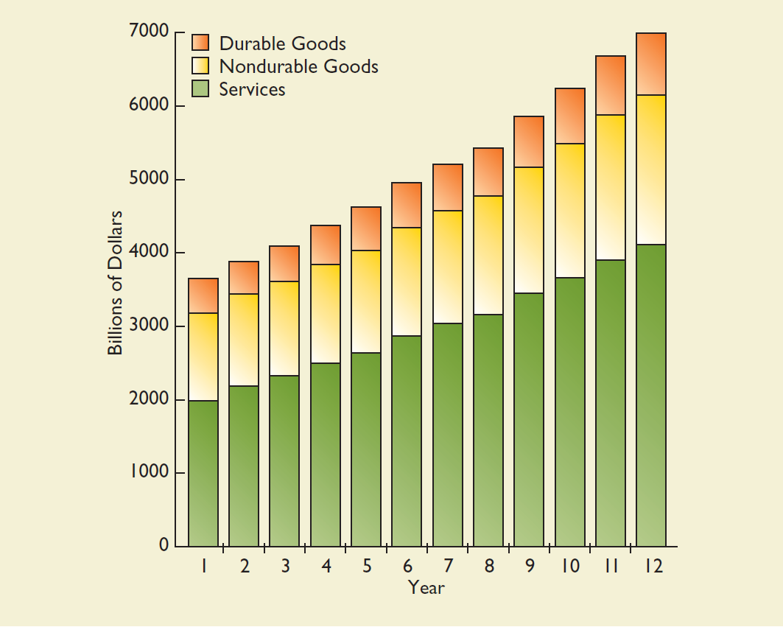
Stacked-Bar Chart

Slide 20
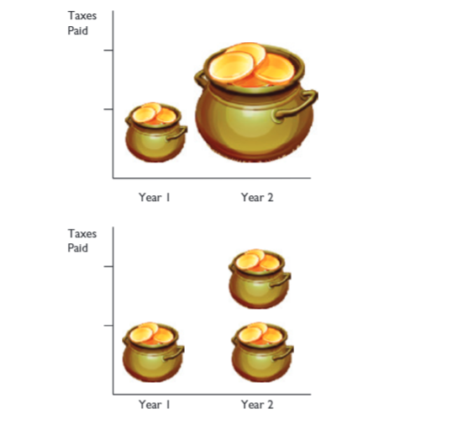
Pictograms

