Slide 1
Happy Monday
Name tag
Check-in
Notes:
Get some candies

Slide 2

iClicker Question
The null hypothesis of the F-test for 2 variances is
Two samples’ variances are equal
Two samples’ variances are not equal
One sample’s variance is less than the other’s variance
All of the above

Slide 3
iClicker Question
Why do we need to care about the F-test before implementing the 2-sample independent t-test?
Because we want to make sure the two variables’ variances are similar
Because we want to make sure the shape of the two distributions (of the two variables) are similar
Both A and B

Slide 4
iClicker Question
The null hypothesis of the 2-sample independent t-test is
The two variables’ means are equal
The two variables’ means are NOT equal

Slide 5
Case 7 (Last Case) - Homecare of America (confidence intervals)
A. Homecare of America is a franchise operation that provides house minders for people when they are out of town. Their services include feeding pets, bringing in newspapers and mail, and generally keeping an eye on things while the homeowner is gone. They gradually expanded their operations to additional cities.
When determining whether to enter a particular market, the company conducts a survey in that market to find out how many days per year homeowners are out of town. In Scranton, Pennsylvania, a survey of 538 homeowners found that homeowners are out of town, on average, 16.7 days, with a standard deviation of 8.6 days.
What is the true mean number of days out of town among homeowners in this area? You want to be 99% confident of your results.
B. In their surveys, the company also describes their house minding services and measures respondents' intentions to use this service if the company expands to their area. In the survey of Scranton, 6.2% of the people surveyed said they would be likely to use the service. What is the likely utilization rate for this service among the population of homeowners in Scranton? You want to be 95% confident of your results. Carry your work out to 4 decimal places.
Notes:
DISCUSSION CASE #7 Be prepared to show your work on the whiteboard in class and to explain what the answers mean?
Hint:
For percentage, : $p±t_{critical} ∗SE$
Standard error = $√(p∗q/n)$ where p = 1- q
For mean, : $\overline{x}±t_{\left\{critical\right\}} ∗SE$
Standard error = $\frac{SD}{√n}$

Slide 6




Correlation

Slide 7
Research Question Reminder
Descriptive RQ
Difference RQ
Association RQ: Correlation
Notes:
We have already covered descriptive RQ, in which we do some descriptive analyses regarding a variable.
It can be categorical or continuous
Then, we also covered difference RQ, in which the difference variable has to be categorical and analysis variable is continuous
Association RQ is between 2 continuous variables.

Slide 8
Examples
Is time spent studying associated with GPA?
Is the font size for a website promotional discount associated with sales on the website?
Is the amount spent on a laptop associated with a person’s satisfaction with their laptop?
Notes:
We will go into detail for the last question

Slide 9
Scatterplot
Notes:
What do you think What type of association is this?

Slide 10
Scatterplot
Notes:
Negative association

Slide 11
Scatterplot
Notes:
What type of association is this?

Slide 12
Correlation
Range of the correlation coefficient:
correlation can range from -1.0 to +1.0
a correlation close to 0 means there is no association

Slide 13
Strength of association
Notes:
Which plot do you think has a stronger association? (Left one)

Slide 14
Nonlinear relationship
Notes:
What we’ve discussed so far is just linear relationship or linear association between satisfaction and laptop cost. But this relationship could also be non-linear
Advanced statistical procedures are required to analyze this kind of relationship

Slide 15
Interpretating Correlations
Correlation between income and fast-food consumption
r = .44
r = -.52
r = .06
Conventional scale:
> |0.8| high correlation
> |0.3|& <|0.8| moderate correlation
<|0.3| low correlation
Notes:
Interpret the first example for students

Slide 16
Interpretating Correlations
Correlation between age and number of days per year out of town
r = -.55
r = .04
r = .61
Notes:
Let students answer
I hope by now you understand how to interpret your result to answer association questions.

Slide 17

Correlation test
Example
Level of measurement for BOTH analysis variable: interval or ratio
Association RQ: Does workers’ incomes increase as their ages increase?
Questionnaire questions:
Q1: What’s your age?
Q2: What’s your income?
Notes:
Back to the project,
If your RQ is does workers’ incomes increase as their ages increase?
Then, your questionnaire questions should be what’s your age and what’s your income?

Slide 18

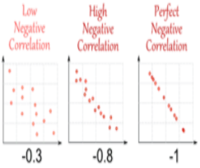
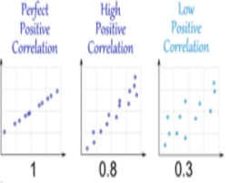
Correlation visualization
If income and age correlation coefficient is 0.8.
Conclusion: We would claim that income is highly and positively correlated with age, when age increases the income increases.
X-axis: income
Y-axis: age
Notes:
And then, after running your analysis you find that your correlation coefficient is 0.8
Your conclusion would be…
Here are some examples for correlation visualization
Notice that we do not claim that higher age causes higher income or vice versa, because correlation does not mean causation.
Does anybody remember what the other two conditions to establish causality besides correlation?
Go to Word docs (correlation)
Then go to excel to do analysis
Then to R for visualization

Slide 19
Chapter 20: The Written Research Report
Notes:
Now, we will cover chapter 20 which I’ll say less cognitively demanding

Slide 20
Learning Objectives
Discuss three writing standards that a report should meet if it is to communicate effectively with readers
Outline the main elements that make up a standard research report
Explain the kind of info contained in the executive summary
Notes:
These are overall learning objectives

Slide 21
The Written Research Report
Research reports are evaluated based on one fundamental issue: How well do they communicate with the reader?
Near-perfect research can get lost in the clutter of a poorly written report
Notes:
Written report is all about how you communicate your result with your audience. Even if you run all kinds of fancy tests, if you cannot relay the results or be able to interpret and communicate them with your boss. Then, you can appear like you did nothing right?
A near-perfect research can get lost in the clutter of a poorly written report

Slide 22
The Paradox of Completeness
Completeness: The degree to which the report provides all the info readers need in language they understand
A written report must be complete… without being too complete. The trick is to determine what really matters and what ought to be shifted to an appendix or left out entirely (caution).
Notes:
However, there is also the paradox of completeness
People who are involved in the analysis process usually want to be as complete as possible because they have done so much works that they want to show off how much work they have done. However, they can also run the risk of being too complete, that might stray their audience from the important message or takeaways.
On the other hand, people can also be deceiving that they can strategically omit stuffs, tests that did not fall into their prediction can be an example. In this case, you as a co-worker or co-researcher need to step up and encourage completeness.

Slide 23
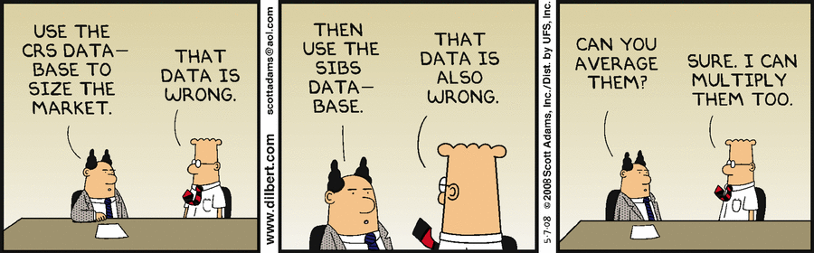
Accuracy
The degree to which the reasoning in the report is logical and the information correct
This Photo by Unknown Author is licensed under CC BY-SA
Notes:
You just don’t want to be deceiving or report incorrect information.
If you have two wrong datasets or data analyses, it doesn’t mean after averaging them you have a correct one.

Slide 24
Examples of Inaccuracy
Inaccuracy | Example
Simple Errors in Addition or Subtraction | “In the US, 14% of the population ahs an elementary school education or less, 51% has attended or graduated form high school, and 16 has attended college.”
Confusion between percentages and Percentage Points | “The company’s profits as a percentage of sales were 6% in 1997 and 8% in 2002. Therefore, they increased only 2% in five years.”
Inaccuracy Caused by Grammatical Errors | “The reduction in the government’s price supports for diary products has reduced farm income from $600 million to $800 million per year.”
Confused Terminology Resulting in Faulty Conclusions | “The Jones’ household annual income increased from $15,000 in 1976 to $45,000 in 2006, thereby tripling the family’s purchasing power.”
Notes:
These are examples of inaccuracy
You can refer to them when you do your project report

Slide 25

Clarity
The degree to which the phrasing in the report is precise
Notes:
You also want clarity in your report. It just means you need to clearly communicate the results and the next step to your managers.
Remember the whole purpose of your research is find evidence that support an alternative as the best option to take.

Slide 26

How to Achieve Clarity
Carefully organize your report
Write in short sentences and paragraphs
Write… rewrite… and rewrite again
Shorten the report until every word has purpose
Notes:
Clarity can be achieved by

Slide 27
Written Research Report Outline
Completeness must be balanced against Clarity

Slide 28
Written Research Report Outline
Exhibit 20.2 Written Research Report Outline
Title page
Table of contents
Executive summary
Introduction
Method
Results
Research Findings
Limitations
Conclusions and recommendations
Appendices
Copies of data collection forms
Data collection forms with univariate results
Codebook
Technical appendix (if necessary)
Exhibits not included in the body (if necessary)
Data file for archival storage
Bibliography
Notes:
Here is a formal written research report outline. You can review these slides later.
However, in this class I do not need you to write pages long of report.
The example here is the report outline in your textbook. Our expected format would be similar, but with some differences
Hence, you should not consult this slide for your report, but the project report guideline
If you can open an example of final report. We can go over my expectation together
Report Guideline: https://github.com/mikenguyen13/mar4050_F21/blob/master/project_assignment/written_report/Project%20Report%20Guideline.pdf
Example: https://github.com/mikenguyen13/mar4050_F21/blob/master/project_assignment/written_report/example1%20SlideDoc%20research%20report.pdf

Slide 29
Executive Summary
Introduction
Results
Conclusions
Recommendations
Notes:
the most important part of the report
Think about what you would most want to communicate about he project if you only had 60 seconds to do so.

Slide 30
Introduction
The introduction sets up the project by providing background for the project and specifying the decision problem and research problem(s)

Slide 31
Method
This section is important – and difficult to handle well. You need to provide enough detail so that readers know how you conducted the research but not so much detail that they get lost and lose sight of the bigger story you are telling in the report.

Slide 32
Results
The results section should be organized to provide answers to the research problem(s) that motivated the project
Because no projects are perfect, be sure to include a limitation section. This often adds credibility to the overall project.
Tables and figures are encouraged IF they help communicate answers to research problems. Place them in the results section to illustrate the key findings.
All other exhibits should probably be placed in an appendix and referenced in the text as needed.

Slide 33
Conclusions and Recommendations
There should be a conclusion for each of the research problems that motivated the study
Researchers' recommendations about what to do next based on the research findings follow the conclusions

Slide 34
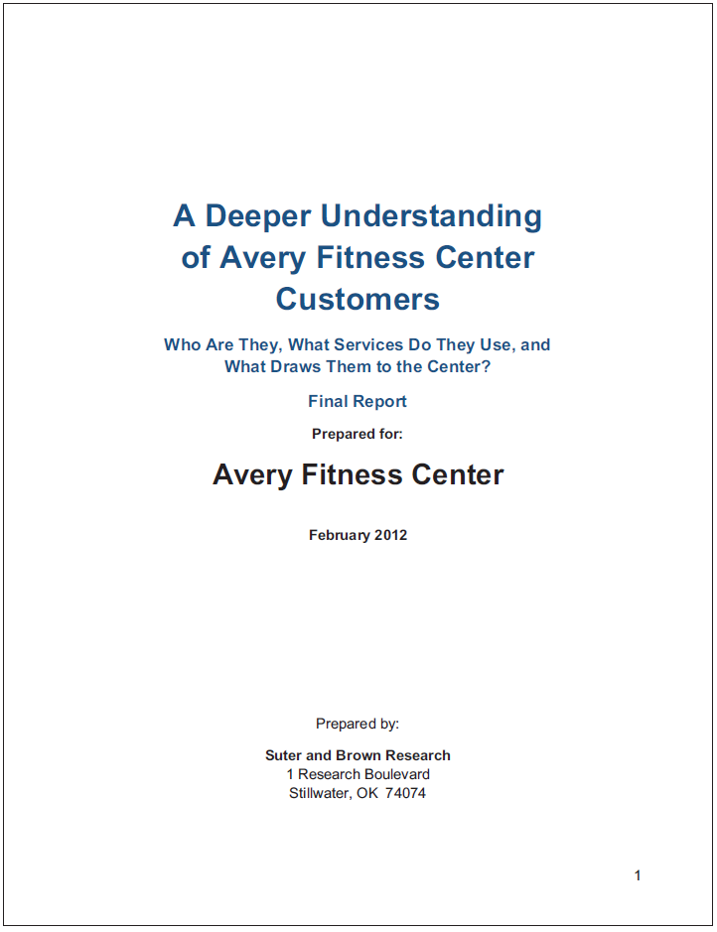
Appendices
The research report provides an archive of the project. Here are some things that should be included:
Copies of data collection forms
Univariate results and/or data tables (often placed on the data collection form)
Codebook
Technical appendix or any additional exhibits not included in results (if needed)
Data file
Bibliography

Slide 35
10-min Group Discussion
Sign-up for presentation day
Start initial data analysis
Notes:
Go over the mid-semester evaluation if have time

Slide 36
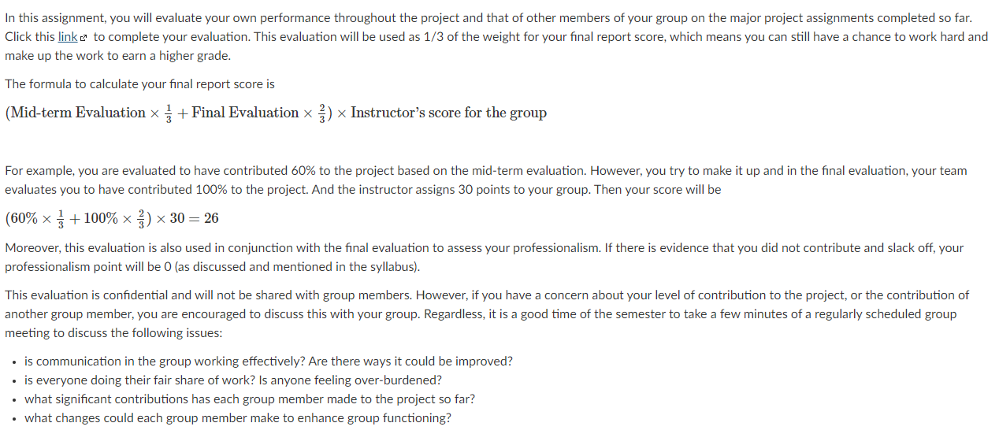
Assignment 7: Mid-semester Peer Evaluation
Notes:
Go to assignment 7

Slide 37
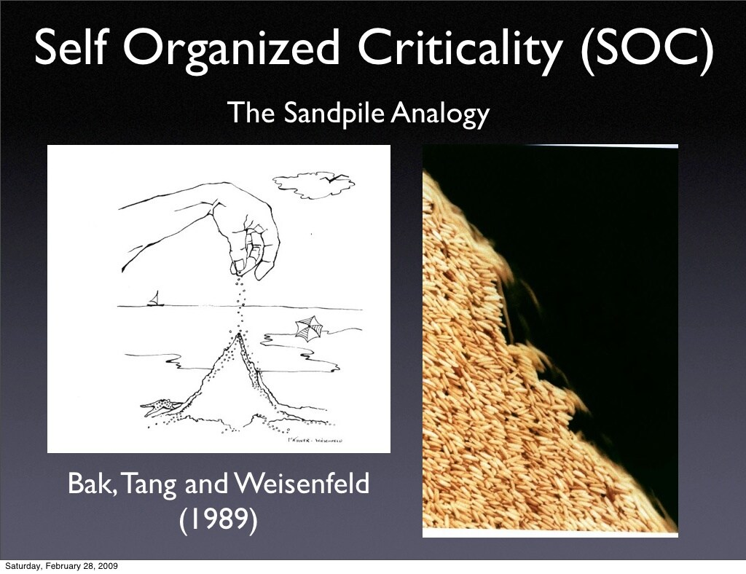
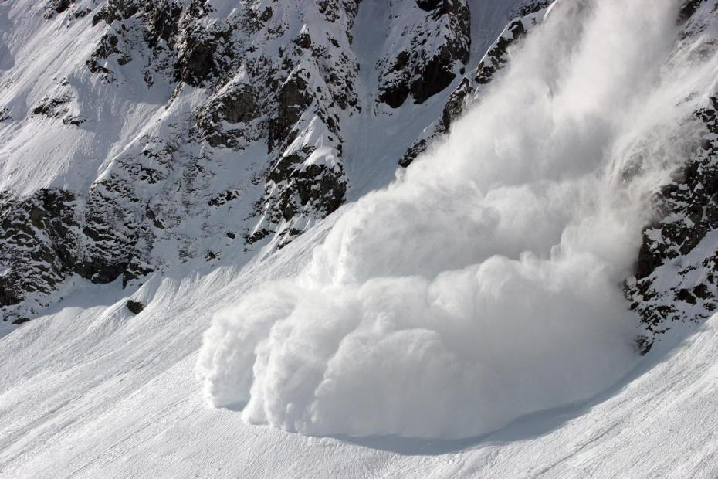
5-min Snippet – self-organized Criticality
Books
The Tipping Point
Why do most things fail?
Ubiquity
Critical Mass
Terms:
Critical point/mass
Turning/Inflection/Tipping point
Notes:
https://www.youtube.com/watch?v=hjGFp7lMi9A&ab_channel=QuantaMagazine
Example: Critical mass is the point at which a growing company becomes self-sustaining and no longer needs additional investment to remain economically viable
A Turning Point is a critical time in your life where big decisions could lead to big change, both in work and in life
This model illustrates a phenomenon known as self-organized criticality. The world is filled with sand organized in columns. Falling sand stacks on top of the sand that is already there. Eventually a column will fall over because it gets too high, and the sand will spill into the surrounding area. This is called a cascade. When a falling column causes other columns to fall, the series of cascades is called an avalanche. The size of an avalanche is the number of cascades that occur from one grain of sand falling.
The graph illustrates the relationship between the logarithm of the size of cascades and the logarithm of the frequency of their occurrence. Per Bak and others pointed out that in this model this graph would eventually become a straight line. A straight line on a log-log graph is indicative of a power law, which means that the relationship between the x and y axes is of the form y = A^Bx. The fact that this power law occurs regardless of the starting circumstances and despite the fact that the process is random is what Per Bak called self-organized criticality.

