Slide 1

Intro to Git or How to be Distributed

Slide 2

Why?
Why DVCS?
Personally
Disconnected
Branching workflow (Easy local branching/merging)
Why git?
Personally
Popularity (Purely anecdotal evidence, no hard data :)
Thriving user group (Means a lot of resources)
Collaboration with other developers
GitHub (facilitates said collaboration)
Wanted to start with a more powerful tool then move to a simpler one if need be.
Why not git?
Git has a steeper learning curve compared to other DVCS’s (from what I hear).
If you don’t like the CLI then the fact that git is mainly a CLI tool will be a downside.
There are many ways to do things (Even the same things).
Git is more powerful and thus more complicated (Depending on your viewpoint) and you may not feel its necessary.
You? I’m not experienced enough with dvcs/git yet to offer more reasons than I’ve stated above. Anyone else want to add something?

Slide 3
Classical approach:

Slide 4
Distributed approach

Slide 5
Git up close (With a remote git repo):
“Remote” branches are actually local. They are special branches that represent a local copy of a remote branch. The name of the remote branch is the remote moniker and the name of the remote branch.
“git commit -a” does not add new files.

Slide 6
Git up close (With a remote svn repo)
Use “git svn rebase” and “git svn dcommit” to sync with the remote repo.
Only rebase! Don’t merge!
http://blog.mikeobrien.net/2010/07/using-git-locally-on-windows-with.html

Slide 7

GitHub
http://github.com/
Git repository host & more!
Free public repos
Collaboration via, watching, forking and pull requests.
Wiki and issue tracking.
Gists
Lets create a repository…

Slide 8
Installing msysgit
http://code.google.com/p/msysgit/downloads/list
I’ve found the “Get Bash Here” explorer context menu to be handy; this can be installed by selecting the option in the “Select Components” installer dialog, under “Windows Explorer Integration”.
I’ve chosen not to have Git adjust the line endings as we are not doing cross platform development.

Slide 9
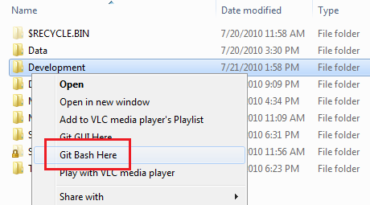
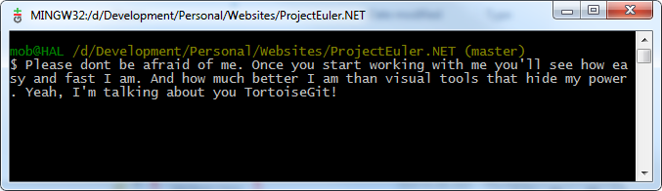
Bash shell

Slide 10
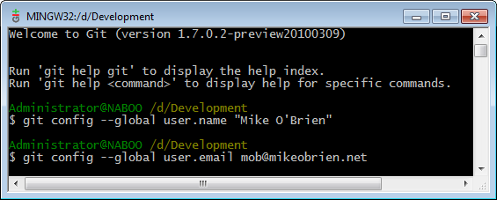
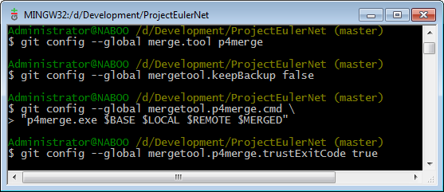
Getting started
Set your global name and email
Set your merge tool (If you don’t want VI). I use the free Perforce merge tool.

Slide 11
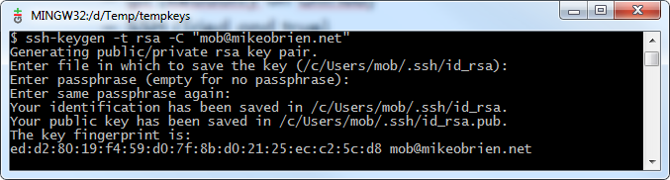
Setting up the local repository
Clone the GitHub repository we just created
Urls
https (New and improved but still buggy)
git (Readonly on GitHub)
SSH (Tried and true)
Generating a key pair (ssh-keygen -t rsa -C "mob@mikeobrien.net")
Get public key from C:\Users\<Username>\.ssh\ id_rsa.pub
Add public key to your GitHub account
Save you key pair!
As is usually the case with git, there are other ways to do this.

Slide 12
Making and pushing changes exercise
Create a .gitignore with touch
Add some content
git add .
git status
git commit -m “Commit message”
git push origin master

Slide 13
Pulling updates exercise
Create some not conflicting updates
git fetch + git rebase vs git pull –rebase <Repo> <Branch>
Resolving conflicts exercise
Make a conflicting change and commit it
git pull –rebase origin master

Slide 14
Branching Exercise
git branch
git branch -r
git checkout -b <BranchName>
Make some changes
git add .
git commit -m “Commit message”
git status
git checkout master
git rebase <BranchName>
git branch -d <BranchName>

Slide 15
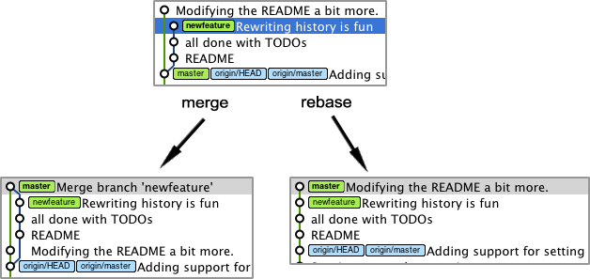
Merging vs Rebasing
Merging preserves branching history.
Rebasing flattens the history.
See here for more (Where I lifted the graphics below): http://www.gitready.com/intermediate/2009/01/31/intro-to-rebase.html
Its up to you. I’m seeing a shift towards rebasing as it leaves a cleaner history.

Slide 16
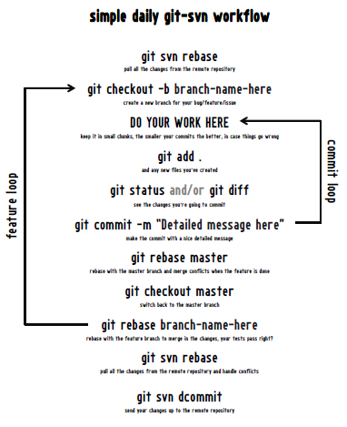
Workflow
Come up with a workflow that suits your needs.
Adapted mine from http://nakedstartup.com/2010/04/simple-daily-git-workflow/

Slide 17
The end.
Slides, code & primary sources on blog.mikeobrien.net

