Slide 1

Intro to IoC/DI/DIP/StructureMap or How to Manage Your Dependencies

Slide 2

Acronym Soup; IoC and DI and DIP…oh my!
IoC (Inversion of Control; Johnson & Foote, c ‘88)
DI (Dependency Injection; Fowler)
DIP (Dependency Inversion Principle; Uncle Bob)

Slide 3
IoC – Inversion of Control
AKA, the Hollywood Principle; Don’t call us, we’ll call you…
Broad term which covers any inversion of control not just regarding dependencies.
For example passing a λ into a method to control its flow is IoC:
public void Main()
{
GetInformation(() =>
{
Console.Write("What is your first name? ");
string first = Console.ReadLine();
Console.Write("What is your last name? ");
string last = Console.ReadLine();
return string.Format("{0} {1}", first, last);
});
}
public void GetInformation(Func<string> getName)
{
string name = getName();
Console.Write("{0}, what are your digits? ", name);
string phoneNumber = Console.ReadLine();
Console.WriteLine("{0}, your digits are {1}.", name, phoneNumber);
Console.ReadKey();
}

Slide 4
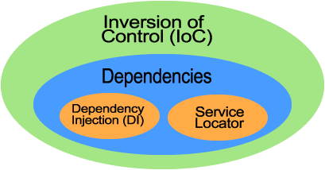
DI - Dependency Injection or how can we get more specific?
Dependency IoC is only one part of the IoC picture:
Martin Fowler tries to clear up the confusion by using the term DI or Dependency Injection to more specifically describe the activity of “IoC containers”.
Doh, “IoC containers” can also act as “Service Locators”, another form of dependency IoC … More on this later, stay tuned.

Slide 5
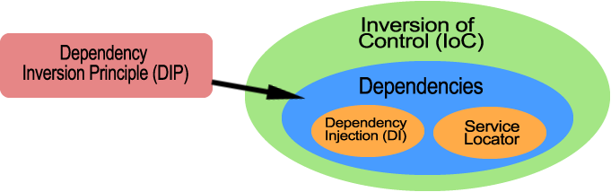
DIP - Dependency Inversion Principle or how we can be a bit less specific.
Coined by Uncle Bob Martin.
Principle components:
A. HIGH LEVEL MODULES SHOULD NOT DEPEND UPON LOWLEVEL MODULES. BOTH SHOULD DEPEND UPON ABSTRACTIONS.
B. ABSTRACTIONS SHOULD NOT DEPEND UPON DETAILS. DETAILS SHOULD DEPEND UPON ABSTRACTIONS.
Can be followed by doing DI or using a Service Locator.

Slide 6
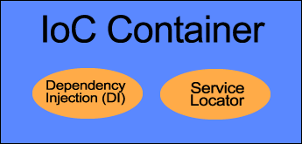
IoC Container
“IoC Container” is really a misnomer since IoC is too broad but the colloquial name stands so we’ll use it.
Also called a “DI container”. Which can also be a misnomer since they can usually act as a Service Locator.
IoC/DI Containers for .NET
StructureMap
Castle Windsor
Unity
AutoFac
Ninject
Spring.NET
And many more…

Slide 7

What is an IoC Container?
In very simple terms it’s a bucket that you can fill with things.
You can then ask it for things in the bucket and it will give them to you.

Slide 8
More specifically…
IoC Containers allow you to register types and instances of types.
These types can be mapped to interfaces if you so desire.
They can later be requested from the IoC container by the interface they are mapped to or the concrete type.
Most IoC containers can manage object lifetime.
They can also generate an entire object graph for a requested type using other types registered in the container.

Slide 9

Simple Example
Lets use a simple example to show how an IoC container can be used.
Before using an IoC container:
public class Notifications
{
public void Send(string to, string subject, string body)
{
var emailService = new NetEmailService();
emailService.Send(to, subject, body);
}
}

Slide 10
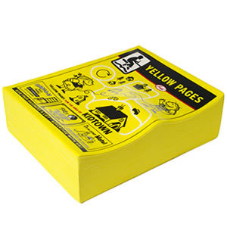

Dependency Injection vs Service Locator
With DI, dependencies are “injected” into the class.
With a Service Locator, the class looks up its dependencies in a “registry”.
VS

Slide 11
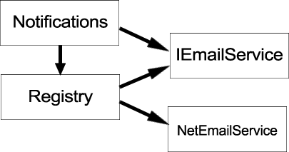
Service Locator
The “registry” or Service Locator is typically a Singleton. Used to lookup a dependency from a class. (We’re not going to focus on this)
public class Notifications
{
private IEmailService _emailService;
public Notifications()
{
_emailService = Registry.Current.Resolve<IEmailService>();
}
public void Send(string to, string subject, string body)
{
_emailService.Send(to, subject, body);
}
}

Slide 12

Dependency Injection (DI)
Dependencies are injected into the target class.
public class Program
{
public static void Run()
{
var notifications = Registry.Current.Resolve<Notifications>();
notifications.Send(...);
}
}
public class Notifications
{
private IEmailService _emailService;
public Notifications(IEmailService emailService)
{
_emailService = emailService;
}
public void Send(string to, string subject, string body)
{
_emailService.Send(to, subject, body);
}
}

Slide 13
Constructor vs Property Injection
Dependencies are injected into either a constructor on instantiation or a property after instantiation. (Constructor injection preferred)
public class Notifications
{
private IEmailService _emailService;
public Notifications(IEmailService emailService)
{
_emailService = emailService;
}
public void Send(string to, string subject, string body)
{
_emailService.Send(to, subject, body);
}
}
public class Notifications
{
private IEmailService _emailService;
public IEmailService EmailService
{ set { _emailService = value; } }
public void Send(string to, string subject, string body)
{
_emailService.Send(to, subject, body);
}
}

Slide 14

Lets experiment ya’ll!

Slide 15
Thanks!
Slides, code & primary sources on blog.mikeobrien.net

