Slide 1
Lyra

Slide 2
Lyra - Key principles
Flexibility, configurable by user
Exec reporting has to look best in class and be usable in the boardroom
Change control – real workflow
Dependencies have to be useful
AI plan generation

Slide 3
Requirements
Solution architecture:
Platform requirements:
Allow for containing client data (therefore accommodate for restrictions that apply)
Work on windows and Mac
Work on mobile (limited functionality)
Work in any jurisdiction
Be fast
Effort estimate to produce prototype
Pricing

Slide 4
Lyra - overview
Lyra is a project planning tool designed to handle maintenance of plans for single or multiple plans. It is flexible and configurable
Its key components are:
Landing page
Home page: choice between hierarchical map of users accessible projects and alphabetical list of users accessible projects
Plan maintenance: day to day running of the plan using gantt or task rows
Change control: audit log and change management: user sets threshold
Dependency management: separate workspace to decide on task relationships before publishing to the plan, all decisions being easily reversible
Reporting: flexible, configurable designed for the board room. Canned reports available for weekly/monthly status reporting
Notifications: configurable notifications can be emailed to task owners e.g. past due
first draft of plan compiled based on existing project materials e.g. SOW
APIs (Teams, planview, clarity etc): Works with teams, data can be uploaded to Planview, Clarity etc
Product management – kanban view – tag which plan tasks have a kanban associated – status to maintained across plan and gantt
Calendar view of tasks
R&I register: automatically generate risk/issue for red planning items. Status commentary needed once, at detailed task level and AI can do the aggregation for workstream/project/programme/portfolio. This is a time-consuming task for PMs and workstream leads

Slide 5
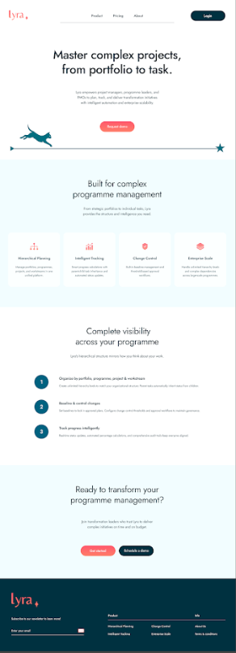
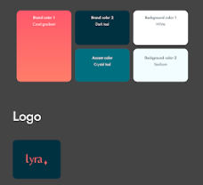
Landing page
This is the landing page to be created and this is the look and feel to be applied to entire site. These colours, font, logo

Slide 6
Plan - Task Attributes
Attribute | Default Column Order | Type | Where its Used | How its Used
Enterprise |  | Free text | All modules | Data to be available in filter lists – click on filter, expect to be able to see & search for data
Portfolio | 1 | Free text | All modules | As above
Programme | 2 | Free text | All modules | As above
Project | 3 | Free text | All modules | As above
Task name | 4 | Free text | All modules | As above
Start Date | 5 | Date: DD-MMM-YY | All modules | As above – needs to be consistent with data on plan page which is master data
Finish Date | 6 | Date: DD-MMM-YY | All modules | As above – needs to be consistent with data on plan page which is master data
Status | 7 | Choice: see below | All modules | As above – needs to be consistent with data on plan page which is master data Choices can be adjusted in settings. Parent values inherited from child values (from RAG) RAG drives gantt colour
% Complete | 8 | % | Plan calcs | Parent values inherited from child values
Milestone | - | Auto | Plan - gantt, Reporting | calculated Yes/No. If start date = Finish date, milestone = yes
All columns filterable with ms excel style filters that allow custom searches, contains etc and small filter incon.
Custom columns can be created. Values can be free text, symbols, date (calendar picker), currency, number, name (with directory look up once feeds in place), location
Must be able to edit task data from plan grid or gantt bar
Status - value options | definition | Colour – configurable but defaults are -
Red | To be replanned | Red
Amber | At risk | Amber
Green | On schedule | Green
On Hold | Paused | Grey
Not Started | Not started | white with black border
Completed | Finished | Blue

Slide 7
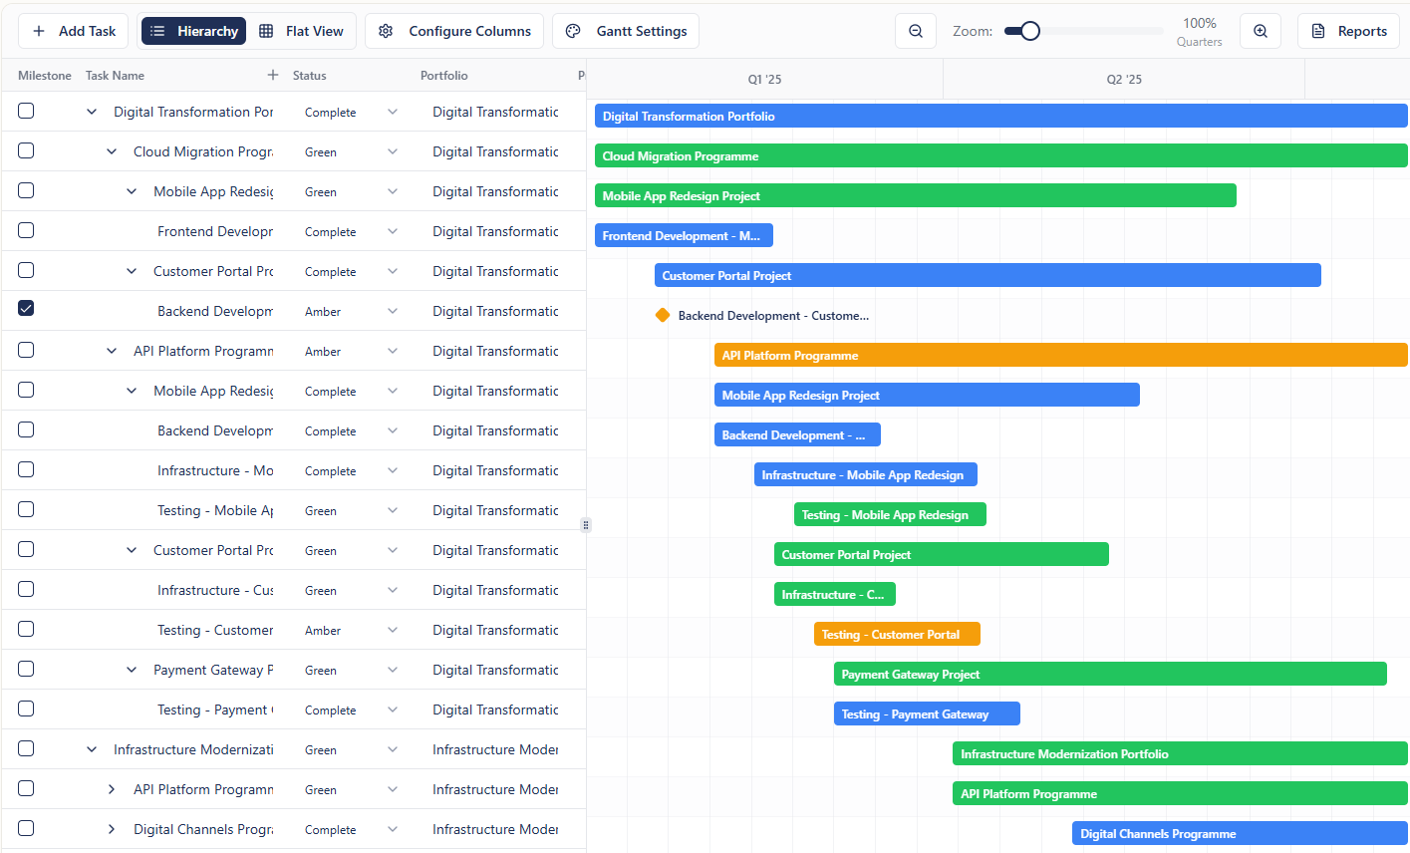
Add a slide bar “time travel” view of the project that shows the gantt and tasks and how it changed over time since the project was created
Need one horizontal and one vertical scroll bar that is always visible
Tabbing and clicking into edit data to work as it does in excel
Must be able to zoom out to 5 years and into a weekly view on the timeline

Slide 8
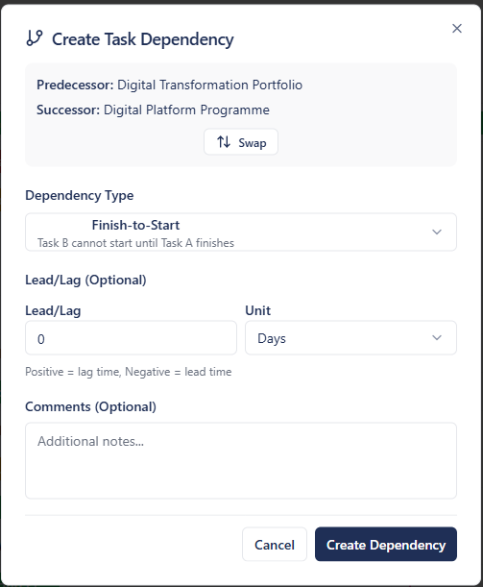
DEPENDENCIES
Add dependencies button for ability to create dependencies using a dependency dialogue box like the below. Needs a delete option at the bottom
When a dependency is created, this should create a relationship between the tasks as described. This link should also be visually clear on the plan without being complex
The dependency should be easy to remove by clicking on the visual indication and pressing delete.
A dependency screen is needed which is a separate workspace for dependencies. This will clearly highlight all the dependencies and bring them to the forefront visually while having other tasks less visually prominent
Dependencies are captured in the dependcies log, next slide and as changes in the change audit log

Slide 9
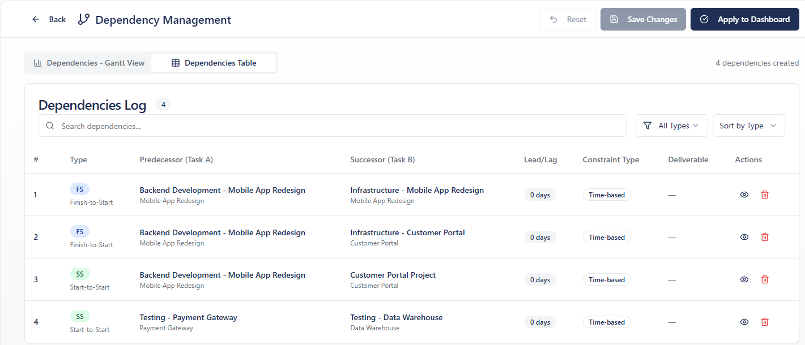

Slide 10
Plan – key principles
Tasks
Screen
Lyra operates using a hierarchical tree structure with no limit to the number of tasks or hierarchical depth. Tasks can be copied in from other sources. E.g Excel (manually) or AI generated
Tasks can be given attributes which can be displayed as columns (or hidden). These attributes are configurable and can be text, date, number, %, symbol etc.
Each task generates a corresponding gantt bar which will appear if the task has date attributes applied.
There is no limit to the number of attributes that can be applied to a task
Columns are moveable
Can add custom columns
Set up with a navigation panel, headers and 2 panels underneath
Task grid on the left panel, gantt on the right panel. User can populate either side and the other will be generated from whichever has data or is edited.
User can zoom out to 5 years or zoom in to a weekly view on the gantt
User is presented with an empty grid for an empty plan. For an in-progress plan, under any existing tasks is an empty grid ready for new tasks to be added. Tasks can be added in the following ways:
Individually typed into the grid
Dragged from the task above (all or some cells)
Copied in from other sources (powerpoint table, excel, email etc)
Tasks can then be organised into the correct hierarchical structure.

Slide 11
Baselining
Baselines can be set at the below hierarchy levels. To set a baseline, user clicks the Baseline button and is presented with a dialogue box to confirm what should be baselined.
There is no limit to the number of times a plan can be re-baselined.
Baselining is logged in the change table
Hierarchies Lyra can baseline at:
Enterprise
Portfolio
Programme
Project
Task
When set baseline is clicked, two things happen:
tasks that are within the baseline should be green. If this changes the Status of any tasks, ask the user first.
the dates of the tasks within the baseline are stored as baseline dates. These can be viewed as an attribute and/or in the baseline history

Slide 12
User clicks on drop down and gets options in 1st list below.
Hovers on selection for further options based on existing data set in plan
Baseline
Set baseline for
Choose hierarchy
Portfolio
Programme
Project
Selected tasks
Project 1
Project 2
Project 3
Project4
Set Baseline
If user has already selected tasks in the plan. If a parent is selected, the children will automatically be selected
Baseline x created
Now that we have Lyra understanding structure, it would be helpful to have the baselines numbered:
Portfolio Baseline 1, 2…n
Programme Baseline 1, 2..n
Project Baseline 1,2..n
No need to number task baselines
Baseline History
Takes user to filtered view of the change log. Baseline is a category – see slide 25

Slide 13
Reporting
Report Build
Report Editing
Report Saving
User types a title, when typing, previously saved titles appear and are also available in a drop down – not mandatory
User chooses attributes to appear on the left panel of the report. No minimum (can be zero) and no maximum although a recommendation of maximum depending on visuals (TBC, ~4). These attributes are not a filter. They are the values from the plan for the data selected for the report. (eg – programme, workstream)
User chooses filter which will define which tasks will appear in the report e.g. Project X, Status = Red, Date range = A-B
User chooses whether to display milestones or gantt bars by ticking relevant check box. This will pull either milestones fitting the above criteria or tasks depending which is ticked (or both)
User Generates report preview
Report preview is produced on screen including critical path outline and title
User can edit the gantt / milestones display using the same setting and dialogue box as in the plan screen.
User can choose ‘styles’ for reports: different headers, borders, swim-lanes.
Once editing is completed, the below options are available:
User can leave the module without saving
User can save the report (which can then be run again)
And / Or
Share the report (email, etc)
PDF, print
Export to excel, ppt and pdf must look best in class

Slide 14
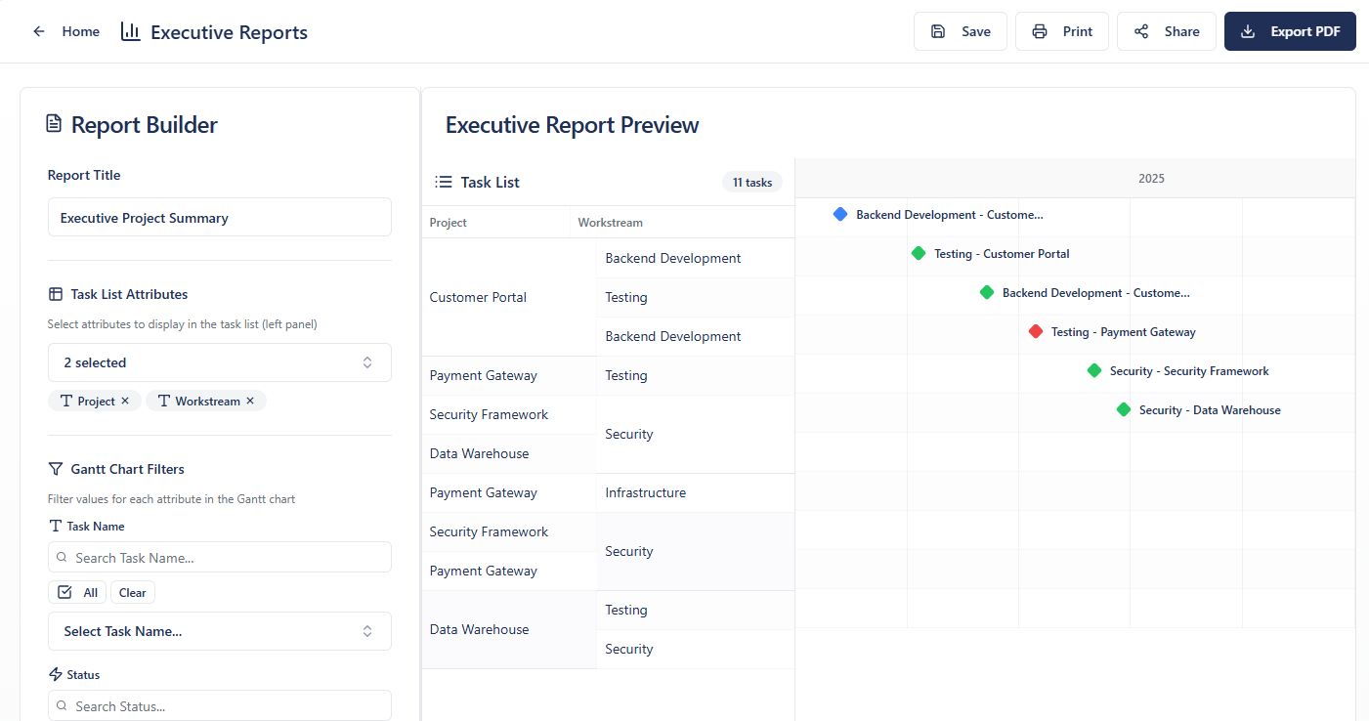
Reports layout should be similar to the below but with a set of canned reports available to choose from at the top: status, dashboard – to be defined later
Export button needs to include excel and powerpoint options and the results of these exports need to look best in class, boardroom ready.
Preview structure to remain the same but more professionally presented (shading is currently looking random). Needs more helpful timeline, more room for titles and headers, more professional looking borders and some options for headers and borders – as are available in powerpoint
Report builder panel should be built in same structure but below screenshot has cut off the preview button. Icons next to field names need to be removed, they are not helpful and take up too much room.

Slide 15
Change Control
Audit Log
Approval Threshold
Change Workflow
Each field change is captured on the change audit log. Changes are flagged as below and filterable:
System generated changes
Changes made as a result of a task relationship (e.g. predecessor)
Baseline & re-baseline
Text changes (e.g. task name changes)
Dependency
Change Management
Audit log is exportable to MSexcel
The approval threshold is set up in the change screen in Settings. It can be applied to any attribute. Date changes is the default choice. The period or calendar date can then be set.
Different thresholds can be set for different projects
When the threshold is breached, the below actions happen:
Change log item will be created, approval column = ‘Required’
CR form will be generated and auto-populated (optional)
Task in the plan will have a status change to red, a CC flag will appear, text will change to italic and the font and gantt will appear paler
Risk or issue will be logged with AI generated text. User to update commentary for reason
Change log item status defaults to ‘Required’ when threshold has been breached. User has below options:
Ignore and remove CC flag, this will revert RAG and formatting. It will update the Change log item status to ‘User Override’
Work through change process:
Comment on reason for change
Seek approval decision, [Outside Lyra], supported by CR form generated by Lyra, optional.
Log approval decision. Approved will update the plan: re-baselining the task to Green. User can upload the evidence of approval and/or comments to the individual change item

Slide 16
Automated plan generation
User uploads existing project documentation: SOWs, meeting minutes, contract, mandate, etc.
Assumption is that the data in these documents will cover enough information for Lyra to populate the eight default attributes: [This worked when we used Claude at Trimstone – we had loads of docs for it to base the data on and it produced something really helpful]
Portfolio
Programme
Project
Task name
Start Date
Finish Date
Status
% Complete
The structure: Portfolio > Programme > Project > Workstream will be estimated by Lyra and presented to the user to review, edit and confirm.
User confirms
Lyra drafts a full plan for the user to edit.

Slide 17

Change Control
Lyra

Slide 18
Lyra Plan Structure
Flex in this structure would be helpful & to be explored later. E.g. sub programmes, sub projects.
Principles – can be unlimited numbers of each of the horizontals e.g. unlimited portfolios, programmes etc
Enterprise
Portfolio A
Programme 1
Programme 2
Portfolio B
Vertical 1
Project x
Workstream
Task
Portfolio C
Programme 3
Project y
Project z
Programme C.1
Project C1.1
Workstream C1.1.

Slide 19
Change Control.
Lyra needs to cover 2 types of changes
1 – running audit of changed fields – who changed what, when
2 – changes that users care about – these will be changes that exceed a certain threshold and the following will cover this
Process / Principle of Tracking change over life of the entity (project/programme/task etc)
User to have option to switch type 2 CC on or off. Having it switched on will create a level of admin.
Purpose of the functionality is to –
Give a warning of potential impact &
Give a retrospective visual of the changes over time
Understand why things changed both in aggregation and retrospectively for future planning purposes
For point 1. Give a warning of potential impact:
Assumption is that if CC is switched on that there is some process outside the system to review and make decisions on changes over certain thresholds (e.g. a change board). Users (PM’s, owners of each of the verticals in above) to decide what should go through this external process. These thresholds can be different at each vertical and within verticals (previous slide)
Scope
Baselined tasks. Tasks may be baselined in isolation.
If a parent is baselined then the children are also baselined.
One workstream can baseline ahead of another – and this is usually the case, more complex workstreams baselining later and workstreams closer to go-live baselining later.
Out of scope
Pre-baselined row items

Slide 20
Steps from mandate to 1st baseline
User in Lyra
Lyra Automation
Section/s baselined and now subject to CC if switched on
New project mandate
Outside Lyra
Change control record added
Baseline ID added to relevant rows in plan
Overall visual indication that line items are baselined
Planner and team make initial notes (in wizard / whiteboard) – mandate, approach, assumptions, constraints, structure etc
SteerCo decision needed?
Scenario plan options drafted
Yes
User baselines in Lyra & uploads minutes (optional)
No
Submit to SteerCo
Yes
SteerCo approved
Submit completed detailed section/s of plan to SteerCo for approval
build bottom-up detailed plan for baselining
Publish HL plan in Lyra – main planning area
SteerCo approved
Yes
No
No
Steerco – assumed example change approval body outside Lyra

Slide 21
Change Control Flow - Draft
Plan is baselined following board approval
Date is changed in baselined plan and breaches threshold set
Format changed to show potential delay on all impacted tasks
CC flag applied
Status flips to Red
Change log entry created with commentary added
Optional CR form generated
Notification to vertical owner of breach & Planner
User in Lyra
Commentary is updated to explain cause of underlying breach
Lyra Automation
Outside Lyra
CR FORMS
Manual intervention?
Change Board / Vertical owner to review
No
Approved
New Plan Agreed / Project terminated
No
Yes
Yes
Dialogue box - Lyra updates change log to approved & and reverts all formatting (as opposed to move to green). Undo options for previous 2 actions
User removes flag on plan screen & updates date
New baseline for impacted tasks

Slide 22
Change Log – Breach & Audit
Ideally the user doesn’t edit much here, it’s a low-admin, trusted selected audit of history that users can interrogate. I think the status will have to be updated manually other than where described (awaiting approval & approved) which can be overwritten
Status | Timestamp | User | changed Column | Previous Value | New Value | Change Reason | Has Deps | Total Time change | Breach Type | Total Changes | Approval Timestamp | Task Name | Parent Task Name | export to excel/other
 | automated | automated | populated from plan | populated from plan | populated from plan | populated from plan | automated | automated count | automated | automated | Automated: Date flag removed | automated | automated
approved |  |  |  |  |  |  |  |  |  |  | Automated: Date flag removed
user overwrite – (Approval not required)
NA – for audit log, not breaches
Awaiting approval (default status for new breaches)
Rejected

Slide 23
Users

Slide 24
Not sure?

