Slide 1
Supply Submission List
https://guaranteedreturns0.sharepoint.com/Field%20Services/Lists/Supply%20Submission%20List/AllItems.aspx

Slide 2
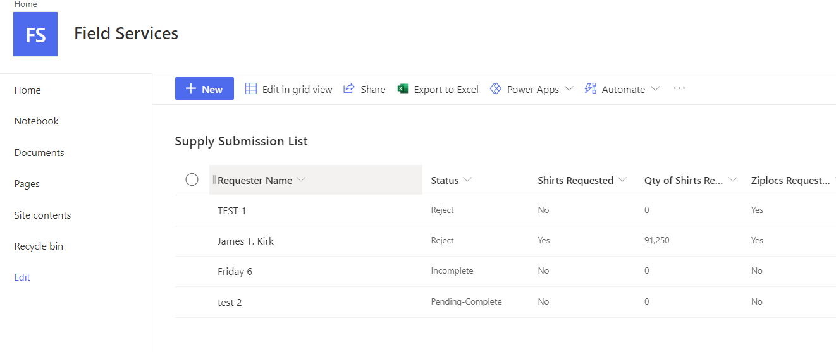
To create a new form, click on "New"

Slide 3
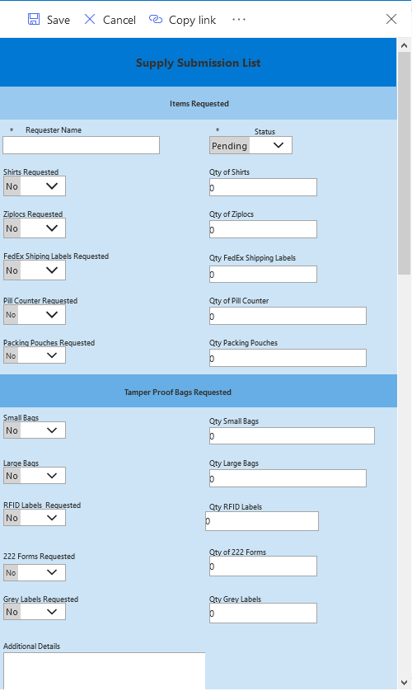
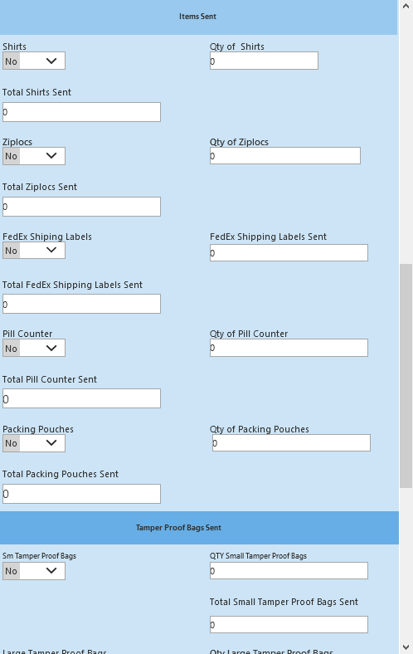
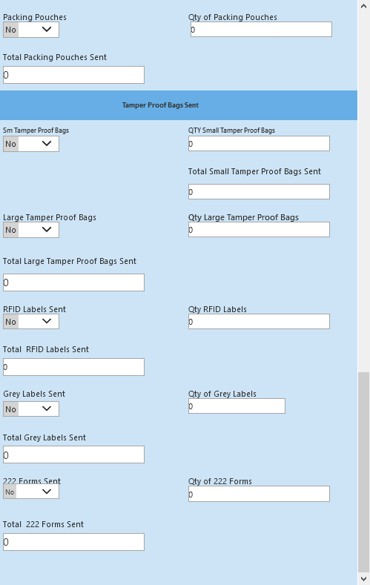
An empty form appears. The form is made up of two sections: Items Requested and Items Sent. If you are requesting items, you only need to fill in the request sections.

Slide 4
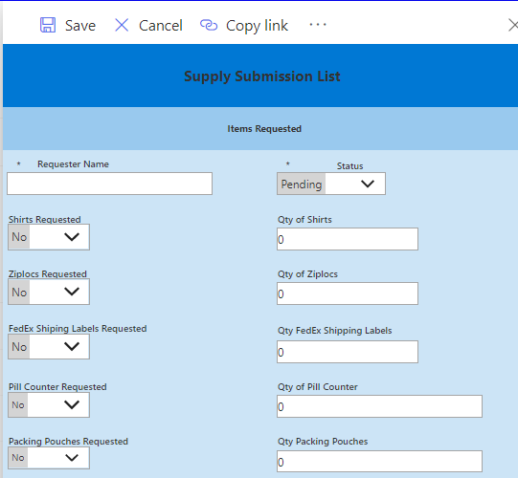
There are two required fields: Requestor Name & Status Required fields have an asterisk next to the field name.

Slide 5

On this new form you are requesting items. Fill in Requestor Name, leave Status as "Pending". To request an item, you need to change the Item Requested field from “No” to “Yes” by selecting the option from the drop down. Then enter the requested quantity.

Slide 6
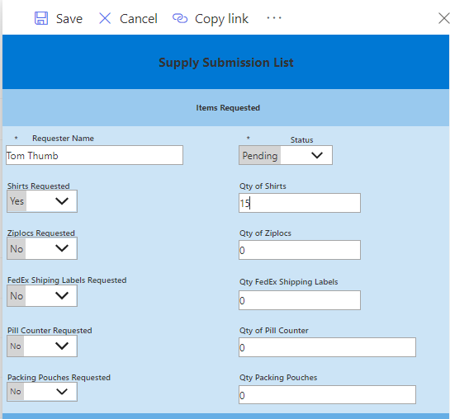
This is an example of a correct request form. This will start the approval process when the form is saved.

Slide 7
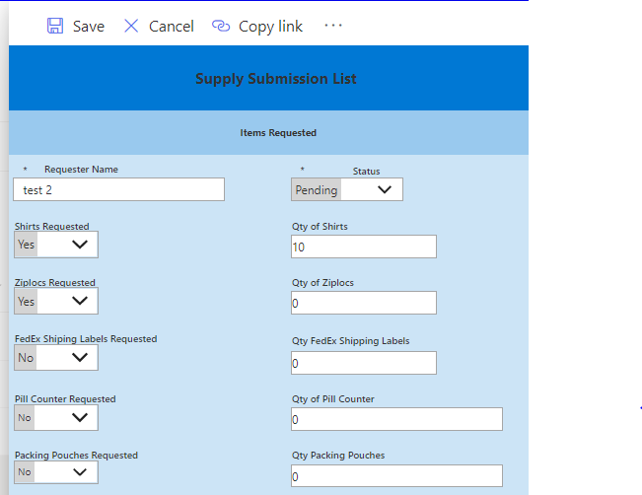
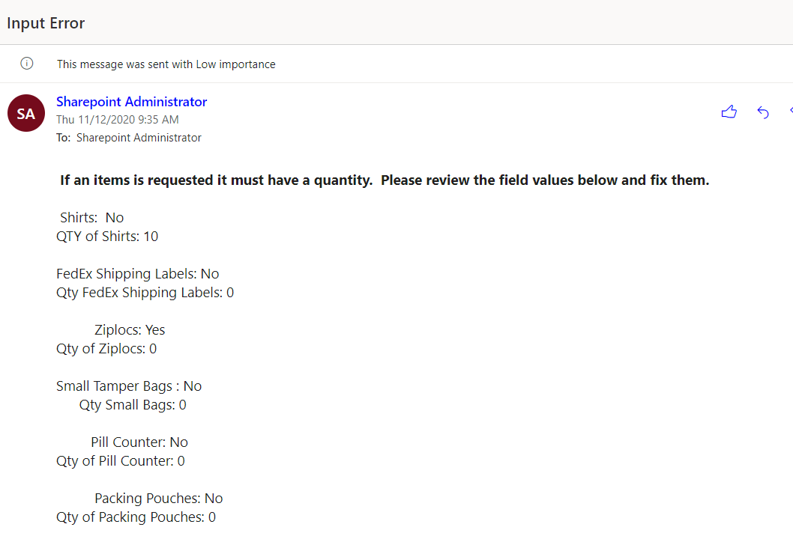
This is an example of an incorrect request form. On this form a field "Ziploc Requested" is set to "Yes" and QTY of Ziplocs is set to "0". If the form is submitted like this, an error will occur. If any of the Items requested are set to "Yes“, the quantity must be greater than zero. The email you would receive on this type of error is shown below.

Slide 8
To Submit the form for processing Save the form.

Slide 9
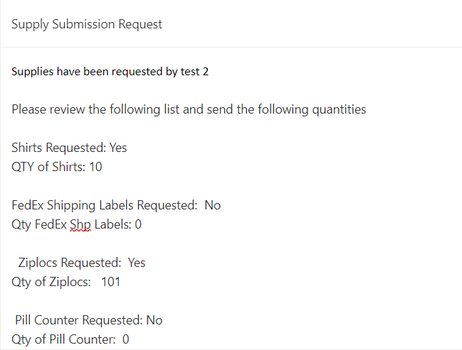
When edits have been passed this email will be sent to Rosemary Waldvogel

Slide 10
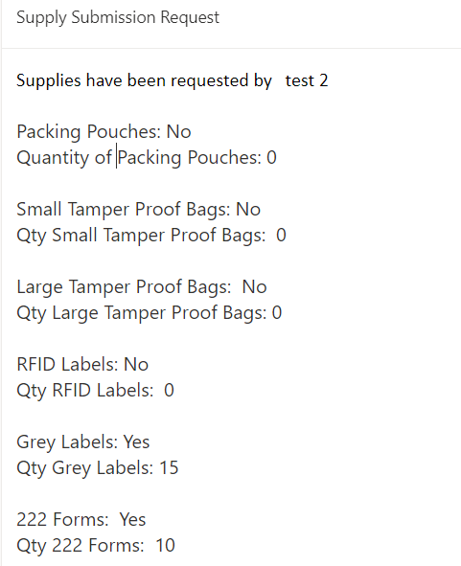
When edits have been passed this email will be sent to Rosemary Waldvogel, Peter Barone, and Kristen Crowley

Slide 11
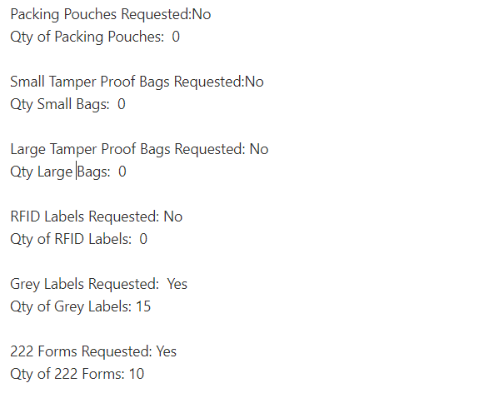
When edits have been passed this email will be sent to Stephen Paparatto, Edison Lucero, and Maria Mora

Slide 12
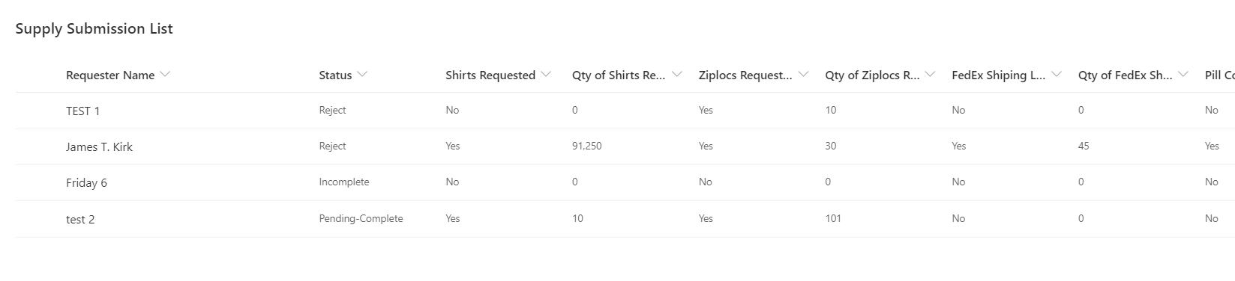
The Status field will be set to "Pending-Complete" after all the Items Requested have been verified.

Slide 13
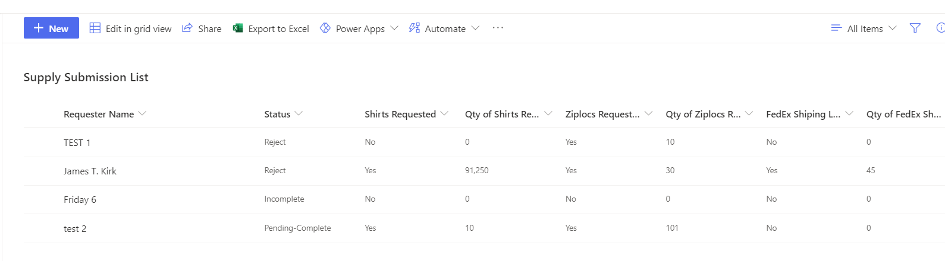
After all the items have been requested, they will be sent. Several thing will need to be done on the form. First, change "New" to "Edit"

Slide 14
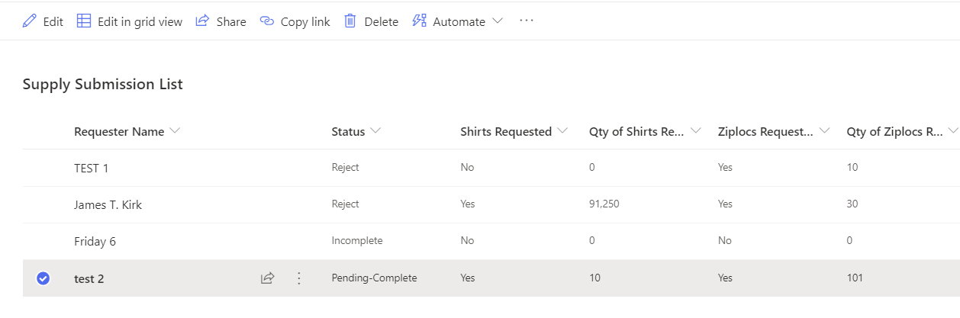
To change "New" to "Edit" select the Item to edit.

Slide 15
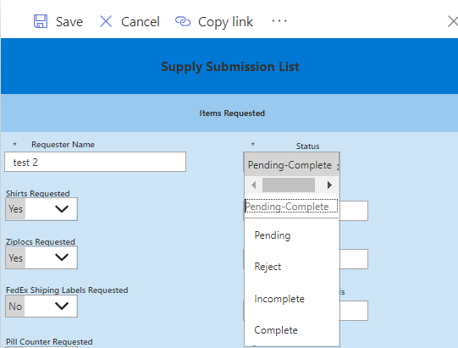
To be able to process Items Sent the Status must be changed to "Incomplete".

Slide 16
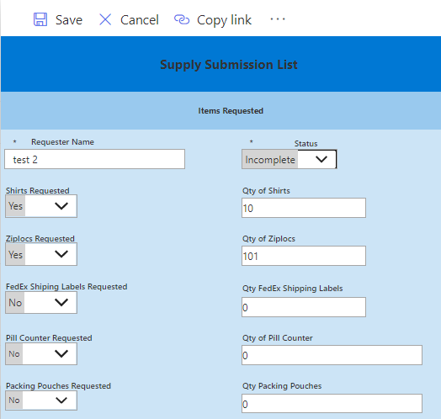
Status is now set to "Incomplete".

Slide 17
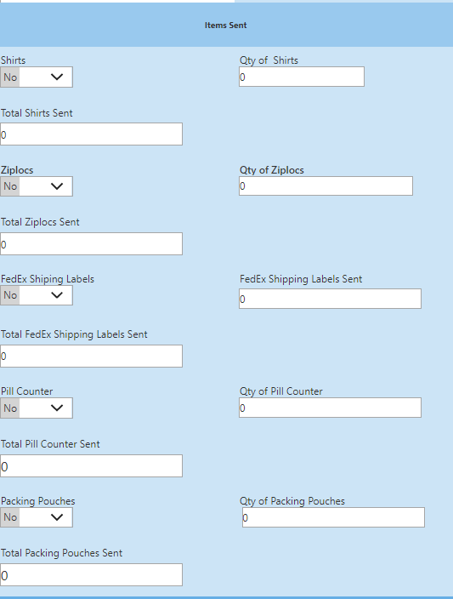
The next 2 pages show all the Items Sent. To indicate an item is sent, the item sent must be set to "Yes" and have a Qty greater than "0" An Item can be sent only after it has been requested.

Slide 18
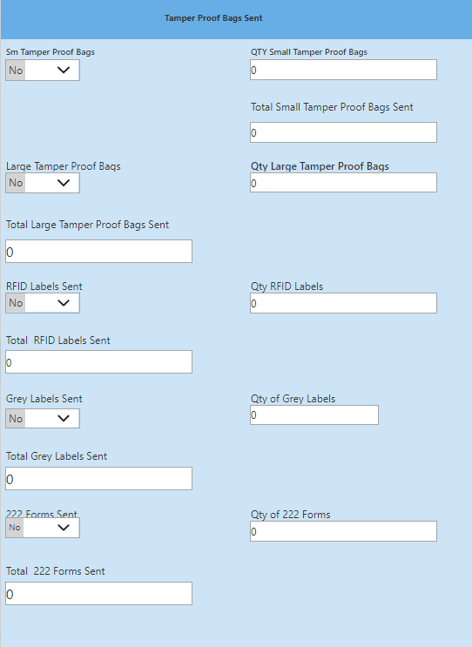

Slide 19
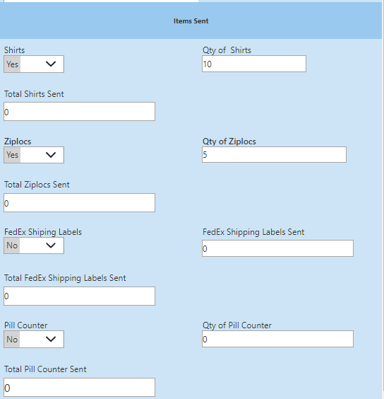

Slide 20
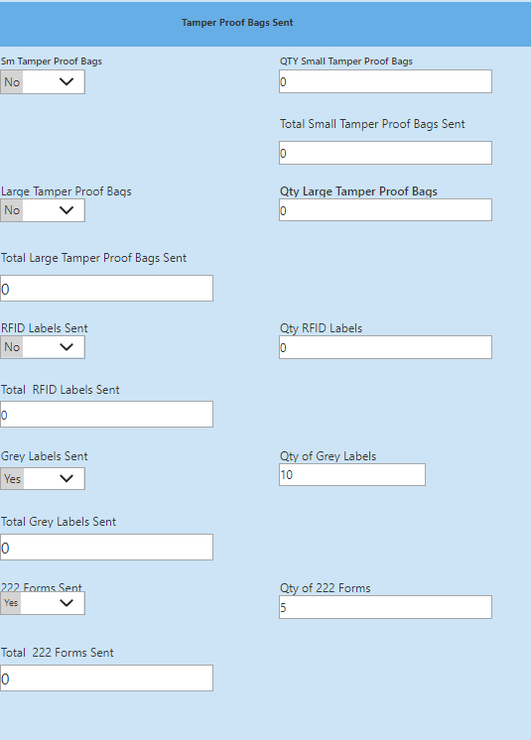

Slide 21
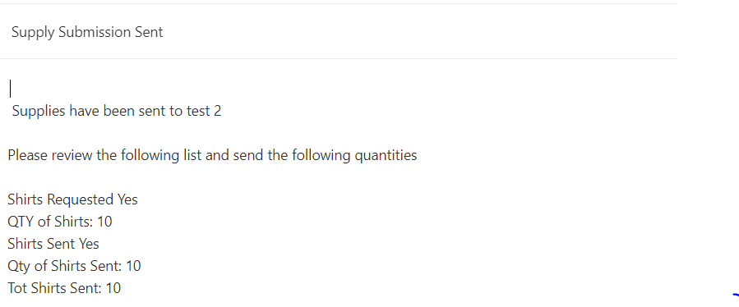
The following 4 pages is an email that will be sent. It shows "Items Requested" and "Items Sent", the "Qty of Items Requested" and "QTY of Items Sent". The total for each item is also sent.

Slide 22
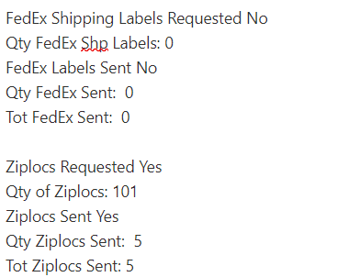
Note that 101 Ziplocs have been "Requested" and only 5 sent. The other 96 could still be sent. The Qty of Ziplocs are added each time to Tot Ziplocs Sent.
Notes:
flo

Slide 23
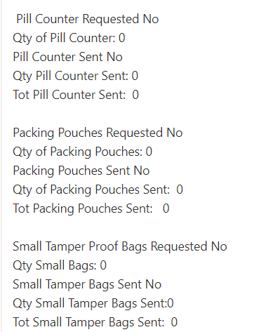
The following 2 pages is an email that will be sent.

Slide 24
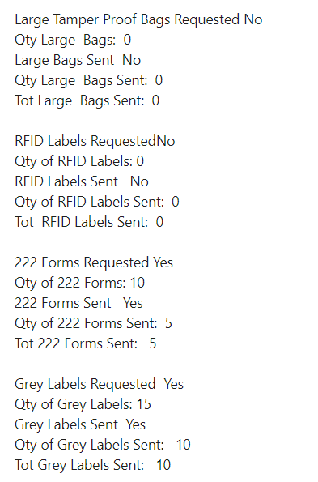
Items 222 Forms Requested and Grey Labels are also partial shipments

Slide 25
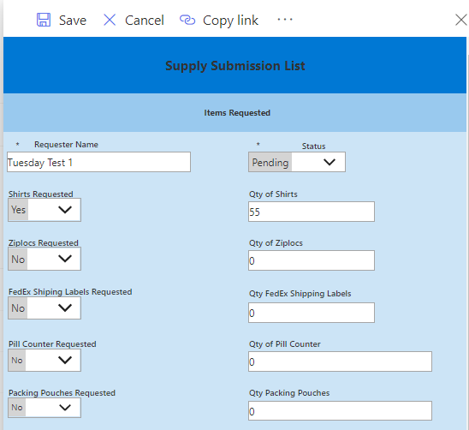
Only Shirts Requested Example

Slide 26
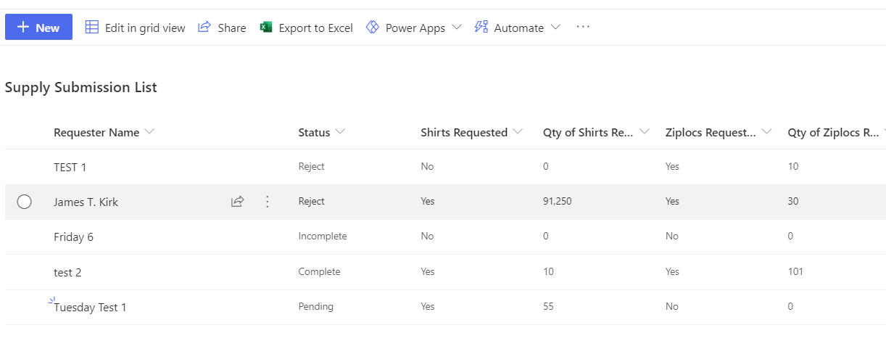
List view of Items Requested

Slide 27
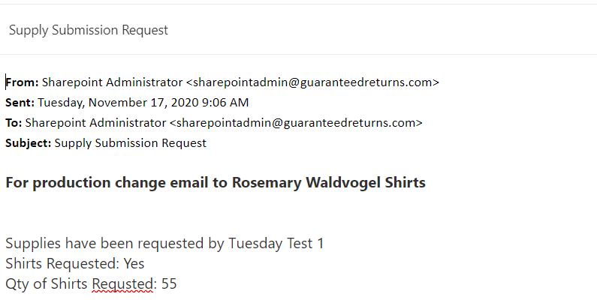

Slide 28
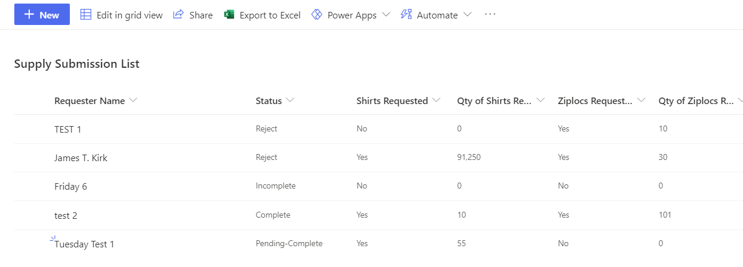
Validation completed for item requested.

Slide 29
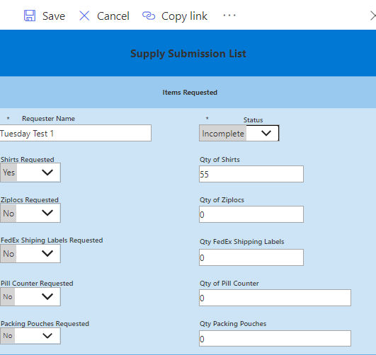
When an item is Sent. Change Status to "Incomplete".

Slide 30
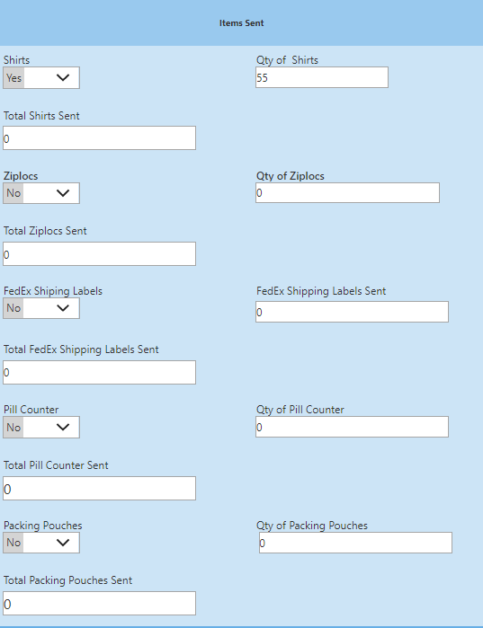
Change Shirts Sent to "Yes" and QTY of Shirts to "55" the amount sent. When you are done making changes "Save" the form and it will "Submit".

Slide 31
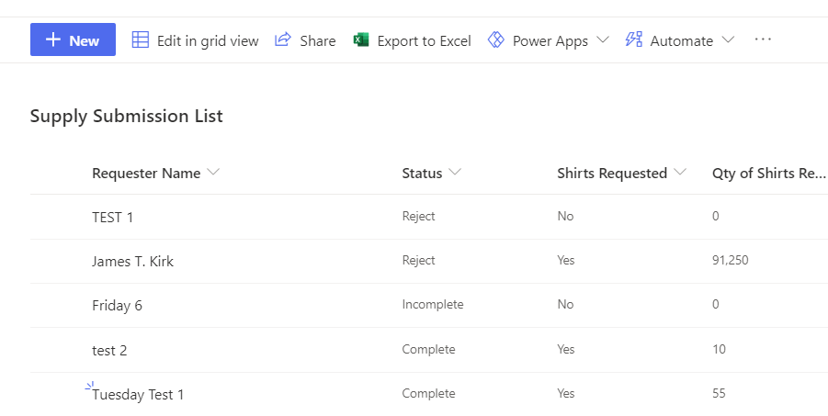
Below is the list view of Shirts Request/QTY of Shirts

Slide 32
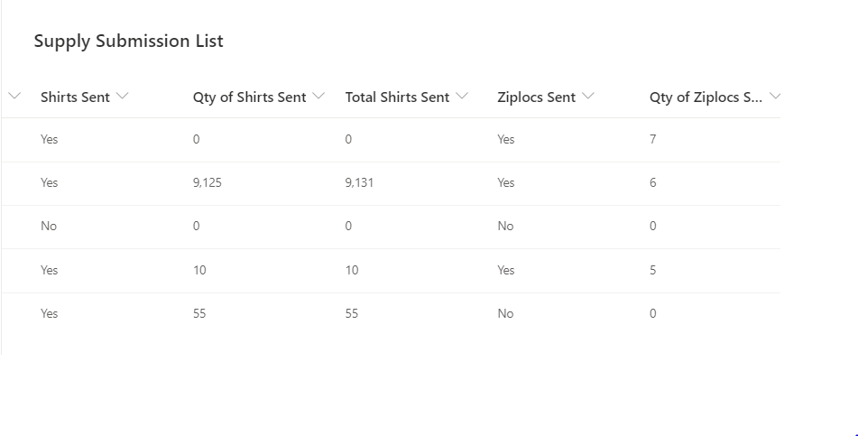
Below is the list view of Shirts Sent/QTY of Shirts Sent and Total Shirts Sent. Note that not all items may be sent at once. That is why QTY Sent field for each item will be added to the Total Sent for each item.

Slide 33
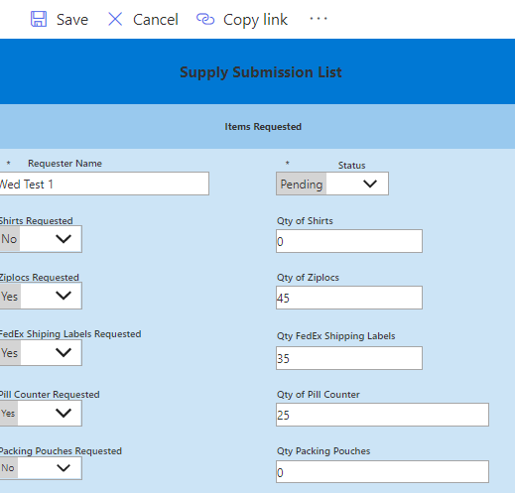
This is an example of a test for Ziplocs Requested, FedEx Shipping Labels Requested, and Pill Counter Requested.

Slide 34
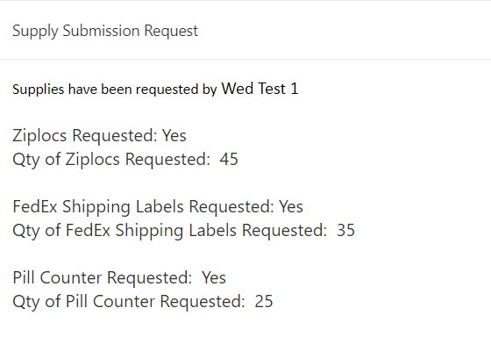
This is an example of the email that will be sent for Ziplocs Requested, FedEx Shipping Labels Requested, and Pill Counter Requested.

Slide 35
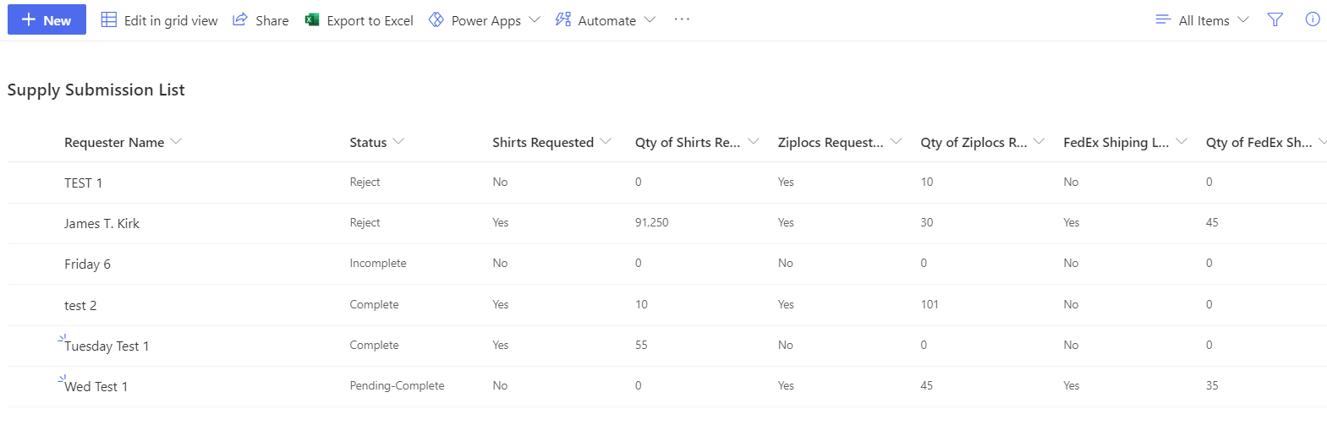
The list view below shows that the Items requested (Ziplocs Requested, FedEx Shipping Labels Requested, and Pill Counter Requested and the QTYs) have passed the edit process. This is signified by the "Status" being changed to "Pending-Complete" in the workflow processing. List view is continued next page

Slide 36
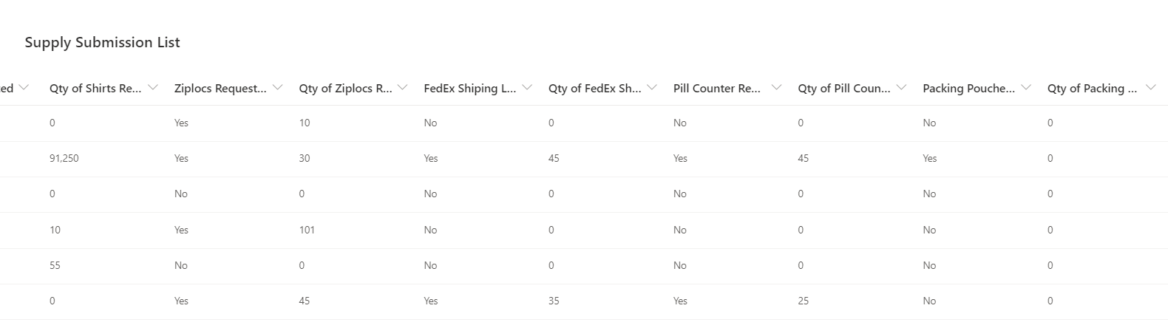
List view is continued

Slide 37
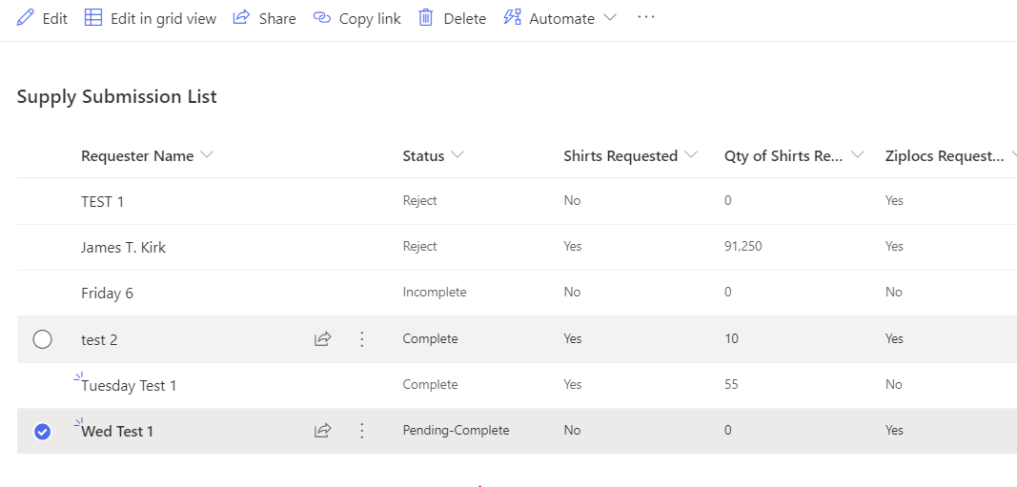
To Edit the form and start processing when the items are sent. Click on the item you need to update. The "Edit" option appears.

Slide 38
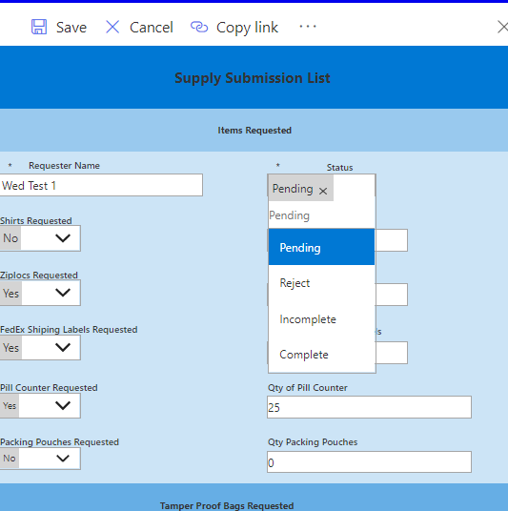
The form opens, click on the Status dropdownfield. Choose a Status of "Incomplete".

Slide 39
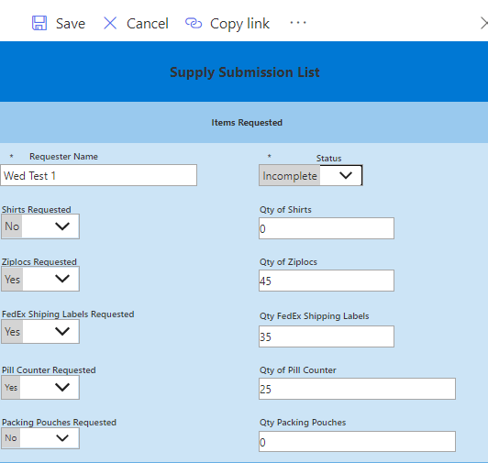
Status is now "Incomplete"

Slide 40
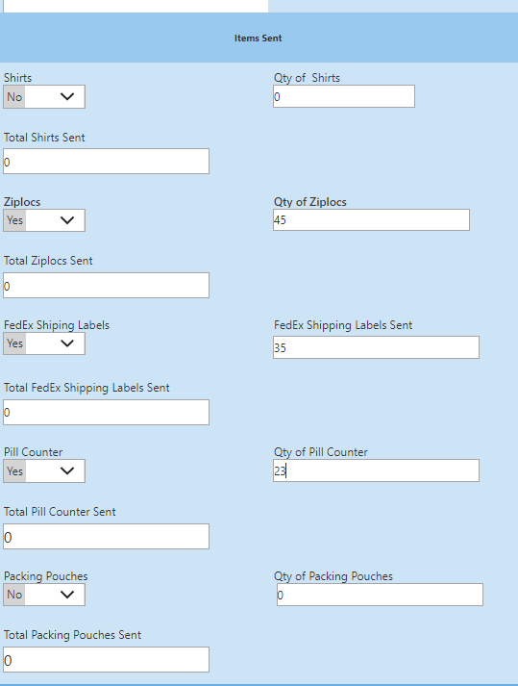
The Items, Ziplocs, FedEx Shipping labels, and Pill Counter are set to "Yes", the Qty for each are set.

Slide 41
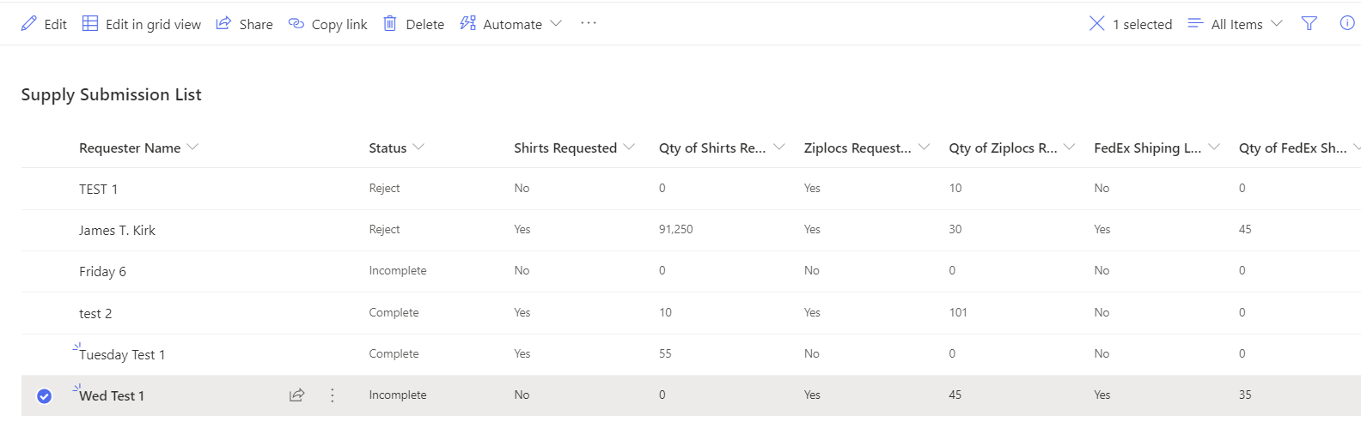
This is the list view of the Items, Ziplocs Sent, FedEx Shipping labels Sent, and Pill Counter Sent are set to "Yes", the Qty Sent for each are set.
The Listview continues the next 6 pages

Slide 42
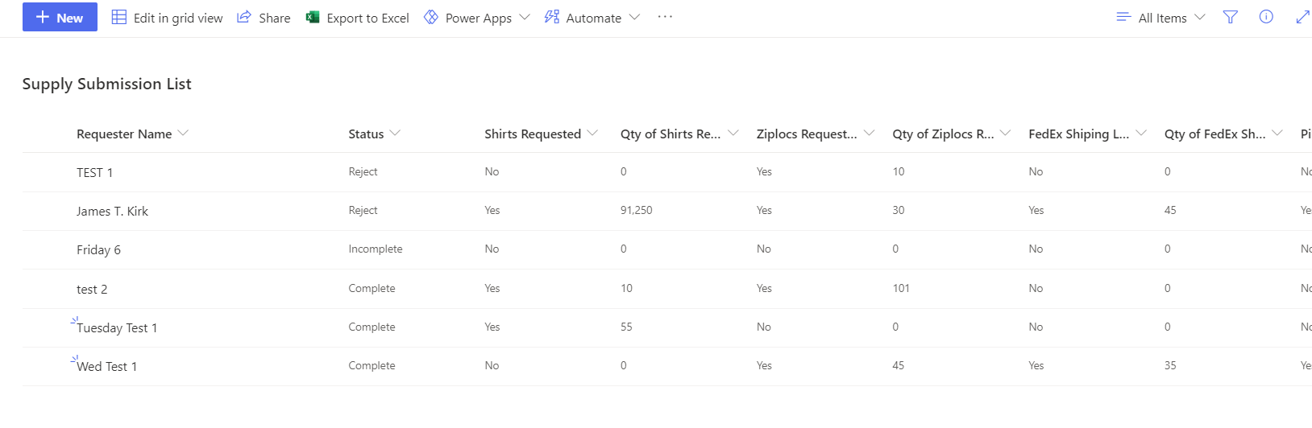
The Listview continues

Slide 43
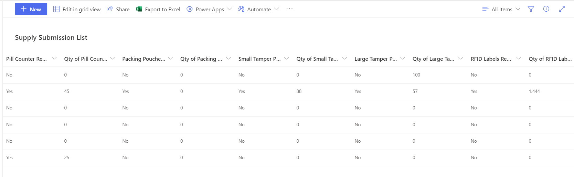
The Listview continues

Slide 44
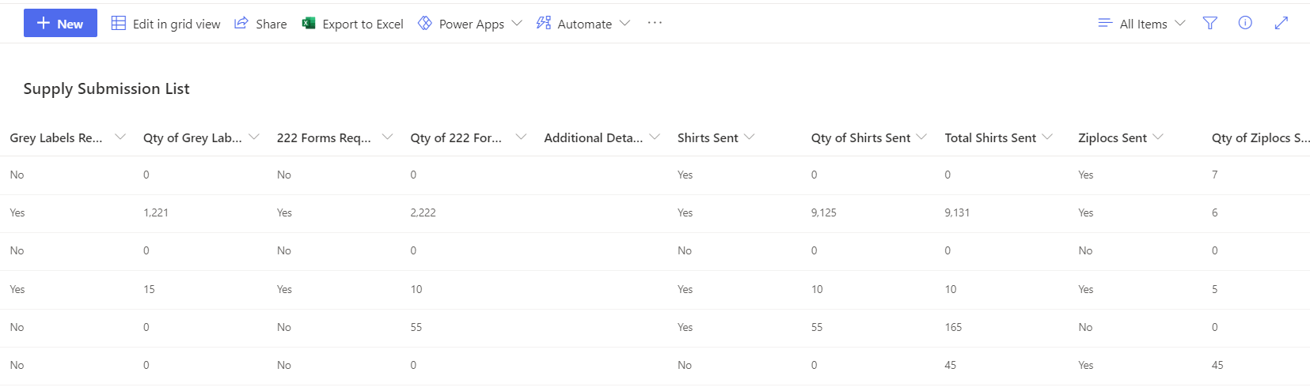
The Listview continues

Slide 45
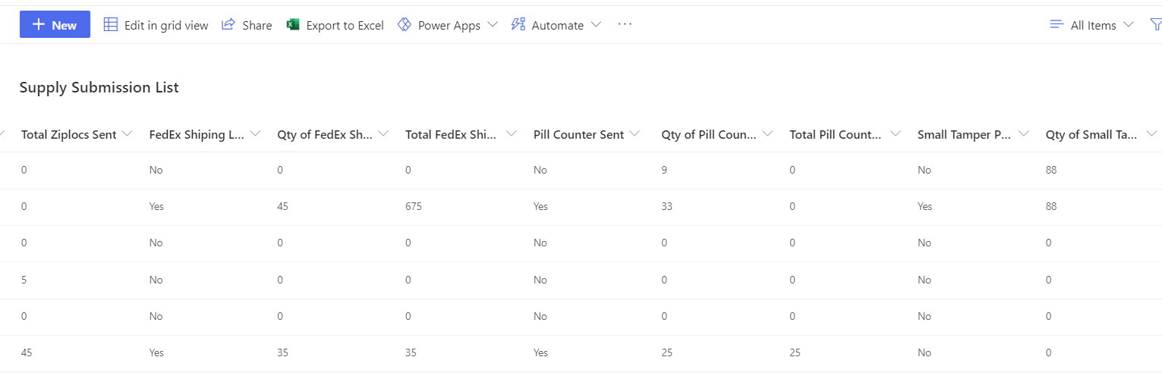
The Listview continues

Slide 46
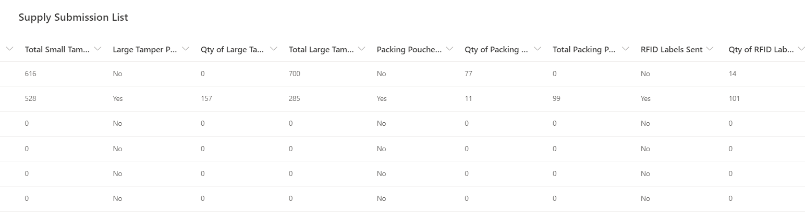
The Listview continues

Slide 47
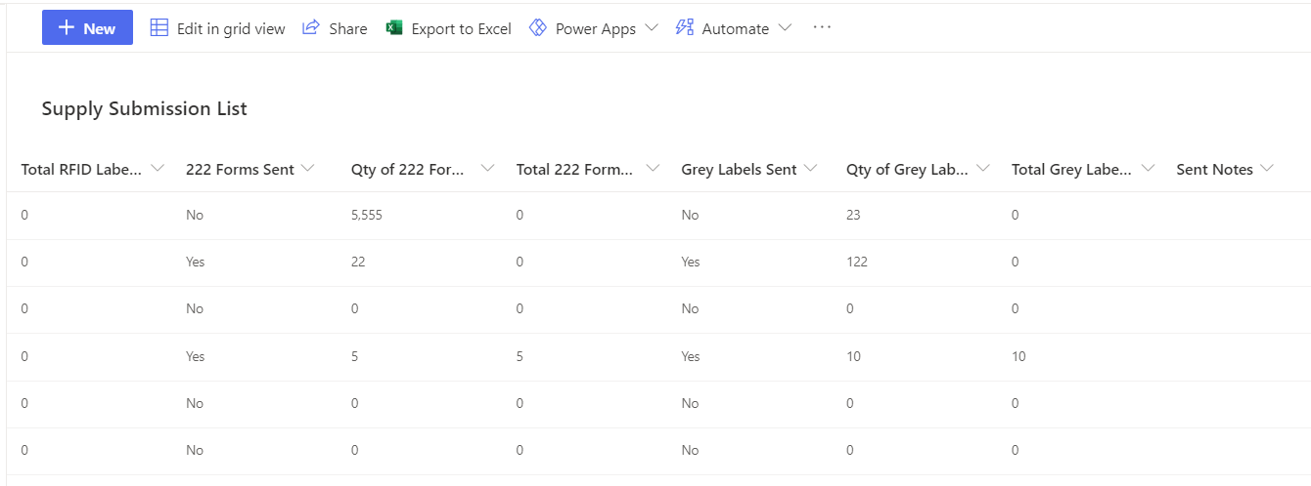
The Listview continues

Slide 48
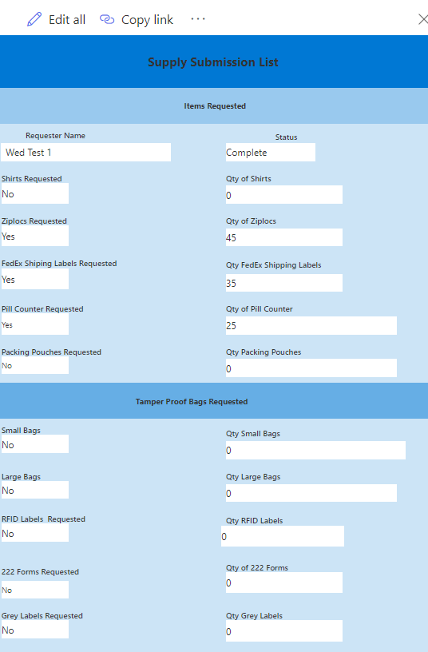

Slide 49
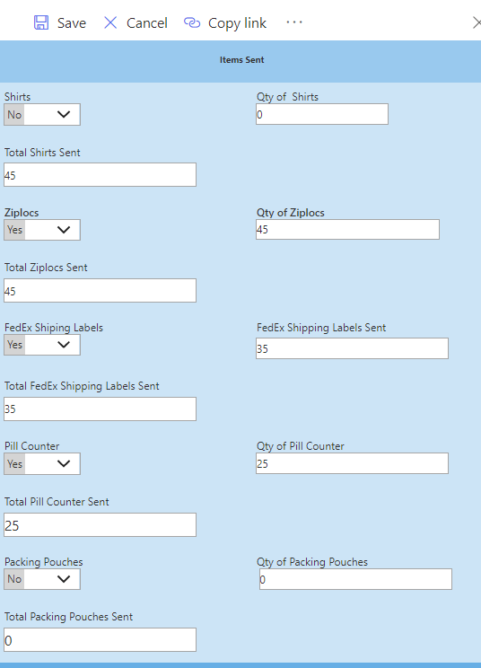

Slide 50
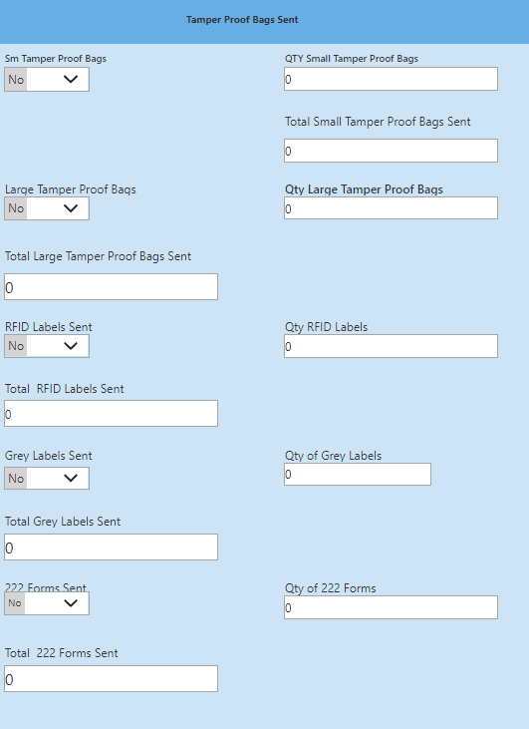

Slide 51

This is the email that will be sent.

Slide 52


Slide 53


Slide 54


Slide 55


Slide 56

This is the email for Item requests for Packing Pouches, Small Tamper Proof Bags, Large Tamper Proof Bags, RFID Labels, Grey Labels, 222Forms, and the Qtys.

Slide 57

This page shows the list view of the Item Request when the flow has successfully passed the field edits. The Status is now "Pending-Complete". The next 6 pages show the rest of the list view.

Slide 58

The next 5 pages show the rest of the list view.

Slide 59

The next 4 pages show the rest of the list view.

Slide 60

The next 3 pages show the rest of the list view.

Slide 61

The next 2 pages show the rest of the list view.

Slide 62

This is the last page of the list view.

Slide 63

When the items are Sent the form should be updated to indicate this and email notification sent. To edit the form choose the item and click on "Edit".

Slide 64

The form opens.

Slide 65

Change the Status to "Incomplete". This will allow the item to process

Slide 66

Change the fields in Items Sent that need to be updated. The form is continued on the next page.

Slide 67

End of form. The Changes are now saved.

Slide 68
Save changes by clicking on Save.

