Slide 1
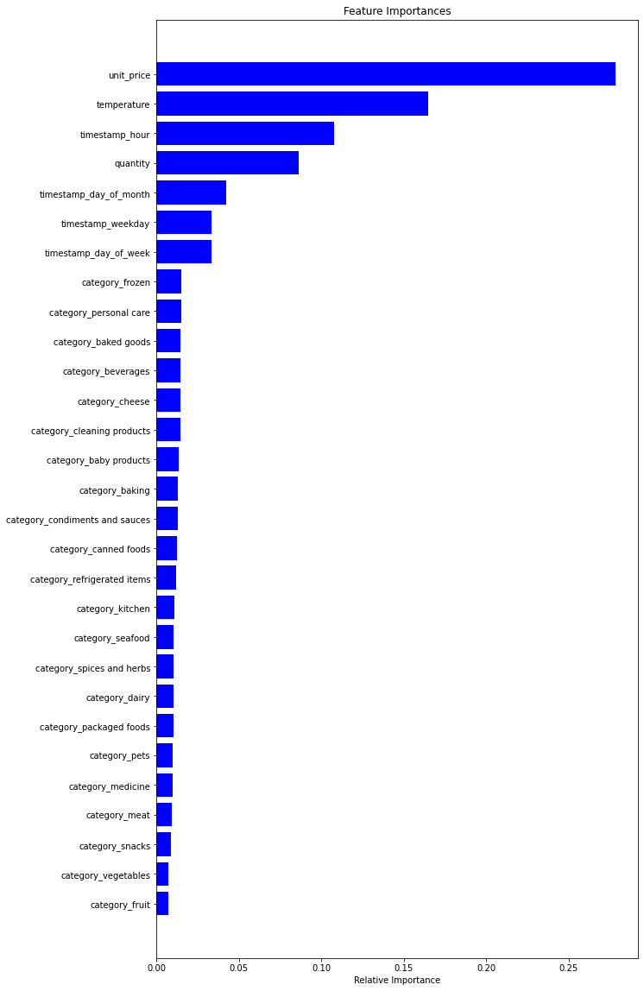
KEY FINDINGS:
The product categories were not that important
The unit price and temperature were important in predicting stock
The hour of day was also important for predicting stock

