Slide 1
Forecasting disease from univariate time series using naive, ARMIA, exponential smoothing, additive regression, and LSTM models
Client summary
Capstone for
Springboard’s data science bootcamp
Mike Pierovich
June 18, 2020

Slide 2
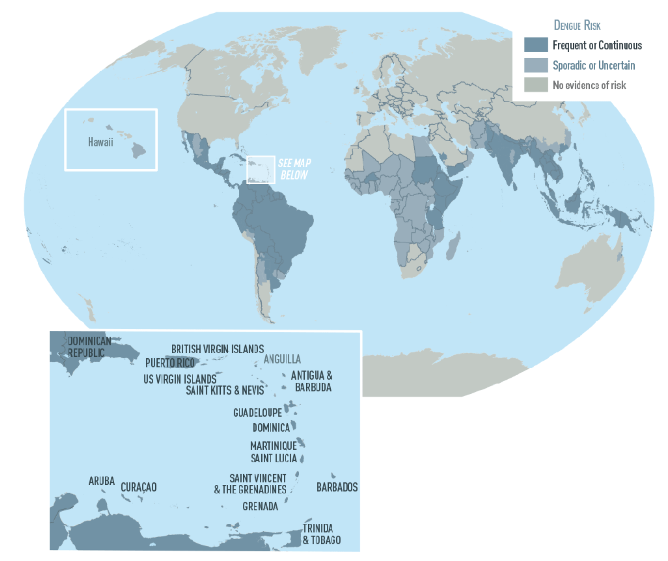

Challenge: Create a multi-year forecast of dengue fever

Slide 3


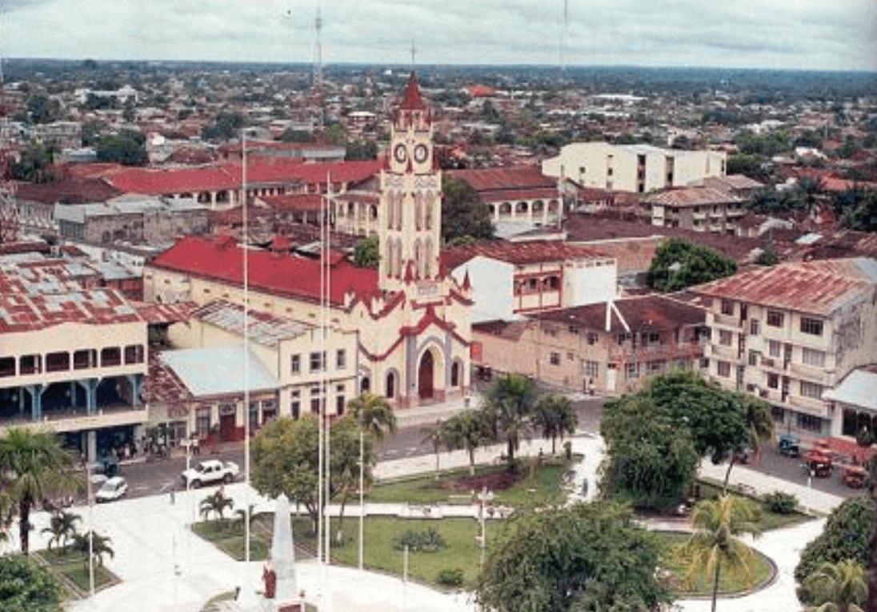
Data: Univariate time series of weekly cases
San Juan, Puerto Rico
Iquitos, Peru

Slide 4
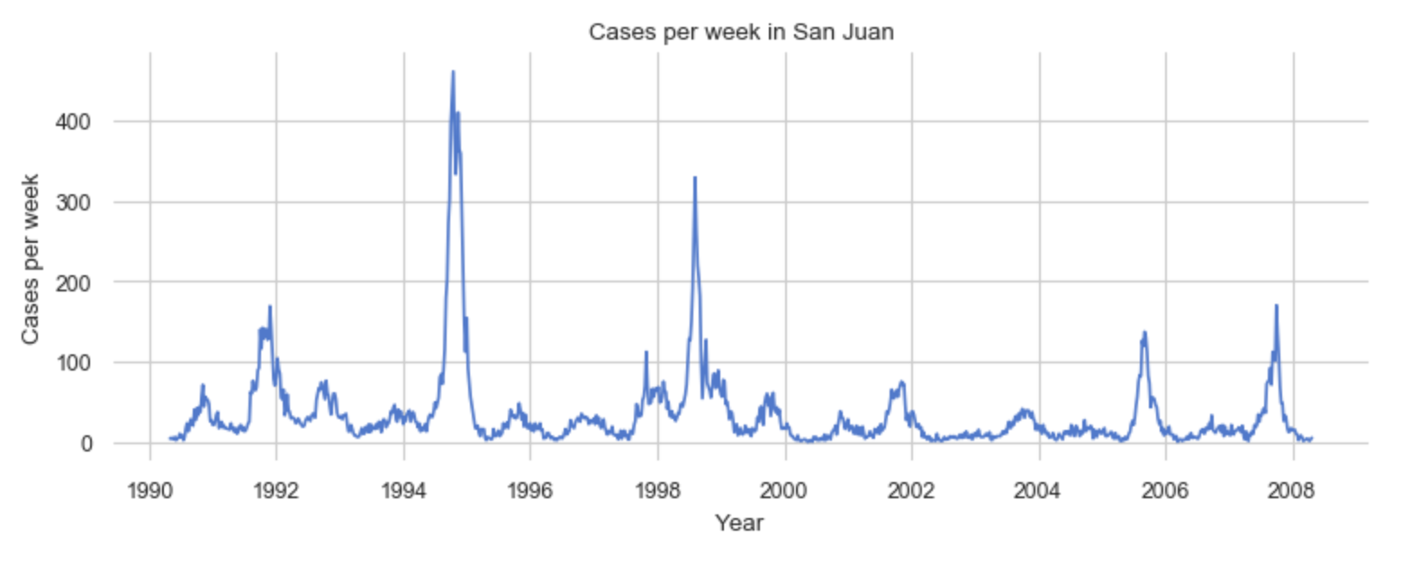
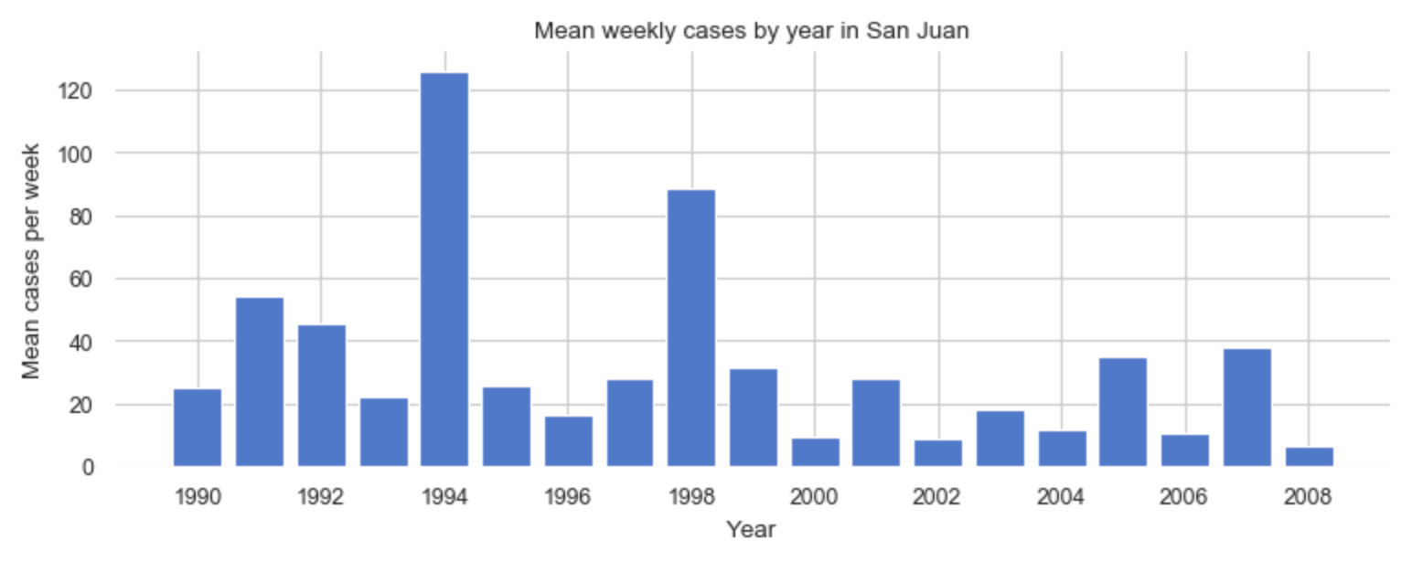
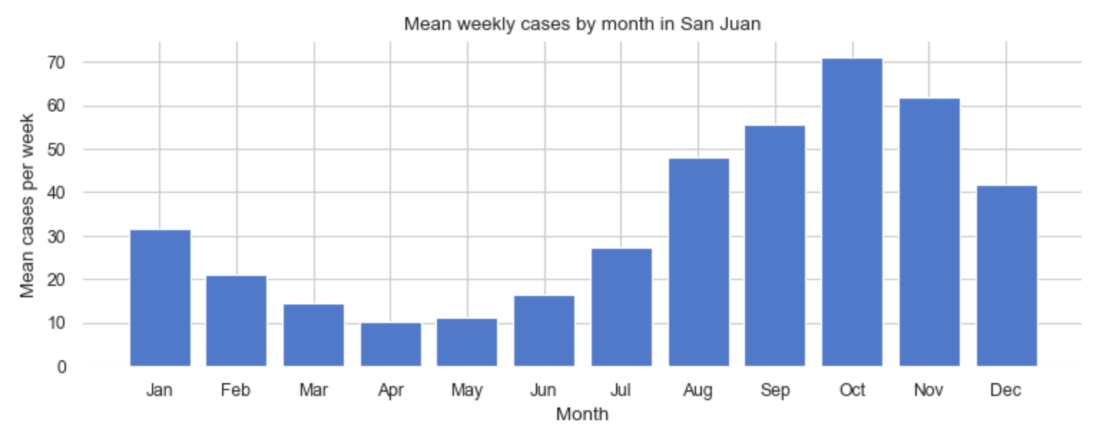
Explore: Spikes, slight downward trend and strong seasonality

Slide 5
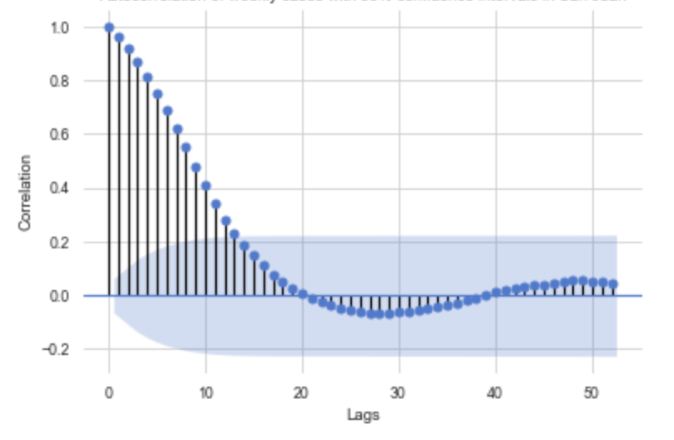
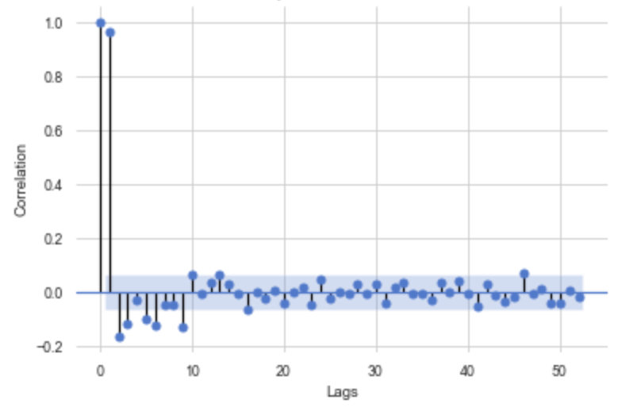
Explore: Time-series statistics
Strong autocorrelation
Lack of stationarity
Autocorrelation of weekly cases
with 95% confidence interval in San Juan
Partial autocorrelation of weekly cases
with 95% confidence interval in San Juan

Slide 6
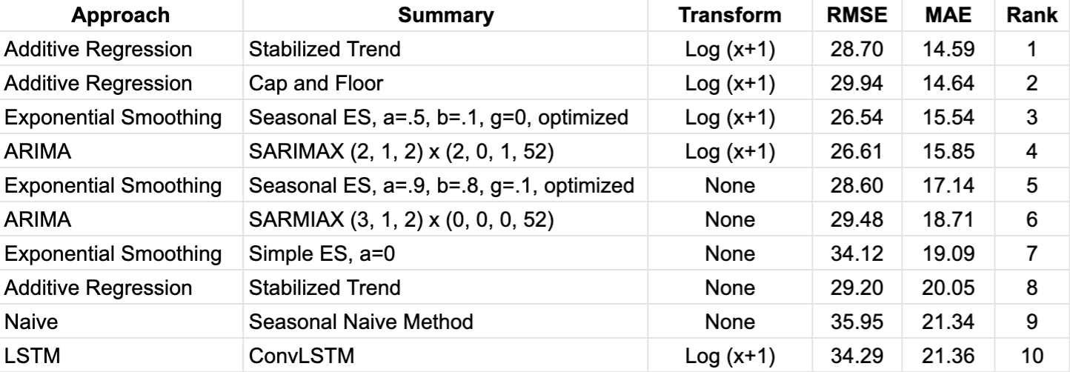
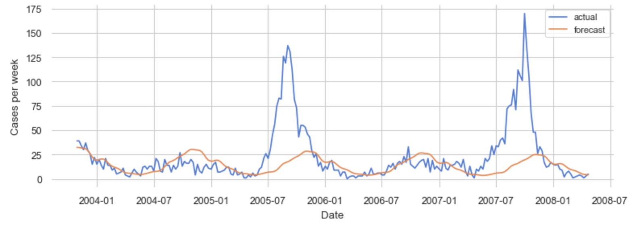
Models: Additive regression on log-transformed data is best
Performance of top-10
models and variations,
ranked by MAE, for San Juan
Actual and forecast of an additive model using Facebook Prophet with “stabilized trend” arguments on log-transformed test data for San Juan

Slide 7
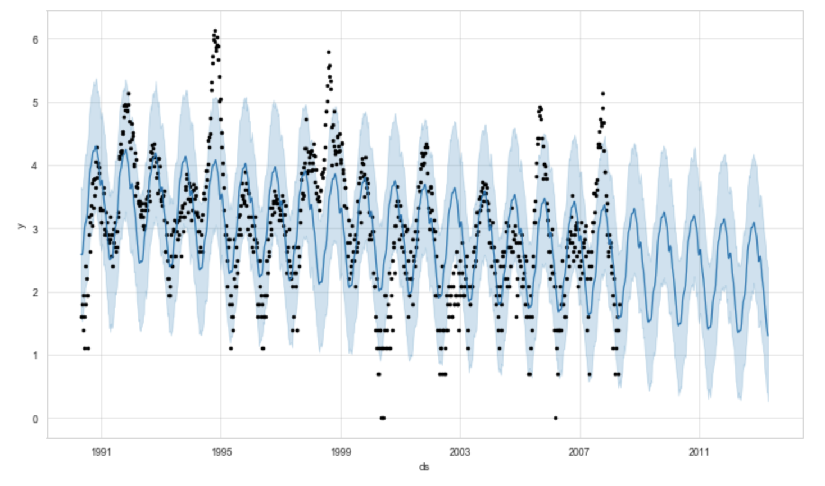
Final forecast
Example forecast value:
Week of August 19, 2008, which is 6 months into forecast period
Forecast value is 26 cases
An 80% constant confidence interval
  Lower bound is 9 cases
  Upper bound is 72 cases
Facebook Prophet’s visualization of the final forecast on a log(x+1) scale for San Juan

Slide 8
Lessons and improvements
Lessons from modeling:
Importance of well-transformed data
Connection between data and model
Limits of univariate data
LSTM’s lack of success
Improvements:
Better understand business context and domain
Refine forecast horizon
Explore additional time-series models
Leverage multivariate data
Explicitly predict spikes

