Slide 1
Predicting home prices with linear, lasso, ridge and random forest regression
Client summary
A first capstone project for
Springboard’s data science bootcamp
Mike Pierovich
2/26/2020

Slide 2

Problem
What’s the home
going go sell for?
And why?

Slide 3

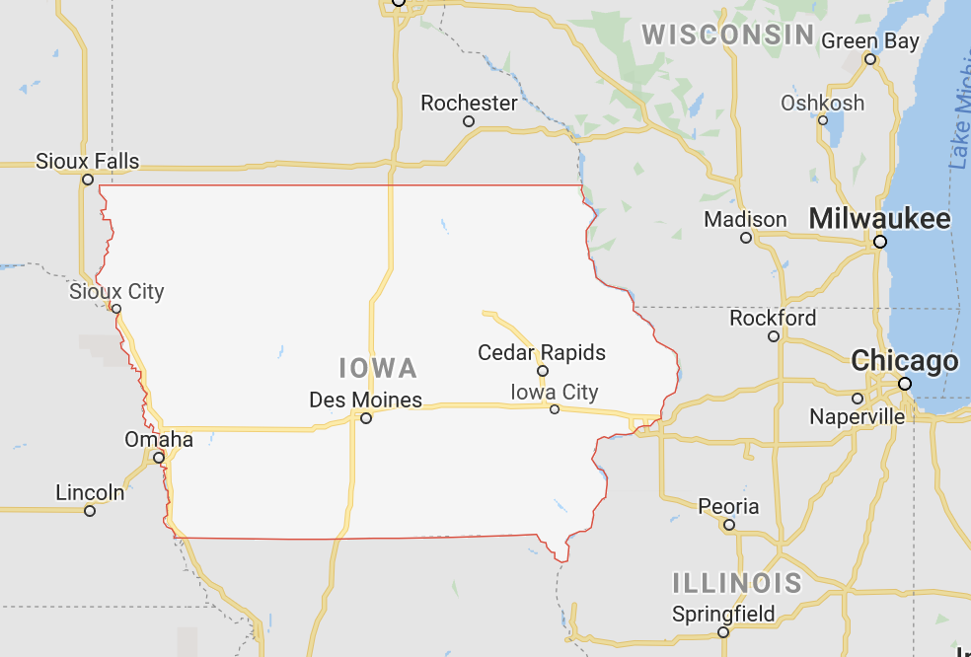
Data
“Ames Housing Data”
Sales price of 700 homes
About 80 features describing each home
From one US city
30 miles north of Des Moines

Slide 4
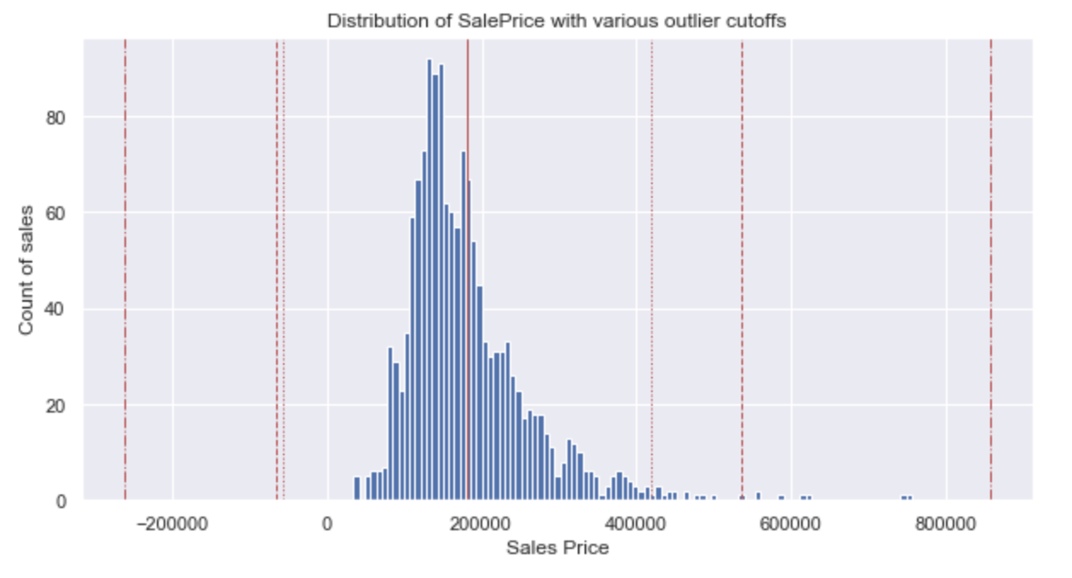
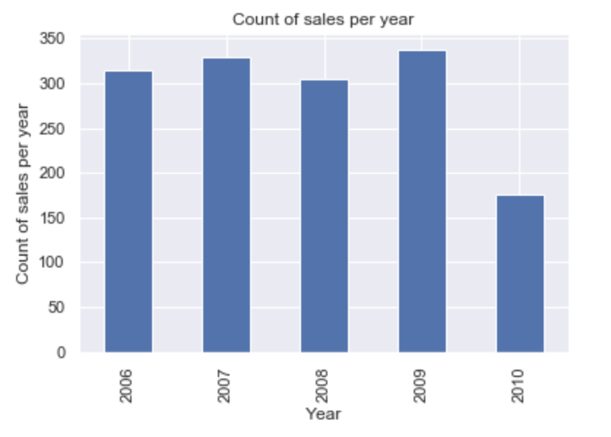
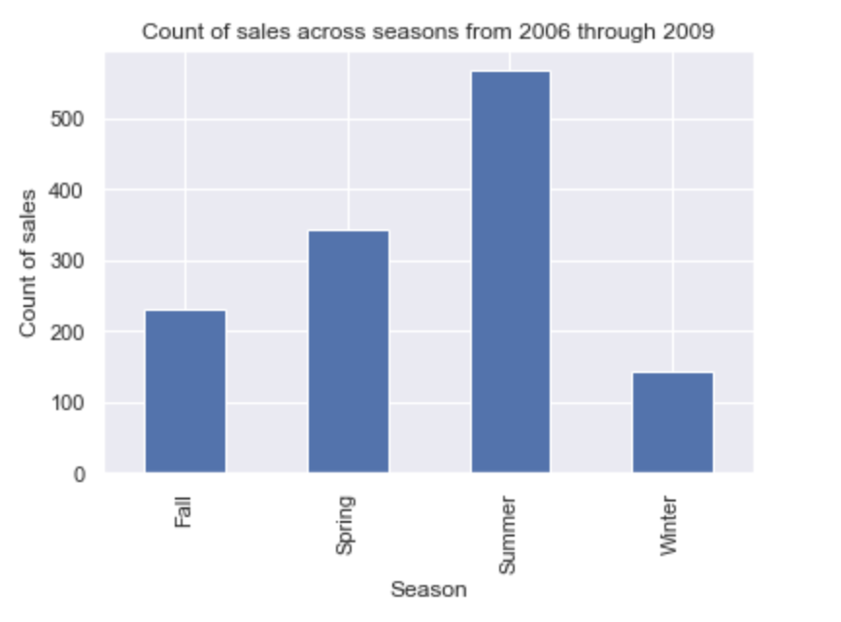
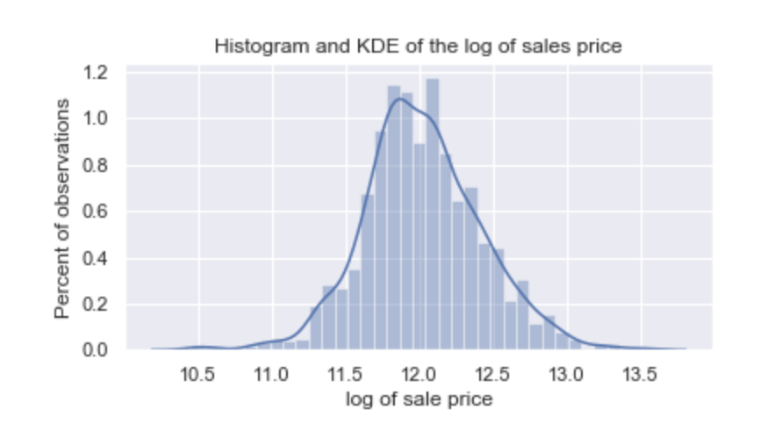
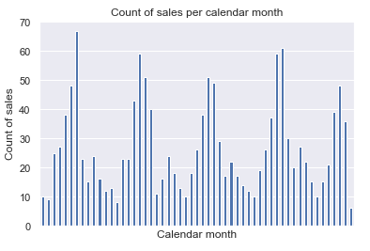
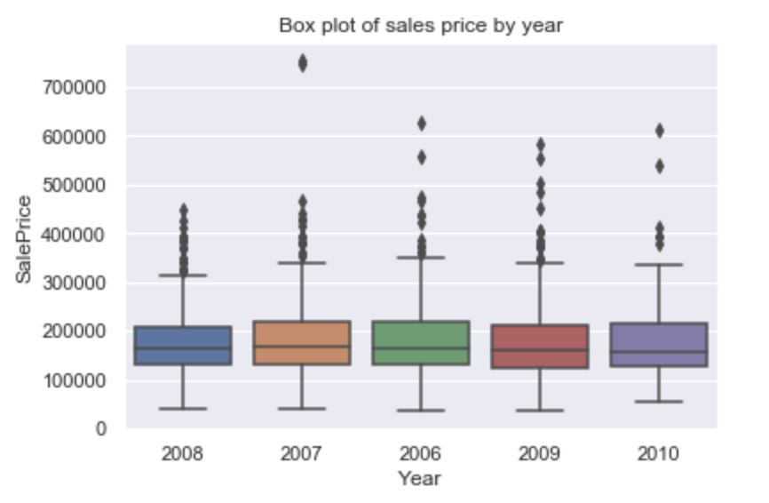
Sales price
$160,000 median
Outliers
300 sales/year
25 sales/month
Seasonal
Prices flat

Slide 5
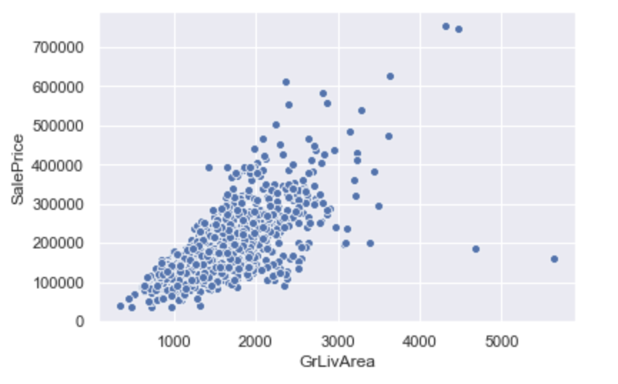
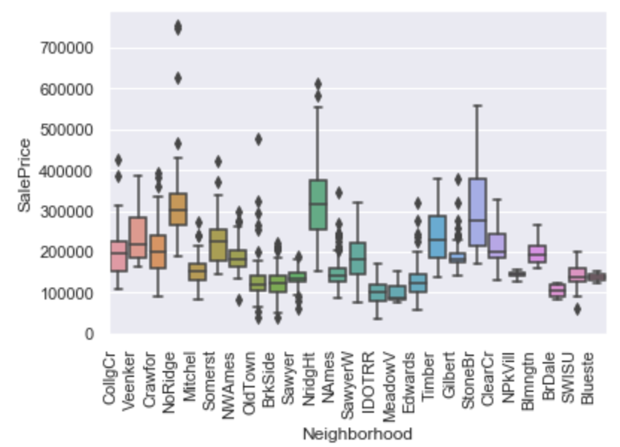
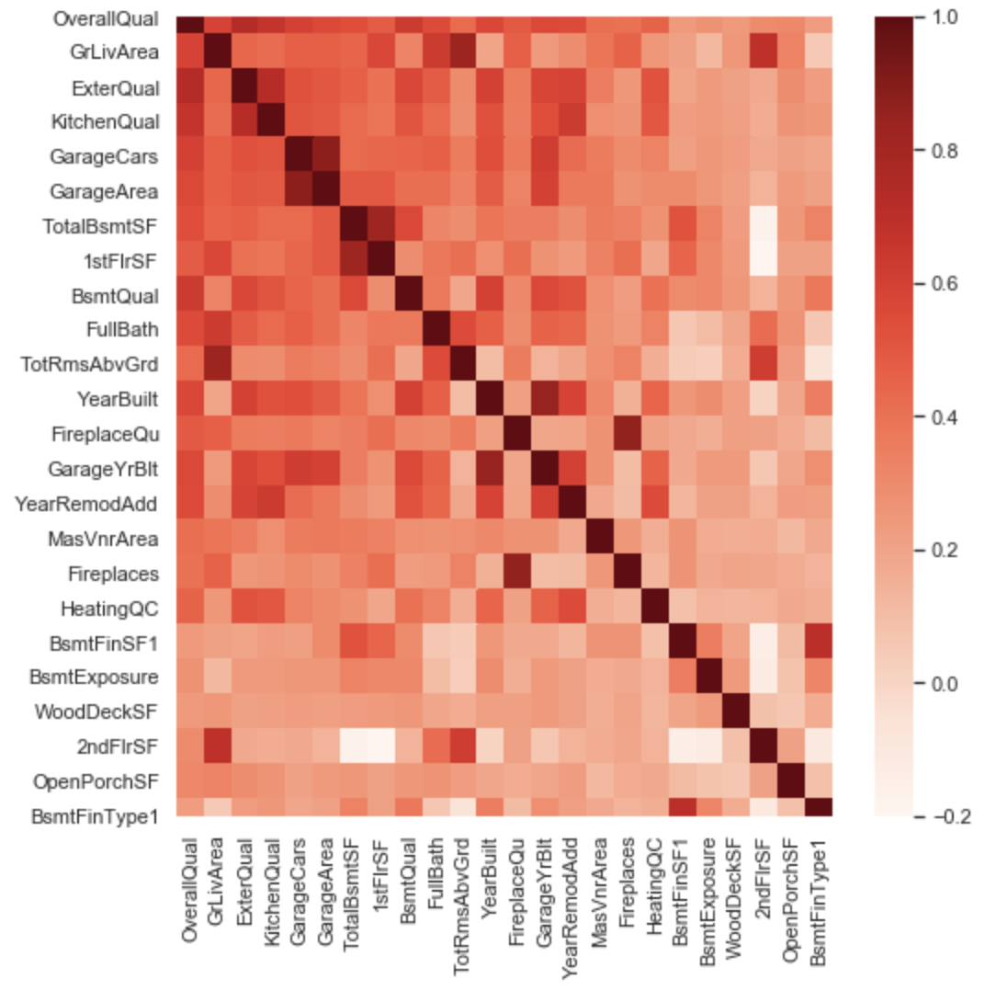
Home features
Of 54 non-categorical
24 with Pearson’s r > 30%
10 with cross correlation < 50%
Of 25 categorical
2 with Pearson’s r > 30%
Selected 12

Slide 6
Models
Build, tune and compare
Best performance
Linear - baseline
Linear - baseline | v. | Linear - normalized
Linear - normalized | v. | Lasso
Linear - normalized | v. | Ridge
 |  | Random forest - baseline - all
 |  | Random forest - baseline - all | v. | Random forest - tuned - all
 |  | Random forest - tuned - all |  | Random forest - tuned - high
 |  | Random forest - tuned - all |  | Random forest - tuned - high+med
 |  | Random forest - tuned - all |  | Random forest - tuned - high+med+low
Linear - normalized | v. |  |  | Random forest - tuned - high+med+low
Linear - normalized
RMSE: .15
MAE: .11
R2: .86

Slide 7
Recommendations
Launch
Minimum viable product around
Predicted price
Prediction interval
For a specific property in Ames, Iowa and
For all properties in Ames, Iowa.
Improve
Data
  Location
  Time
  Features
Model
  Regression
  Other models

