Slide 1
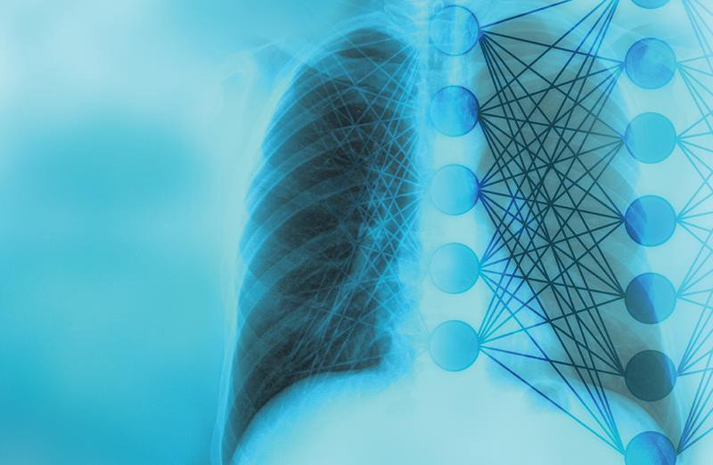
PNEUMONIA DETECTION WITH CNN
Mounica P., Amro E., Michael A., Petros P.

Slide 2
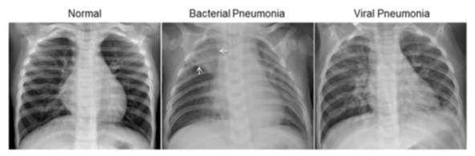
Motivation
Pneumonia is one of the most common causes of death among children
Deaths from pneumonia happen due to delays in diagnosing

Slide 3
Dataset
5863 Images from Kaggle split in training, test and validation datasets
1 Gb of image data
Grouped into 2 categories [Normal, Pneumonia]
Regrouped in 3 categories [Normal, Virus, Bacteria]
X-ray pictures (Original)
Normal
Pneumonia
X-ray pictures (Restructured)
Normal
Bacteria Pn
Virus Pn

Slide 4
Scope
Investigate ML algorithms for Image Classification and select the most appropriate one
INCEPTION-RESNET
INCEPTION-V3
VGG19
XCEPTION
Explore existing public datasets with labeled X-Ray pictures for training and validation
Create a functional application that can categorize Xrays for Pneumonia and Non Pneumonia conditions
If possible model to specify type of pneumonia (Virus vs Bacteria)

Slide 5
Tools/Library Used
Python
Keras
Tenserflow
Numpy
Matplotlib
Scikit - learn
Flask
HTML, CSS
Tableau
MongoDB

Slide 6
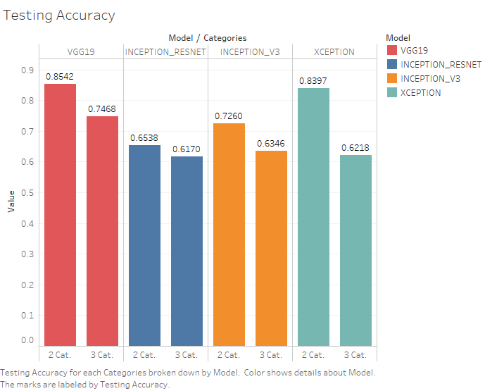
Model Accuracy Results
Best Model: VGG19 (0.846)
2 stage categorization [Pneumonia, Normal] has higher Accuracy
3 stage categorization [Normal, Bacteria, Virus] has low accuracy and is discarded

Slide 7
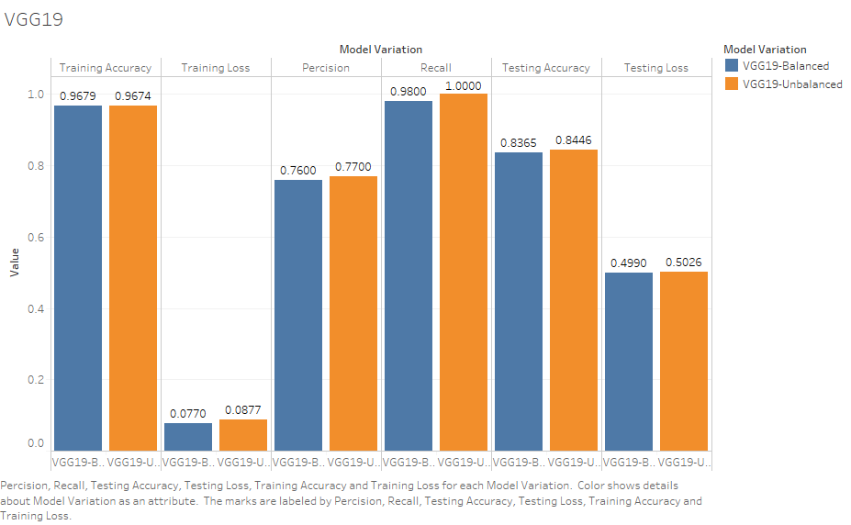
Model training with an unbiased dataset
Imbalance between training datasets [3x more Pneumonia Data]
Remove extra Pneumonia Data in order to achieve a 1:1 ratio
Insignificant change between the 2 datasets.
Proceeded with balanced dataset

