Slide 1
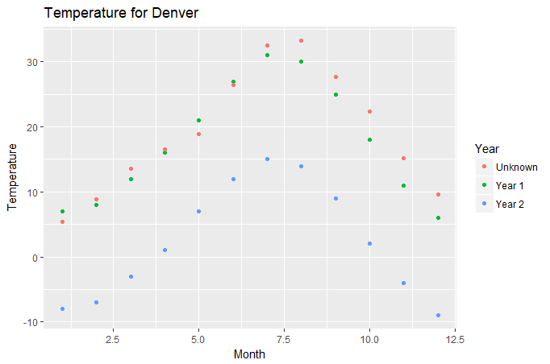
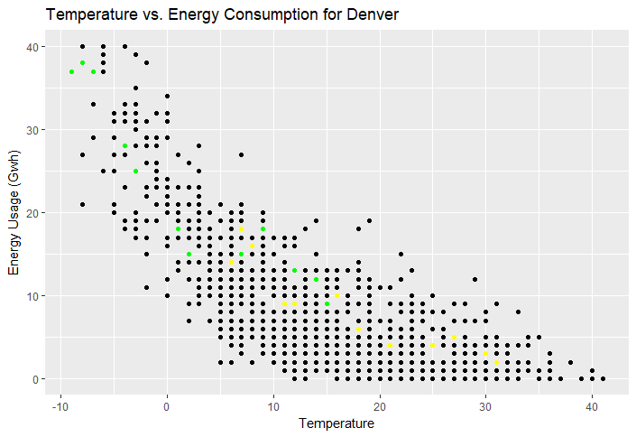
Predicting Energy Usage for Denver
Year 1
Year 2
- Michael Ramsey
- APPM 5590
- Final Project

Slide 2
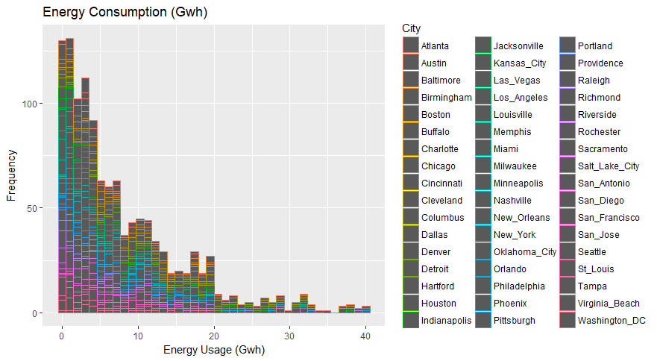
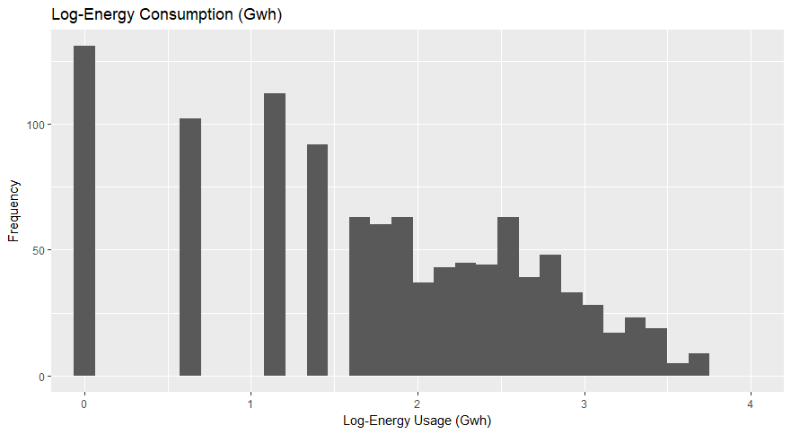
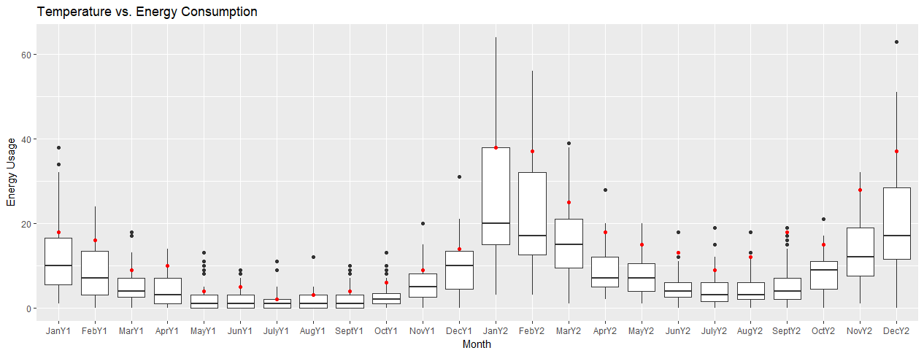
Data Exploration
Poisson Regression
Region Predictor not effective
Population Predictor not effective

Slide 3
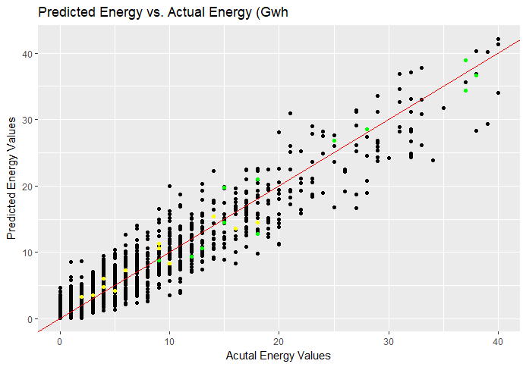
My Prediction
Month | Prediction (Gwh) | LB (Gwh) | UB (Gwh)
1 | 16 | 9 | 24
2 | 12.9 | 6 | 20
3 | 9.6 | 3 | 16
4 | 8 | 3 | 14
5 | 6.9 | 2 | 13
6 | 4.4 | 1 | 9
7 | 3 | 0 | 7
8 | 2.8 | 0 | 7
9 | 4 | 1 | 9
10 | 5.6 | 1 | 11
11 | 8.7 | 4 | 15
12 | 12.3 | 6 | 20
Year 1
Year 2

