Slide 1
Wavelet Based De-noising and Peak Detection of Infrared Spectra
Presentation By: Michael Ramsey
Advisor: Dr. Caroline Haddad
Secondary Advisor: dr. Barnabas Gikonyo

Slide 2
Talk Outline:
Infrared Spectroscopy Background
1-Dimensional Discrete Wavelet Transform
De-noising of Infrared Spectra
1-Dimensional Undecimated Discrete Wavelet Transform
Compound Identification Using Infrared Spectra

Slide 3
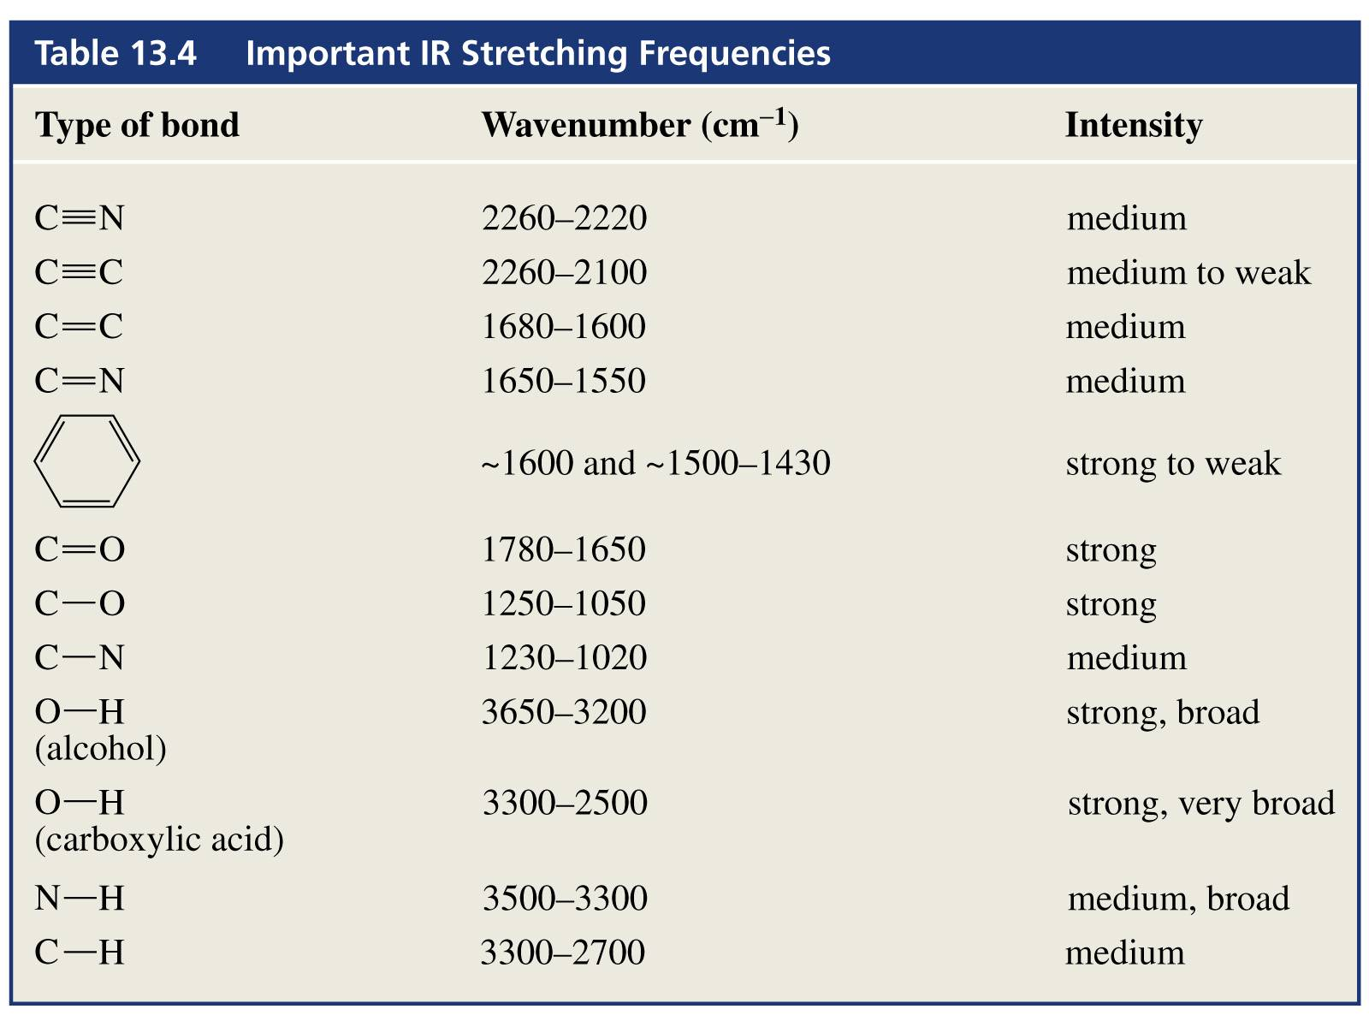
Infrared Spectroscopy Background
An Infrared Spectrometer bombards a molecule with infrared light
Molecules absorb specific frequencies of light dependent on the molecular structure
Too high of a frequency may cause the bonds to break
Infrared light has a lower frequency that other parts of the electromagnetic spectrum (visible, ultraviolet)
Instead of breaking, the bonds will vibrate, yielding information on the bonds present
Vibrational Modes: symmetric and antisymmetric stretching, scissoring, rocking, wagging and twisting

Slide 4
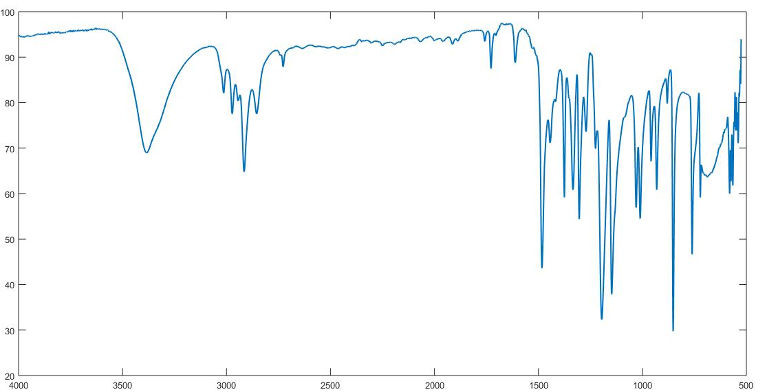
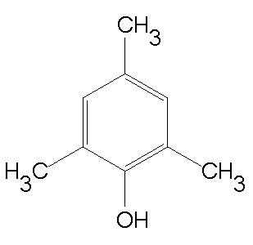
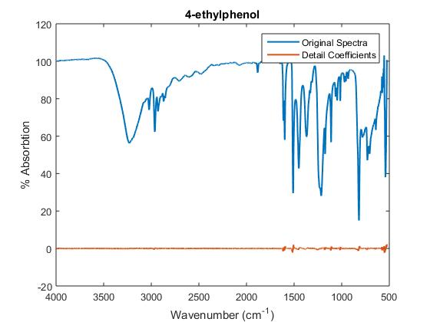
Infrared Spectrum for 2,4,6-trimethylphenol
2,4,6-trimethylphenol

Slide 5
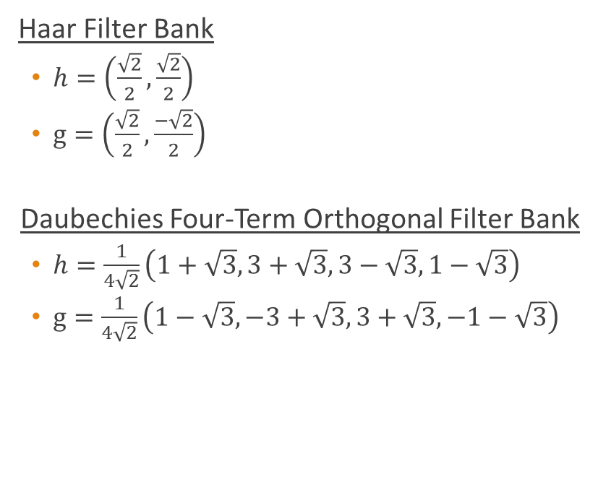
1-D Discrete Wavelet Transform (DWT)
Transforms Data so that we obtain frequency information, and the time associated with the frequencies
Fourier transform only captures frequency information
This transform can be described using filter banks
Filters separates the signal into multiple components, each representing a frequency sub-band
Haar Filter Bank
$h=\left(\frac{\sqrt{2}}{2},\frac{\sqrt{2}}{2}\right)$
$g=\left(\frac{\sqrt{2}}{2},\frac{−\sqrt{2}}{2}\right)$
Daubechies Four-Term Orthogonal Filter Bank
$h=\frac{1}{4\sqrt{2}}\left(1+\sqrt{3},3+\sqrt{3},3−\sqrt{3},1−\sqrt{3}\right)$
$g=\frac{1}{4\sqrt{2}}\left(1−\sqrt{3},−3+\sqrt{3},3+\sqrt{3},−1−\sqrt{3}\right)$

Slide 6

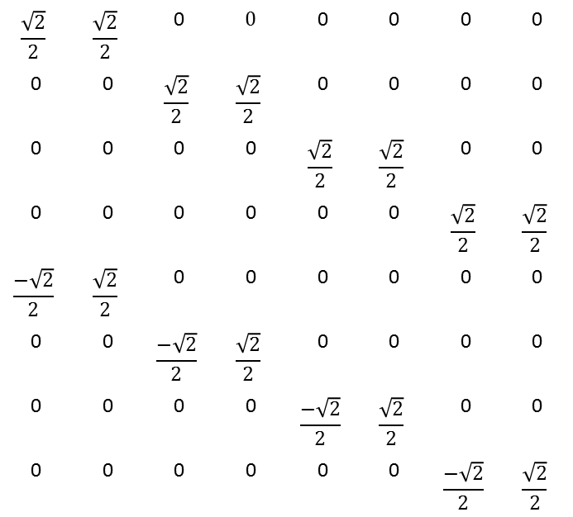
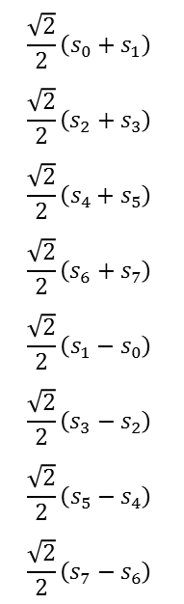
Computation of HWT
$$\frac{\sqrt{2}}{2}$$ | $$\frac{\sqrt{2}}{2}$$ | 0 | $$0$$ | 0 | 0 | 0 | 0
0 | 0 | $$\frac{\sqrt{2}}{2}$$ | $$\frac{\sqrt{2}}{2}$$ | 0 | 0 | 0 | 0
0 | 0 | 0 | 0 | $$\frac{\sqrt{2}}{2}$$ | $$\frac{\sqrt{2}}{2}$$ | 0 | 0
0 | 0 | 0 | 0 | 0 | 0 | $$\frac{\sqrt{2}}{2}$$ | $$\frac{\sqrt{2}}{2}$$
$$\frac{−\sqrt{2}}{2}$$ | $$\frac{\sqrt{2}}{2}$$ | 0 | 0 | 0 | 0 | 0 | 0
0 | 0 | $$\frac{−\sqrt{2}}{2}$$ | $$\frac{\sqrt{2}}{2}$$ | 0 | 0 | 0 | 0
0 | 0 | 0 | 0 | $$\frac{−\sqrt{2}}{2}$$ | $$\frac{\sqrt{2}}{2}$$ | 0 | 0
0 | 0 | 0 | 0 | 0 | 0 | $$\frac{−\sqrt{2}}{2}$$ | $$\frac{\sqrt{2}}{2}$$
$$s_{0}$$
$$s_{1}$$
$$s_{2}$$
$$s_{3}$$
$$s_{4}$$
$$s_{5}$$
$$s_{6}$$
$$s_{7}$$
$$\frac{\sqrt{2}}{2}\left(s_{0}+s_{1}\right)$$
$$\frac{\sqrt{2}}{2}\left(s_{2}+s_{3}\right)$$
$$\frac{\sqrt{2}}{2}\left(s_{4}+s_{5}\right)$$
$$\frac{\sqrt{2}}{2}\left(s_{6}+s_{7}\right)$$
$$\frac{\sqrt{2}}{2}\left(s_{1}−s_{0}\right)$$
$$\frac{\sqrt{2}}{2}\left(s_{3}−s_{2}\right)$$
$$\frac{\sqrt{2}}{2}\left(s_{5}−s_{4}\right)$$
$$\frac{\sqrt{2}}{2}\left(s_{7}−s_{6}\right)$$
Computation model using the haar wavelet transform
This can be generalized for longer length vectors
Note that the vector input must be of even length
Is this transform invertible?
*
=

Slide 7

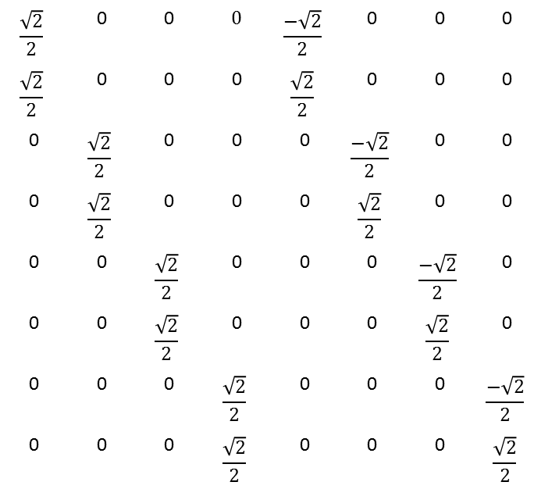
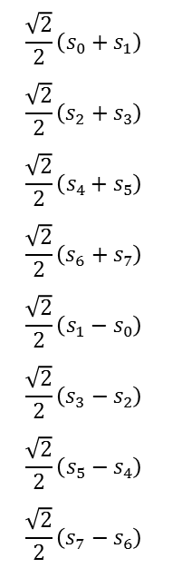
Inverse HWT
$$\frac{\sqrt{2}}{2}$$ | 0 | 0 | $$0$$ | $$\frac{−\sqrt{2}}{2}$$ | 0 | 0 | 0
$$\frac{\sqrt{2}}{2}$$ | 0 | 0 | 0 | $$\frac{\sqrt{2}}{2}$$ | 0 | 0 | 0
0 | $$\frac{\sqrt{2}}{2}$$ | 0 | 0 | 0 | $$\frac{−\sqrt{2}}{2}$$ | 0 | 0
0 | $$\frac{\sqrt{2}}{2}$$ | 0 | 0 | 0 | $$\frac{\sqrt{2}}{2}$$ | 0 | 0
0 | 0 | $$\frac{\sqrt{2}}{2}$$ | 0 | 0 | 0 | $$\frac{−\sqrt{2}}{2}$$ | 0
0 | 0 | $$\frac{\sqrt{2}}{2}$$ | 0 | 0 | 0 | $$\frac{\sqrt{2}}{2}$$ | 0
0 | 0 | 0 | $$\frac{\sqrt{2}}{2}$$ | 0 | 0 | 0 | $$\frac{−\sqrt{2}}{2}$$
0 | 0 | 0 | $$\frac{\sqrt{2}}{2}$$ | 0 | 0 | 0 | $$\frac{\sqrt{2}}{2}$$
$$\frac{\sqrt{2}}{2}\left(s_{0}+s_{1}\right)$$
$$\frac{\sqrt{2}}{2}\left(s_{2}+s_{3}\right)$$
$$\frac{\sqrt{2}}{2}\left(s_{4}+s_{5}\right)$$
$$\frac{\sqrt{2}}{2}\left(s_{6}+s_{7}\right)$$
$$\frac{\sqrt{2}}{2}\left(s_{1}−s_{0}\right)$$
$$\frac{\sqrt{2}}{2}\left(s_{3}−s_{2}\right)$$
$$\frac{\sqrt{2}}{2}\left(s_{5}−s_{4}\right)$$
$$\frac{\sqrt{2}}{2}\left(s_{7}−s_{6}\right)$$
$$s_{0}$$
$$s_{1}$$
$$s_{2}$$
$$s_{3}$$
$$s_{4}$$
$$s_{5}$$
$$s_{6}$$
$$s_{7}$$
We have an orthogonal matrix, therefore to compute the inverse transform, simply pre-multiply by the transpose
Matrix multiplication is inefficient for computing. Instead, we implement algorithms to compute the transform
*
=

Slide 8
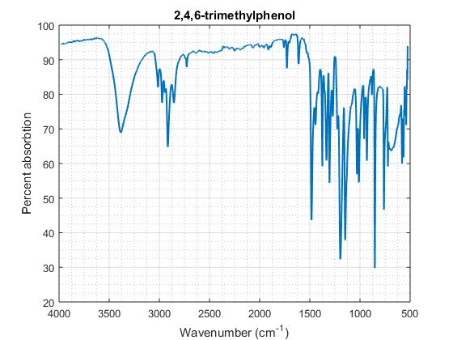
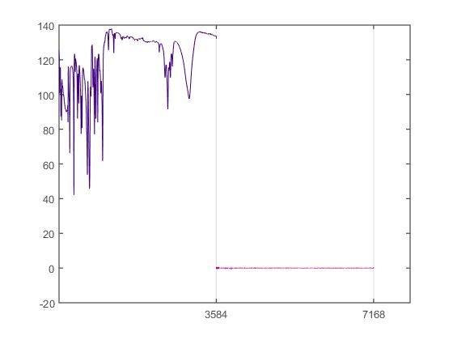
Daubechies-4 Transform of 2,4,6-trimethylphenol
Averaging
Detail

Slide 9
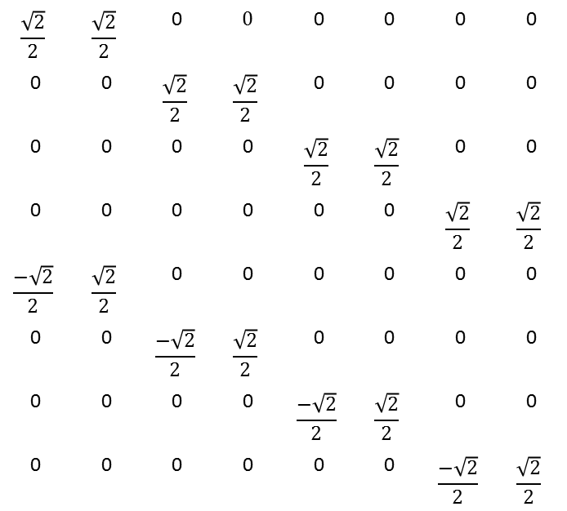
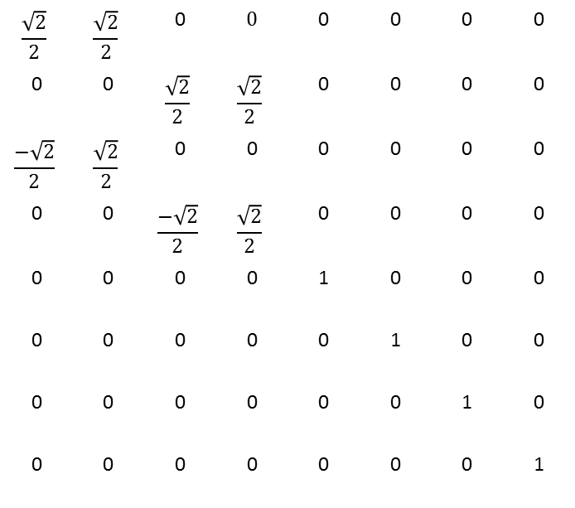
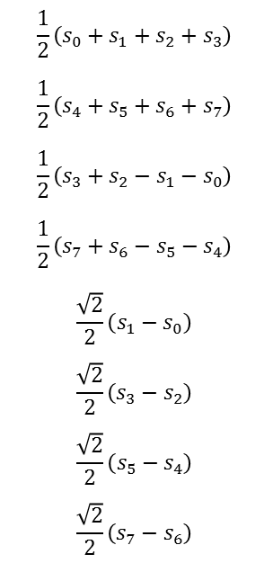
Iterating the HWT
$$\frac{\sqrt{2}}{2}$$ | $$\frac{\sqrt{2}}{2}$$ | 0 | $$0$$ | 0 | 0 | 0 | 0
0 | 0 | $$\frac{\sqrt{2}}{2}$$ | $$\frac{\sqrt{2}}{2}$$ | 0 | 0 | 0 | 0
$$\frac{−\sqrt{2}}{2}$$ | $$\frac{\sqrt{2}}{2}$$ | 0 | 0 | 0 | 0 | 0 | 0
0 | 0 | $$\frac{−\sqrt{2}}{2}$$ | $$\frac{\sqrt{2}}{2}$$ | 0 | 0 | 0 | 0
0 | 0 | 0 | 0 | 1 | 0 | 0 | 0
0 | 0 | 0 | 0 | 0 | 1 | 0 | 0
0 | 0 | 0 | 0 | 0 | 0 | 1 | 0
0 | 0 | 0 | 0 | 0 | 0 | 0 | 1
$$\frac{\sqrt{2}}{2}$$ | $$\frac{\sqrt{2}}{2}$$ | 0 | $$0$$ | 0 | 0 | 0 | 0
0 | 0 | $$\frac{\sqrt{2}}{2}$$ | $$\frac{\sqrt{2}}{2}$$ | 0 | 0 | 0 | 0
0 | 0 | 0 | 0 | $$\frac{\sqrt{2}}{2}$$ | $$\frac{\sqrt{2}}{2}$$ | 0 | 0
0 | 0 | 0 | 0 | 0 | 0 | $$\frac{\sqrt{2}}{2}$$ | $$\frac{\sqrt{2}}{2}$$
$$\frac{−\sqrt{2}}{2}$$ | $$\frac{\sqrt{2}}{2}$$ | 0 | 0 | 0 | 0 | 0 | 0
0 | 0 | $$\frac{−\sqrt{2}}{2}$$ | $$\frac{\sqrt{2}}{2}$$ | 0 | 0 | 0 | 0
0 | 0 | 0 | 0 | $$\frac{−\sqrt{2}}{2}$$ | $$\frac{\sqrt{2}}{2}$$ | 0 | 0
0 | 0 | 0 | 0 | 0 | 0 | $$\frac{−\sqrt{2}}{2}$$ | $$\frac{\sqrt{2}}{2}$$
$$s_{0}$$
$$s_{1}$$
$$s_{2}$$
$$s_{3}$$
$$s_{4}$$
$$s_{5}$$
$$s_{6}$$
$$s_{7}$$
$$\frac{1}{2}\left(s_{0}+s_{1}+s_{2}+s_{3}\right)$$
$$\frac{1}{2}\left(s_{4}+s_{5}+s_{6}+s_{7}\right)$$
$$\frac{1}{2}\left(s_{3}+s_{2}−s_{1}−s_{0}\right)$$
$$\frac{1}{2}\left(s_{7}+s_{6}−s_{5}−s_{4}\right)$$
$$\frac{\sqrt{2}}{2}\left(s_{1}−s_{0}\right)$$
$$\frac{\sqrt{2}}{2}\left(s_{3}−s_{2}\right)$$
$$\frac{\sqrt{2}}{2}\left(s_{5}−s_{4}\right)$$
$$\frac{\sqrt{2}}{2}\left(s_{7}−s_{6}\right)$$
*
=

Slide 10
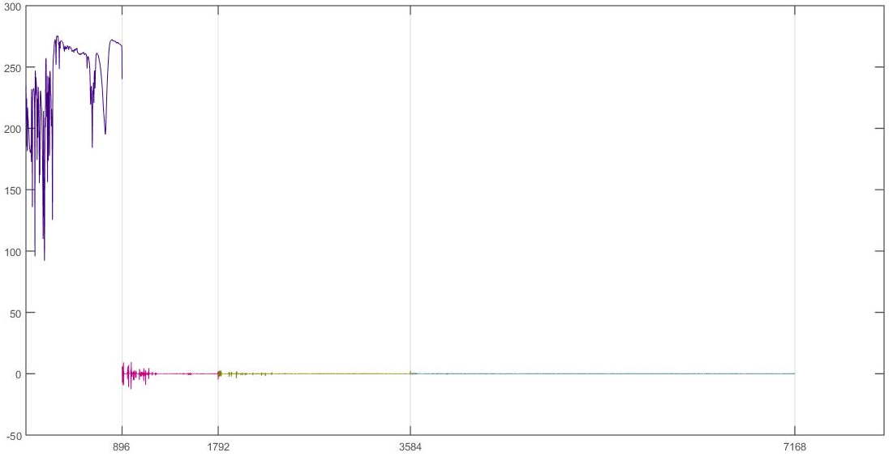
3 Iterations of the Daubechies-4 Transform of 2,4,6-trimethylphenol

Slide 11
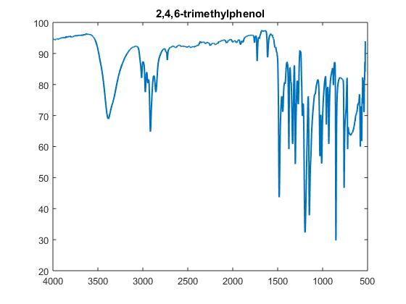
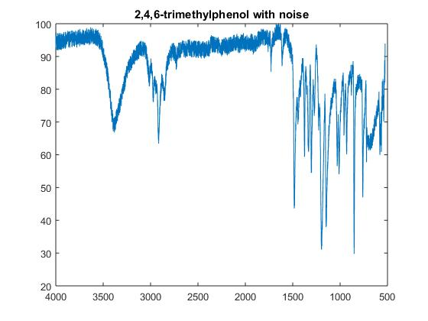
De-noising Infrared Spectra
Our goal is to recover the original spectra

Slide 12
How can de-noising be achieved?
Co-adding Spectra
Obtain many different spectra of the compound
Take the average of all the spectra obtained
Pros
Usually does a good job of de-noising
Cons
Requires a Large Sample of Spectra
Time consuming to continually take samples
2. Mathematical Methods
Pros
Also does a good job of de-noising
Much faster than co-adding spectra
Procedure or Algorithm
Compute the Wavelet Transform
Apply a threshold rule to the highpass portion (detail coefficients) of the wavelet transform
Rejoin the lowpass with the revised highpass portion
Compute the Inverse Wavelet Transform

Slide 13
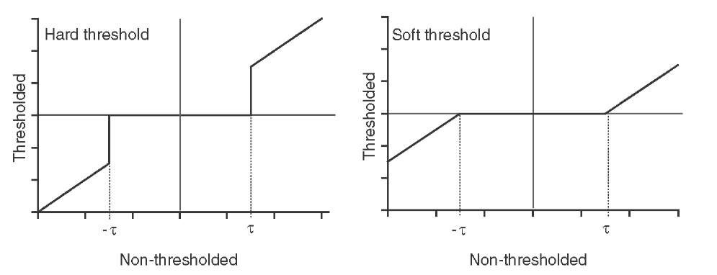
Hard vs. Soft Thresholding

Slide 14
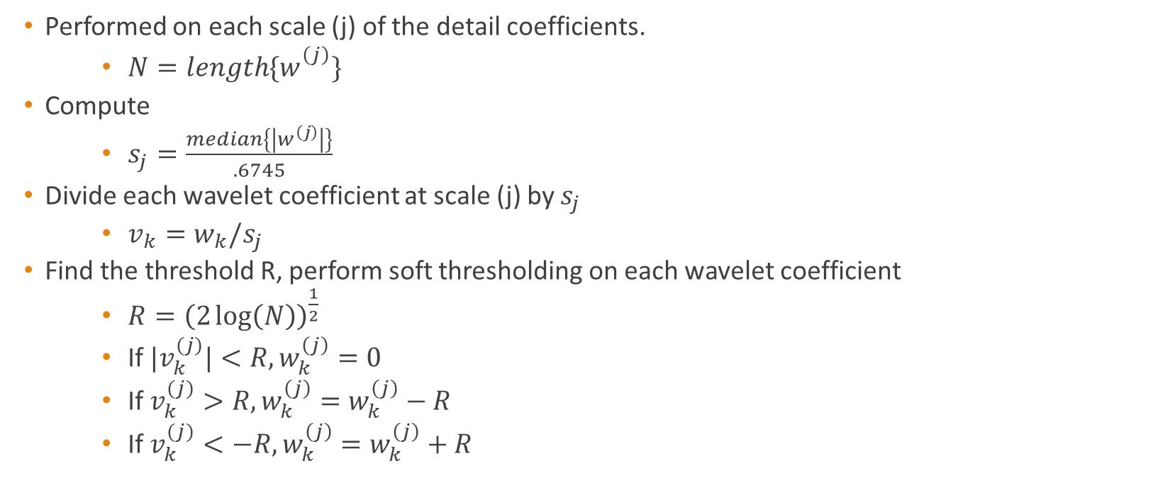
Median Absolute Deviation
Performed on each scale (j) of the detail coefficients.
$N=length\{w_{}^{\left(j\right)}\}$
Compute
$s_{j}=\frac{median\left\{\left|w^{\left(j\right)}\right|\right\}}{.6745}$
Divide each wavelet coefficient at scale (j) by $s_{j}$
$v_{k}=w_{k}/s_{j}$
Find the threshold R, perform soft thresholding on each wavelet coefficient
$R={\left(2\log\left(N\right)\right)}^{\frac{1}{2}}$
If ${|v}_{k}^{(j)}|<R, w_{k}^{\left(j\right)}=0$
If $v_{k}^{(j)}>R, w_{k}^{\left(j\right)}=w_{k}^{\left(j\right)}−R$
If $v_{k}^{(j)}<−R, w_{k}^{\left(j\right)}=w_{k}^{\left(j\right)}+R$

Slide 15
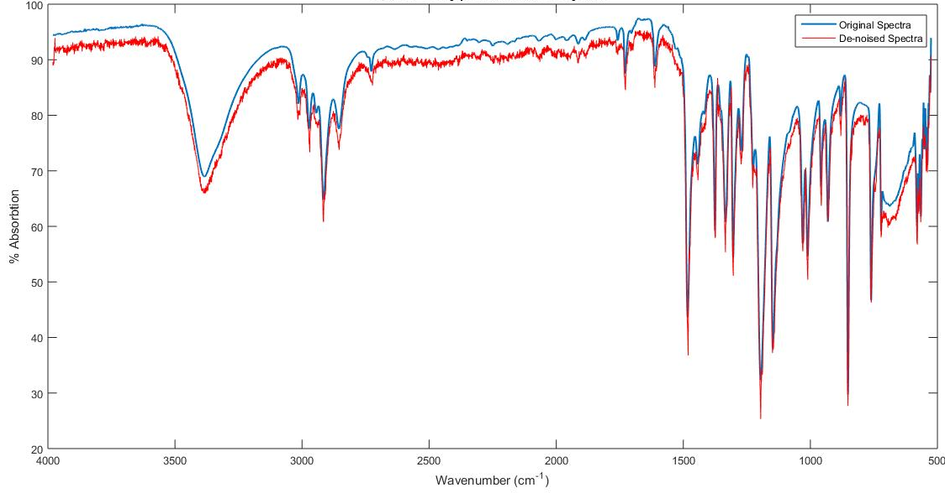
2,4,6-trimethylphenol De-noised by MAD

Slide 16
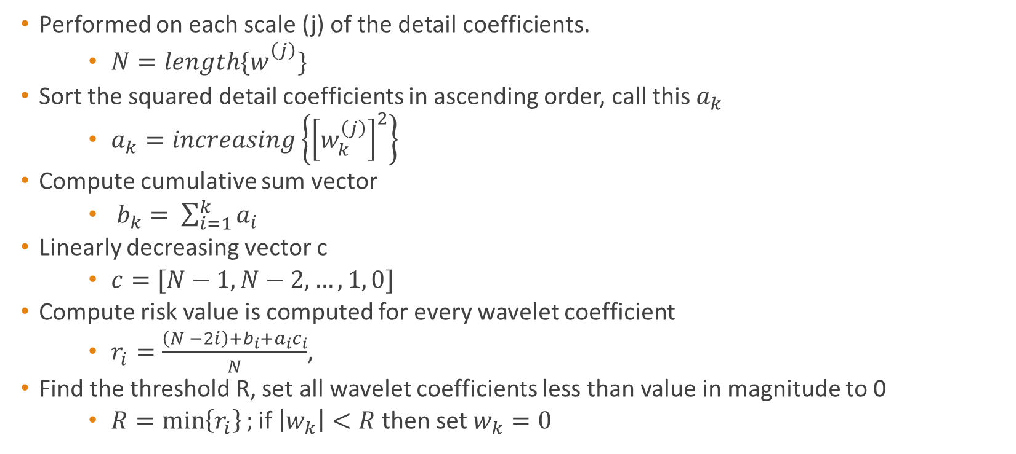
Stein’s Unbiased Risk Estimate
Performed on each scale (j) of the detail coefficients.
$N=length\{w_{}^{\left(j\right)}\}$
Sort the squared detail coefficients in ascending order, call this $a_{k}$
$a_{k}=increasing\left\{{\left[w_{k}^{\left(j\right)}\right]}^{2}\right\}$
Compute cumulative sum vector
$b_{k}= \sum_{i=1}^{k}{a_{i}}$
Linearly decreasing vector c
$c=[N−1, N−2, …, 1, 0]$
Compute risk value is computed for every wavelet coefficient
$r_{i}=\frac{\left(N −2i\right)+b_{i}+a_{i}c_{i}}{N}$,
Find the threshold R, set all wavelet coefficients less than value in magnitude to 0
$R=\min\left\{r_{i}\right\};$ if $\left|w_{k}\right|<R$ then set $w_{k}=0$

Slide 17
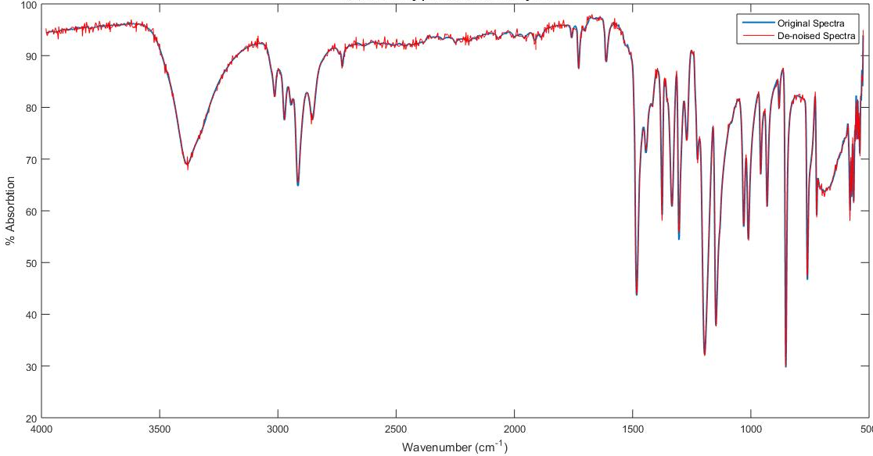
2,4,6-trimethylphenol De-noised by SURE

Slide 18
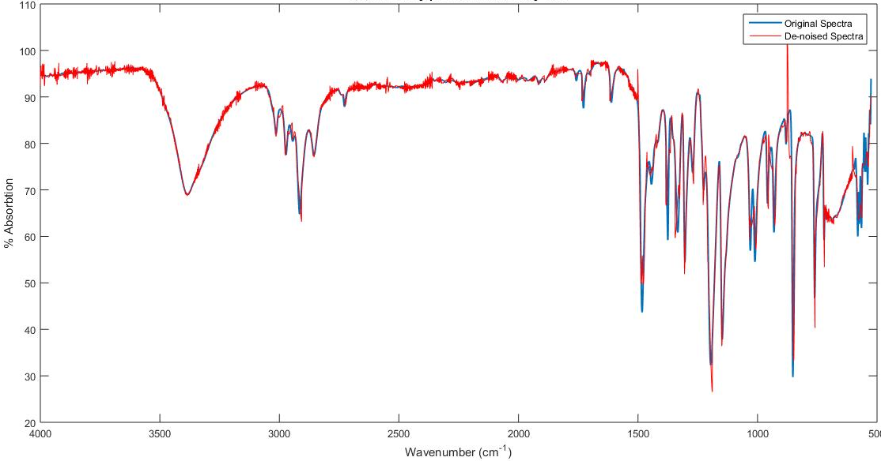
2,4,6-trimethylphenol De-noised by Singular Value Decomposition

Slide 19
Computation of HWT
$$\frac{\sqrt{2}}{2}$$ | $$\frac{\sqrt{2}}{2}$$ | 0 | $$0$$ | 0 | 0 | 0 | 0
0 | 0 | $$\frac{\sqrt{2}}{2}$$ | $$\frac{\sqrt{2}}{2}$$ | 0 | 0 | 0 | 0
0 | 0 | 0 | 0 | $$\frac{\sqrt{2}}{2}$$ | $$\frac{\sqrt{2}}{2}$$ | 0 | 0
0 | 0 | 0 | 0 | 0 | 0 | $$\frac{\sqrt{2}}{2}$$ | $$\frac{\sqrt{2}}{2}$$
$$\frac{−\sqrt{2}}{2}$$ | $$\frac{\sqrt{2}}{2}$$ | 0 | 0 | 0 | 0 | 0 | 0
0 | 0 | $$\frac{−\sqrt{2}}{2}$$ | $$\frac{\sqrt{2}}{2}$$ | 0 | 0 | 0 | 0
0 | 0 | 0 | 0 | $$\frac{−\sqrt{2}}{2}$$ | $$\frac{\sqrt{2}}{2}$$ | 0 | 0
0 | 0 | 0 | 0 | 0 | 0 | $$\frac{−\sqrt{2}}{2}$$ | $$\frac{\sqrt{2}}{2}$$
$$s_{0}$$
$$s_{1}$$
$$s_{2}$$
$$s_{3}$$
$$s_{4}$$
$$s_{5}$$
$$s_{6}$$
$$s_{7}$$
$$\frac{\sqrt{2}}{2}\left(s_{0}+s_{1}\right)$$
$$\frac{\sqrt{2}}{2}\left(s_{2}+s_{3}\right)$$
$$\frac{\sqrt{2}}{2}\left(s_{4}+s_{5}\right)$$
$$\frac{\sqrt{2}}{2}\left(s_{6}+s_{7}\right)$$
$$\frac{\sqrt{2}}{2}\left(s_{1}−s_{0}\right)$$
$$\frac{\sqrt{2}}{2}\left(s_{3}−s_{2}\right)$$
$$\frac{\sqrt{2}}{2}\left(s_{5}−s_{4}\right)$$
$$\frac{\sqrt{2}}{2}\left(s_{7}−s_{6}\right)$$
Computation model using the haar wavelet transform
This can be generalized for longer length vectors
Note that the vector input must be of even length
Is this transform invertible?
*
=

Slide 20
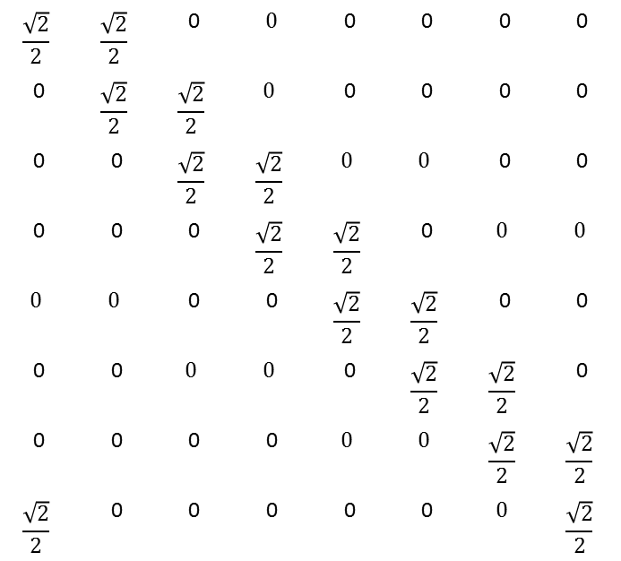
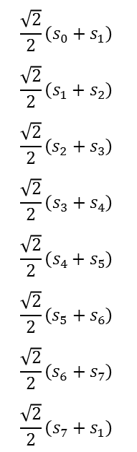
The Undecimated Haar Wavelet Transform (UHWT)
$$\frac{\sqrt{2}}{2}$$ | $$\frac{\sqrt{2}}{2}$$ | 0 | $$0$$ | 0 | 0 | 0 | 0
0 | $$\frac{\sqrt{2}}{2}$$ | $$\frac{\sqrt{2}}{2}$$ | $$0$$ | 0 | 0 | 0 | 0
0 | 0 | $$\frac{\sqrt{2}}{2}$$ | $$\frac{\sqrt{2}}{2}$$ | $$0$$ | $$0$$ | 0 | 0
0 | 0 | 0 | $$\frac{\sqrt{2}}{2}$$ | $$\frac{\sqrt{2}}{2}$$ | 0 | $$0$$ | $$0$$
$$0$$ | $$0$$ | 0 | 0 | $$\frac{\sqrt{2}}{2}$$ | $$\frac{\sqrt{2}}{2}$$ | 0 | 0
0 | 0 | $$0$$ | $$0$$ | 0 | $$\frac{\sqrt{2}}{2}$$ | $$\frac{\sqrt{2}}{2}$$ | 0
0 | 0 | 0 | 0 | $$0$$ | $$0$$ | $$\frac{\sqrt{2}}{2}$$ | $$\frac{\sqrt{2}}{2}$$
$$\frac{\sqrt{2}}{2}$$ | 0 | 0 | 0 | 0 | 0 | $$0$$ | $$\frac{\sqrt{2}}{2}$$
$$s_{0}$$
$$s_{1}$$
$$s_{2}$$
$$s_{3}$$
$$s_{4}$$
$$s_{5}$$
$$s_{6}$$
$$s_{7}$$
$$\frac{\sqrt{2}}{2}\left(s_{0}+s_{1}\right)$$
$$\frac{\sqrt{2}}{2}\left(s_{1}+s_{2}\right)$$
$$\frac{\sqrt{2}}{2}\left(s_{2}+s_{3}\right)$$
$$\frac{\sqrt{2}}{2}\left(s_{3}+s_{4}\right)$$
$$\frac{\sqrt{2}}{2}\left(s_{4}+s_{5}\right)$$
$$\frac{\sqrt{2}}{2}\left(s_{5}+s_{6}\right)$$
$$\frac{\sqrt{2}}{2}\left(s_{6}+s_{7}\right)$$
$$\frac{\sqrt{2}}{2}\left(s_{7}+s_{1}\right)$$
This computes only the lowpass portion (averaging coefficients) of the UHWT
We add redundancy to the wavelet transform. This means there are multiple ways to compute the inverse transform
*
=

Slide 21
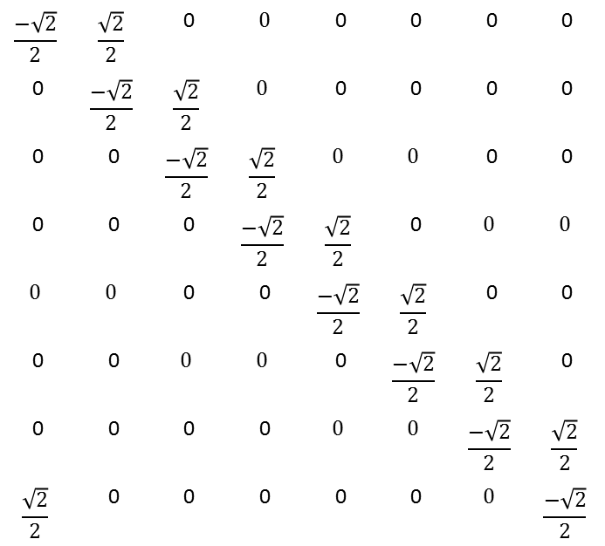
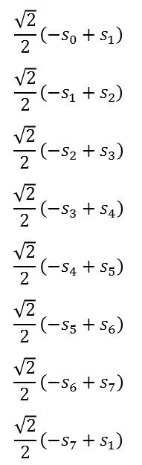
Highpass Portion (Averaging Coefficients) of the UHWT
$$\frac{−\sqrt{2}}{2}$$ | $$\frac{\sqrt{2}}{2}$$ | 0 | $$0$$ | 0 | 0 | 0 | 0
0 | $$\frac{−\sqrt{2}}{2}$$ | $$\frac{\sqrt{2}}{2}$$ | $$0$$ | 0 | 0 | 0 | 0
0 | 0 | $$\frac{−\sqrt{2}}{2}$$ | $$\frac{\sqrt{2}}{2}$$ | $$0$$ | $$0$$ | 0 | 0
0 | 0 | 0 | $$\frac{−\sqrt{2}}{2}$$ | $$\frac{\sqrt{2}}{2}$$ | 0 | $$0$$ | $$0$$
$$0$$ | $$0$$ | 0 | 0 | $$\frac{−\sqrt{2}}{2}$$ | $$\frac{\sqrt{2}}{2}$$ | 0 | 0
0 | 0 | $$0$$ | $$0$$ | 0 | $$\frac{−\sqrt{2}}{2}$$ | $$\frac{\sqrt{2}}{2}$$ | 0
0 | 0 | 0 | 0 | $$0$$ | $$0$$ | $$\frac{−\sqrt{2}}{2}$$ | $$\frac{\sqrt{2}}{2}$$
$$\frac{\sqrt{2}}{2}$$ | 0 | 0 | 0 | 0 | 0 | $$0$$ | $$\frac{−\sqrt{2}}{2}$$
$$s_{0}$$
$$s_{1}$$
$$s_{2}$$
$$s_{3}$$
$$s_{4}$$
$$s_{5}$$
$$s_{6}$$
$$s_{7}$$
$$\frac{\sqrt{2}}{2}\left({−s}_{0}+s_{1}\right)$$
$$\frac{\sqrt{2}}{2}\left({−s}_{1}+s_{2}\right)$$
$$\frac{\sqrt{2}}{2}\left({−s}_{2}+s_{3}\right)$$
$$\frac{\sqrt{2}}{2}\left({−s}_{3}+s_{4}\right)$$
$$\frac{\sqrt{2}}{2}\left({−s}_{4}+s_{5}\right)$$
$$\frac{\sqrt{2}}{2}\left({−s}_{5}+s_{6}\right)$$
$$\frac{\sqrt{2}}{2}\left({−s}_{6}+s_{7}\right)$$
$$\frac{\sqrt{2}}{2}\left({−s}_{7}+s_{1}\right)$$
Also notice that these matrices are no longer orthogonal
In fact, these matrices are no longer invertible
In this example, we obtain a transformed vector of length 16
The UWT yields a vector that is twice the length of the original vector
*
=

Slide 22
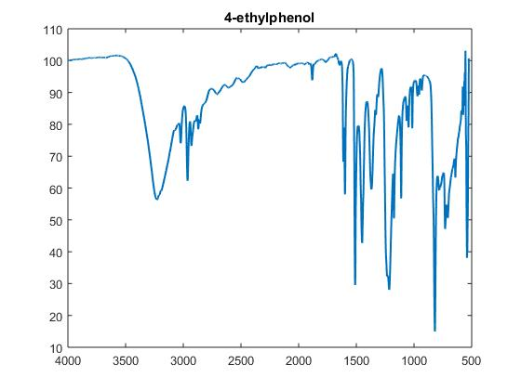
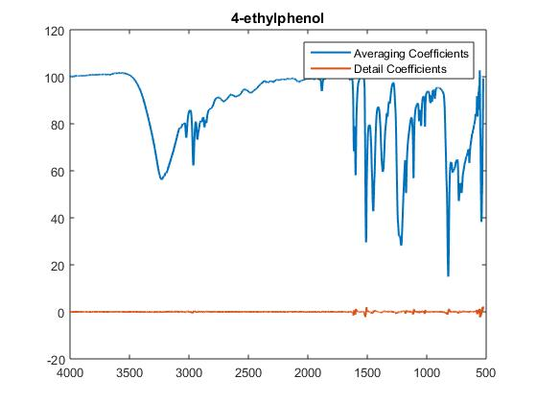
The UHWT of 4-ethylphenol

Slide 23
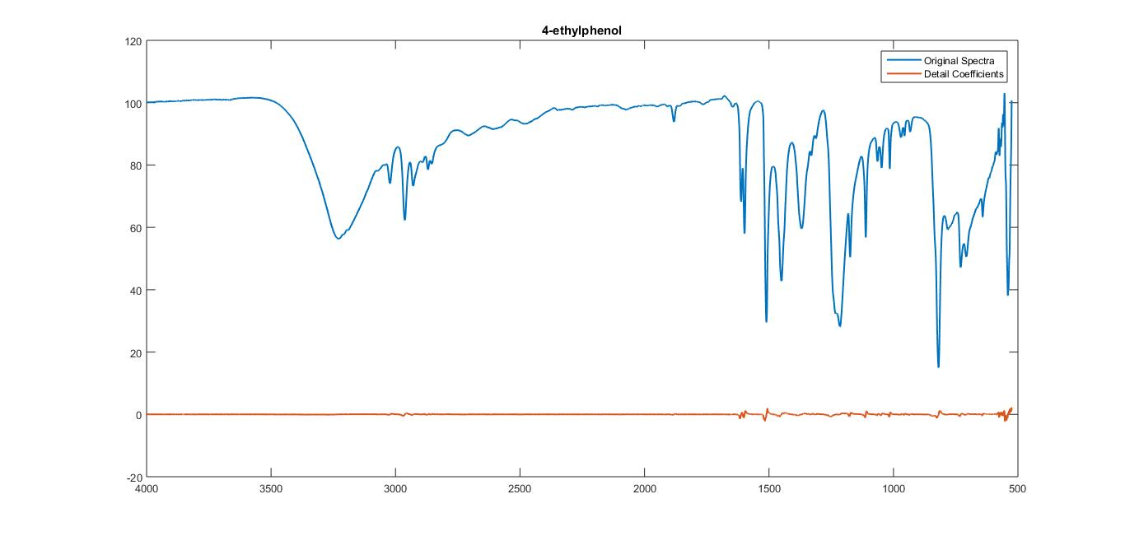
The Undecimated Haar Wavelet Transform

Slide 24
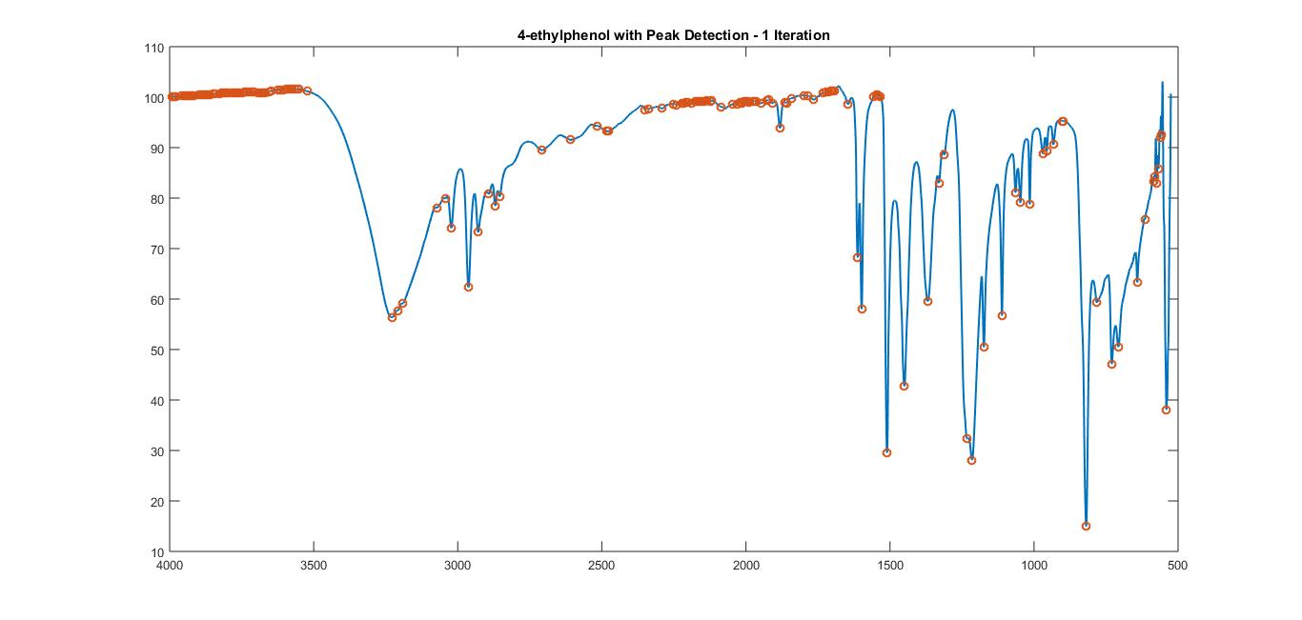
Peak Detection with the UHWT
159 Peaks!!!

Slide 25
Iterating the UHWT
1 | 2 | 3 | 4 | 5 | 6 | 7 | 8 | 9 | 10
426 | 426 | 425 | 425 | 424 | 424 | 423 | 423 | 529 | 528
533 | 532 | 532 | 531 | 531 | 530 | 530 | 529 | 607 | 606
610 | 610 | 610 | 609 | 609 | 608 | 608 | 607 | 775 | 775
775 | 775 | 774 | 778 | 778 | 777 | 776 | 776 | 843 | 842
780 | 779 | 779 | 845 | 845 | 844 | 844 | 843 | 890 | 890
847 | 846 | 846 | 892 | 892 | 891 | 891 | 890 | 919 | 918
894 | 893 | 893 | 921 | 921 | 920 | 920 | 919 | 1013 | 1012
923 | 922 | 922 | 1015 | 1015 | 1014 | 1014 | 1013 | 1081 | 1080
1017 | 1016 | 1016 | 1083 | 1083 | 1082 | 1082 | 1081 | 1115 | 1115
1085 | 1084 | 1084 | 1118 | 1117 | 1117 | 1116 | 1116 | 1213 | 1212

Slide 26

Peak Detection with the UWT – 10 iterations
143 Peaks!!!

Slide 27
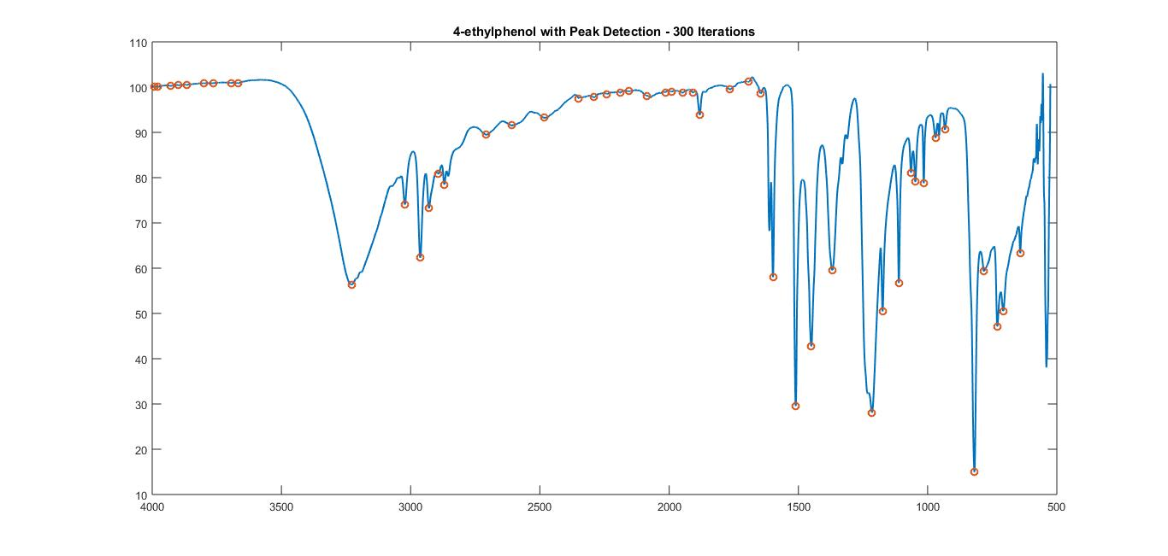
Peak Detection with the UWT – 300 iterations
50 Peaks!!!

Slide 28
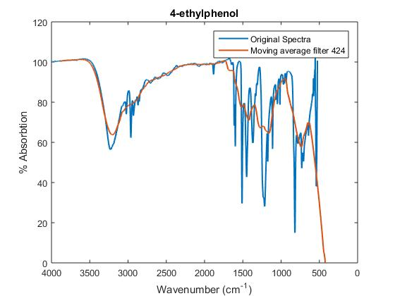
Signal Smoothing
There are still too many peaks detected
We need to smooth the signal further, however more iterations of the UHWT will not do a good enough job.
We start over by utilizing a moving average filter of length N to make more drastic smoothing to the spectra
We can also iterate this process with multiple filter lengths
Here we apply one iteration of a moving average filter of length 424

Slide 29
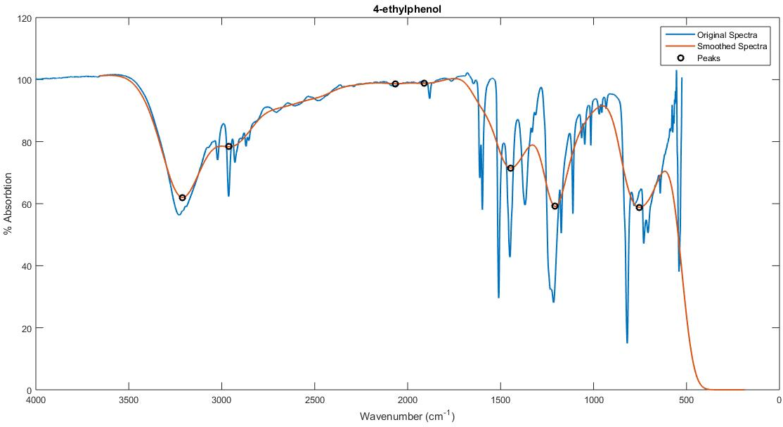
4-ethylphenol

Slide 30
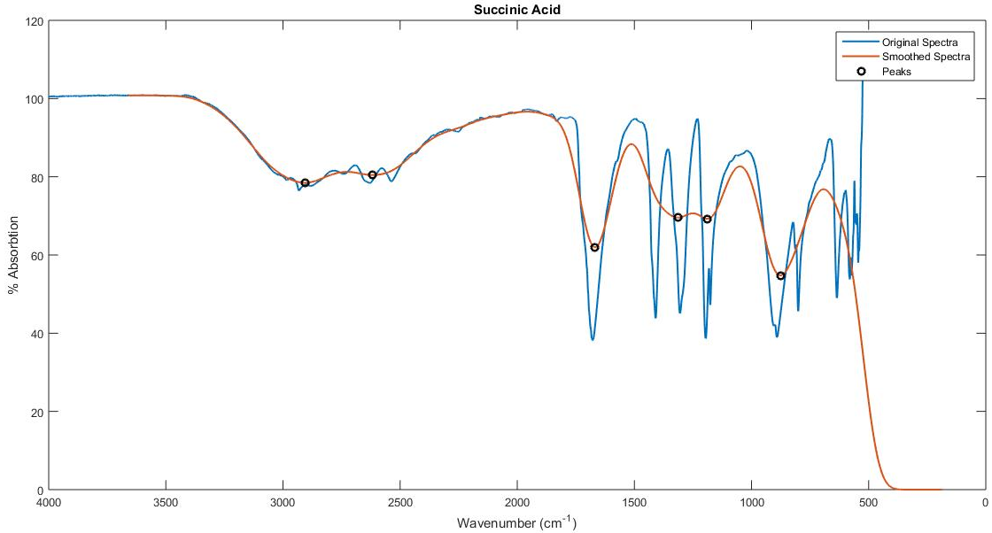
Succinic Acid

Slide 31
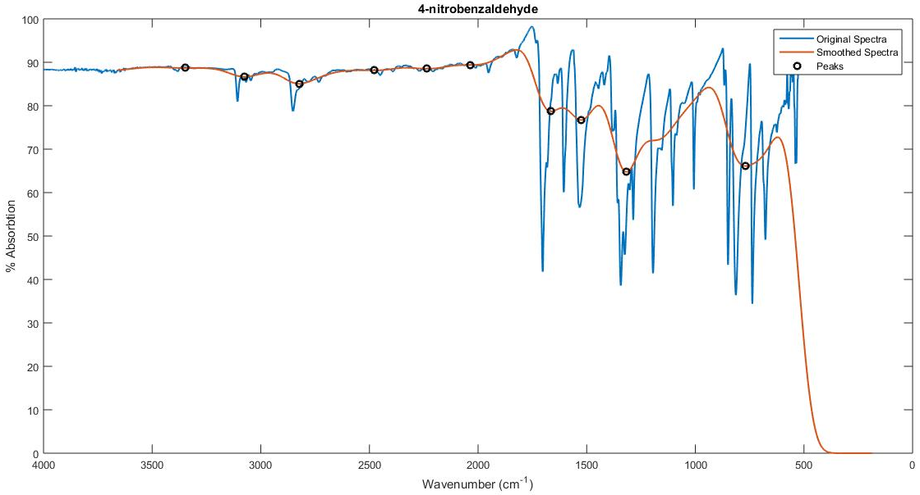
4-nitrobenzaldehyde

Slide 32
Results
Peak detection performs well in identifying –OH and –CH₃ functional groups
Procedure also does well at identifying aromatic rings
Misidentification of Alkenes and C=N bonds is present
Need to implement a way to decipher between –OH and –COOH functional groups
This will likely be computed by an area calculation
Must improve peak finding in 500cm⁻¹ - 2000cm⁻¹ region

Slide 33
Future Research
Investigate other de-noising methods and threshold determination techniques
Attempt de-noising using the undecimated wavelet transform
Further improve my model for peak detection, and investigate other methods as well
Obtain more information for my compound identification scheme
Nuclear Magnetic Resonance, Mass Spectroscopy
Incorporate probabilistic determination into compound identification

Slide 34
References
Papers
Alsberg, “Wavelet De-noising of Infrared Spectra”, Analyst, July 1997, Vol. 122 (645–652)
Bos, “The wavelet transform for pre-processing IR spectra in the identification of mono- and di-substituted benzenes”, Chemometrics and intelligent laboratory systems, October 1993
Gu, “Redundant Wavelet Transform and its Application in Denoising and Prediction”, Harvard University
Van Fleet, Discrete Wavelet Transformations: An elementary approach with applications, 2008
Websites
http://www.mathworks.com/help/signal/examples/signal-smoothing.html?s_eid=PSM_12299&requestedDomain=www.mathworks.com
http://wps.prenhall.com/wps/media/objects/724/741576/chapter_13.html
http://www.ni.com/white-paper/5432/en/

Slide 35
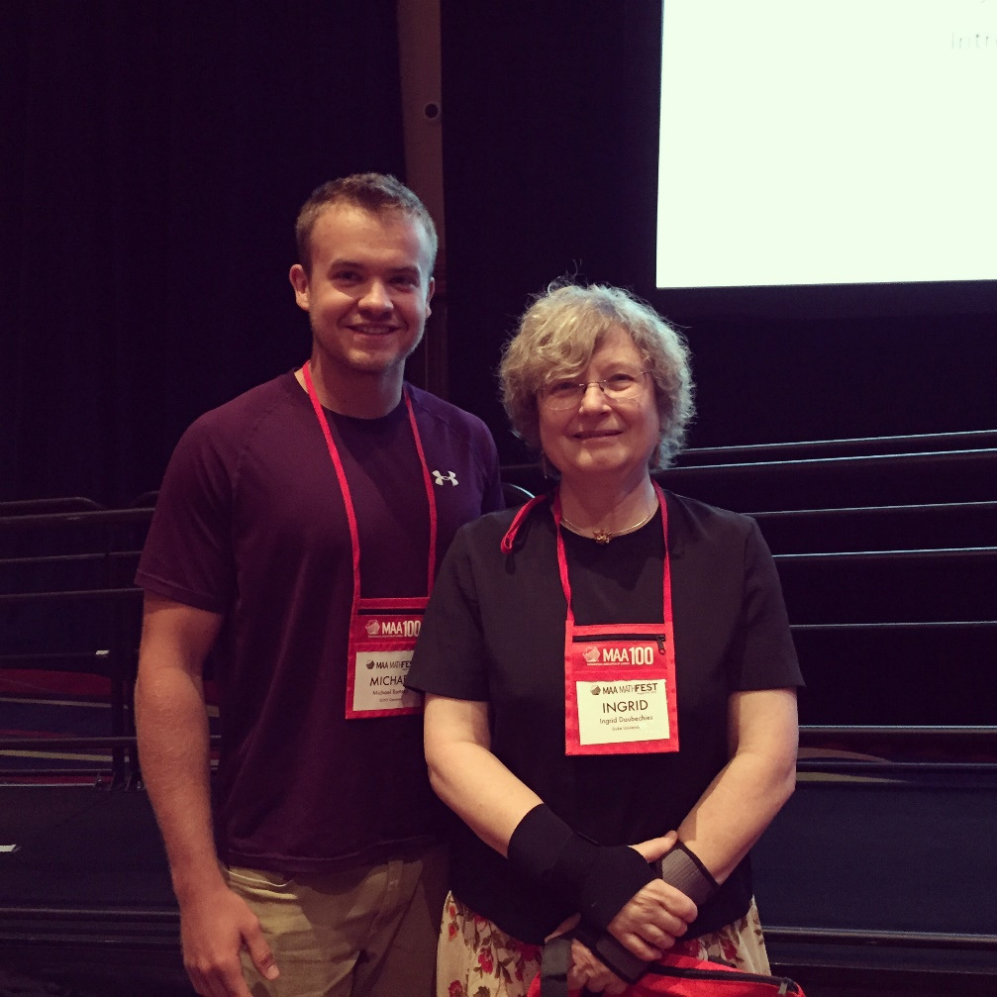
Questions?
Thank you for Attending

