Slide 1
Binary Encoding with Go: The “other” encoding packages
January 24, 2019

Slide 2
Agenda
ASN.1
GOB
Comparison with the more well-used encodings
Notes:
Why is binary encoding so important?
Everything is binary encoded at some level:
Character-sets: ASCII (7- & 8-bit), UTF-8 & 16, EBCDIC
Floating point numbers: IEEE 754
Binary encodings of structured data can save time and space when encoding/decoding when human readability isn’t important.

Slide 3
ASN.1 (Abstract Syntax Notation One)

Slide 4
ASN.1 - Background
Interface Description Language (IDL) for describing data structures in a cross-platform way.
ISO/IEC (8824) and ITU-T standard (X.680-X.699)
Standardized in 1984 with updates as recently as August 2015
Used in telecommunications, networking, and cryptography (X.509)
Meant to be both human and computer readable
Used directly in three languages:
SDL for modelling event driven systems
TTCN-3 for conformance testing
Erlang
Notes:
Sounds like CORBA
Human readable since this became a standard in 1984
X.509, and ASN.1, defines the format of the certs used in HTTPS.
Also used in LDAP, VoIP, SNMP, and cellular standards like 3G and 4G.

Slide 5
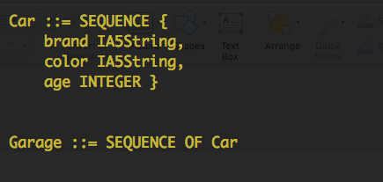
ASN.1 - IDL Syntax & Structure
Case sensitive syntax with keywords in ALL CAPS
No underscores allowed for some reason
Comments start with “--”, end with another “--” or EOL
Assignment uses “::=“
Base datatypes are: BOOLEAN, INTEGER, ENUMERATED, REAL, NULL
DATE, TIME-OF-DAY, and DATE-TIME
Structs are fields grouped using into SEQUENCE(s) or SET(s)
SEQUENCE OF and SET OF arrays and sets of structs
Notes:
Syntax and structure of the IDL aren’t important from Go’s perspective, but still useful background.
Date and time fields use a format similar to RFC-3339
STRING TYPES:
IA5String – International Alphabet #5. Uses 7-bits for each character. 7-bit ASCII in the US.
VisibileString – IA5String without the control characters (\n, \t, \r, etc)
UTF8String – traditional 8-bit Unicode strings
Binary strings
Hex strings are also supported with special quoting
`01001`B
`1F4D`H

Slide 6
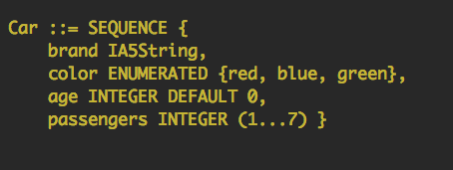
ASN.1 – IDL Syntax & Structure
Supports ENUMERATED, DEFAULT values along with ranges for supported data types.
Fields can also be OPTIONAL
Ranges can be specified using ‘…’ syntax or ‘|’ syntax, (1 | 5 | 10 | 20 )

Slide 7
ASN.1 - Encoding
ASN.1 Supports a number of encodings:
BER: Basic Encoding Rule
Basic TLV (Type, Length, Value) encoding
PER: Packed Encoding Rule
Everything is optional. Compact but hard to understand and implement
XER: XML Encoding Rule
DER: Distinguished Encoding Rule
Restriction on BER that allows for a single method for encoding. Always provides length information for structs/fields. This is the encoding that encoding/asn1 uses in Go.
Type (1B)
Length (1B)
Value
Notes:
Each structure has its own bit representation:
Type has:
2 bits for class (universal, application, private, context-specific)
1 bit for form (primitive or constructed)
5 bits for “tag”, which is analogous to type

Slide 8
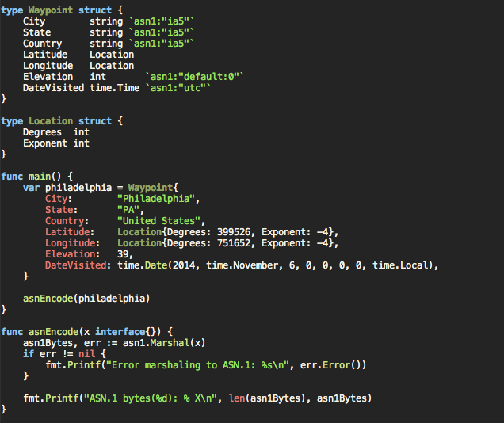
ASN.1 – Encoding Example
Notes:
Each structure has its own bit representation:
Type has:
2 bits for class (universal, application, private, context-specific)
1 bit for form (primitive or constructed)
5 bits for “tag”, which is analogous to type

Slide 9
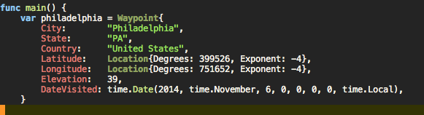
ASN.1 – Binary Output
0x30 – Type tag indicating a SEQUENCE (struct)
0x4B – Length of remaining bytes (75 in this case)
0x16 – Type tag indicating an IA5String
0x0C – Length of IA5String (12 bytes)
50 68 69 6C 61 64 65 6C 70 68 69 61 – “Philadelphia” in IA5String
Same sequence for State and Country fields.
0x30 – Type tag for the Latitude SEQUENCE type
0x08 – Length of Latitude SEQUENCE
0x02 – Type tag for INTEGER
0x03 – Length for INTEGER
06 18 A6 – Value for Degrees field (399526)
Notes:
77 total bytes of output when the Philadelphia struct is encoded using DER encoding.
The DER binary format for ASN.1 is fairly straightforward to understand and parse.

Slide 10
ASN.1 – Struct Tags
Go provides struct tags, like JSON and XML packages, that give the encoder and decoder hints about the data it’s about to consume.
Marshal Tags:
ia5: causes strings to be marshaled as ASN.1, IA5String values
omitempty: causes empty slices to be skipped
printable: causes strings to be marshaled as ASN.1, PrintableString values
utf8: causes strings to be marshaled as ASN.1, UTF8String values
utc: causes time.Time to be marshaled as ASN.1, UTCTime values
generalized: causes time.Time to be marshaled as ASN.1, GeneralizedTime values
Unmarshal Tags:
application specifies that an APPLICATION tag is used
private specifies that a PRIVATE tag is used
default:x sets the default value for optional integer fields (only used if optional is also present)
explicit specifies that an additional, explicit tag wraps the implicit one
optional marks the field as ASN.1 OPTIONAL
set causes a SET, rather than a SEQUENCE type to be expected
tag:x specifies the ASN.1 tag number; implies ASN.1 CONTEXT SPECIFIC

Slide 11
GOB

Slide 12
GOB - Background
Go-specific binary encoding, not language-independent
No IDL to define the interfaces and shims to implement, uses reflection instead
Lessons-learned from protocol-buffers
Used in the net/rpc package to implement Go RPC
Notes:
Go-SPECIFIC BINARY ENCODING:
There is no Gob spec although the wire formats are documented in the package docs.
There is a python project that purports to decode GOB bitstreams but it hasn’t been updated in 2 years and only supports a limited set of the GOB bitstream format.
https://github.com/mgeisler/pygob
NO IDL:
Unlike Avro, Flatbuffers, Protocol buffers, and Thrift
No IDL is good in that it’s one less thing to do when changing your interfaces, but it limits the endpoints of those interfaces to Go.u
LESSONS-LEARNED FROM PROTOBUFS
protobufs only work on structs. Serializing an array of primitive types? Create a container struct to hold it.
No required fields in Gob.
In protobufs, required fields add to the CPU and memory overhead of encoding/decoding.
Can impede updating the protobuf definition if you want to remove a required field since you'd have to update all consumers in what could be a multistep process.
No default values in Gob
Default fields can raise portability issues like character sets, precision, etc.
Unset fields in a struct will be set to the zero-value of the field in the Gob encoding of that struct.

Slide 13
GOB - Encoding
Encode only exported fields, just like JSON, XML, etc.
No struct tags for encoder/decoder hints.
Will only encode fields that aren’t that types zero-value
Source and destination structs don’t have to be identical
Cannot encode channels nor functions
Uses a similar encoding to ASN.1 BER/DER with Type-Length-Value
Self-describing:
First time a type is encoded the encoder will included a description of the type in the bitstream
Go runtime knows how to parse this description struct and all primitive types.
Notes:
ZERO-VALUE FIELDS:
If the field type is int and the value is zero, GOB won’t encode the value since the receiver is another Go program and knows that int fields have a zero-value of zero.
SOURCE AND DESTINATION STRUCTS DON”T HAVE TO BE IDENTICAL
Gob will matches fields based on name and COMPATIBLE type (not exact type)
Encoding of numerical types is done in a size-less way: int8, int16, int32, and int64 are encoded in the same way. This means the struct on the encoding side can be more restrictive than on the decoding side:
42 can be represented as an int8 on the sender, but decoded into an int32 or int64 by the receiver. (Errors are thrown if the decoded value doesn't fit into the receiver field).
SELF-DESCRIBING:
When read from beginning to end, they contain all the information needed to decode the contents. The stream itself contains information about the structure to be decoded into.

Slide 14
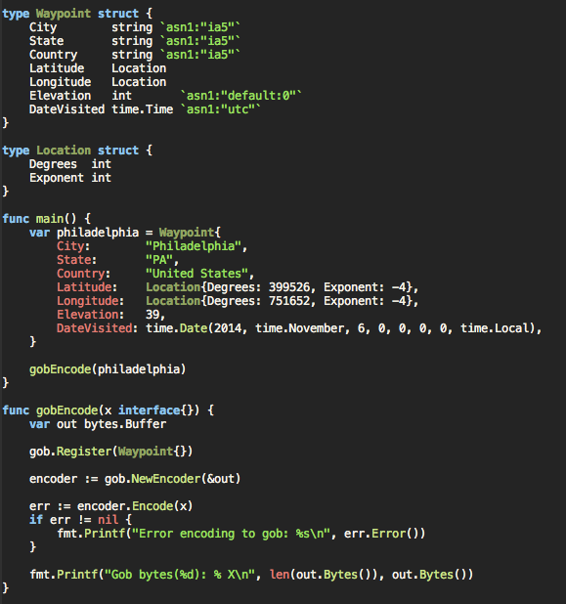
GOB – Encoding Example
Notes:
You need to register the struct before encoding it.
This tells the encoder that it needs to create a wire type that describes the struct in a way the receiver can use to map to struct(s) on their end.

Slide 15
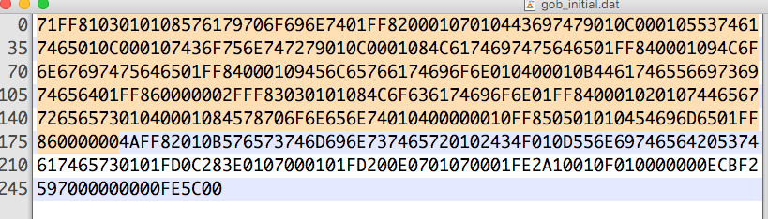
GOB – Binary Output
Encoding of GOB structures follows this structure:
(byteCount (-type id, encoding of a wireType)* (type id, encoding of a value))*
The highlighted portion is the description of the type that follows in the un-highlighted portion.
The description starts with a unique ID (0xFF or 255 in this case) that is then referenced when subsequent values of the specified type are encoded.
This overhead is 179 bytes, compared to just 75 bytes for the actual data.

Slide 16

GOB – Binary Output
The highlighted hex numbers are the lengths of the string fields in the struct:
- 0x0B (11) Followed by 57 65 73 74 6D 69 6E 73 74 65 72 gives “Westminster”
- 0x02 (2) Followed by 43 4F gives “CO”
- 0x0D (13) Followed by 55 6E 69 74 65 64 20 53 74 61 74 65 73 gives “United States”

Slide 17
Encoding Performance
Encoding | Single Waypoint{} | []Waypoint{}
JSON | 1960 ns/op (208 bytes) | 9251 ns/op (1042 bytes)
XML | 6444 ns/op (312 bytes) | 34,755 ns/op (1556 bytes)
ASN.1 | 6865 ns/op (77 bytes) | 36,289 ns/op (377 bytes)
GOB | 1297 ns/op (253 bytes/74 bytes)* | 5211 ns/op (547 bytes)
Notes:
Is that includes the full encoded struct that’s passed to the consumer for reconstitution. Only 74 bytes on subsequent runs.

Slide 18
We’re Hiring!
Principal Engineer for Time Shifted Video (Cloud DVR)
The core product this team is developing and managing is the next generation cloud DVR system (cDVR). We developed this system from the ground up.
Experience with Go highly desired
Developing software for Networking, Web services, HTTP, and TCP/IP
Engineer 3 on CDN
As an engineer in the CDN team, you will help build the infrastructure and develop software to support the systems that deliver IP content for a wide range of mobile and first-screen television devices.
Experience developing software with Go (2+ years)
Experience developing software for large, distributed systems
Experience developing software for networking, DNS, HTTP, and TCP/IP
Principal Engineer, Distributed Systems (Infrastructure)
More specifically, we write server-side code in Go for a load balancer, log aggregator, monitoring tool, resource provisioning daemons, deployment tool, and a REST API. We also have a UI written in VueJS.
Docker and Kubernetes

Slide 19
Sources
https://en.wikipedia.org/wiki/Abstract_Syntax_Notation_One
https://en.wikipedia.org/wiki/X.690
https://www.youtube.com/watch?time_continue=3&v=EccHushRhWs
http://luca.ntop.org/Teaching/Appunti/asn1.html
https://blog.golang.org/gobs-of-data

