Slide 1
Team Barrie onboarding
Step-by-step guide for getting a new user into Transit Scheduler
TS
Goal: create an account, join Barrie Transit, and learn the first workspaces safely.
Team Barrie onboarding · Transit Scheduler

Slide 2
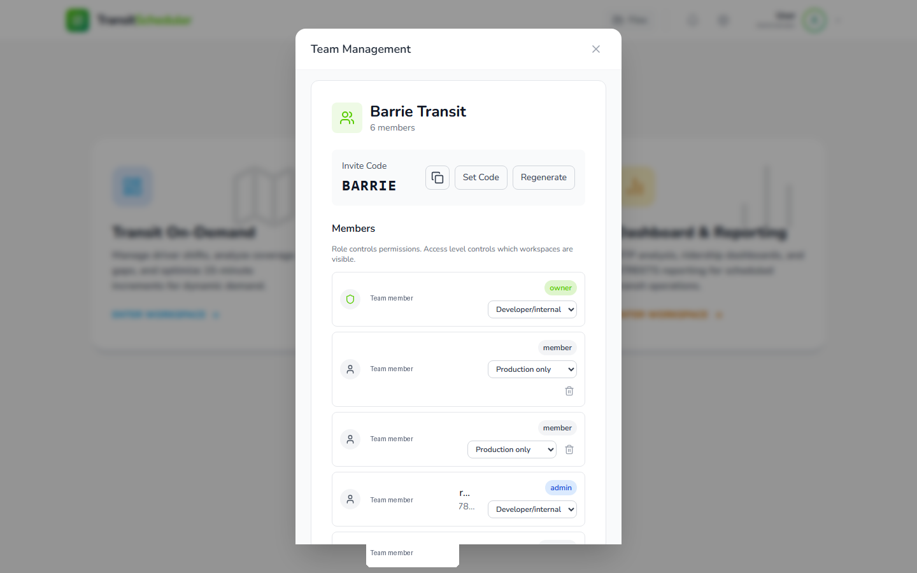
Before the new user starts
Admin prep takes about two minutes.
ADMIN
Open the user menu, then Team Management.
Copy the invite code for Barrie Transit.
Decide the user’s role and access level after they join.
For most new users, start with Production only unless they need planning tools.
Copy invite code
Set access level
Team Barrie onboarding · Transit Scheduler
Admin prep

Slide 3
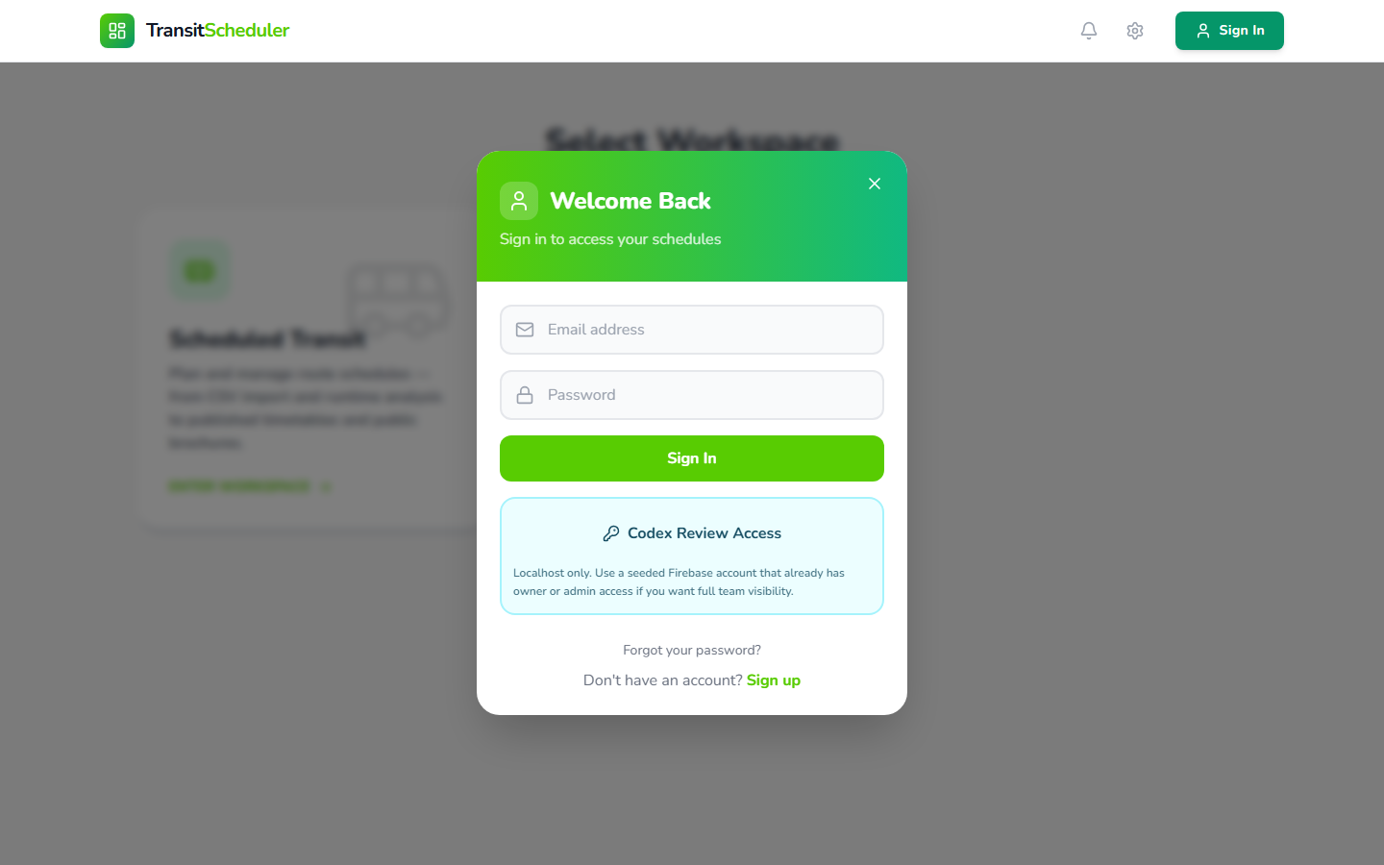
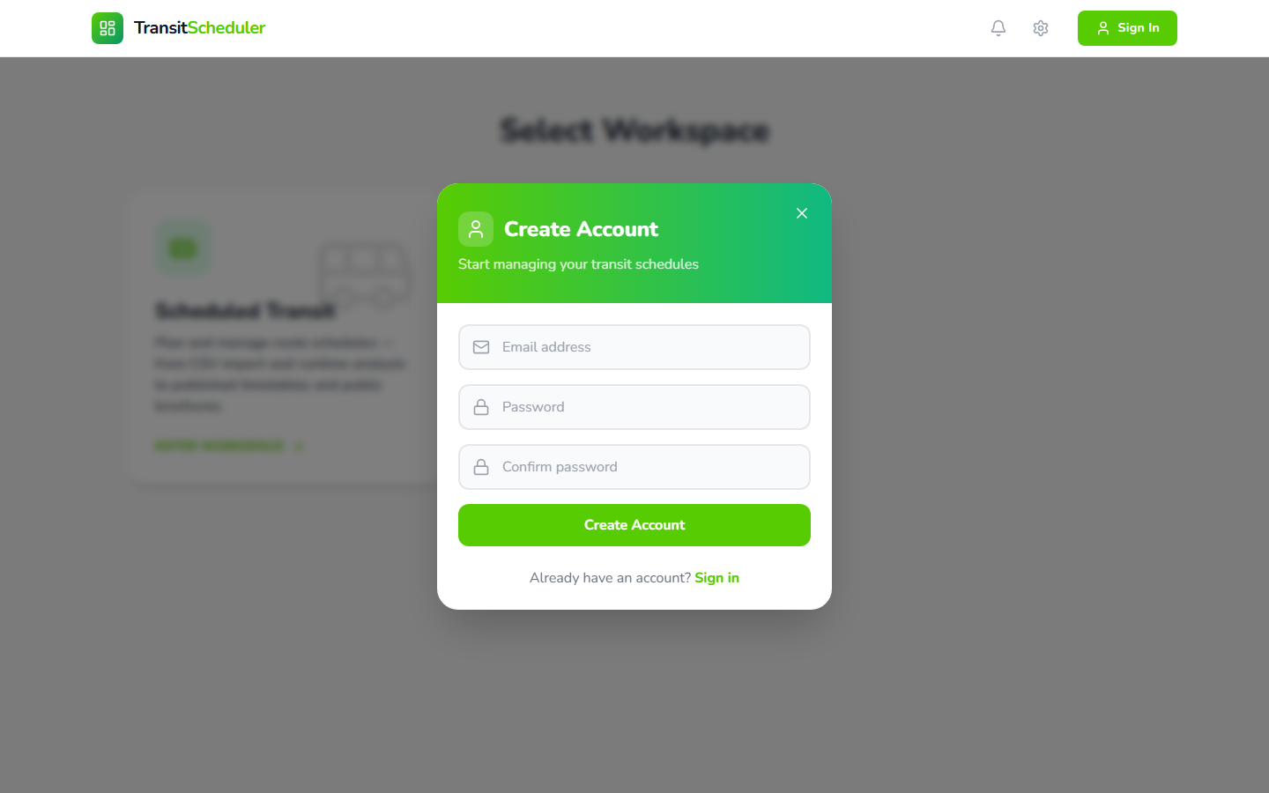
Step 1: Create or sign in
Use the account tied to the new user’s work email.
STEP 1
Go to the Transit Scheduler app URL.
Click Sign In in the top-right corner.
New users select Sign up and create a password.
Returning users sign in with their existing account.
Sign in
Or create account
Team Barrie onboarding · Transit Scheduler
Step 1

Slide 4
Step 2: Join Team Barrie
The invite code connects the user to Barrie Transit data.
STEP 2
After signing in, open Team Management if prompted.
Choose Join with Code.
Enter the six-character Barrie invite code.
Confirm the user can see Barrie Transit as their team.
Invite code: BARRIE
Team Barrie onboarding · Transit Scheduler
Step 2

Slide 5
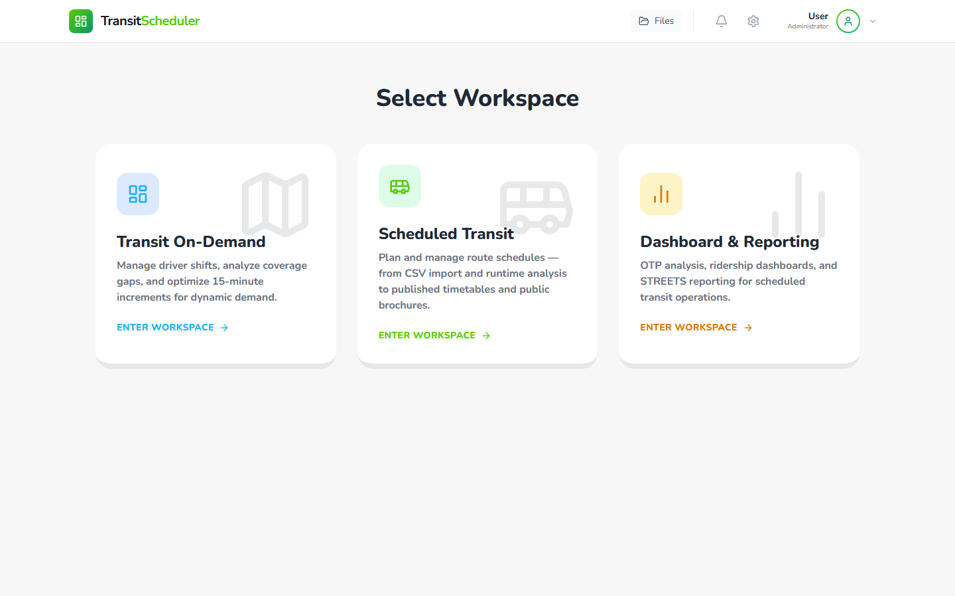
Step 3: Land on the workspace selector
This is the app’s starting point after sign-in.
STEP 3
Scheduled Transit is the main fixed-route planning area.
Transit On-Demand is for demand-responsive scheduling.
Dashboard & Reporting is for performance reporting.
Choose Scheduled Transit first
Team Barrie onboarding · Transit Scheduler
Step 3

Slide 6
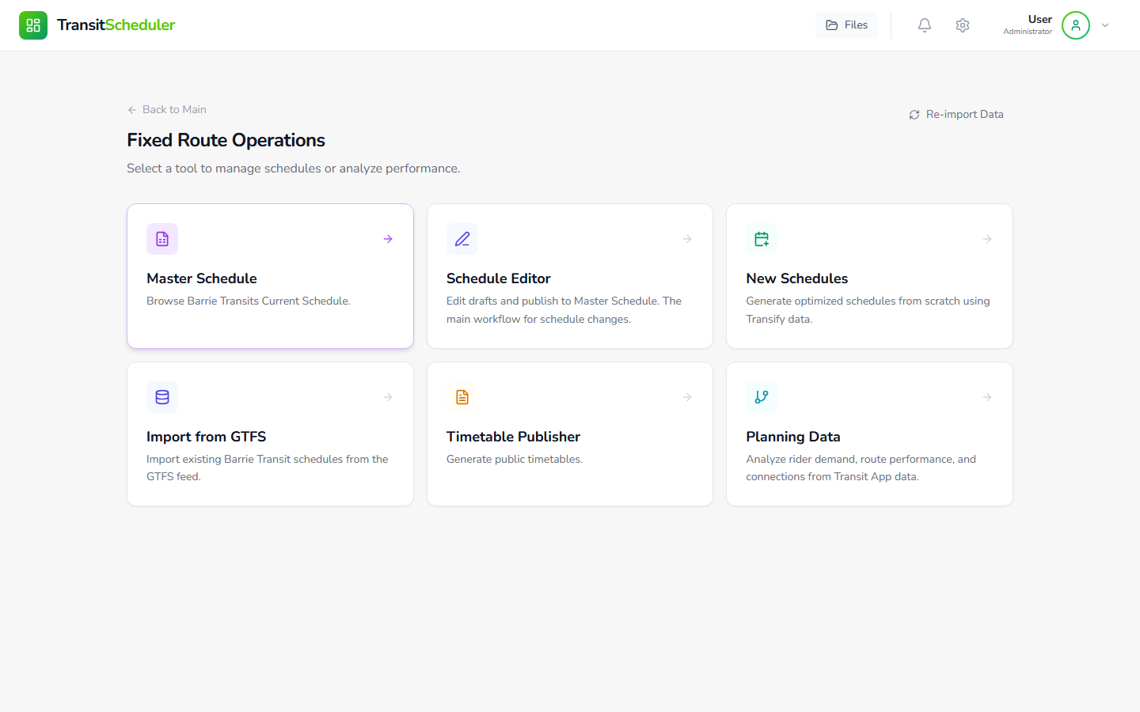
Step 4: Open Scheduled Transit
This dashboard is the fixed-route command center.
STEP 4
Start with Master Schedule to view what is live.
Use Schedule Editor for draft changes.
Use New Schedules only when building from runtime data.
Use Import from GTFS when bringing in published GTFS schedules.
Team Barrie onboarding · Transit Scheduler
Step 4

Slide 7
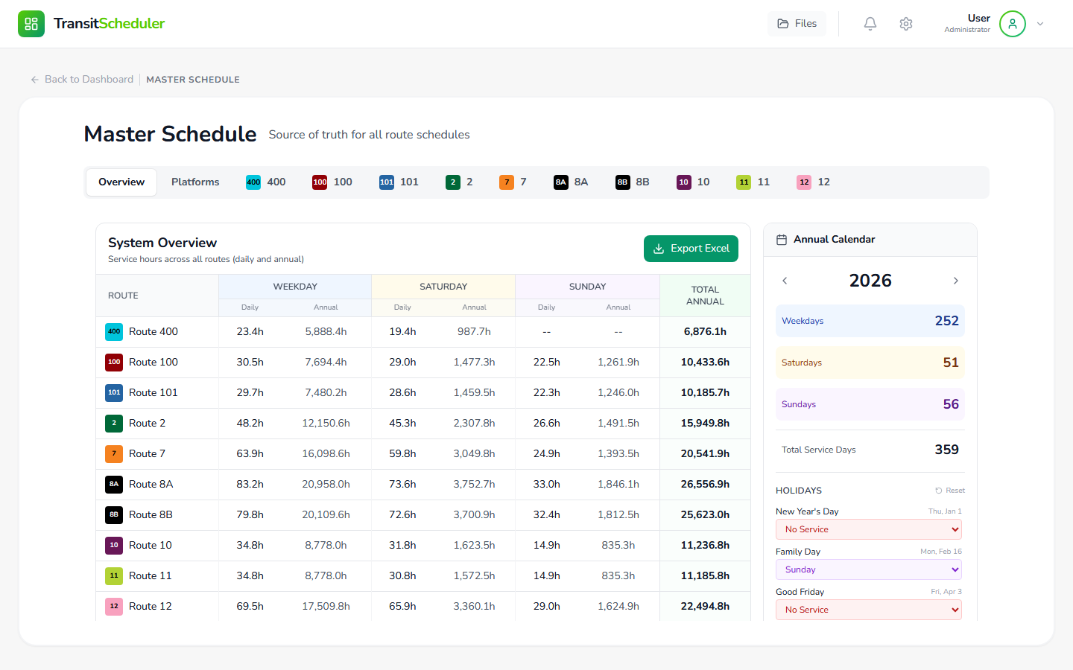
Step 5: Review the Master Schedule
Master schedules are the published reference copies.
STEP 5
Published source of truth
Use filters for route and day type.
Open a route to inspect current published service.
Do not edit master schedules directly.
Copy to draft when changes are needed.
Team Barrie onboarding · Transit Scheduler
Step 5

Slide 8
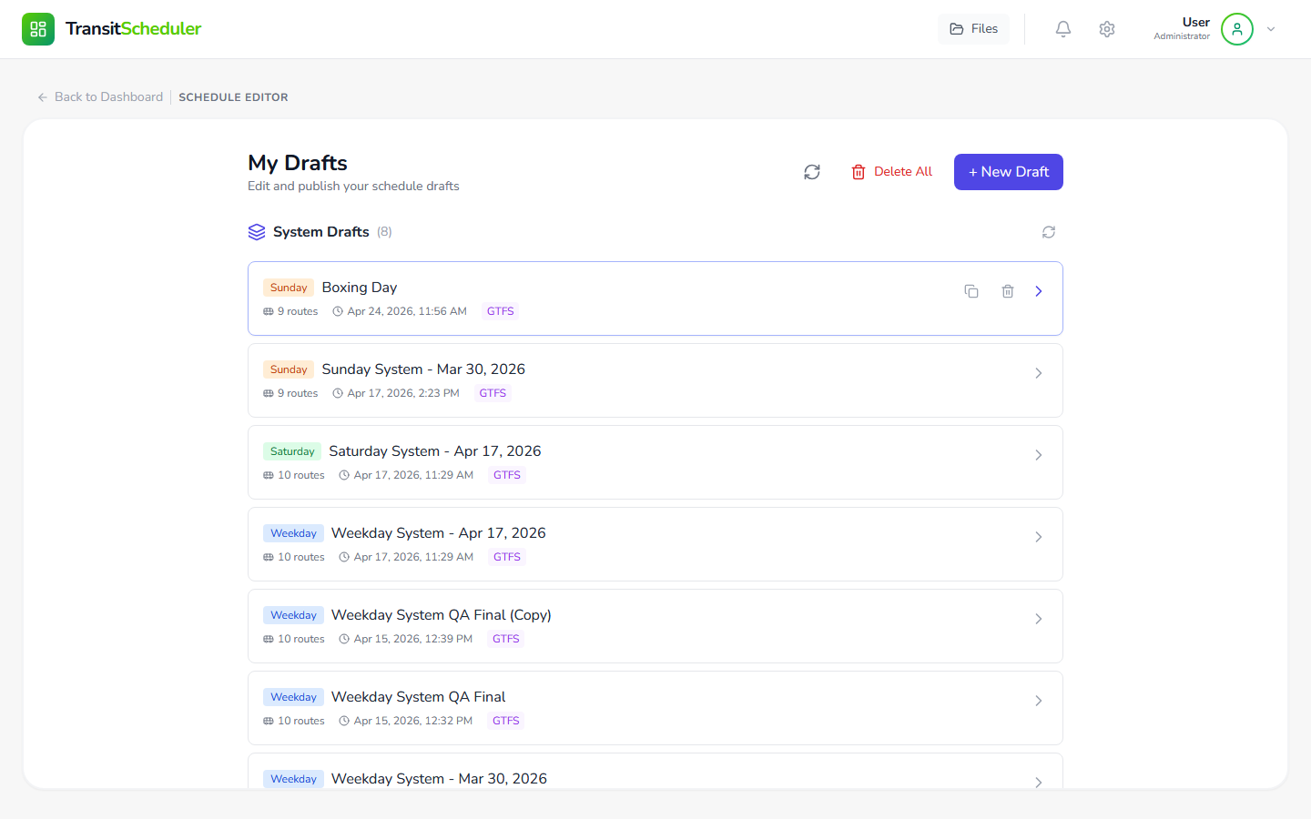
Step 6: Work from drafts
Drafts are the safe place to make schedule changes.
STEP 6
Open an existing draft or create one from a master schedule.
Review route, day type, and last updated date before editing.
Publish only after review and approval.
When unsure, duplicate a draft before major edits.
Drafts list
Team Barrie onboarding · Transit Scheduler
Step 6

Slide 9
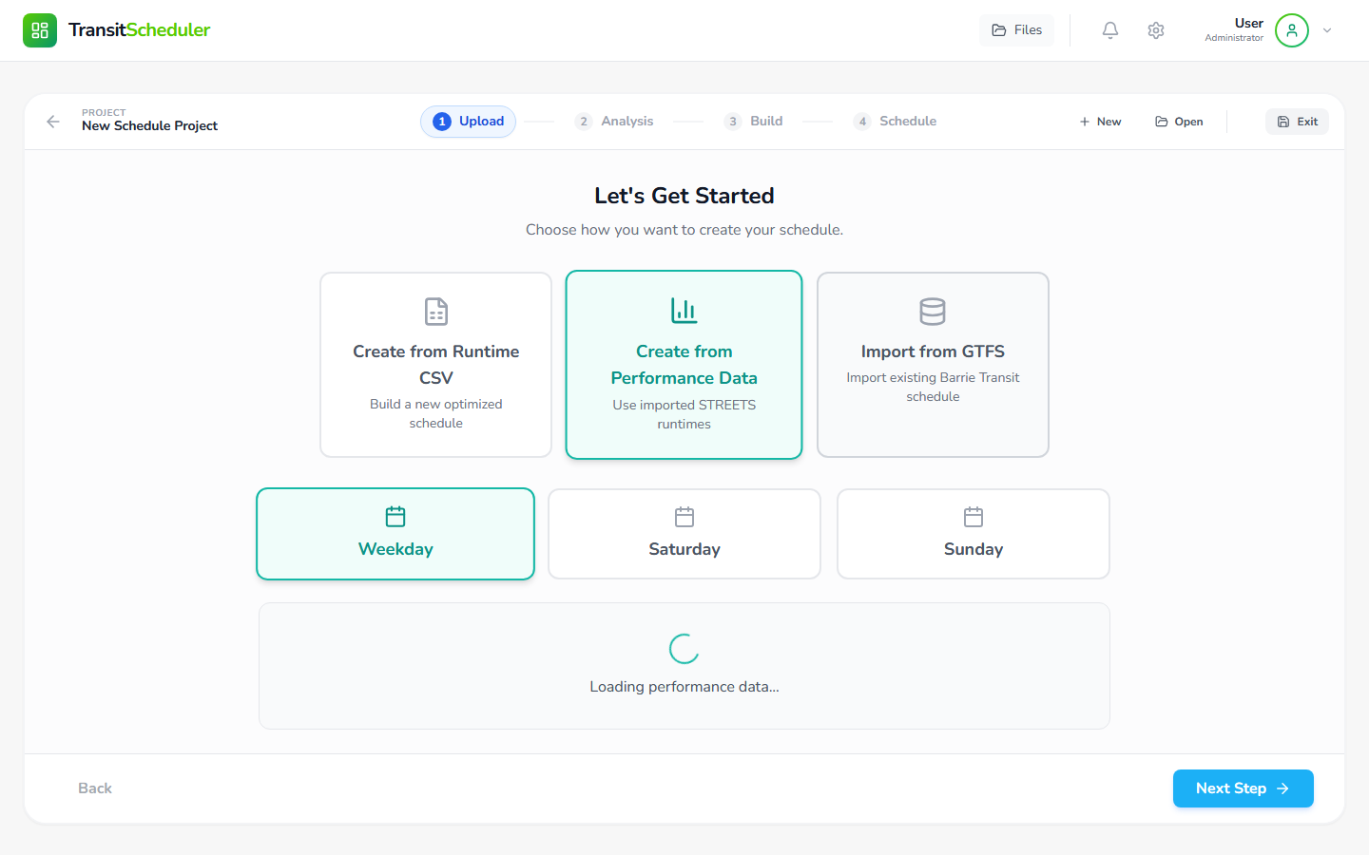
Step 7: New Schedule wizard
Use this flow to build from runtime data.
STEP 7
Start with CSV runtime data or a sample template.
Choose route and service day carefully.
The wizard guides Upload → Analysis → Build → Schedule → Connections.
Planner review is required before publishing.
Start here for new builds
Team Barrie onboarding · Transit Scheduler
Step 7

Slide 10
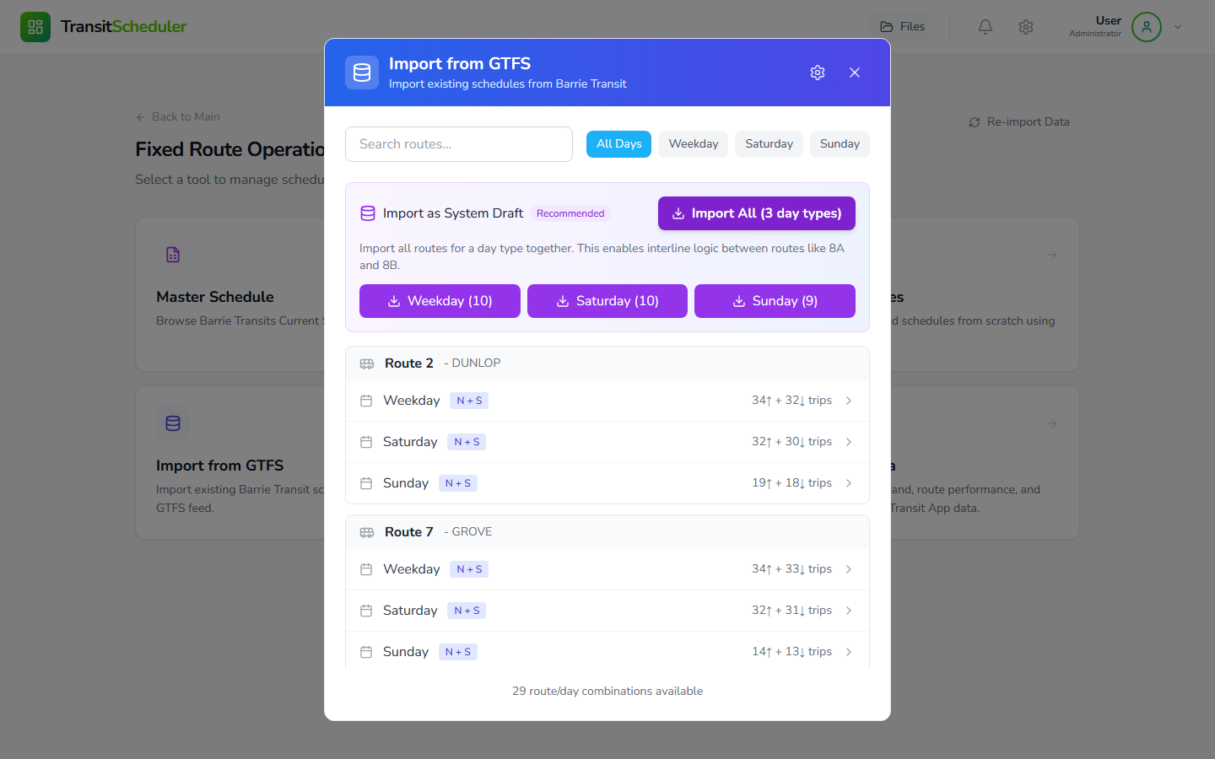
Step 8: Import from GTFS
Use GTFS import to bring existing schedules into drafts.
STEP 8
Select a route or import a full system day type.
Choose the correct service period.
Review warnings after import.
Imported schedules still become drafts before publishing.
Import creates drafts
Team Barrie onboarding · Transit Scheduler
Step 8

Slide 11
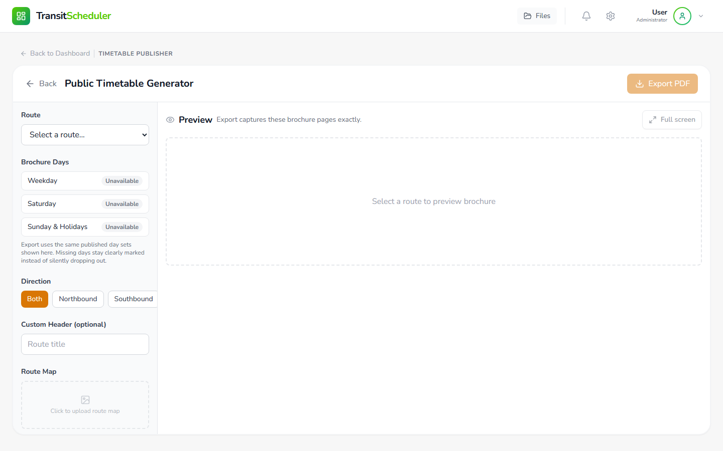
Step 9: Timetable Publisher
Use this area for public-facing timetable outputs.
STEP 9
Preview before export
Choose the route and timetable format.
Preview before exporting.
Use current master schedule data unless told otherwise.
Check maps, notes, and effective dates before sharing.
Team Barrie onboarding · Transit Scheduler
Step 9

Slide 12
How to work safely
The app is built around draft → review → publish.
SAFETY
Never treat a master schedule as a scratchpad.
Use drafts for edits, experiments, and imports.
Let the app calculate timing; avoid manual workarounds.
AI may suggest optimizations, but planners make final decisions.
Ask an admin before changing access levels or publishing.
Master
Copy to draft
Edit / review
Publish version
Team Barrie onboarding · Transit Scheduler
Safety

Slide 13
Access levels to know
Access controls what each team member sees.
ADMIN
Production only
Best for dispatch/reference users. Shows core operational surfaces.
Planner
Adds planning workspaces for route and service analysis.
Admin
For people managing team settings and publishing workflows.
Developer/internal
For development/testing only; do not use for regular onboarding.
Team Barrie onboarding · Transit Scheduler
Admin

Slide 14
New user first-day checklist
Use this to confirm onboarding is complete.
Account created with work email
Can view Master Schedule
Joined Barrie Transit team
Understands drafts before publishing
Correct role and access level assigned
Knows who to ask for help
Can open Scheduled Transit
Team Barrie onboarding · Transit Scheduler
Checklist

Slide 15
You are ready to start
Recommended first path: Sign in → Join Barrie Transit → Scheduled Transit → Master Schedule → Drafts
Start by viewing, then edit only in drafts
Team Barrie onboarding · Transit Scheduler
Done

