Slide 1

Lloyds Banking Group AVD Bicep Workshop (2 days)
Michael Ross (CSA)

Slide 2
Agenda – Day 2
09:00 – Review of Day 1
09:30 – Building in Bicep - AVD
10:15 – Break
10:30 – Building in Bicep - AVD
12:00 – Lunch
13:00 – Open Afternoon Q&A
15:00 – Break
16:30 – Workshop review

Slide 3

Workshop Day 2

Slide 4
Welcome Back
So where did we get to?
Overview of the Architecture
Setting up the environment
Review of Bicep
Base infrastructure deployment
So what’s left?
Finish the base infrastructure if required
Deploy the AVD components
Connect it to AD/AADDS
Test it

Slide 5
User Accounts (reminder)
Name | User Name | Unique ID | VNET CIDR
Name | Azure login name | 001 | 10.201.1.0/24
Name | Azure login name | 002 | 10.201.2.0/24
Name | Azure login name | 003 | 10.201.3.0/24
Name | Azure login name | 004 | 10.201.4.0/24
Name | Azure login name | 005 | 10.201.5.0/24
Name | Azure login name | 006 | 10.201.6.0/24
Name | Azure login name | 007 | 10.201.7.0/24
Name | Azure login name | 008 | 10.201.8.0/24
Name | Azure login name | 009 | 10.201.9.0/24
Name | Azure login name | 010 | 10.201.10.0/24
NOTE: These accounts will be destroyed at the end of the course along with any personal details associated.

Slide 6
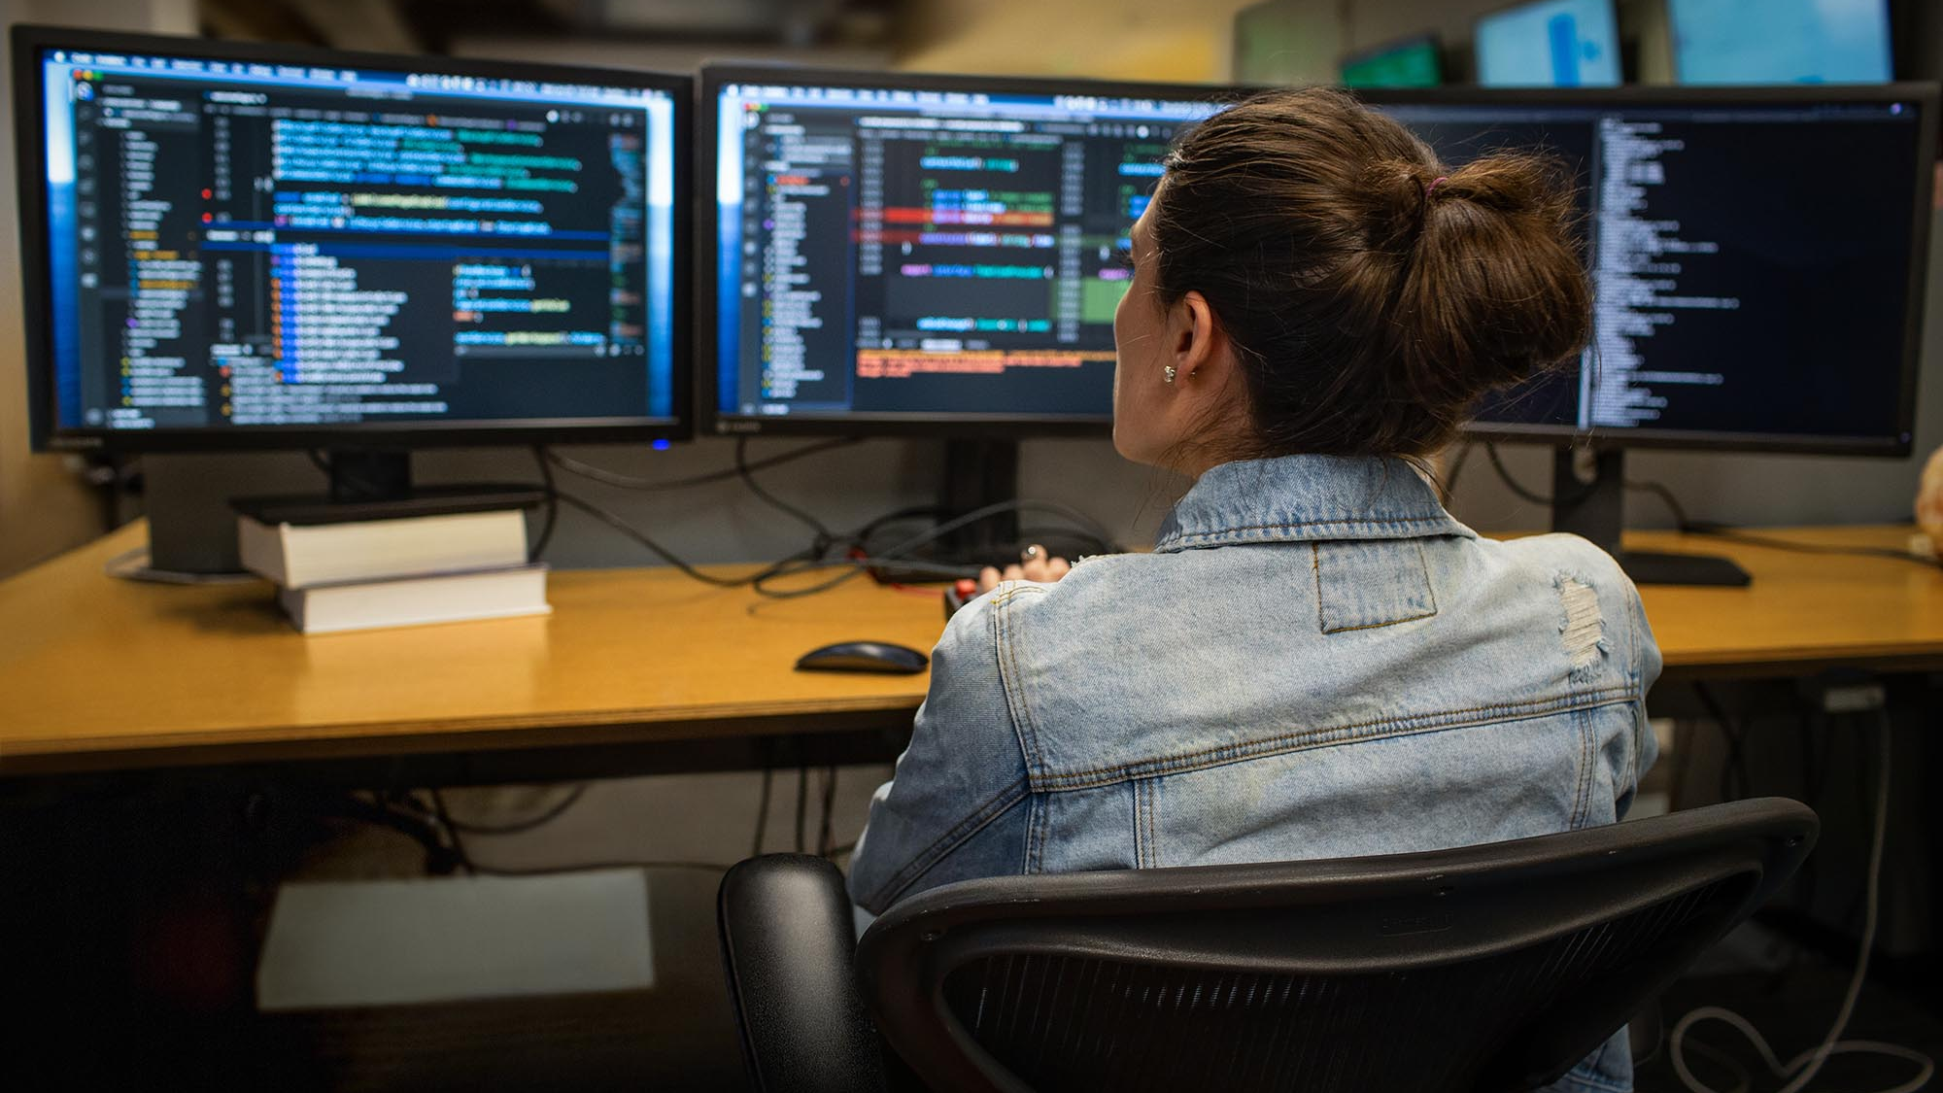
Lets get building

Slide 7
Lab 2 - Base Infrastructure
Finishing off the Base Infrastructure (if required)
Remaining base infrastructure
Peering (walkthrough)

Slide 8
Break Time Back in 15 mins
"Infrastructure as code: because who doesn't love spending their days automating things that used to be done manually and breaking things in new and exciting ways?”

Slide 9
Lab 3 - AVD Infrastructure
And now onto the main event
In this lab we will build out and deploy the main components required for an AVD service including:
AVD Host Pool
AVD Workspace
AVD Application Group

Slide 10
Lab 3 - Deploying your Bicep
Deploying AVD
You will be a dab hand at this by now. But as this is a new day, you may need to log back in to Azure
As before, the script takes several parameters but now two are mandatory.
.\deploy.ps1 -uniqueIdentifier “Provided unique ID" -avdVnetCIDR "provided CIDR“
Notes:
Always use the same CIDR and Unique ID when deploying to avoid conflicts.
To save time, take a look at the README.md – it provides examples of some of the other parameters.

Slide 11
Lab 4 - AVD Hosts
And finally, the action
You have worked hard to get to this point, now we just need to add some compute and a touch of configuration. So in this Lab we will be doing the following:
Deploying some hosts
Connecting them to AD / AADDS
Running up some basic extensions
Logging into a desktop

Slide 12
Testing
Testing your AVD
Make sure of the following:
You have hosts up and running
The hosts are visible in the host pool
The RBAC permissions have been set in the Application Group
Then connect to:
https://client.wvd.microsoft.com/arm/webclient/index.html
You will be asked to log in – use the same credentials as you used for building.
If all was successful you will see a Workspace with a icon for “SessionDesktop”. Click on it and log in.

Slide 13
Lunch Back in 1 hour
"Using Azure Bicep is like having a sous chef for your cloud infrastructure. It takes care of the heavy lifting, so you can focus on the creative aspects of building your application. Just don't let it near your recipe book - you never know what kind of cloud-native concoctions it might come up with!"

Slide 14
Demos and Discussions
Over to you
For the rest of the afternoon, we can look at any other elements of AVD that you want to cover.
Examples include:
Using a DevOps pipeline to deploy your code
FSLogix
Walk through of the full code base

Slide 15
Break Back in 15 mins
"Using Azure Bicep is like a carpenter using power tools for the first time. It can be scary at first, but once you get the hang of it, you'll wonder how you ever managed without it. And just like with power tools, you'll want to make sure you wear your safety glasses and have a first-aid kit handy!“
Mark Russinovich, CTO of Microsoft Azure

Slide 16
Wrapping Up
So what did we learn?
The structure of a typical AVD deployment
The required resources to make it work
The IaC Bicep content for each resource
How all that Bicep code work together
How to deploy it all using a powershell script

Slide 17
Questions?
“I fundamentally believe that if you are not learning new things, you stop doing great and useful things. So family, curiosity, and hunger for knowledge all define me.“
Satya Nadella, CEO Microsoft

Slide 18

Thank you and well done

