Slide 1

Azure Image Builder
Michael Ross

Slide 2
What is Azure Image Builder
Azure Image Builder simplifies the process of creating, customizing, and managing virtual machine (VM) images in Azure
Key Benefits:
Automation and Efficiency
Consistency and Standardisation
Customisation and Flexibility
Integration with DevOps and Automation
Scalability and Rapid Provisioning
Versioning and Rollback
Security and Compliance
Notes:
Automation and Efficiency: Azure Image Builder automates the image creation process, reducing manual effort and saving time. It eliminates the need for manual installations and configurations, allowing you to create and update images at scale.
Consistency and Standardization: With Azure Image Builder, you can define image templates that specify the desired configuration settings, software installations, and customizations. This ensures consistency across all your VM instances, reducing errors and improving reliability.
Customization and Flexibility: Azure Image Builder allows you to customize your images by adding software, configuring settings, running scripts, and injecting files. This flexibility enables you to create tailored images that meet specific application requirements.
Integration with DevOps and Automation: Azure Image Builder seamlessly integrates with Azure DevOps and other automation tools, enabling you to incorporate image building into your CI/CD pipeline. This integration streamlines the image creation and deployment process, facilitating continuous integration and delivery.
Scalability and Rapid Provisioning: Azure Image Builder leverages the scalability of Azure to handle large-scale image deployments. You can quickly provision multiple VM instances from a customized image, allowing for efficient scaling of your infrastructure.
Image Versioning and Rollbacks: Azure Image Builder provides versioning capabilities, allowing you to maintain a history of image iterations. This feature enables easy rollbacks to previous versions if issues arise, providing greater control and management of your images.
Security and Compliance: Azure Image Builder includes built-in security features to help meet your organization's security and compliance requirements. It supports image signing, encryption, and vulnerability scanning, ensuring that your images are secure and compliant with industry standards.
Collaboration and Image Sharing: Azure Image Builder supports sharing and distribution of images across different environments. You can use Azure Shared Image Gallery or Azure Marketplace to make your customized images available to other teams, customers, or the wider Azure community.

Slide 3
Key Features
Template-based Image Creation
Source Image Customisation
Based on industry standard Packer
Automated Image Distribution
Pipeline Integration
Fully managed service
Automated testing and compliance
If you can run it in Powershell or CLI, you can run it during an image build
Notes:
Feature 1: Template-Based Image Creation
Azure Image Builder utilizes template-based image creation, allowing you to define and manage image templates that serve as blueprints for creating VM images.
Image templates provide a standardized and repeatable way to specify the desired configuration settings, software installations, and customizations for your images.
You can define template parameters such as the base image, provisioning scripts, artifacts, and distribution targets to streamline the image creation process.
Feature 2: Source Image Customization
Azure Image Builder enables you to easily customize your VM images based on source images.
You can add or remove software, configure settings, run scripts, and inject files during the image creation process.
This customization capability allows you to tailor your images to meet specific application requirements or compliance needs.
Feature 3: Automated Image Distribution
Azure Image Builder simplifies the distribution of your custom images to various target environments.
You can distribute your images to Azure Shared Image Gallery, Azure Marketplace, or other custom target locations.
This automated distribution ensures that your custom images are easily accessible for deployment across your organization or shared with external customers.
Feature 4: Integration with Azure DevOps and Automation
Azure Image Builder seamlessly integrates with Azure DevOps and other automation tools, providing a smooth workflow for image creation and management.
You can incorporate image building into your CI/CD pipeline, enabling continuous integration and delivery of updated images.
Integration with automation tools allows you to automate the image building process, ensuring efficiency and consistency in your deployments.
Feature 5: Security and Compliance
Azure Image Builder includes robust security features to help you meet your organization's security and compliance requirements.
It supports image signing, allowing you to verify the integrity and authenticity of your images.
Additionally, Azure Image Builder facilitates image encryption and provides vulnerability scanning to ensure that your images are secure and compliant with industry standards.

Slide 4
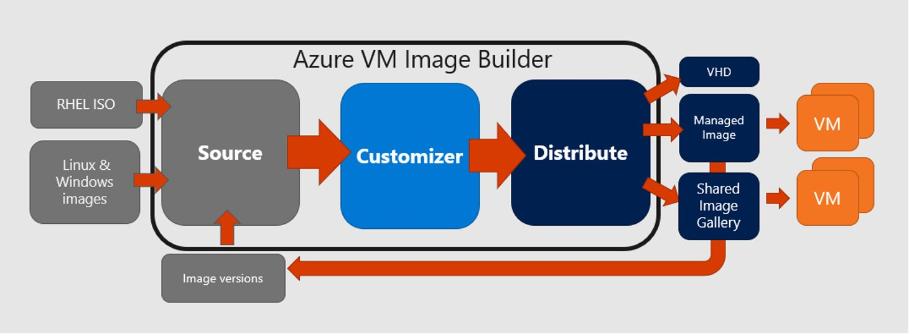
The Image Builder Service
Subtitle or descriptive text

Slide 5
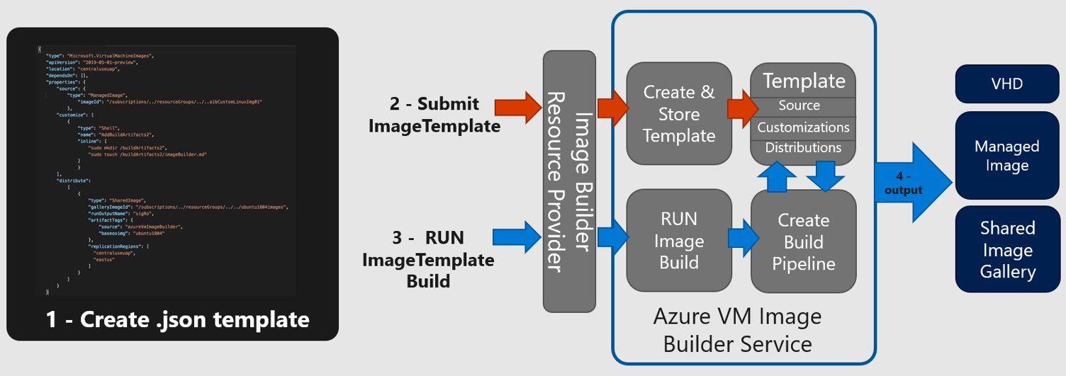
Image Builder Process
Notes:
Azure Image Builder follows a streamlined and intuitive workflow for creating, customizing, and managing VM images. The image building process can be divided into the following steps:
Image Template Creation:
Start by creating an image template, which serves as a blueprint for your VM image.
Define template parameters such as the base image, provisioning scripts, artifacts, and distribution targets.
The template captures the desired configuration settings and customizations to be applied during image creation.
Source Image Selection:
Choose a source image as the starting point for your customized VM image.
Azure Image Builder supports a wide range of base images, including popular operating systems and Azure Marketplace offerings.
You can select a pre-configured base image that aligns with your requirements or bring your own custom image.
Customization Options:
Customize your VM image by adding software, configuring settings, running scripts, and injecting files.
Azure Image Builder provides a range of customization options to meet your application-specific requirements.
These options enable you to tailor the image to include specific packages, settings, or modifications needed for your workload.
Image Building and Provisioning:
Initiate the image building process, during which Azure Image Builder combines the source image and customization instructions from the template.
Azure Image Builder automatically applies the specified customizations and configurations to create the new VM image.
The image building process is automated and can be performed at scale to generate multiple images simultaneously.
Image Distribution:
Once the image is built, Azure Image Builder simplifies the distribution of your custom images to various target environments.
You can distribute your images to Azure Shared Image Gallery, Azure Marketplace, or other custom target locations.
This automated distribution ensures that your custom images are readily available for deployment across your organization or for sharing externally.
Image Management and Updates:
Azure Image Builder provides versioning and management capabilities for your images.
You can track and manage multiple versions of your images, making it easy to roll back to previous versions if needed.
When updates are required, you can modify the image template and initiate the image building process again to create updated images.
By following this workflow, Azure Image Builder simplifies and streamlines the image creation process, allowing organizations to efficiently build and manage a library of standardized and customized VM images for their Azure deployments.

Slide 6
Image Management
Image Builder can create standalone images as VHD file
It also fully supports Azure Compute Gallery for Image Management
Versioning
Multi-Region Image Distribution
Replicas
Images can be managed through both Shell and Portal
Image Management Process can now also be managed in Portal
Can be deployed to both VM and VMSS resources

Slide 7
Components
Base Components
Compute Gallery
Storage Account
User Managed Identity (UMI)
Image components
Powershell – run a powershell command or script on the image
Shell – run a shell command (linux) on the image
Windows Restart – restart the image builder
Windows Update – run windows update
File – Upload a file

Slide 8
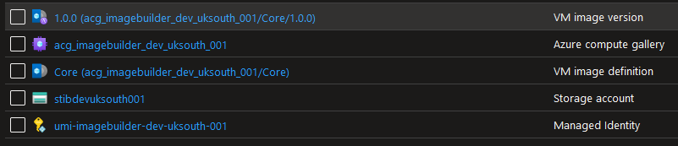
Image Builder Components In Azure
Managed Identity
Storage Account
Compute Gallery
Image Definition
Image Version

Slide 9
Template Creation
“An image template is a predefined blueprint that encapsulates the configuration settings, customizations, and provisioning instructions for creating a virtual machine (VM) image in Azure.”
What is involved?
Base image selection
Scripts and artifacts
Configuration settings
Distribution targets
Template validation
Notes:
Image templates play a central role in Azure Image Builder, allowing you to define the configuration and customization settings for your VM images. Here's an overview of the image template creation process:
Template Parameters:
Start by defining the parameters for your image template.
These parameters include the base image, provisioning scripts, artifacts, and distribution targets.
Parameters provide flexibility and customization options, allowing you to dynamically configure your image creation process.
Base Image Selection:
Choose a base image that serves as the foundation for your VM image.
Azure Image Builder offers a variety of base images, including popular operating systems and Azure Marketplace offerings.
Select a base image that aligns with your application requirements, ensuring a solid starting point for customization.
Provisioning Scripts and Artifacts:
Incorporate provisioning scripts and artifacts into your image template.
Provisioning scripts automate the installation of software, configuration changes, and other customization tasks during the image creation process.
Artifacts include files or resources that need to be included in the final VM image, such as additional software packages, configuration files, or application code.
Configuration Settings:
Specify the desired configuration settings for your VM image.
This includes defining network settings, security configurations, user accounts, and other parameters required for your specific use case.
Configuration settings ensure consistency and alignment with your organization's standards and policies.
Distribution Targets:
Define the distribution targets for your custom images.
Azure Image Builder provides various distribution options, including Azure Shared Image Gallery, Azure Marketplace, or other custom target locations.
Choose the appropriate target(s) based on your deployment requirements and sharing preferences.
Template Validation and Management:
Validate your image template to ensure its correctness and completeness.
Azure Image Builder provides validation mechanisms to check for any errors or misconfigurations in the template.
Once validated, you can manage and version your image templates, making it easy to track changes and maintain a history of template iterations.
By creating image templates in Azure Image Builder, you establish a reusable and standardized framework for image creation. These templates streamline the process, provide flexibility for customization, and ensure consistency across your VM images.

Slide 10
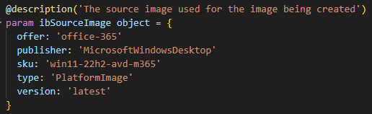

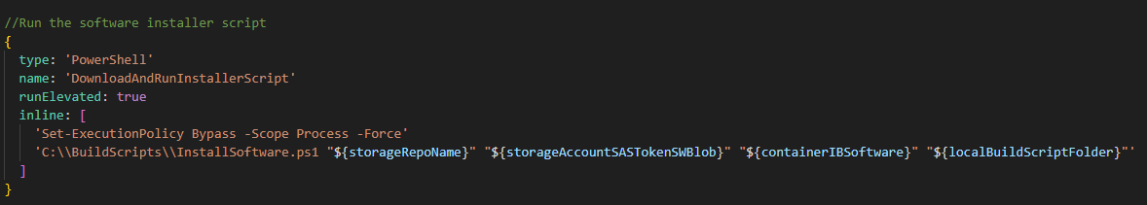
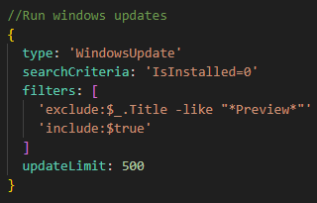
Templates in code (bicep)

Slide 11
Automation
As part of the build you can automate:
The installation of software
Testing of installed software
Updating and patching
You can then automate the build schedule as part of a pipeline. This helps to:
Reduce human error
Provide consistency and repeatability
Reduce costs and time
Keep images up to date
Notes:
Azure Image Builder seamlessly integrates with Azure DevOps and other automation tools, providing numerous benefits for organizations:
CI/CD Pipeline Integration:
Azure Image Builder can be easily integrated into your CI/CD pipeline, enabling automated image creation and deployment.
Integration with Azure DevOps allows for streamlined release management and continuous integration and delivery of updated images.
Infrastructure as Code (IaC) Compatibility:
Azure Image Builder supports Infrastructure as Code (IaC) practices, enabling image creation and management through code.
IaC tools such as Azure Resource Manager (ARM) templates and Azure PowerShell can be utilized to define and manage image templates.
Repeatable and Consistent Deployments:
By integrating Azure Image Builder into your automation workflows, organizations can achieve repeatable and consistent image deployments.
Automation ensures that every deployment follows the same predefined configurations, reducing configuration drift and potential errors.
Faster Time-to-Market:
The integration of Azure Image Builder with DevOps and automation tools accelerates the time-to-market for applications and services.
Automated image creation and deployment processes enable faster iterations, ensuring that updated images are available for deployment when needed.
By leveraging Azure Image Builder's integration capabilities, organizations can achieve efficient, automated, and consistent image creation and deployment processes within their DevOps and automation workflows.

Slide 12
Security and Compliance
Validated Golden Images
Patching and update
Vulnerability scanning
Image Signing
Versioning
Rollback
Notes:
Azure Image Builder incorporates robust security features to enhance the security and compliance of VM images:
Image Signing:
Azure Image Builder supports image signing, allowing you to verify the integrity and authenticity of your images.
Image signing prevents tampering and ensures that only trusted images are deployed.
Vulnerability Scanning: (part of the test script phase)
Azure Image Builder includes vulnerability scanning capabilities to identify and address security vulnerabilities in your images.
This feature helps organizations ensure that their images meet security standards and comply with industry regulations.
Compliance Requirements:
By leveraging Azure Image Builder's security features, organizations can meet various compliance requirements.
The ability to sign images, encrypt sensitive data, and address vulnerabilities helps organizations align with industry regulations and internal security policies.

Slide 13
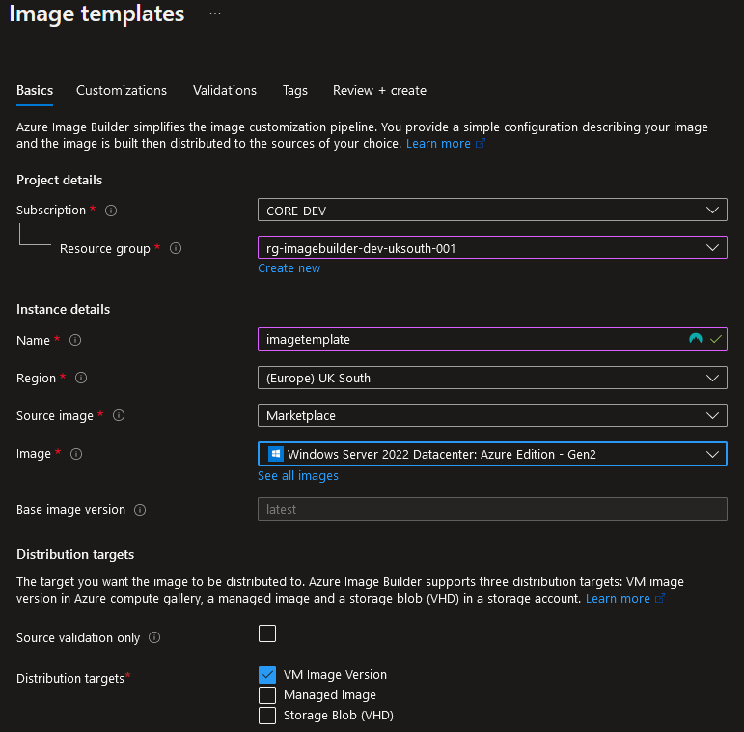
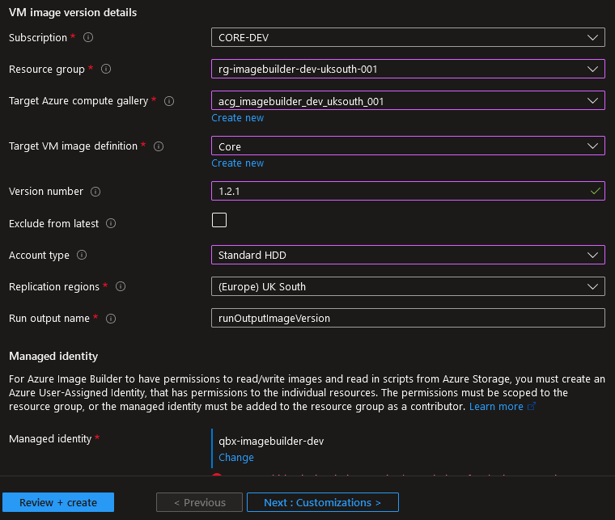
Image Builder in the Portal

Slide 14
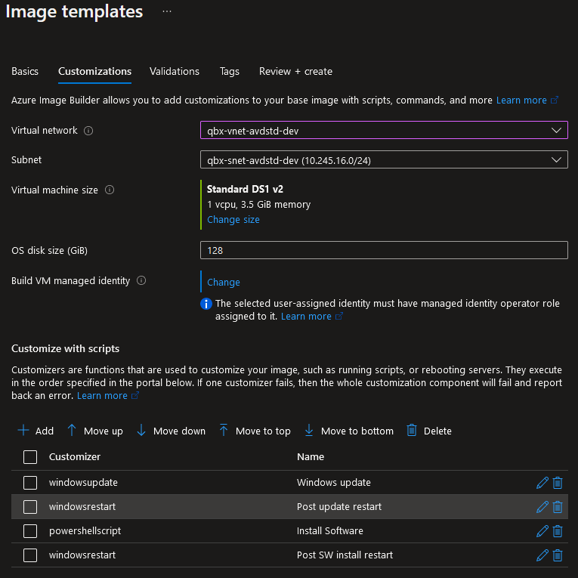
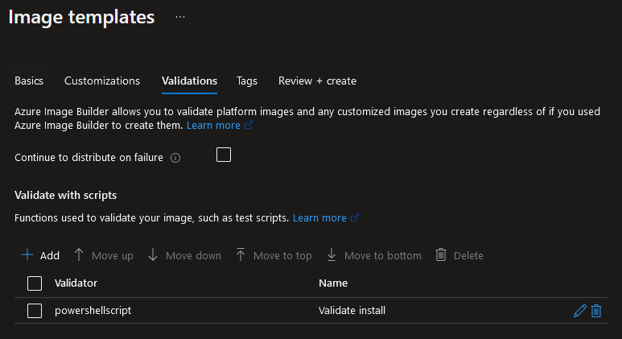
Image Builder in the Portal

Slide 15
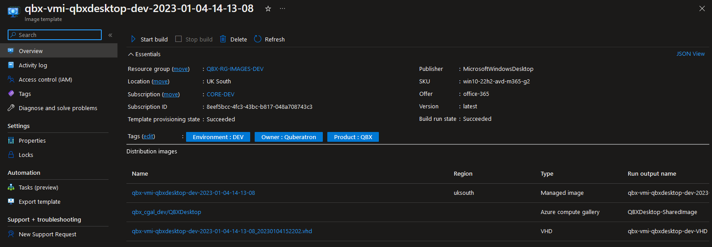
Image Builder in the Portal

Slide 16
Practicalities
Images can take a while to build
Windows minimum is usually around 30 mins
Linux minimum is around 20 mins
Maximum time is set as a parameter
Packer logs are available from the moment the build starts
Use an install library to help manage the software installation
Build a dedicated test script for your image
Remember to manage your gallery – images can build up over time
Use a storage repo for your exe’s for consistency
Use it with Windows Desktop, Windows Server and Linux
Automate it!

Slide 17
Demo

Slide 18
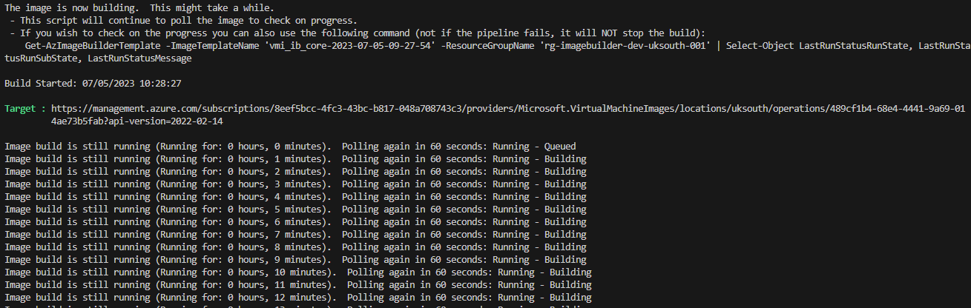
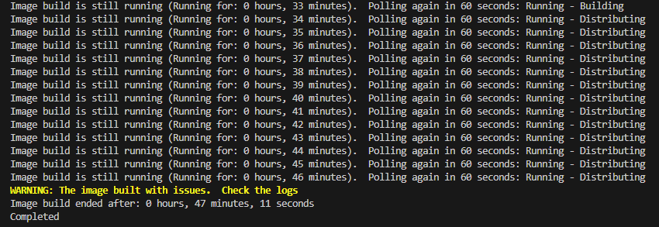
Running the build

Slide 19
Debugging
Unfortunately builds do fail from time to time and it is critical that you can debug it.
Debugging Options:
Check for pipeline errors (if using)
Check the Packer Logs for the build
Run the build manually and verify each stage
If the build fails on testing, it is likely a piece of software has not installed as required. E.g. Installed for the user and not the system.

Slide 20
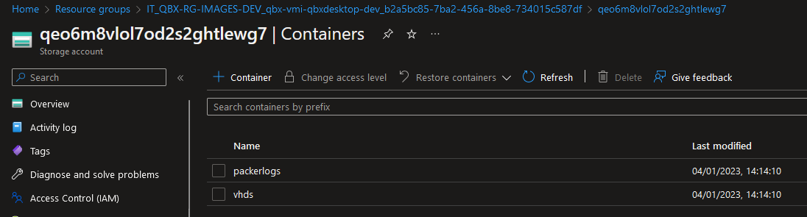
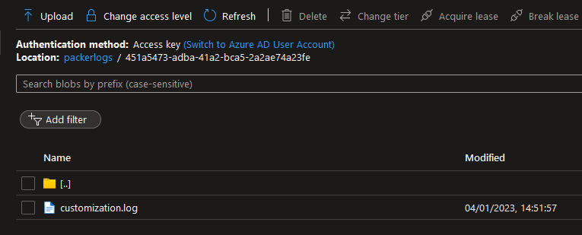
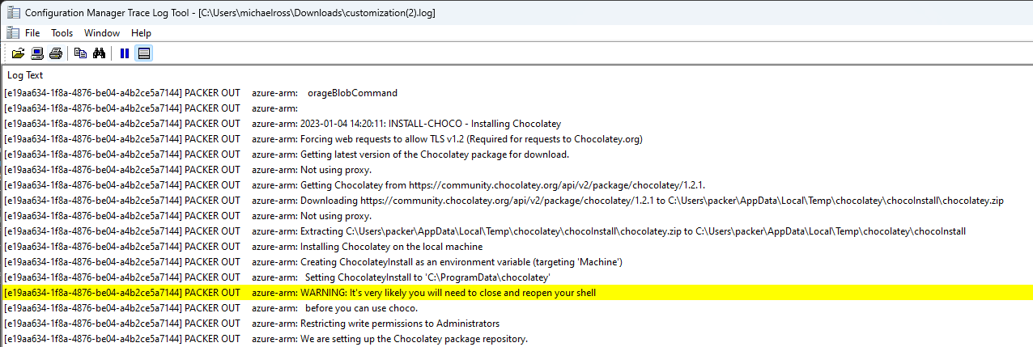
The Packer Log
The packer log contains a LOT of information about every stage of the build.
It can be found in the Resource Group created by the Image Builder as part of its build run

Slide 21
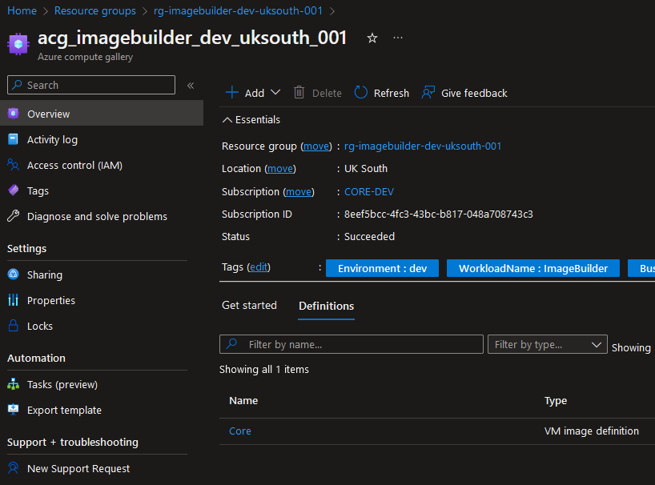
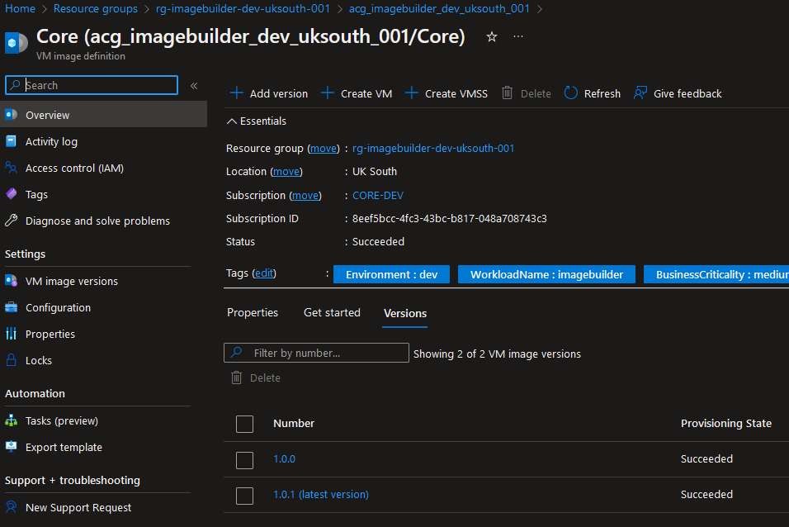
The Compute Gallery

Slide 22
Summary
Summary
Purpose and Benefits:
Simplifies creation and management of custom VM images
Automation, customisation, scalability, security, and integration benefits
Benefits of Azure Image Builder:
Blueprints for consistent image creation
Define configuration, customisations, and distribution targets
Automation and efficiency
Security and compliance
Integration with DevOps and automation
Scalability and rapid provisioning
Notes:
Azure Image Builder: Purpose and Benefits:
Azure Image Builder simplifies the process of creating and managing custom virtual machine (VM) images in Azure.
It automates image creation, ensuring consistency and efficiency.
Key benefits include automation and efficiency, customization and flexibility, scalability and rapid provisioning, security and compliance, and integration with DevOps and automation tools.
Image Template Creation:
Image templates serve as blueprints for creating VM images.
They define configuration settings, customizations, and distribution targets.
Templates provide standardization, reusability, and ease of management.
Key Features of Azure Image Builder:
Template-Based Image Creation: Define and manage image templates for consistent and repeatable image creation.
Source Image Customization: Easily customize VM images based on source images with software installations, configurations, and scripts.
Automated Image Distribution: Simplify image distribution to Azure Shared Image Gallery, Azure Marketplace, and custom target locations.
Integration with Azure DevOps and Automation: Seamlessly integrate with DevOps and automation tools for streamlined image building workflows.
Security and Compliance: Image signing, encryption, and vulnerability scanning ensure secure and compliant images.
Scalability and Rapid Provisioning: Rapidly provision multiple VM instances from customized images to meet workload demands.
Benefits of Azure Image Builder:
Automation and Efficiency: Streamlined image creation, time and cost savings, scalability, and standardized image library.
Security and Compliance: Image signing, encryption, vulnerability scanning, and compliance alignment.
Integration with DevOps and Automation: CI/CD pipeline integration, IaC compatibility, repeatable and consistent deployments, and faster time-to-market.
By leveraging Azure Image Builder, organizations can automate image creation, achieve consistency and standardization, enhance security and compliance, and integrate image building into their DevOps and automation workflows for efficient and scalable deployments.

Slide 23
Any questions?
"Azure Image Builder: the best way to customize your cloud images. No matter what your requirements are, Azure Image Builder can meet them. You can use it to create images for any platform, any application, and any purpose. Just don’t use it to create images of yourself, because that would be weird.”
- Bing Chat

Slide 24

Thank you

