Slide 1

Azure Image Builder
Michael Ross

Slide 2
So why Image Builder?
Creates customised VM images
Based on industry standard Packer
Reduces complexity of image management
Can be fully automated
Image creation cost minimized
Enhances compliance (e.g. Security)

Slide 3
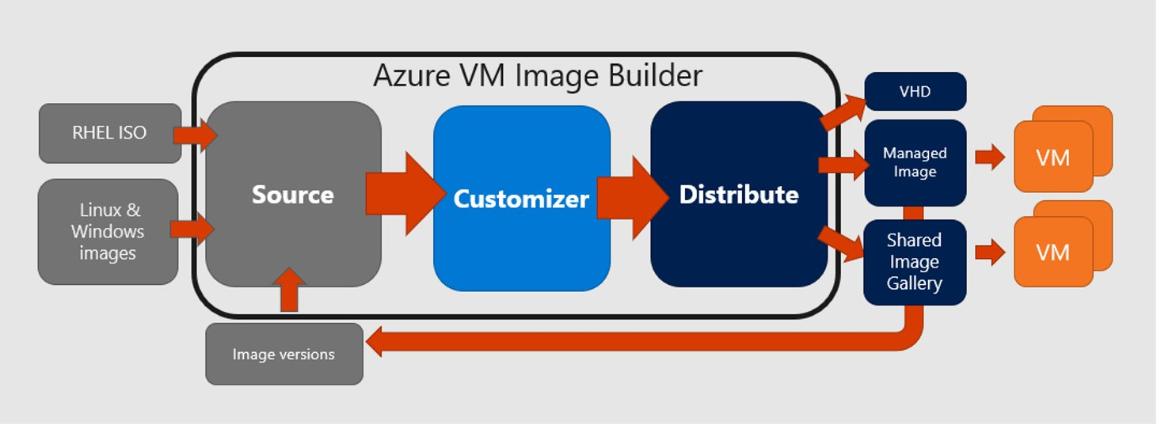
The Image Builder Service
Subtitle or descriptive text

Slide 4
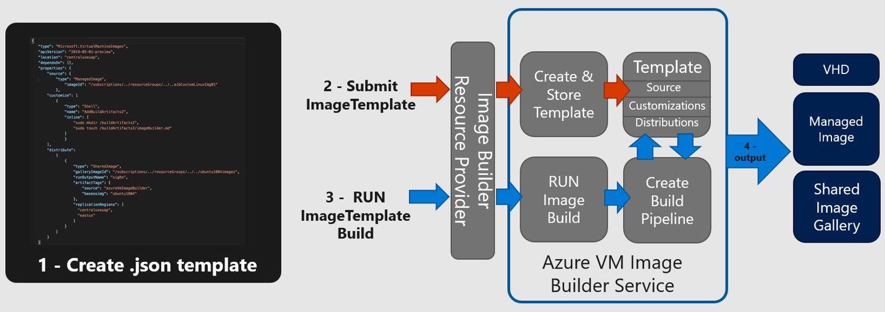
Image Builder Process

Slide 5
Image Management
Image Builder can create standalone images as VHD file BUT
It also fully supports Azure Compute Gallery for Image Management
Versioning
Multi-Region Image Distribution
Replicas
Images can be managed through both Shell and Portal
Image Management Process can now also be managed in Portal
Can be deployed to both VM and VMSS resources

Slide 6
Image Builder Components
Base Components
Compute Gallery
Storage Account
User Managed Identity (UMI)
Image components
Powershell – run a powershell command or script on the image
Shell – run a shell command (linux) on the image
Windows Restart – restart the image builder
Windows Update – run windows update
File – Upload a file

Slide 7
Practicalities
Images can take a while to build
Windows minimum is usually around 30 mins
Linux minimum is around 20 mins
Maximum time is set as a parameter
Packer logs are available from the moment the build starts
Use an install library to help manage the software installation
Build a dedicated test script for your image
Remember to manage your gallery – images can build up over time
Use a storage repo for your exe’s for consistency
Use it with Windows Desktop, Windows Server and Linux
Automate it!

Slide 8
Demo

Slide 9
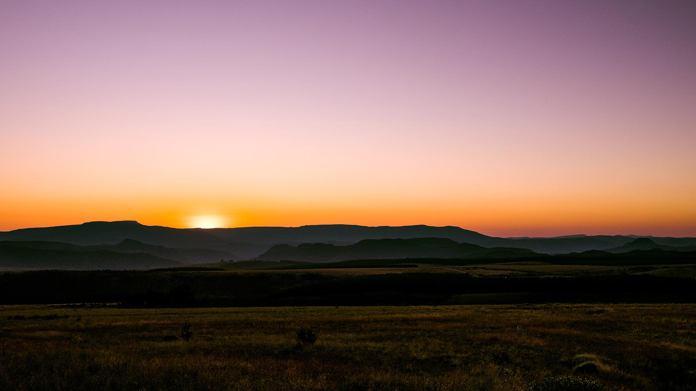
Thank you

