Slide 1
IB290 SEM 465
Topics in Phylogenetics
Meeting 5: potpourii
Weds Oct 04

Slide 2
Bayesian Inference
Philosophy, how it works, etc.
  What we want: prob(ourTree|ourData)
    But how?? We can calculate prob(ourData|aTree), which we call the likelihood, and pick the tree that makes that probability the greatest (maximum likelihood). But that’s not really what we want.
    More generally, we can imagine that our data were produced by some true abstract mystical process (tree) out there, and we’ll never know what it is, but we can sample some data from it and, from that sample, estimate what that process is/was.
    But there’s another way…

Slide 3
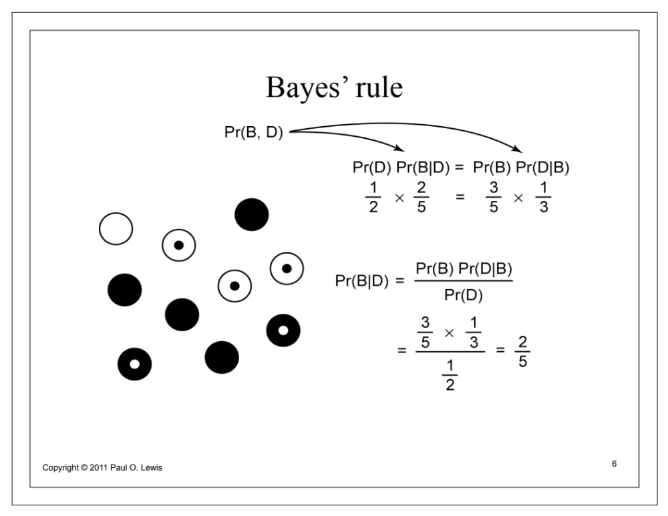
Fair coin?

Slide 4
MCMC to the rescue
Markov Chain Monte Carlo
  A mathematical technique (algorithm) to approximate complex distributions by sampling from them

Slide 5
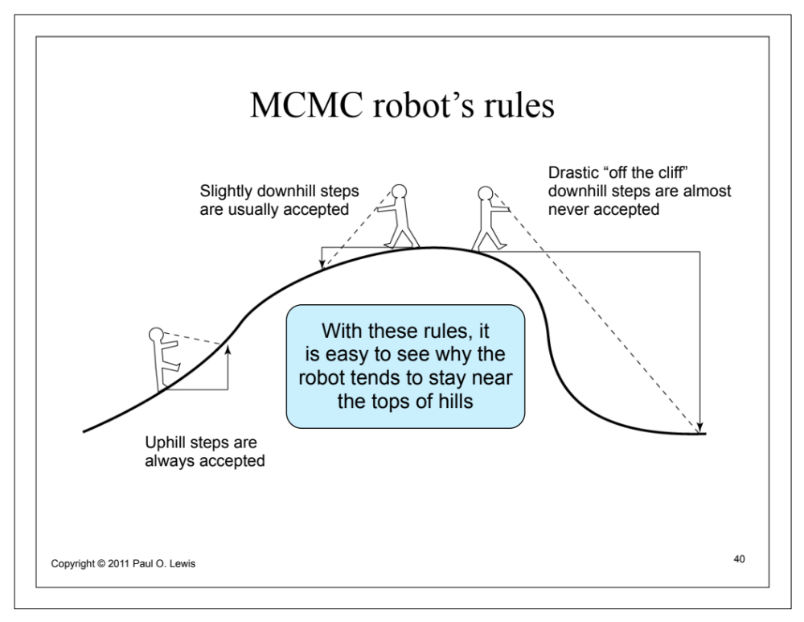

Slide 6
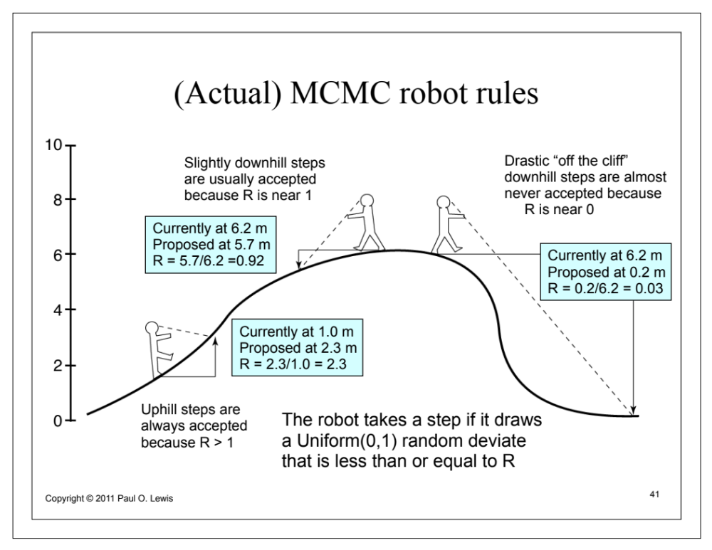

Slide 7
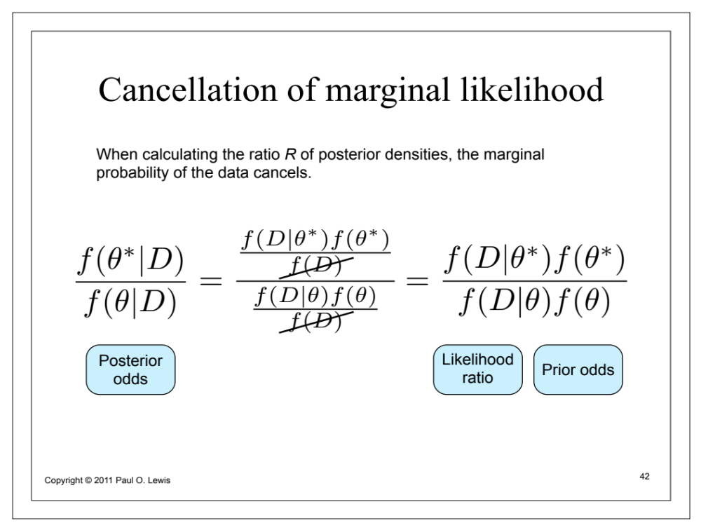
mcmcRobot

Slide 8
What is the actual process of inferring a phylogeny?
How does everything that we’ve covered so far fit together?
  Two major approaches:
    “Hill-climbing”: Start somewhere in parameter space, and then propose new values for the parameters, and if those new values result in a better likelihood, accept them and try again. Otherwise, don’t accept them, and try some other values. [Analogous approaches for max. parsimony]
    MCMC: Accept proposals in proportion to their posterior probability

Slide 9
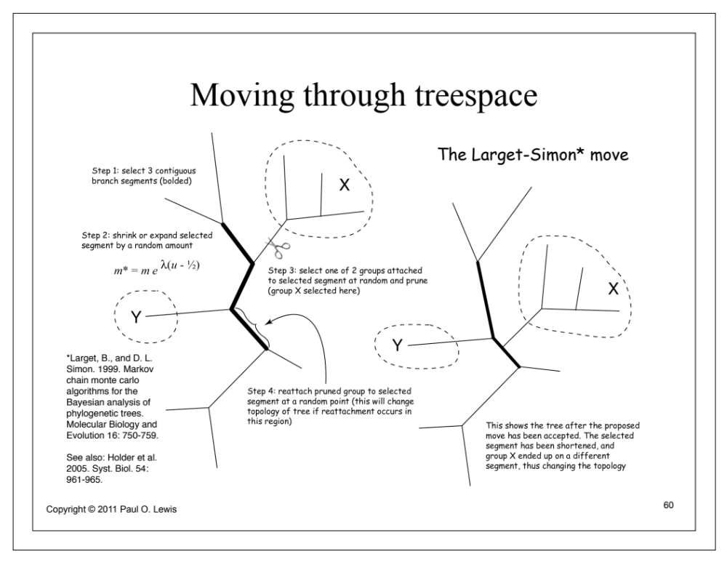
TBR, NNI, ….

Slide 10
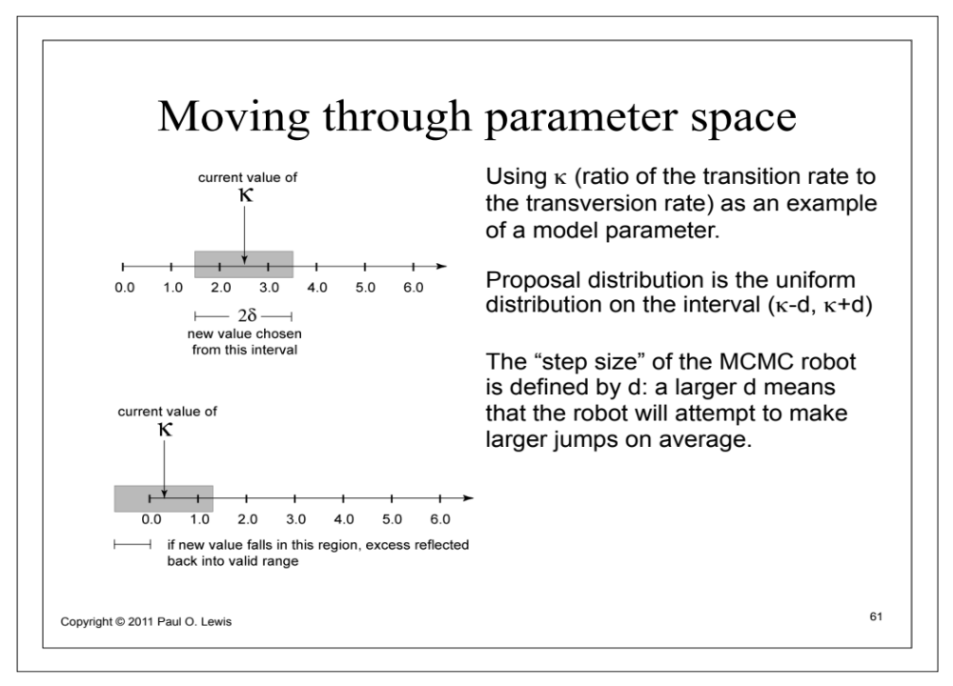

Slide 11
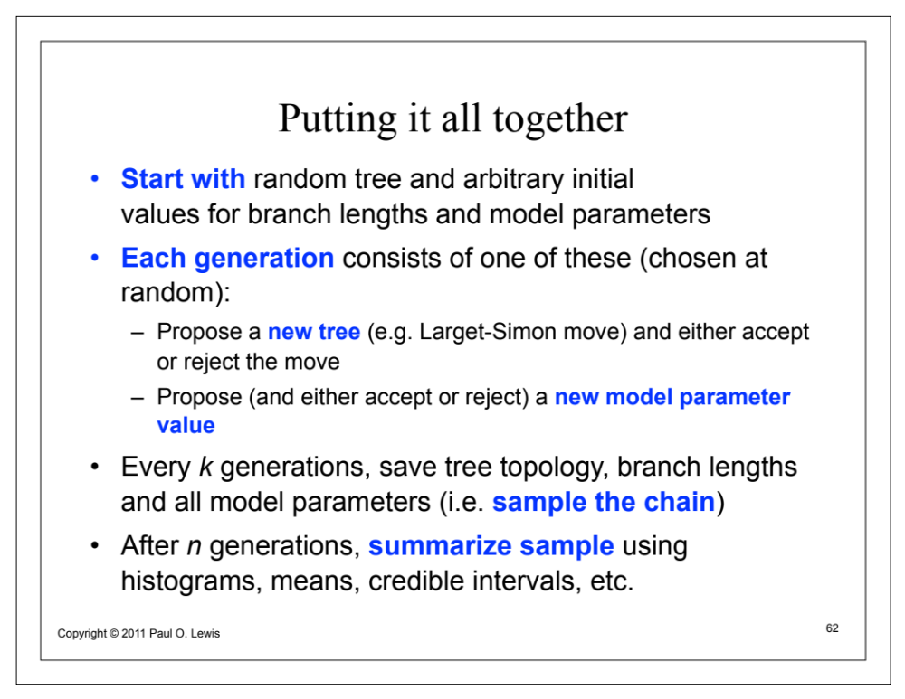

Slide 12
Support values…
Posterior probabilities
Non-parametric bootstrapping

Slide 13
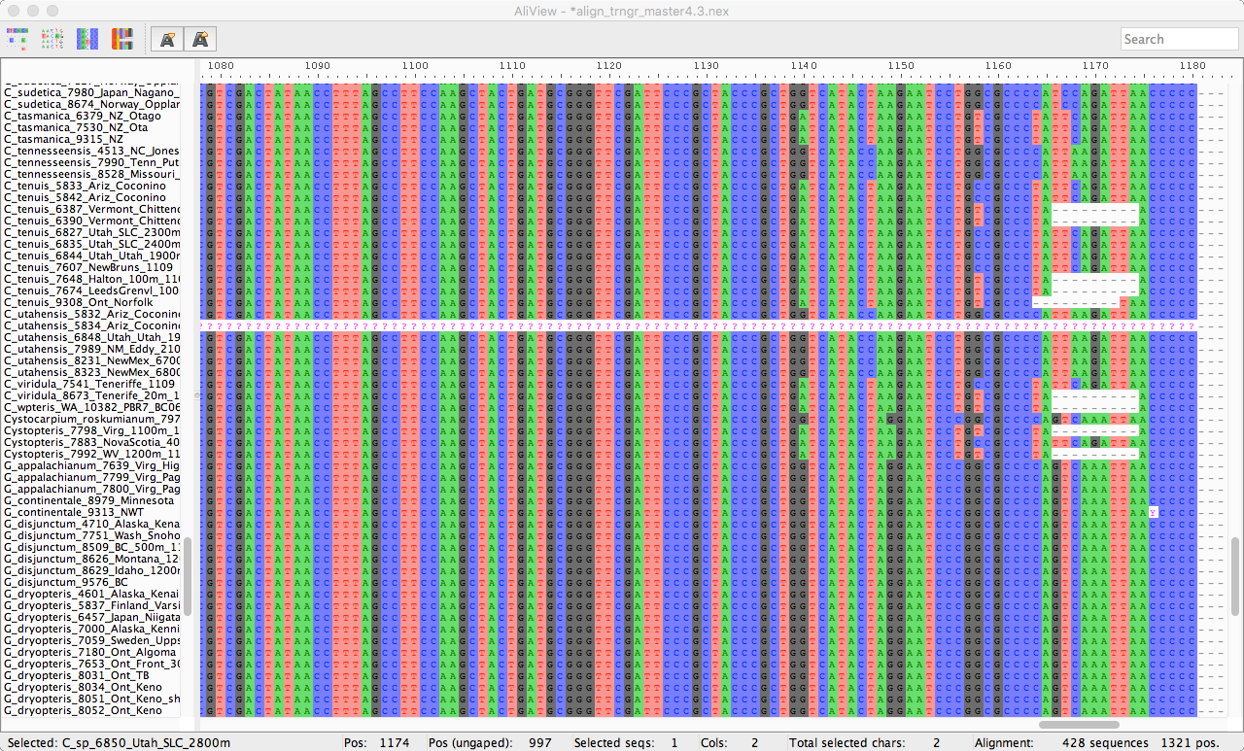

Slide 14
Support values…
Posterior probabilities
Non-parametric bootstrapping
Parametric bootstrapping

Slide 15
So how many trees are there anyway?
(2n-3)!/(2^(n-2)*(n-3)!)
Think about this when you’re trying to infer your tree of 100 tips…

Slide 16

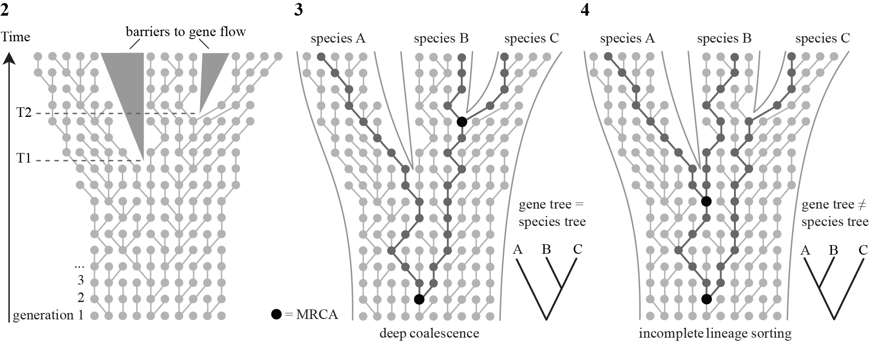
The coalescent

Slide 17
The coalescent, ILS (incomplete lineage sorting), gene trees, species trees…

Slide 18
Trees, topologies, etc
Under a Yule process (a pure birth process, i.e., a birth-death process with the rate of death = 0) , for any split in the tree subtending n tips, the number of tips in the smaller side is uniformly distributed from 1 to n-1…
Yule trees and birth-death trees have the same expected topologies, but differ in the relative lengths of the branches
Uptick in lineage-through-time plots

